Slide 1
Databases 1
DML | Queries 1
Topic Aim: to introduce and apply queries in a Oracle relational database

Slide 2
Query | Objectives
SELECT statements
DISTINCT command
WHERE Clause
Column Prefix and Alias
Comparison Operators;
  IN , BETWEEN, LIKE, IS NULL
Multiple conditions
Logical operators;
  AND, OR, NOT
Precedence rules

Slide 3
SELECT.. FROM.. statements
DML, Data Query Language
Most concentrated focus of SQL
Provides full functionality of relational algebra
SELECT command
  Queries or questions to the database
  Returns a given set of rows
  Can include a number of tables
  Includes options and clauses
Command builds temporary table
  Based on tables that exist in the database

Slide 4
SELECT statements
SELECT something
  FROM somewhere;
Syntax
SELECT column_name,…,column_name2 | *
  FROM table_name,…,table_name2;
Includes a single asterisk or
  An asterisk indicates all columns will be selected
Projection set operator includes a list of columns
  Separated by comma
Projection limits data to defined columns
Note: Not both; column list and asterisk
Pipe means or
Can’t use both

Slide 5
Query Practise
Consider a table to record text books
  text_books (isbn, title, author, publish_date, topic)
Write a query to:
  Return all columns
  Return book names and authors
SELECT *
FROM text_books;
SELECT title, author
FROM text_books;

Slide 6
DISTINCT option
Returns 1 instance of each set of duplicate rows
Syntax
  SELECT DISTINCT (column_name)
  FROM table_name;
Suppresses duplicate rows
Applied on all columns specified in select clause
Forces the results to be stored
Requires more processing

Slide 7
Example: DISTINCT
Retrieve all cities where students live
  SELECT city SELECT DISTINCT (city)
  FROM students; FROM students;
Output Output
CITY CITY
------------------ ---------------------------------
NORTHAMPTON NORTHAMPTON
BEDFORD BEDFORD
BEDFORD LONDON
LONDON
NORTHAMPTON

Slide 8
WHERE Clause
Condition to RESTRICT the rows of data
Returns data that matches a given criteria
WHERE clause values are called predicates
Syntax
SELECT column_name,…,column_name
  FROM table_name,…,table_name
  WHERE condition;
  Eg WHERE column_name = ‘SOMETHING’;
  L_script.txt
Notes:
Predicates: an expression that evaluates to TRUE, FALSE, or UNKNOWN.
Predicates are used in the search condition of where and having clauses, the join conditions of from clauses.

Slide 9
WHERE Practise
Consider a table to record books
  text_books (isbn, title, author, publish_date, topic)
Write a query to:
  Return book names written by Morrell
SELECT title, author
FROM text_books
WHERE author = ‘MORRELL’;
Notes:
Useful to include a visual check in the select list.

Slide 10
Alias
Temporarily renames objects in SQL statement
  Tables or columns
  Reduces key stokes
Actual name does not change
Alias must be unique in statement
Each column or table may be followed by an alias
Aliases can contain more that one word
  More than one word must be in “double quotes”
Column alias can only be referenced with
  ORDER BY clause

Slide 11
Example: Table Alias
Syntax
SELECT tablenamealias.column_name, column_name
FROM table_name table_alias, table_name table_alias;
  SELECT rc.site_id
  FROM site, running_course rc;
What is the alias?
Where is the alias
  defined
  used
    L_script.txt
Note the space

Slide 12
Example: Column Alias
Query the student table, replacing the
  student_id with ID
  student_lname with Last Name
  SELECT student_id ID, student_lname “Last Name”
  FROM students;
What is the alias?
Where is the alias
  defined
  used

Slide 13
Table Alias Practise
Consider a table to record books
  text_books (isbn, title, author, publish_date, topic)
Write a query to:
  Return book names written by Morrell
  Use a table alias; books
SELECT books.title, author
FROM text_books books
WHERE author = ‘MORRELL’;

Slide 14
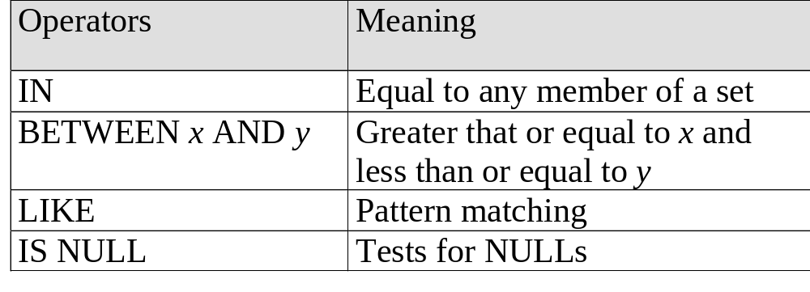
Comparison Operators
Can be used with NOT
Logic should be positive
  Takes less processing
Notes:
Where have we used LIKE before?

Slide 15
IN Comparison Operator
Used to compare a column with a list of values
Evaluated to TRUE if a column value matches at least one value in a list
NOT IN evaluates to TRUE if a column does not match any values in a list

Slide 16
Example: IN
Select student_id from the students table for students living in Northampton, Bedford and MK
Syntax
  SELECT s.student_id
  FROM students s
  WHERE s.city IN (‘NORTHAMPTON’, ‘BEDFORD’, ‘MK’);
Where have you used IN before?
    L_script.txt

Slide 17
IN Practise
Consider a table to record books
  text_books (isbn, title, author, publish_date, topic)
Write a query to:
  Return book names written by Morrell
  And the book is about SQL or PL/SQL
  Use a table alias; books
SELECT books.title, author
FROM text_books books
WHERE author = ‘MORRELL’
AND topic IN( ‘SQL’ , ’PL/SQL’ );

Slide 18
BETWEEN Operator
Used to compare a column with an inclusive range
Evaluates to TRUE if a column value is in the range
Includes end values
NOT BETWEEN evaluates to TRUE if a column value is outside the range
  What is the positive way to do this?

Slide 19
Example: BETWEEN
Select trainer_name
  Who earn a rate between 5.50 and 6.50
  Use a table alias; t
  SELECT t.trainer_name
  FROM trainers t
  WHERE t.rate BETWEEN 5.50 AND 6.50;

Slide 20
LIKE Operator
Used to compare character columns with a string
  Pattern matching
Evaluates to TRUE if column values match string
NOT LIKE evaluates to true if a column value does not match string
String can contain wildcards for pattern matching
  An underscore [ _ ] matches exactly one character
  A percent sign [%] matches zero or more characters

Slide 21
Example: LIKE
Syntax
    SELECT trainer_name
    FROM trainers t
    WHERE t.city LIKE ‘N%’;
    -- or
    WHERE t.city LIKE ‘%RD’;
    -- or
    WHERE t.city LIKE ‘L_ _D’;
Note case
What do the WHERE clauses achieve?
    L_script.txt

Slide 22
LIKE Practise
Consider a table to record books
  text_books (isbn, title, author, publish_date, topic)
Write a query to:
  Return book names and authors
  Whose name starts with m
  And the book is about SQL or PL/SQL
  Use a table alias; books
SELECT books.title, author
FROM text_books books
WHERE author LIKE ‘M%’
AND topic IN( ‘SQL’ , ‘PL/SQL’ );

Slide 23
IS NULL Operator
NULL is an undefined value
  Can only exist in optional columns
  Different from zero
Arithmetic expression containing NULL evaluates to NULL
  NULL + 10 = NULL
IS NULL is used to test column for NULL values
Evaluates to TRUE if a column value is NULL
IS NOT NULL evaluates to TRUE if column value is not NULL

Slide 24
Example: IS NULL
Syntax
    SELECT trainer_name
    FROM trainers t
    WHERE t.city IS NULL;
    -- or
    WHERE t.city IS NOT NULL;
What is the alias, is it column or table?
Where is the alias
  defined
  used

Slide 25
WHERE clause with multiple conditions
Uses relational algebra
Restriction query
Results more precise with multiple conditions
Can contain unlimited number of conditions
Multiple conditions connected by logical operators
  AND and OR

Slide 26
Syntax: WHERE with multiple conditions
Syntax
    SELECT column_name
    FROM table_name
    WHERE condition
    AND condition
    OR condition;

Slide 27
AND Operator
Combines 2 conditions
Returns a result when both conditions are TRUE
Example: female students who live in the UK
    SELECT s.student_surname
    FROM students s
    WHERE s.gender = ‘F’
    AND s.country = ‘UK’;

Slide 28
OR Operator
Combines 2 conditions
Returns a result if either condition is TRUE
Example: students born after 1 Jan 1960 or
before 31 Dec 1940
    SELECT student_lname
    FROM student
    WHERE DOB >‘01-JAN-1960’
    OR DOB < ‘31-DEC-1940’;
Positive for
  NOT BETWEEN ‘31-DEC-1940’ AND ‘1-JAN-1960’

Slide 29
NOT Operator
Inverts a condition or a set of conditions
Returns result if combination of conditions aren't TRUE
NOT (condition A and condition B) is equivalent to
NOT condition A or NOT condition B
Syntax
NOT (condition..AND |OR …condition)

Slide 30
Example: NOT
Select companies that do not meet the requirement that their revenue or training_budget is greater than 50000
SELECT c.company_name
FROM companies c
WHERE NOT (revenue > 50000 or training_budget > 50000);

Slide 31
Precedence Rules
Order the conditions are evaluated
Similar to precedence in maths
  BDMAS
Default logical operators from highest to lowest
  NOT, AND, OR
Parentheses() override default precedence
  Precedence is established by depth of the brackets

Slide 32
Practicals Check Up
You should have completed 1-5
4 files saved with your login number
in csy1026 folder saved on a USB eg
  F/csy1026/scripts/create_00.txt
  F/csy1026/scripts//alter_00.txt
  F/csy1026/scripts/insert_00.txt
  F/csy1026/scripts/drop_00.txt
  F/csy1026/scripts/querries_00.txt – starting
Your assignment should look like this too!

Slide 33
Review Questions
What does DQL stand for?
Name 2 key words are used to query data?
What is * used for in SQL?
What is the set operator for limiting columns?
What is DISTINCT used for?
What command is used to restrict the data returned?
What is an alias?
Name 3 comparison operators
Name 2 logical operators
What is the precedence order?
Ask me a question.
10

Slide 34
Summary…
SELECT statements
DISTINCT command
WHERE Clause
Column Prefix and Alias
Comparison Operators;
  IN , BETWEEN, LIKE, IS NULL
Multiple conditions
Logical operators;
  AND, OR, NOT
Precedence rules
Next: more queries with joins

