Slide 1
HARDWARE KEY LOGGER
K.SIVAKUMAR

Slide 2
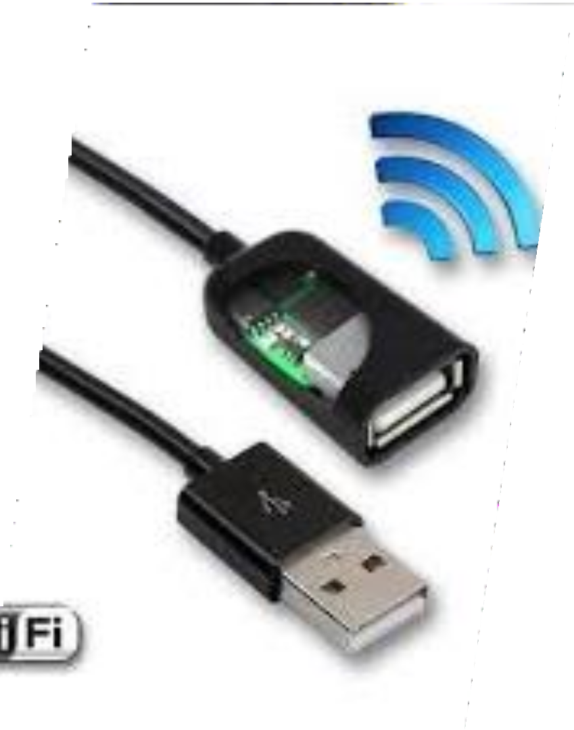
Introduction
Keyloggers are stealthy software or hardware designed to secretly
record keystrokes on a computer or mobile
device, often used by
cybercriminals to steal sensitive information like passwords and
financial data. Understanding keyloggers is crucial for cybersecurity
to mitigate their risks and protect against
unauthorized access to
sensitive information.

Slide 3








List of topics to be covered in the presentation.
PROBLEM STATEMENT PROJECT OVERVIEW
WHO ARE THE END USERS?
YOUR SOLUTION AND ITS VALUE PROPOSITION THE WOW IN YOUR SOLUTION
MODELLING
RESULTS
Agenda

Slide 4
Problem Statement
Keyloggers are a cybersecurity problem because they silently track and record keystrokes on devices, allowing hackers to steal sensitive information like passwords and financial data without the user's knowledge. This poses a serious threat to personal and organizational security, requiring effective measures to detect and mitigate their impact.

Slide 5



Project Overview
This project focuses on studying hardware keyloggers in cybersecurity.
It involves analyzing how these physical devices capture keystrokes,
which can compromise sensitive information. Through research and
testing, the project aims to identify vulnerabilities and develop
defenses against these keylogging devices, ultimately enhancing
cybersecurity measures.

Slide 6
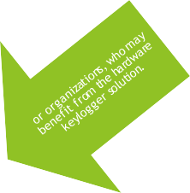

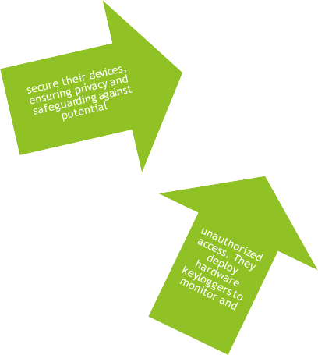
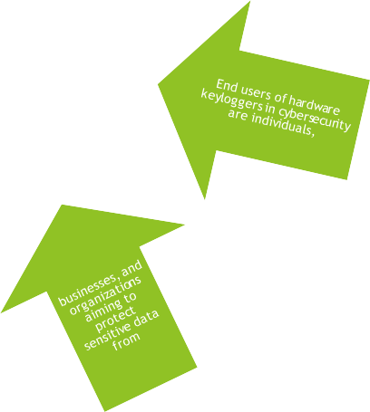
End Users
Identification of potential end users, such as individuals, businesses,

Slide 7












Description of the hardware keylogger solution and its value proposition,
emphasizing its ability to effectively monitor and secure keystrokes.
Solution and Its Value Proposition
The solution provided by hardware keyloggers
is straightforward: they
effectively monitor and secure keystrokes on
devices, enhancing overall
cybersecurity.

Slide 8


The Wow Factor
Highlighting unique features or benefits of the hardware keylogger solution that set it
apart from other keylogging solutions on the market.
The "wow factor" in hardware keyloggers lies in their compact size, ease of use,
compatibility, encryption, stealth mode, remote access, security features, battery
life, and user-friendly interfaces, making them effective and impressive tools for
keystroke monitoring.

Slide 9
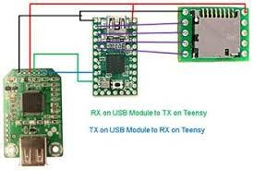
Modelling
Overview of the hardware design and functionality,
including diagrams or
illustrations to demonstrate how the keylogger works.
Modeling in hardware keyloggers involves designing the circuitry,
selecting microcontrollers, managing memory, implementing stealth
features, designing interfaces, managing power, incorporating security
measures, and testing for functionality and reliability.

Slide 10
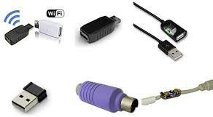
o testing or g the
ty of the on.

