Slide 1
Ontologies for biology
Karen Eilbeck
Programming for Biology
CSHL 2017

Slide 2
What we will cover
Introduction to ontologies
Gene Ontology case study
Structure
Annotation
Usage
Other biological ontology applications
Upper ontologies and management issues

Slide 3
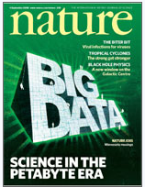
Building ontologies for the genomics big data challenge
We have more data than we can handle by eye
Data needs to be described in a rigorous fashion to render it computable
Functional annotation using the Gene Ontology (GO)
Structural annotation using the Sequence Ontology (SO)
Human Phenotype Ontology (HPO)
Nature: 4th September 2008

Slide 4
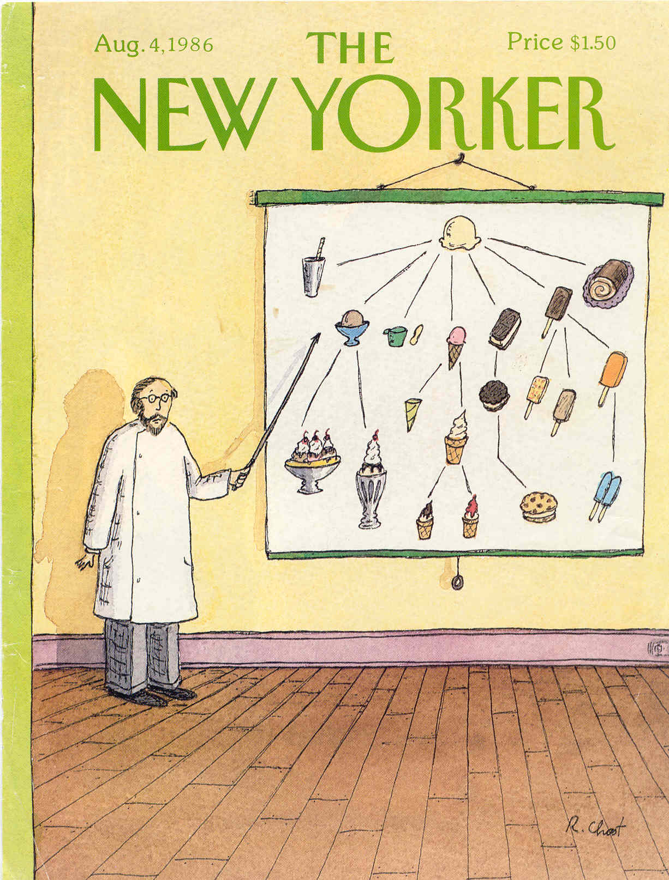
Ice Cream Ontology

Slide 5
Ontologies are:
Semantic models for domains of reality
Tool for communication
Explain observations
Predict new relations
Provide framework for data integration

Slide 6
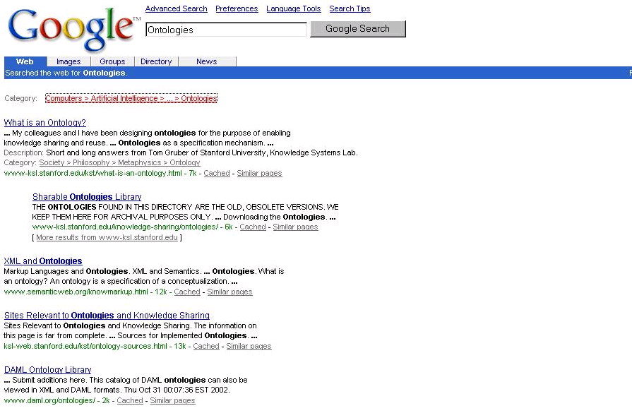
Ontologies in everyday life
Google uses ontologies
to organize and empower its
search capabilities
https://www.quora.com/Does-Google-use-ontologies-and-for-which-purposes

Slide 7
The is_a relationship
Processed_transcript
hypernym
is_a
is_a
mRNA
hyponym
Subsumption hierarchy
General to specific categorization
Define terms with regard to is_a (An A is a B that C’s.)

Slide 8
The is_a relationship
The is_a relation is like inheritance.
Children terms inherit the properties and relationships of the parent term.
part_of
transcript
exon
is_a
mRNA inherits the attributes of transcript
Therefore exons can be parts of mRNA
Processed_transcript
is_a
mRNA

Slide 9
The part_of relationship
mRNA
holonym
part_of
part_of
part_of
UTR
CDS
meronym
Meronomy
A dissection of a whole into constituent parts

Slide 10
The part_of relationship
The rules of being a part:
Nothing is a part of itself
If A is a part of B then the B is not a part of A
If A is a part of B and B is a part of C then A is a part of C
The relationship is asymmetrical and transitive
Parts do not inherit properties from the whole

Slide 11
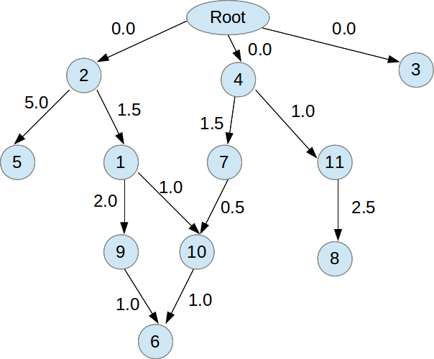
Ontologies are often directed acyclic graphs DAG
https://stackoverflow.com/questions/25005850/directed-acyclic-graph-with-multi-parent-nodes

Slide 12
Bio-ontologies
Annotation of databases
Semantically aware searching
Inference and reasoning
Find inconsistencies in data
Understanding high-throughput data
Over representation analysis
Semantic similarity analysis

Slide 13
A biomedical ontology organizes data
Classify the kinds of things we are interested in (domain).
Taxonomy
Categorize the interactions between the things – define other relations.
Ontologies are applied to the raw data via curation process.
The data can then be traversed and manipulated computationally using the relationships.
We have conquered the big data.

Slide 14
How do we keep on top of all the data?
Biology papers are indexed by medline and live in a db called pubmed.
http://www.ncbi.nlm.nih.gov/pubmed/
You can search pubmed by names and terms.
Behind pubmed is a terminology called MeSH for medical sub headings.
It organizes synonyms, etc. to make the searches more efficient.
This is still not enough, but it is a start.
Millions of abstracts are indexed.

Slide 15
Imagine if someone read the papers for you
Gene Ontology functional annotation
http://www.geneontology.org
A massive multinational project, including many model organism database groups.
An ontology of 30 000+ terms, organized into a hierarchy of specificity.
Skilled curators who are paid to read articles and annotate the genes with the function, process and location.

Slide 16
Gene Ontology
1998
The problem: a lot of sequence databases. No common vocabulary to talk about genes. No way to search sequences databases other than by similarity.
The solution: describe function, process and location, directed acyclic graph, unify vocabulary, provide structure to aid annotation and querying

Slide 17

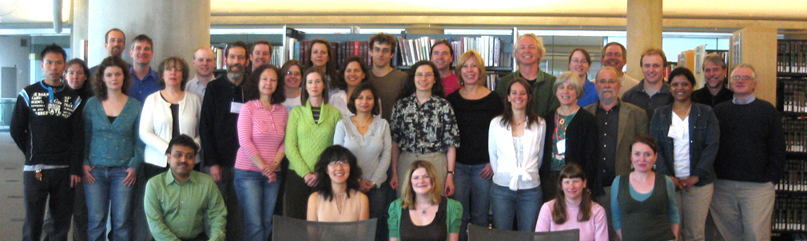
Describes the location, function and process of a gene product (protein or functional RNA).
MODs employ curators to transfer knowledge from the literature and bioinformatics experiments to the genome.
28,000 terms, 44,545,253 annotations 386,268 genes (52 databases)
www.geneontology.org

Slide 18
How does GO help manage big data?
Unified the descriptive vocabulary between the model organism communities.
Structured the semantic nature of what genes do.
Enables querying: It allows sequence databases to be queried on something other than sequence similarity.
Downstream analyses use the GO annotations across the board in all aspects of biology.

Slide 19
Find transcription factors in multiple databases
TF have diverse sequence structures. There are many ways to bind DNA. You can’t do a similarity search with one kind of TF and find the rest.
GO allows you to search a sequence database on semantics rather than sequence. So if the TF are annotated with GO, you could find them easily across multiple organism databases.

Slide 20
GO is useful for processing results of experiments.
What kinds of protein are enriched in my microarray experiment?
How does my newly sequenced boutique genome compare to a similar established model organism?
Increasingly cited:
Notes:
Compiled from medline break down of citations per year

Slide 21
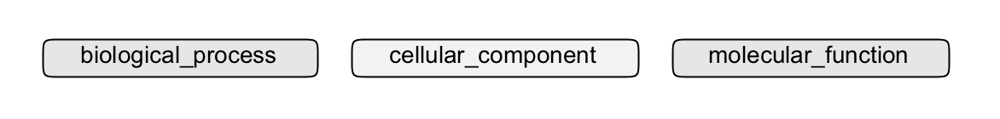
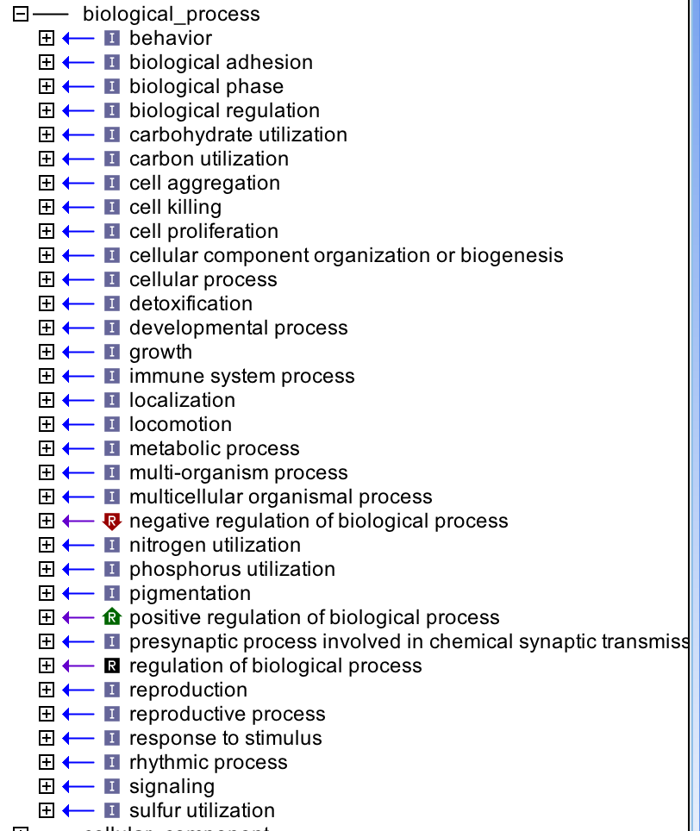
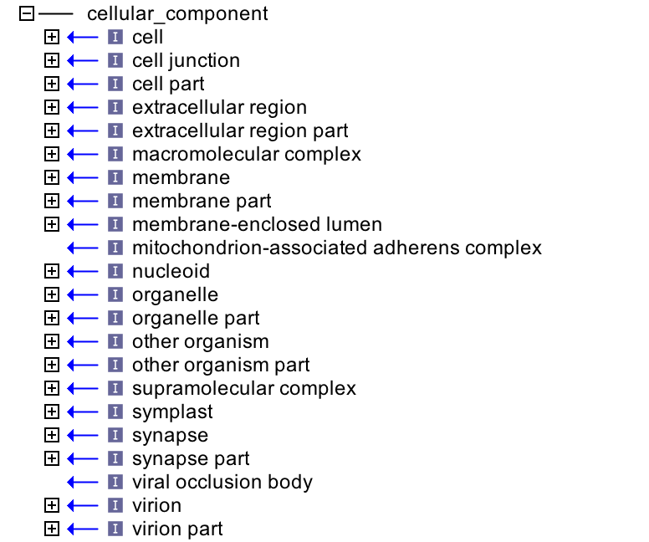
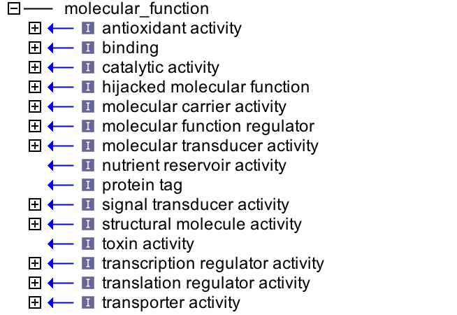
Structure

Slide 22
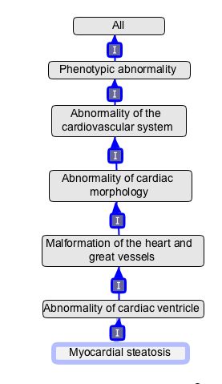
True path rule
Genes annotated to myocardial steatosis is also annotated by transitivity to each parent node in the ontology
Increases flexibility when searching and making inferences about genes
inheritance

Slide 23
Annotation
http://www.geneontology.org/page/download-annotations The files
http://www.geneontology.org/page/go-annotation-file-formats Understanding the columns
http://wiki.geneontology.org/index.php/Introduction_to_the_GO_Consortium_annotation_set more info

Slide 24
Annotation - simple
GeneID – GO term – pubmedID – evidence code
Annotate to the deepest level of knowledge
Difference between un-annotated and uncharacterized – when you have tried to find function/process/location and the information is not out there, you annotate the gene to the root node.
Qualifiers – contributes-to, co-localized with and NOT. Be careful!

Slide 25
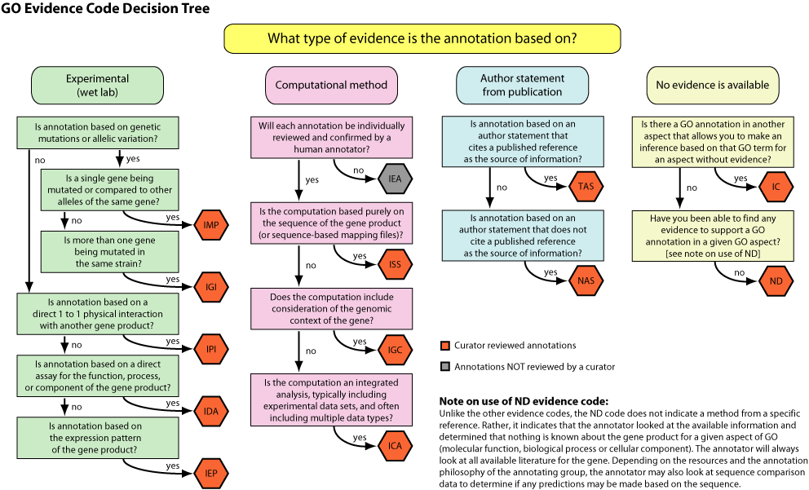
Evidence

Slide 26
The kinds of evidence:
Experimental from literature (direct)
Expression pattern
Physical interaction
Computational evidence (inferred)
Pairwise alignment
Sequence orthology
Curator/author assertions (indirect)

Slide 27
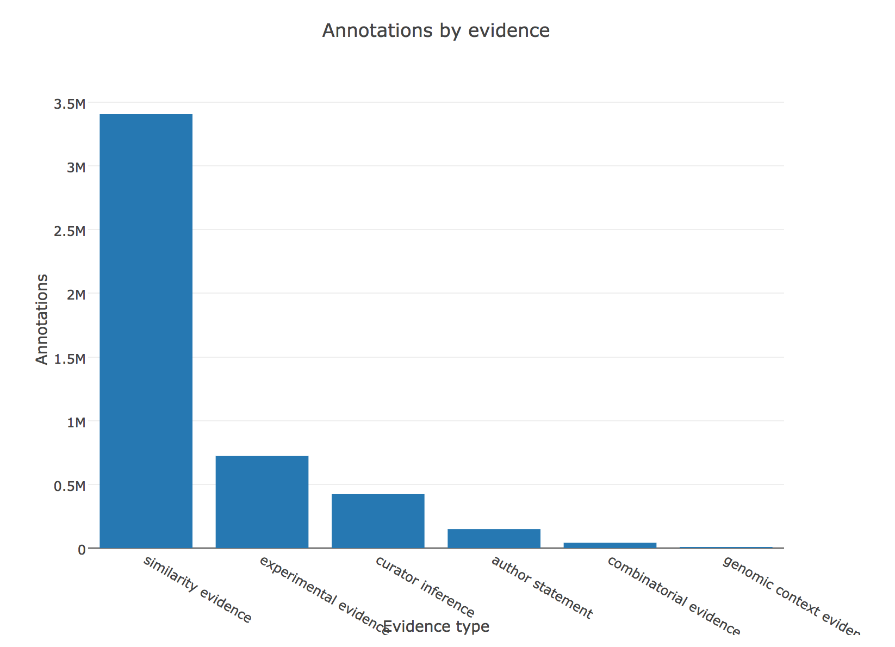
http://amigo.geneontology.org/amigo/base_statistics

Slide 28
Usage
How is this ontology used?
High through-put studies that produced lists of genes micro-array and RNA-seq
Functional categorization – what does this newly sequenced genme do?

Slide 29
What does the GO give us?
For every gene in a genome we can get an understanding of what the gene is doing.
If the gene has not been studied, we can infer from similar genes that have been.
We can traverse a genome based on an understanding of function. We can use this to understand result of experiments that produce collections of genes under certain circumstances.
All of these genes have something to do with cell cycle control etc

Slide 30
Over representation analysis
GO has annotated millions of gene products
RNA-seq detects expression of these genes and produce lists of differentially expressed genes.
Does a GO term show up more than you would expect? (Your usual observed/expected kind of analysis)

Slide 31
Quick Yeast example
221 yeast genes labeled with sporulation (out of 6000)
In a microarray experiment 100 genes are up-regulated compared to control
You would expect 3-4 to be annotated to sporulation by chance
If you found 40, that would be over representation

Slide 32
Over representation tools
http://david.abcc.ncifcrf.gov/ now provides a comprehensive set of functional annotation tools for investigators to understand biological meaning behind large list of genes
Go term Finder http://go.princeton.edu/cgi-bin/LAGO

Slide 33
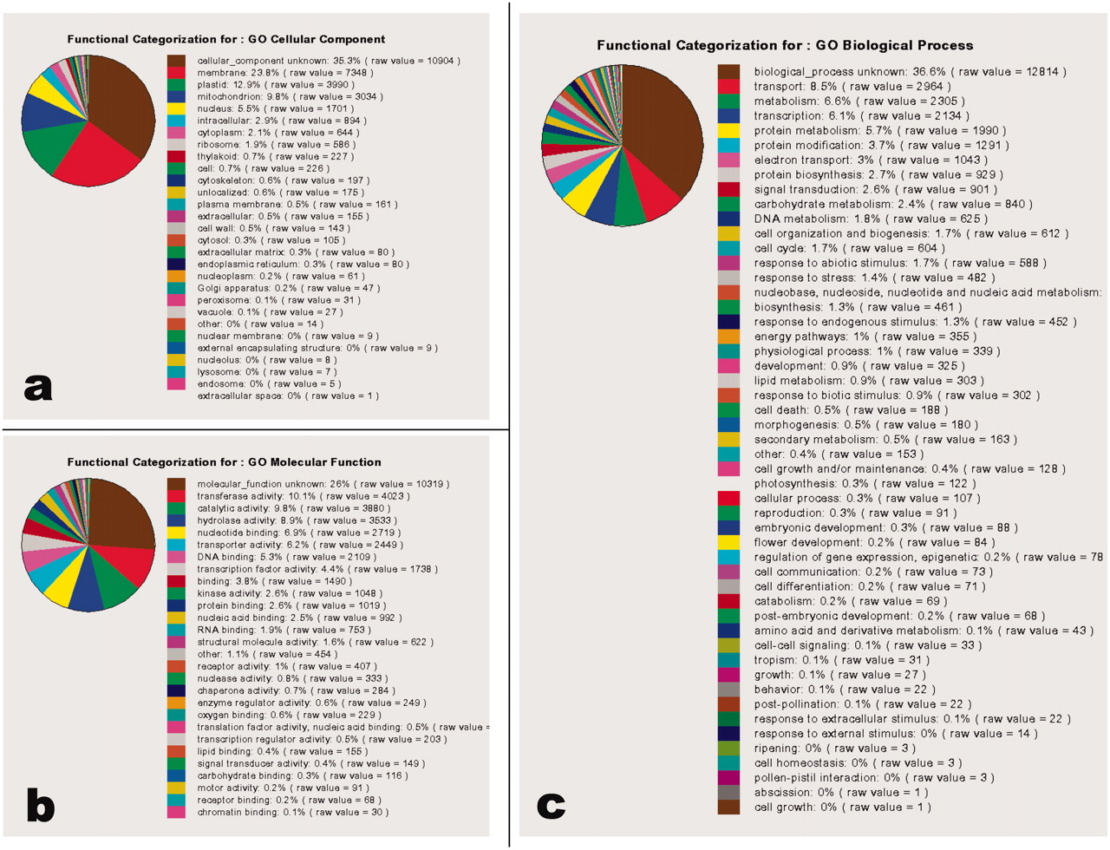
http://www.plantphysiol.org/content/135/2/745 Beradini et al, 2004

Slide 34
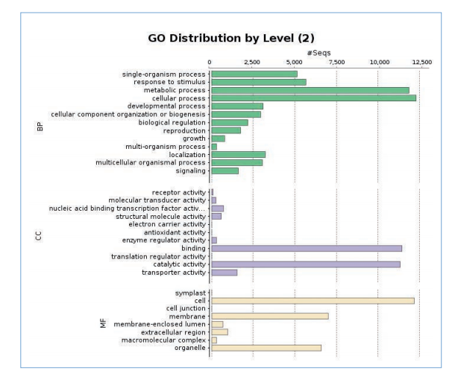
Blast2GO for tomato
http://resources.qiagenbioinformatics.com/application-notes/Whole_genome_functional_annotation_of_Solanum_lycopersicum.pdf

Slide 35
How do I make high level summaries like that?
http://www.geneontology.org/page/go-slim-and-subset-guide
Slim ontology – hand pruned tope level terms.
Propagate annotations up the tree to the new leaf node.

Slide 36
Resources
Use and misuse of the gene ontology annotations S Rhee et al. http://www.nature.com/nrg/journal/v9/n7/full/nrg2363.html
Ten Quick Tips for Using the Gene Ontology http://www.nature.com/nrg/journal/v9/n7/full/nrg2363.html Judith Blake

Slide 37
2 other bio ontologies

Slide 38

The Sequence Ontology
The SO describes the parts of a genome and how they relate to each other in topological space and other dimensions such as regulatory space.
It includes terms and relations to describe not only gene models but other genomic phenomena such as transposons and repeats.
It also describes variations and the consequences of variation.
About 2000 terms
www.sequenceontology.org

Slide 39
SO mission statement
To provide the vocabulary and relations for the annotation, validation and querying of the features and properties of biological sequence.
In other words describe genome assemblies and their annotations

Slide 40
SO is used for
Genome annotation
Typing features in Model Organism databases (Chado)
Typing variant data in re-sequencing projects
And file formats - GFF3, GVF
Genome browsing - Gbrowse
Protein feature annotation -biosapiens
Natural Language Processing – RSC
ICCG, ICGC, UCSC browser, EBI, NCBI ClinVar, DBVar

Slide 41
What do the sequence annotators want from SO
To annotate the sequence of the assembly - contigs, scaffolds, gaps, etc.
To annotate the experimental evidence for gene annotations- blast hits, repeats.
To annotate known and postulated biological features - exons, transposons.
Now they also want to annotate variants.

Slide 42
How does SO help manage big data?
It has standardized the vocabulary used to define the parts of genomes.
It is used by the MODs to annotate features onto their genomes.
It is used by EBI, personal genome companies and institutes to manage variant data.
The contents of a genome are now more easily analyzed by ontology aware software tools.

Slide 43
Organisms with SO based genome annotations:
Anopheles spp., Antonospora locustae, Arabidopsis thaliana, Ascomycota, Avena spp., Basidiomycota, Bos taurus, Brachionus plicatilis, Caenorhabditis spp., Ciano intestinalis, Cryptosporidium sp., Culex quinquefasciatus, Danio rerio, Daphnia pulex, Dictyostelium discoideum, Drosophila spp., Emiliania huxleyi, Franciscella tularensis, Giardia spp., Glycine max, Homo sapiens, Ixodes scapularis, Lotus japonicus, Medicago truncatula, Microsporidia, Mycobacterium tuberculosis, Oryza spp., Paramecium tetraurelia, Pediculus humanus, Plasmodium spp., Populus trichocarpa, Pseudomonas spp., Ricinus communis, Rattus norvegicus, Rubiaceae, Saccharomyces spp., Schizosaccharomyces pombe, Schmidtea mediterranea, Solanaceae, Sorghum bicolor, Strongylocentrotus purpuratus, Tetrahymena thermophila, Theileria spp., Toxoplasma spp., Tribolium castaneum, Trichomonas spp., Triticeae, Trypanosoma brucei, Vitis vinifera, Zea mays, Zygomycota, the influenza virus
… and many many more…

Slide 44
SO facilitates:
Data sharing
Comparative genomics - all data uses same language.
Genomics tool development
Quality control - traversing the relationships implied by SO is used to validate annotation (syntactic, semantic and topological)
Annotation exploration - how are annotations evolving?

Slide 45
Human Phenotype Ontology
http://www.human-phenotype-ontology.org
The Human Phenotype Ontology (HPO) aims to provide a standardized vocabulary of phenotypic abnormalities encountered in human disease.
Browse http://compbio.charite.de/phenexplorer/

Slide 46
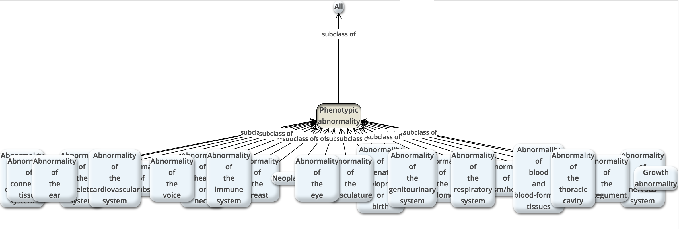
Organized by body system
You can also view the structure here: https://bioportal.bioontology.org/ontologies/HP

Slide 47
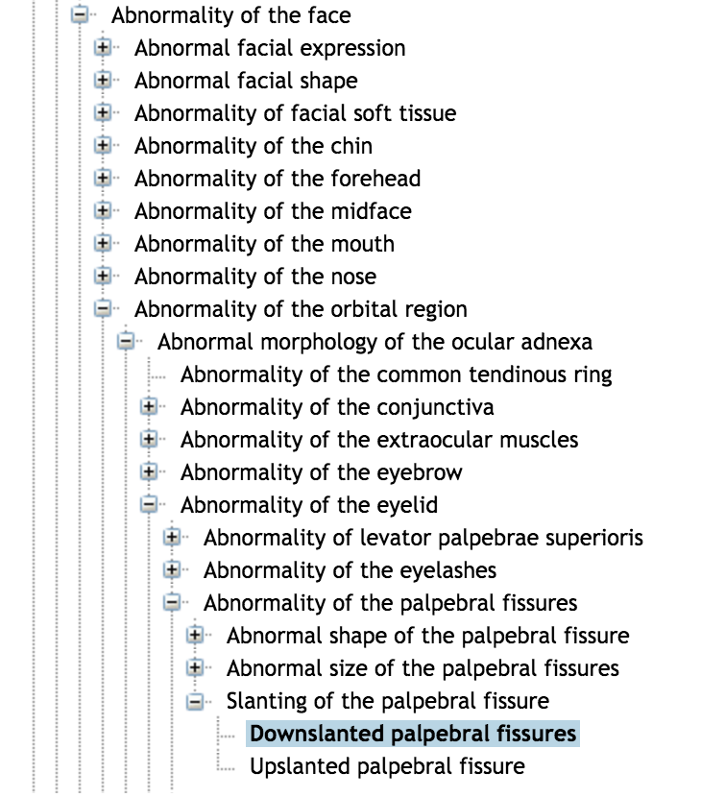
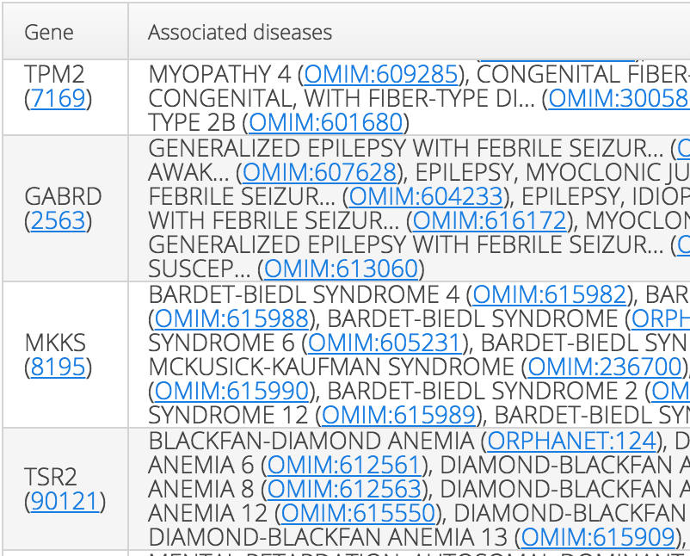
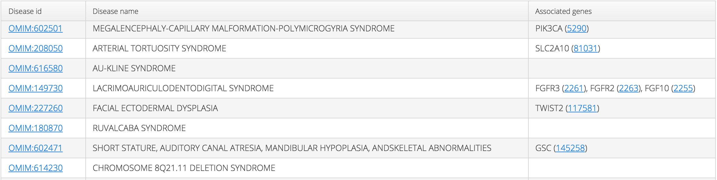
Example of phenotype and annotation

Slide 48
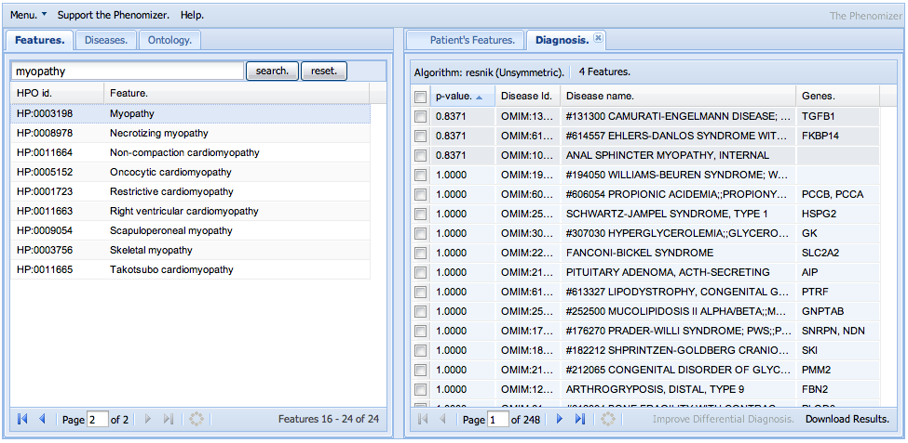
Phenomizer
scoliosis, osteopenia, myopathy
Genes to disease annotation
Phenotypes to disease annotation

Slide 49
Upper ontologies and management

Slide 50
Places to find biomedical ontologies
The OBO foundry www.obofoundry.org
The NCBO www.bioontology.org
The goal of the National Center for Biomedical Ontology is to support biomedical researchers in their knowledge-intensive work, by providing online tools and a web portal enabling them to access, review, and integrate disparate ontological resources in all aspects of biomedical investigation and clinical practice. A major focus of our work involves the use of biomedical ontologies to aid in the management and analysis of data derived from complex experiments.

Slide 51

OBO Foundry
Open
Common syntax
Unique identifier space
Versioning control
orthogonality
Definitions
OBO relations
Provide documentation
Plurality of independent users
Developed collaboratively
http://www.obofoundry.org/

Slide 52
Span of biomedical domain
Granularity from molecule to organism
complexity
Molecular
process
Cell physiology
Organism
physiology
Patho
physiology
SO
RNAO
PRO
chEBI
Molecular
function
Cell
types
species
patho
anatomy
molecule
Cell anatomy
Organism anatomy
granularity

Slide 53

BFO basic formal ontology
“narrowly focused on the task of providing a genuine upper ontology which can be used in support of domain ontologies developed for scientific research, as for example in biomedicine within the framework of the OBO Foundry.”
http://www.ifomis.org/bfo

Slide 54
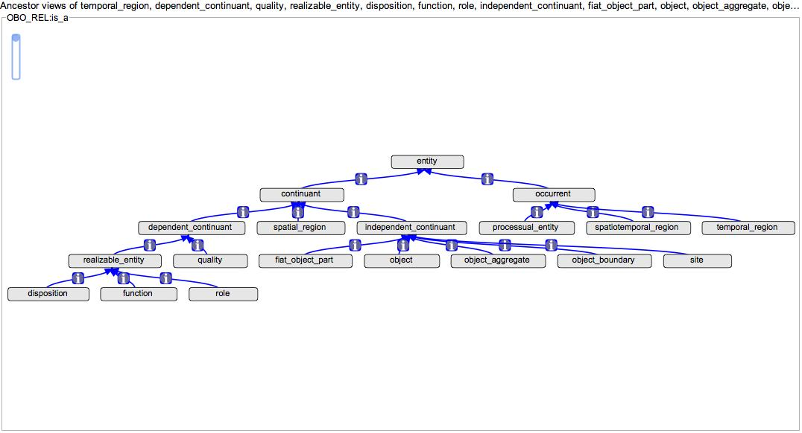
Top level terms of BFO
Things that develop over time
Things that exist through time
Things that inhere in other entities
A thing that bear qualities

Slide 55

relation ontology
The RO provides class level and instance level relations.
ALL SOME RULE – for class level relations
Improves reasoning
All start_codon part_of some CDS
http://www.obofoundry.org/ro/
Notes:
class-level relations, which follow from the instance-level definition in the standard all-some pattern.
The RO provides a set of defined formal type level and instance level relations. The list of relations may be extended by individual ontologies as required. The class level relations follow the “ALL_SOME” rule¹⁷. This rule is necessary to improve the ability to reason over data that uses the ontology. In practice, making these changes to SO has required the addition of the ‘has_part’ relation to the ontology. Prior to this change the SO stated that:
TATA_box part_of RNApol_II_promoter and
TATA_box part_of RNApol_III_promoter.
This was incorrect as all TATA_boxes are not part of both kinds of promoter. The ontology now states that RNApol_III_promoter has_part TATA_box.
The integral_part_of relation and its inverse have been added to clarify the occasions when the part and the whole must both exist.

Slide 56
Questions?

Slide 57
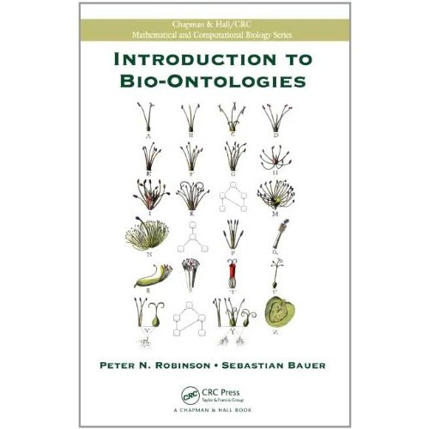
Excellent book
Introduction to bio-ontologies by Robinson and Bauer
CRC Press

