Slide 1
WHAT IS UNIQUE ABOUT NODE.JS?
JavaScript used in client-side but node.js puts the JavaScript on server-side thus making communication between client and server will happen in same language
Servers are normally thread based but Node.JS is “Event” based. Node.JS serves each request in a Evented loop that can able to handle simultaneous requests.

Slide 2
WHAT CAN’T DO WITH NODE?
Node is a platform for writing JavaScript applications outside web browsers. This is not the JavaScript we are familiar with in web browsers. There is no DOM built into Node, nor any other browser capability.
Node can’t run on GUI, but run on terminal

Slide 3
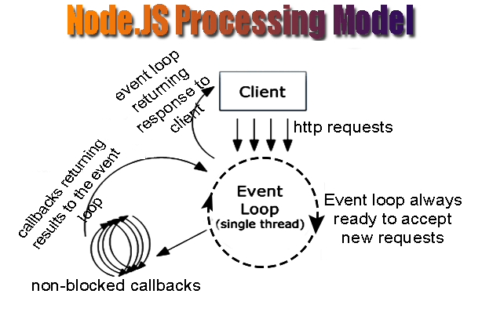

Slide 4
WHY NODE.JS USE EVENT-BASED?
In a normal process cycle the webserver while processing the request will have to wait for the IO operations and thus blocking the next request to be processed.
Node.JS process each request as events, The server doesn’t wait for the IO operation to complete while it can handle other request at the same time.
When the IO operation of first request is completed it will call-back the server to complete the request.

Slide 5
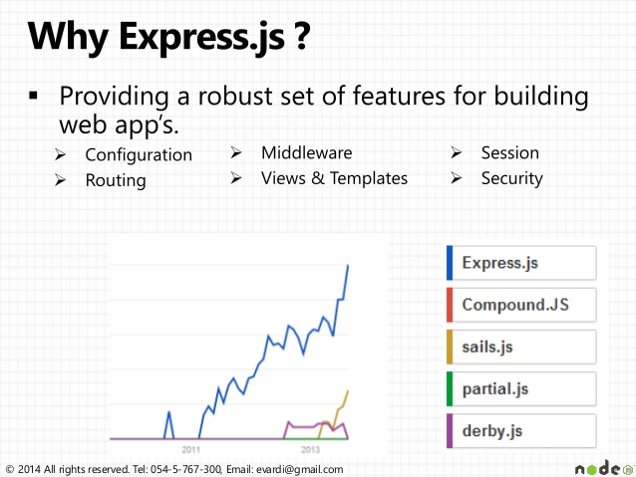

Slide 6
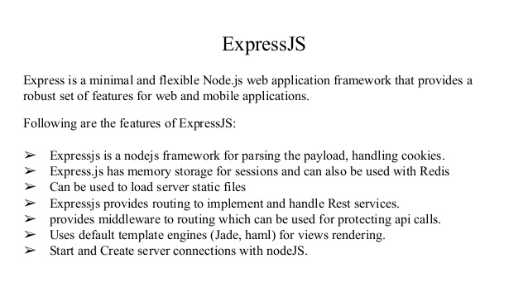

Slide 7
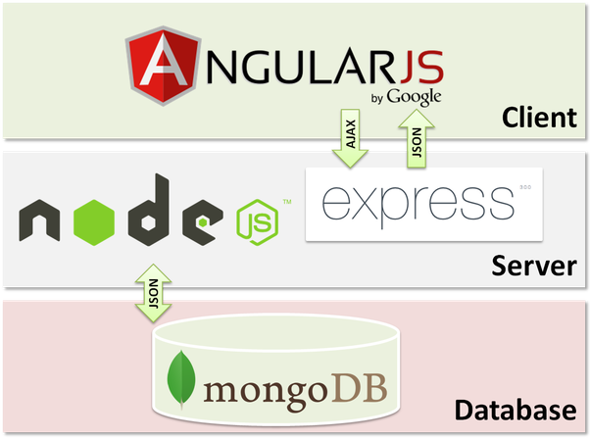

Slide 8
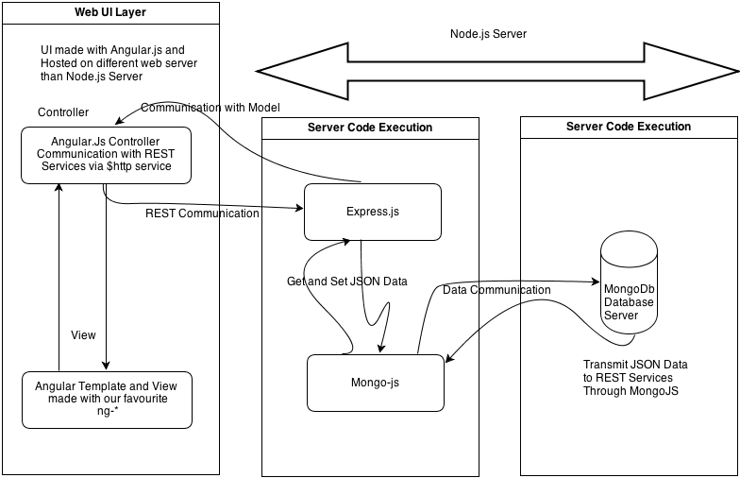

Slide 9
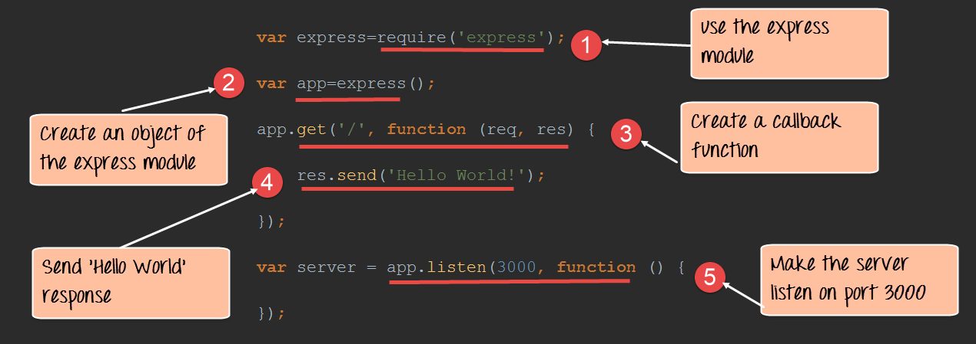

Slide 10
Additional References
https://nodesource.com/blog/the-basics-of-package-json-in-node-js-and-npm/

