Slide 1
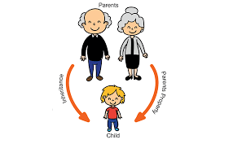
Inheritance

Slide 2
Definition
Inheritance is a mechanism in which one class acquires the property of another class. For example, a child inherits the traits of his/her parents.
With inheritance, we can reuse the fields and methods of the existing class. Hence, inheritance facilitates Reusability and is an important concept of OOPs.

Slide 3
EXAMPLE - INHERITANCE
Shape
Circle
Triangle
Line

Slide 4
Types of Inheritance in java
Single Inheritance
Multilevel Inheritance
Hierarchical Inheritance
Multiple Inheritance
Hybrid Inheritance

Slide 5
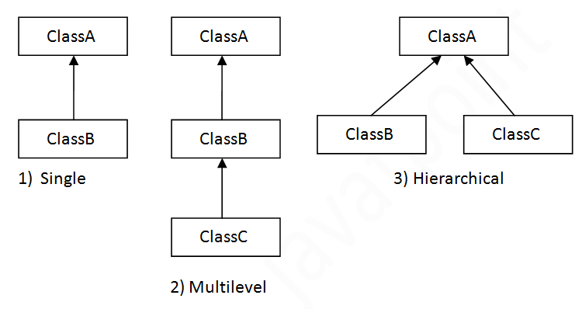

Slide 6
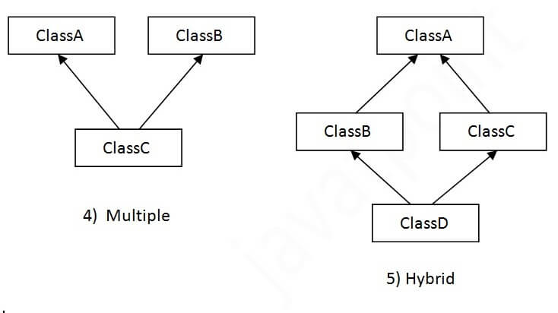

Slide 7
Thank you

