Slide 1

Ministry of Agriculture and Farmers Welfare
By Team:Action Replay

Slide 2
Problem Statement

Slide 3
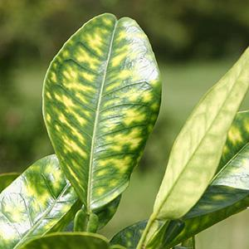
Real time identification of crops, weeds, disease and pest damage and nutrient deficiency symptoms.

Slide 4
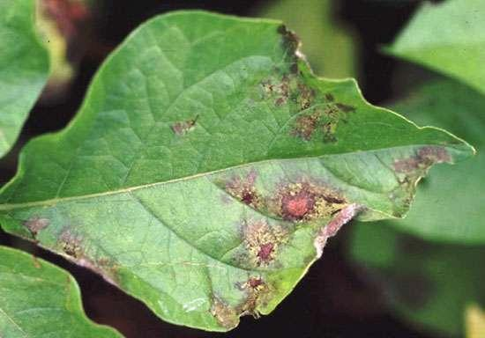
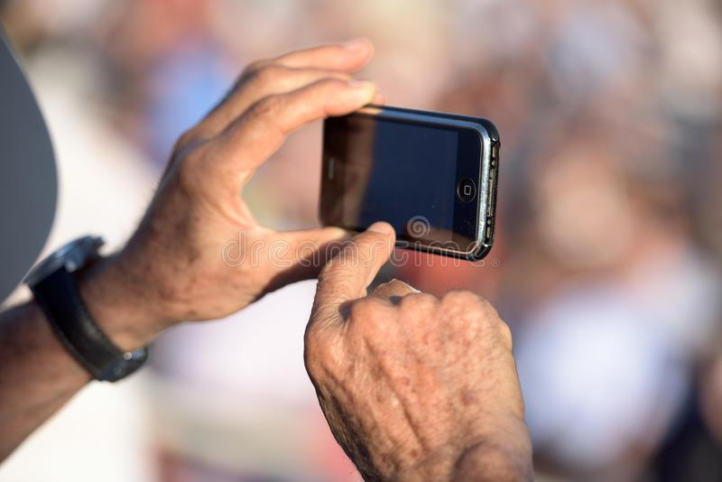
Proposed Solution
An android application that facilitates farmers, scientists and botanists to detect the type of plant or crops, detect pests and any other kind of diseases in them.
The app sends the image of the plant to the server where it is analysed using CNN classifier model.
Once detected, the disease and its solutions are displayed to the user. Also the closest pesticides selling centers are suggested.

Slide 5
Approach and Mechanism

Slide 6
The problem is solved in 4 phases:
PHASE 1. Collection of DataSet
PHASE 2. Training
PHASE 3. Android Application
PHASE 4. Testing

Slide 7
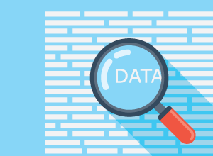
PHASE 1. Collection of DataSets
Publicly available datasets​: We collect different datasets each for plant type, weeds, disease, pests etc that are publicly available.
Resizing images for efficient storage and prediction.

Slide 8
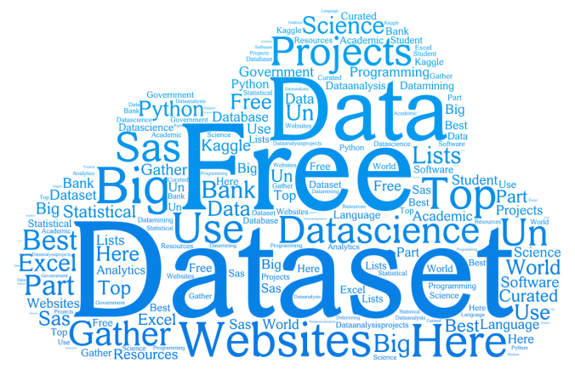
Datasets :
Horticulture crops taken :
Corn
Peach
Disease categories:
1 healthy for each plant crop
1 diseases for Peach
2 diseases for Corn

Slide 9
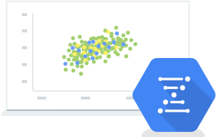
PHASE 2. Training
Vectorize each image of dataset when loaded.
Train a CNN (YOLO architecture) on different categories of datasets using keras with tensorflow backend.
Save the weights.

Slide 10
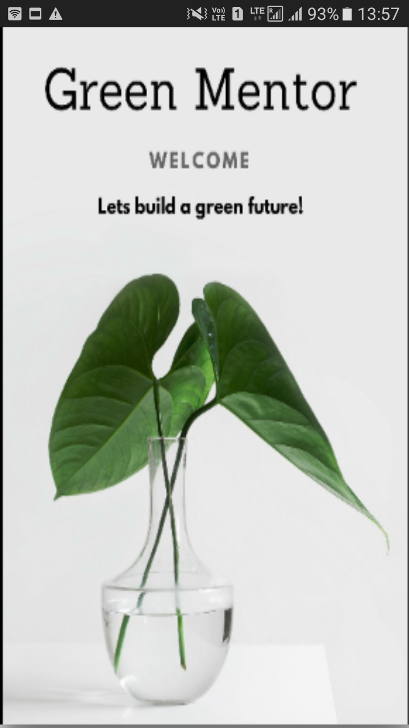
PHASE 3. Android Application
Green Mentor

Slide 11
Application Flow
Android Application
News Feed
Camera Activity
User Timeline
Sellers Nearby

Slide 12
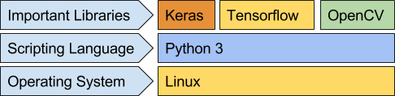
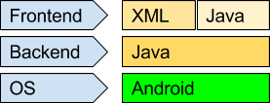
Technology Stack :
Server Side:
Backend
, Django
Client Side:

Slide 13
DEMO:

Slide 14
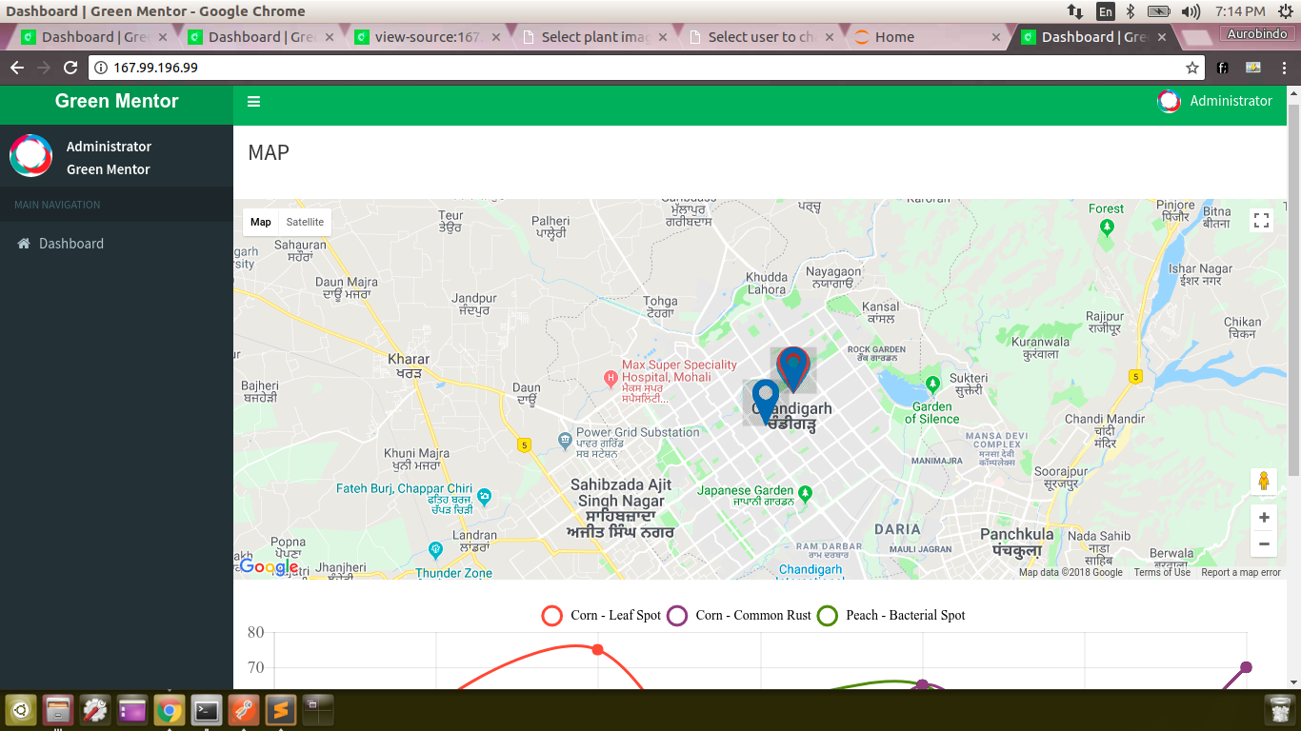
DEMO:

Slide 15
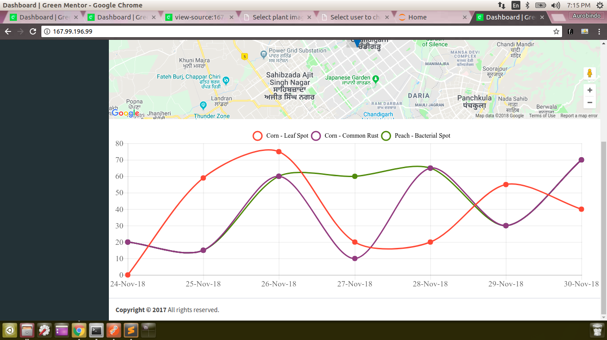
DEMO:

Slide 16
Future Scope :
Using Reinforcement learning through time to time feedbacks to improve the accuracy of our product.
Extending the product for other horticulture crops.
Localisation of the application.

