Slide 1


The Effects Ethnocentrism Has on World
种族中心论对世界的影响
答辩人：
第六小组
王少博 张舒怡 胡春城

Slide 2
Contents
The definition and examples of ethnocentrism and the reasons why it comes into being
Theoretical Basis
The effects ethnocentrism has on some aspects, including culture, politics and so on
Main Content
The proper attitude we are supposed to hold toward ethnocentrism
Conclusion

Slide 3
PART
Theoretical Basis
01

Slide 4
Theoretical Basis
Main Content
Conclusion
What is “Ethnocentrism”?
01
the tendency to think of one's own culture as being at the center of the world
02
What causes ethnocentric beliefs?
a strong identification with one's own culture that directly creates a positive view of that culture
03
Are the effects of ethnocentrism negative or positive?
both nagative and positive effects

Slide 5
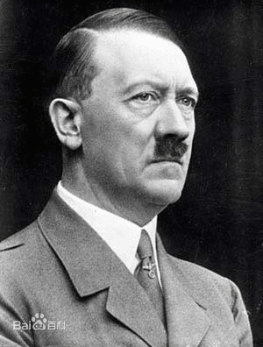


Theoretical Basis
Main Content
Conclusion
the Nazi party
the Olympic Games
the Belt and Road Initiative
What they did is so inhumane that all the human beings should be humiliated by their behavior.
a celebration of sports and friendly competition between cultures
a signal to initiate intercultural communications

Slide 6
PART
Main Content
02

Slide 7
Theoretical Basis
Main Content
Conclusion
Racism
Film
Effects
Media
Social Media

Slide 8
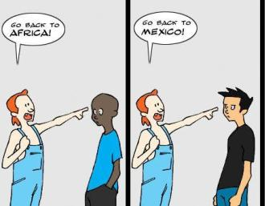
Theoretical Basis
Main Content
Conclusion
Ethnocentrism and Racism
Ethnocentrism is usually associated with racism. However, as mentioned before, ethnocentrism does not necessarily implicate a negative connotation.
In European research the term racism is not linked to ethnocentrism because Europeans avoid applying the concept of race to humans; meanwhile, using this term is not a problem for American researchers. Since ethnocentrism implicated a strong identification with one's in-group, it mostly automatically leads to negative feelings and stereotyping to the members of the out-group, which can be confused with racism. Finally, scholars agree that avoiding stereotypes is an indispensable prerequisite to overcome ethnocentrism; and mass media play a key role regarding this issue.

Slide 9
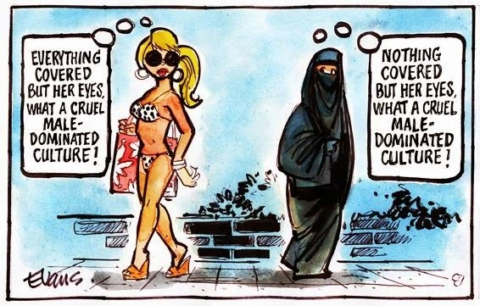
Theoretical Basis
Main Content
Conclusion
Effects of ethnocentrism in the media
Mass media plays an important role in our current society. We are constantly exposed to media content every day.
Researchers had found that ethnocentrism is dysfunctional in communication and similar fields because the lack of acceptance of other cultures leads to the creation of barriers for people of different backgrounds to interact with each other. The presence of ethnocentrism in media content creates an issue in the exchange of messages in the communication process. The media industry is dominated by the Global North, so Western ethnocentrism tends to be exposed in the media. This can be seen in the predominance of Westerner content in TV shows, film, and other forms of mass media. Some Western shows tend to depict foreign cultures as inferior or strange in contrast to their own culture.

Slide 10


Theoretical Basis
Main Content
Conclusion
Effects on film
Cinema has been around our society since the beginning of the 20th century, and it is an important tool that allow to entertain and educate the viewer. Western companies are usually the leaders of the film industry. Thus, it is common to be exposed to content based on Westerners' point of view.
Examples
Example
Ethnocentrism in Western films
Aladdin from Disney as an example of ethnocentrism

Slide 11
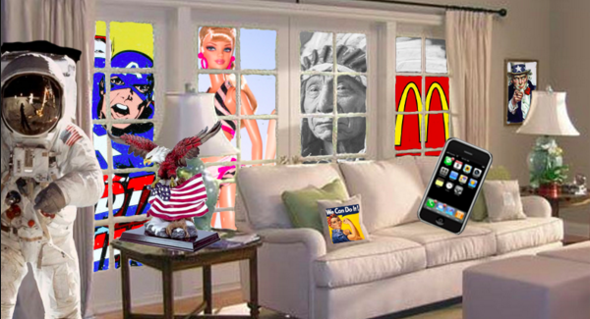
Theoretical Basis
Main Content
Conclusion
Effects on Social Media
Social media plays an essential role in society, and it is considered an important part of human life.
Similarly to the film industry, social media platforms are mainly owned by Western companies. For example, in the present, the most popular social media platforms are Facebook and Instagram, which are owned by the American Mark Zuckerberg. In today's world, a considerable amount of people is exposed to social media, whose purpose is to encourage interaction among users. Social media has been associated with increase of access and interaction, and a tool created for information delivery and exchange of information. However, that exchange of information can be blocked by ethnocentrism because it can diminish the interest of interacting with people from other cultures, it also can act as a discouraging factor in pursuing intercultural friendships. In this way, ethnocentrism affects social media not only because the majority of the content came from the West but also because it can decrease the interaction with other users due to their culture.

Slide 12
Theoretical Basis
Main Content
Conclusion
Movie
Effects in Popular Culture
Literature
TV

Slide 13
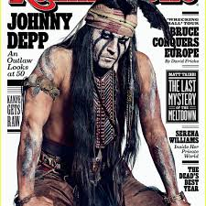
Theoretical Basis
Main Content
Conclusion
Ethnocentrism in Pop Culture
In the Movies
In the movies, ethnocentrism isn't often presented as a serious problem. It serves more as an entertaining device.
In the movies, ethnocentrism isn't often presented as a serious problem. It serves more as an entertaining device. The father in My Big Fat Greek Wedding constantly states that he can trace any word back to Greek origins. Furthermore, the entire movie is centered around the thrills and issues of planning a Greek wedding. Ultimately, though, the movie has a happy ending, subtly suggesting that the positives outweigh the negatives. Another example of ethnocentrism covered with humor occurs in the comedy American Wedding. Upon learning that her grandson isn't marrying a Jewish girl, Jim's grandmother becomes inconsolable. Furthermore, Michelle's father makes the mistake of toasting to his soon-to-be in-laws with hopes that they'll sit many happy shivas together. He's painted as a fool for his statement, and the movie subtly indicates a Jewish ethnocentrism.
In Television

Slide 14
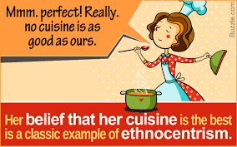
Theoretical Basis
Main Content
Conclusion
Ethnocentrism in Pop Culture
If you have Amazon Prime, you've probably seen ads for The Marvelous Mrs. Maisel. It tells the story of a young Jewish girl living in New York City in the 1950s. She was raised by strict Jewish parents, went off to college, and then married a nice Jewish boy. A few years into their marriage, her husband left her for - Heaven forbid - a Gentile.
In Television
We watch the family as they spend their Sabbaths in the temple and clamor to win the rabbi's affection so he'll visit their home on the Sabbath. Mrs. Maisel befriends a Catholic co-worker and mocks the name of her church - Our Lady of Perpetual Sorrow. The show is purely a comedy, but there's no doubt this Jewish family thinks their culture is far superior to any Gentile's way of living.
In Television

Slide 15
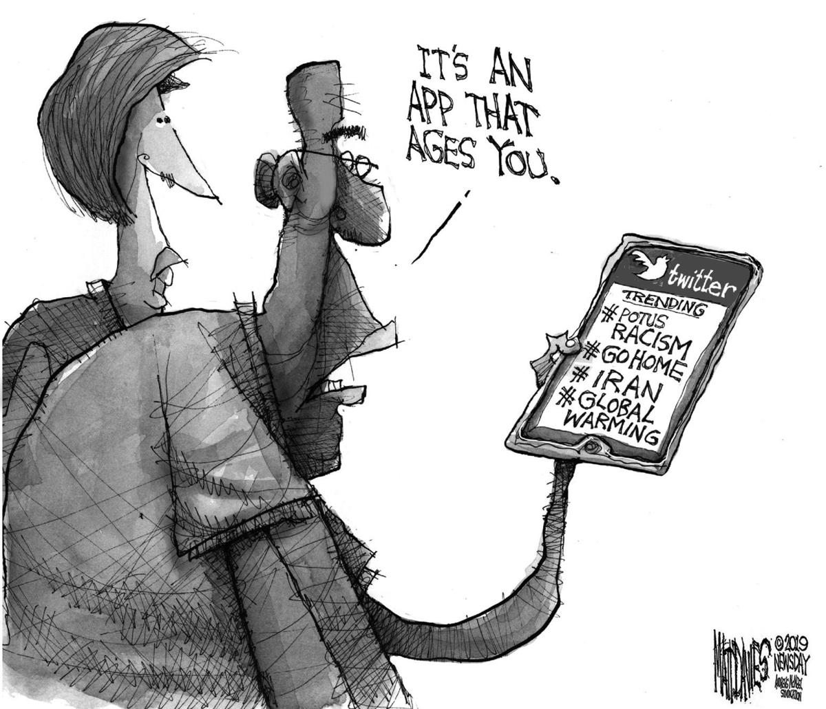
Theoretical Basis
Main Content
Conclusion
Ethnocentrism in Pop Culture
In Zora Neale Hurston's Their Eyes Were Watching God, the main character, Janie Starks, is a light-skinned black woman. For this, the other black woman in her town are full of contempt for her. She seems to straddle the line between black and white at various points.
In Literature
This novel indicates that ethnocentrism is an extremely broad topic because even within one's own ethnicity, divisions will be found. The writing illustrates important components of ethnocentrism in history as well because, before the victory of the Civil Rights era, blacks would often try to "pass" for whites, and those who succeeded were often scorned by other blacks.
The Merchant of Venice by William Shakespeare portrays an intense disagreement between the Jewish character Shylock and the Christian character Antonio. Antonio constantly scorns Shylock for being a Jew, which ultimately culminates in one of the most famous speeches of all time where Shylock asks:
In Television

Slide 16
PART
Conclusion
03

Slide 17
Theoretical Basis
Main Content
Conclusion
Ethnocentrism may not, in some circumstances, be avoidable. We all often have instinctual reactions toward another person or culture’s practices or beliefs
Conclusion
But these reactions do not have to result in horrible events such as genocide or war. In order to avoid such awful things like those we must all try to be more culturally relative.
. Ethnocentrism is one solution to tension between one cultural self and another cultural self. It helps reduce the other way of life to a version of one’s own.

Slide 18
THANKS
王少博 张舒怡 胡春城

