Slide 1

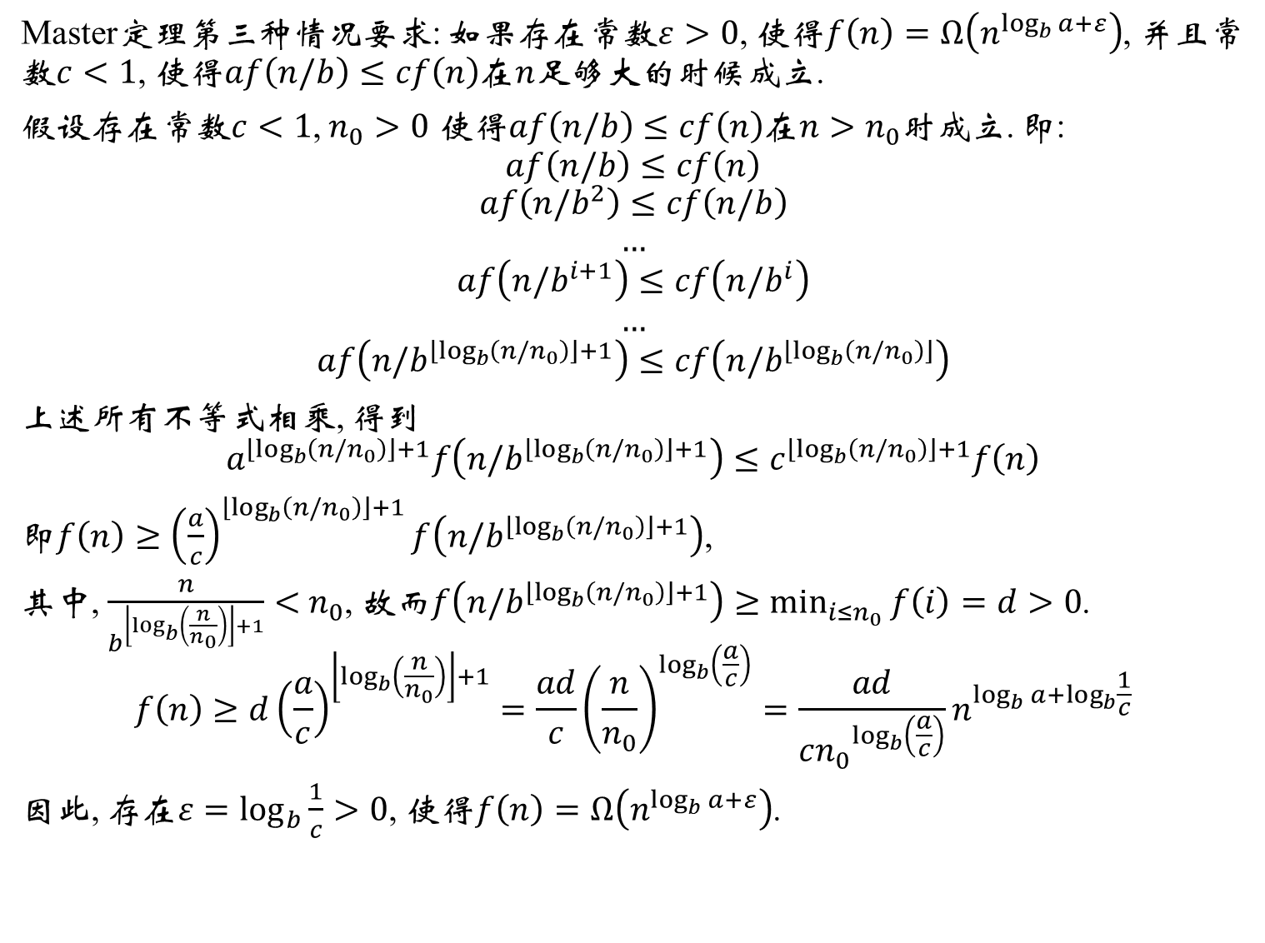
Master定理第三种情况要求: 如果存在常数$ε>0$, 使得$f\left(n\right)=Ω\left(n^{\log_{b}{a}+ε}\right)$, 并且常数$c<1$, 使得$af\left(n/b\right)≤cf\left(n\right)$在$n$足够大的时候成立.
假设存在常数$c<1$, $n_{0}>0$ 使得$af\left(n/b\right)≤cf\left(n\right)$在$n>n_{0}$时成立. 即:
$$af\left(n/b\right)≤cf\left(n\right)$$
$$af\left(n/b^{2}\right)≤cf\left(n/b\right)$$
$$…$$
$$af\left(n/b^{i+1}\right)≤cf\left(n/b^{i}\right)$$
$$…$$
$$af\left(n/b^{\left\lfloor \log_{b}\left(n/n_{0}\right)\right\rfloor +1}\right)≤cf\left(n/b^{\left\lfloor \log_{b}\left(n/n_{0}\right)\right\rfloor }\right)$$
上述所有不等式相乘, 得到
$$a^{\left\lfloor \log_{b}\left(n/n_{0}\right)\right\rfloor +1}f\left(n/b^{\left\lfloor \log_{b}\left(n/n_{0}\right)\right\rfloor +1}\right)≤c^{\left\lfloor \log_{b}\left(n/n_{0}\right)\right\rfloor +1}f\left(n\right)$$
即$f\left(n\right)≥{\left(\frac{a}{c}\right)}^{\left\lfloor \log_{b}\left(n/n_{0}\right)\right\rfloor +1}f\left(n/b^{\left\lfloor \log_{b}\left(n/n_{0}\right)\right\rfloor +1}\right)$,
其中, $\frac{n}{b^{\left\lfloor \log_{b}\left(\frac{n}{n_{0}}\right)\right\rfloor +1}}<$ $n_{0}$, 故而$f\left(n/b^{\left\lfloor \log_{b}\left(n/n_{0}\right)\right\rfloor +1}\right)≥\min_{i≤n_{0}}{f\left(i\right)}=d>0$.
$$f\left(n\right)≥d{\left(\frac{a}{c}\right)}^{\left\lfloor \log_{b}\left(\frac{n}{n_{0}}\right)\right\rfloor +1}=\frac{ad}{c}{\left(\frac{n}{n_{0}}\right)}^{\log_{b}\left(\frac{a}{c}\right)}=\frac{ad}{c{n_{0}}^{\log_{b}\left(\frac{a}{c}\right)}}n^{\log_{b}{a}+\log_{b}{\frac{1}{c}}}$$
因此, 存在$ε=\log_{b}{\frac{1}{c}}>0$, 使得$f\left(n\right)=Ω\left(n^{\log_{b}{a}+ε}\right)$.
$n/b^{i}≥$ $n_{0}$, 因此$i≤\log_{b}\left(n/n_{0}\right)$

