Slide 1
Software Architecture
Lecture 4-2. Dataflow Systems
Pipes and Filters Architecture
管道过滤器架构
Professor:
Yushan (Michael) Sun
Fall 2020

Slide 2
本讲内容
Concept of Pipes-and-filters architecture
Example programs designed in pipes and filters architecture
Unix support for pipes and filters architecture
Comparison of batch sequential architecture and pipes and filters architecture

Slide 3
Concept of Pipes and Filters architecture
管道-过滤器架构

Slide 4
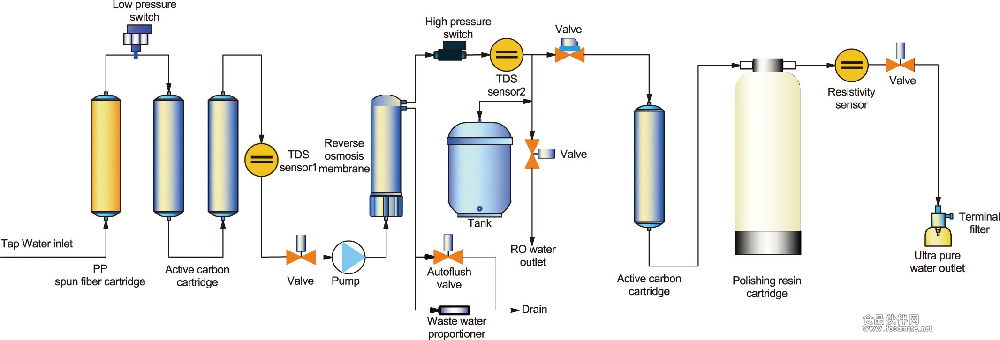
Pipes and Filters architecture 管道-过滤器软件体系结构
聚丙烯纺
丝纤维筒
活性炭
滤芯
活性炭
滤芯
抛光
树脂盒
纯净水生产流程图：每个过滤器都有其特定的功能

Slide 5
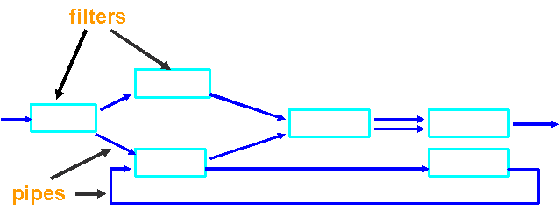
Pipes and Filters architecture
管道-过滤器软件体系结构的定义：
Pipes and filters architecture is composed of filters to do data processing and pipes that carry data from one filter to the next filter.
Processing step
Data stream
Pipes and filters architecture

Slide 6
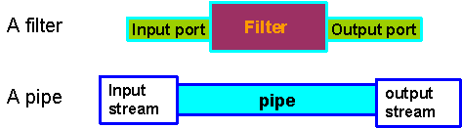
Pipes and Filters architecture
A program
Process data
transmit data
filter1
pipe
filter2
pipe
filter3
filter structure and pipe structure

Slide 7
Pipes and Filters architecture
过滤器的功能(Functionalities of Filters):
Incrementally transform some of the
source data into sink data
添加信息. Enrich data by computing and adding information
变换数据. Transform data by changing representation
流对流变换. Stream to stream transformation
不保留状态. Preserve no state between instantiations (forget what has happened)

Slide 8
Pipes and Filters architecture
管道的功能(Functionalities of a Pipe):
move data from a filter’s output to a
filter’s input
单向流. One way flow
数据传输图. Pipes form data transmission graph

Slide 9
Pipes and Filters architecture
整体运行机制(Overall operations)
Run pipes and filters until no more computations are possible
Action is mediated by data delivery
Back

Slide 10
Example programs designed in
pipes and filters architecture

Slide 11
Pipes and Filters architecture
例1. 千年虫与政治问题 (Year 2000 problem and political issues)
In a text file, change all year expressions “xx” into “19xx”, e.g. “89” into “1989”, and change all expressions “Republic of China” into “Taiwan”
legacy.txt
Input
Y2K
Political
Issue
Output
new.txt
Legacy file update system designed using Pipes and filters architecture

Slide 12
Pipes and Filters architecture
legacy.txt
Input
Y2K
Political
Issue
Output
new.txt
After Input: Television $3800 Republic of China 95-12-11
After Y2K: Television $3800 Republic of China 1995-12-11
After Political Issue: Television $3800 Taiwan 1995-12-11
After Output: Television $3800 China 1995-12-11
数据以数据流的方式从左端流入，流经各个过滤器，对数据进行处理；对于处理完的数据，立即写入到下游管道.

Slide 13
Pipes and Filters architecture
例2: 编译器(Compiler example)
A typical architecture of a compiler example
is pipes and filters architecture describing
in the next page.

Slide 14
Pipes and Filters architecture
ASCII program text
Lexical Analysis
进行词法分析
Scanner
token stream
Syntax Analysis
进行语法分析
Parser
abstract syntax tree
Semantic Analysis
进行语义分析
Semantic checker
augmented abstract syntax tree
生成字节码
Byte code generator
program running on virtual machine
优化字节码
Byte code optimizer
Virtual machine
生成机器代码
Machine code generator
machine instructions of
a specific processor

Slide 15
Pipes and Filters architecture
Functionalities of each filter
Scanner: Lexical Analysis （词法分析）
Misspellings: such as “String” into “Sting”
Parser: Syntax Analysis （语法分析）
Omission, wrong order of tokens
Semantic checker: Semantic Analysis （语义分析）
Incompatible types: e.g., “float”, “double”
Byte code generator (字节代码生成器) : byte code generation:
C/C++ compiler: from source code to assembly code
Java compiler: from Java code to bytecode。
Java跨平台其实就是基于相同的bytecode规范做不同平台的虚拟机，我们的Java程序编译成bytecode后就可以在不同平台跑了。
Byte code optimizer: optimizing byte code
Machine code generator: generating machine code

Slide 16

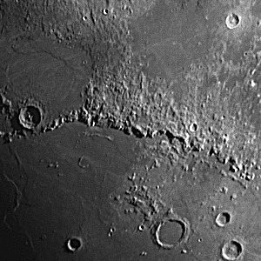
例3：关于图像处理问题
Pipes and Filters architecture
Image processing problem
Pipes and Filters architecture can be used to do some image processing to digital pictures (images)
Picture before and after image sharpening

Slide 17
Pipes and Filters architecture
使用管道-过滤器体系结构设计的数字图像处理系统。分别实现对彩色图像的
RGBFilter (三色素滤波，Red，Green, Blue; 值0：255)，
ThreshHoldFilter (阈值滤波；例如超过186，全过滤掉)，
TransFilter (变换滤波；用数学公式改变颜色的强度）
GrayOutFilter(变灰滤波；图片颜色变得暗淡)
img.jpg
T1
RGBFilter
ThreshHoldFilter
TransFilter
GrayOutFilter
设计逻辑
T5
newImg.jpg

Slide 18
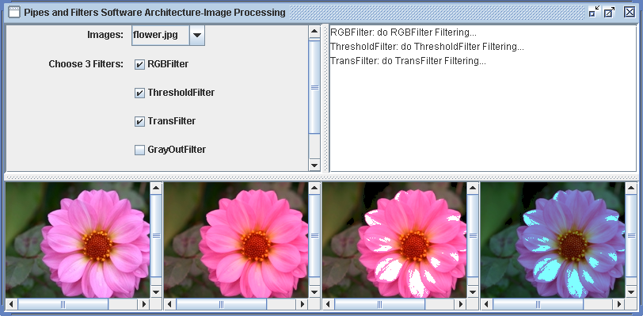
Pipes and Filters architecture
利用管道-过滤器架构设计的数字图像处理系统用户界面图
Back

Slide 19
Unix support for
pipes and filters architecture

Slide 20
Pipes and Filters architecture
例4. 在Unix环境下怎样搭建、实现管道-过滤器架构
Example 4. 如下的Unix命令组成一个管道/过滤器程
序，将in.txt文件的包含“Heroin”的行进行排序，
然后将结果输出到out.txt文件中。
命令行：
cat in.txt | grep “Heroin” | sort > out.txt
Cat:将指定的文件按照标准输出到显示器
Grep: 在本文档
中查找字符串
Sort:
将文档内容排序

Slide 21
Pipes and Filters architecture
以上命令行的管道/过滤器结构图如下。
in.txt
Cat
Grep
Sort
Grep负责在文件in.txt中搜索包含
表达式“Heroin”的所有的行，
并且将它们输出到下游管道。
将上游管道来的
行进行排序，以后
写到out.txt中
out.txt

Slide 22
Pipes and Filters architecture
带有分支的管道-过滤器架构
The pipes and filters pattern allows filters with multiple input and/or multiple output pipes to be connected in any directed graph (有向图) structure.
In the UNIX system, the tee filter provides a mechanism to split a stream into two streams

Slide 23
Pipes and Filters architecture
例5. 在Unix下搭建分支的管道-过滤器架构
Example 3: Tee & Join in Unix
Task: Print a sorted list of words that occur more than
once
mknod pipeA p
mknod pipeB p
sort pipeA > pipeB &
cat file1 | tee pipeA | sort -u | comm -13 - pipeB > file2
Tee: 读取标准输入的数据，并将其内容输出成几个文件。
comm命令可以用于两个文件之间的比较。前提：两个文件必须有序。

Slide 24
Pipes and Filters architecture
以上命令行的管道/过滤器结构图如下。
pipeA
pipeB
Sort
file1
cat
tee
file2
Sort
comm
分叉
合并
最后将在file1中出现过2次或者更多次的文字打印出来
Back

Slide 25
Comparison of
batch sequential architecture
and
pipes and filters architecture

Slide 26
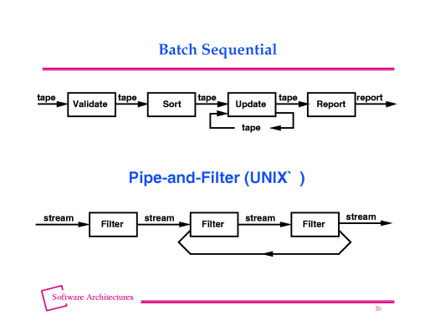
Pipes and Filters architecture
Comparison between batch sequential architecture
and pipes-and-filters architecture

Slide 27
Pipes and Filters architecture
相似之处：处理过程之间互不调用 (independent processing modules)
In both Batch sequential and pipes and filters architectures, the processing steps are independent of each other, that is
one filter in pipes and filters architecture doesn’t call any other filters in the system
one processing step in batch sequential architecture doesn’t call any other processing step in the system

Slide 28
Pipes and Filters architecture
区别1： 数据处理方式不同（the way for data
processing is different):
In batch sequencial Architecture (数据以块状形式传输), each step runs to completion before the next step starts, that is, data is transmitted as a whole between steps
In pipes and filters architecture (数据以流的形式传输), the filters Incrementally transform some of the source data into sink data, that is, the filters do stream to stream transformation

Slide 29
Pipes and Filters architecture
区别 2：数据量不同 (data amount is different):
In batch sequential Architecture, the amount of data is limited
In pipes and filters architecture, the amount of data can be unlimited
Back

