Slide 1
桌面软件体系结构
三层层次架构
MVC软件体系结构
主程序-子程序架构
面向对象系统
批处理架构
管道-过滤器软件体系结构
事件系统架构

Slide 2
Presentation
Layer
Controller
1）架构有几个组件组成
2）每个组件的功能
3）组件之间怎样互动？
Application
Layer
View
Model
Permanent Data
Storage Layer
Database
Database
3层层次架构
MVC架构

Slide 3
主程序-子程序架构
main
1）架构有几个组件组成
2）每个组件的功能
3）组件之间怎样互动？
fun1
Fun2
fun11
fun12
fun13
fun21
fun22
fun121
fun122
An arrow means a function call

Slide 4
医药成本计算问
题的程序结构图：
Medicine Cost
Computation
Validated medicine name
Total medicine cost
Validated medicine name
Total medicine cost per unit
Enter medicine
name
Calculate medicine
cost
Output cost
Medicine name
Medicine production cost
Medicine
Research cost
Per unit
Medicine name
DB
Get research
Cost per unit
Get production
Cost per unit
DB
structure chart of the medicine cost program

Slide 5
面向对象设计
1）架构有几个组件组成
2）每个组件的功能
3）组件之间怎样互动？
面向对象设计产生类图

Slide 6
批处理系统的定义.
Batch sequential process is formed by a sequence of processing steps, intermediating by some kind of storage, such as megatapes, hard disk, etc.
Each step will do some operation on the input storage to get some useful information or modify the contents of the source storage and then save the resultant data to its sink storage.
1）架构有几个组件组成
2）每个组件的功能
3）组件之间怎样互动？
Proc 1
Proc 2
Proc 3

Slide 7
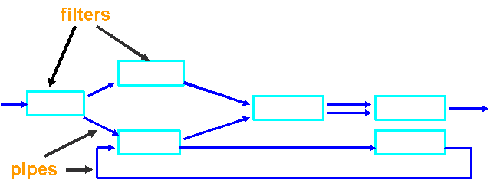
管道-过滤器软件体系结构的定义：
Pipes and filters architecture is composed of filters to do data processing and pipes that carry data from one filter to the next filter.
Processing step
1）架构有几个组件组成
2）每个组件的功能
3）组件之间怎样互动？
Data stream
Pipes and filters architecture

Slide 8
有独立事件调度模块的系统
1）架构有几个组件组成
2）每个组件的功能
3）组件之间怎样互动？
分发事件
Dispatcher
调度模块
读取
事件
Event space
事件广播

Slide 9
发布/订阅策略
1）架构有几个组件组成
2）每个组件的功能
3）组件之间怎样互动？
publisher
dispatcher
I did not register and so I did not get event
subscriber
subscriber
subscriber
Publish/Subscribe strategy

Slide 10
2. Strategy of Events Handling
无独立事件调度模块的系统
1）架构有几个组件组成
2）每个组件的功能
3）组件之间怎样互动？
listen
Event Space
listen
listen
listen
listen
Observable/Observer modle

Slide 11
2. Strategy of Events Handling
This modle is usually called observable/Observer
每个模块都允许其它模块对其所发送的事件感兴趣
Each module allows other modules to declare
interest in events that it is sending.
只将事件发送给注册者
Whenever a module sends an event it sends
that event to exactly those modules that
registered interest in that event.

Slide 12
2. Strategy of Events Handling
Observable
1）架构有几个组件组成
2）每个组件的功能
3）组件之间怎样互动？
Observer
Observer
Observer
Observable/Observer modle
(被观察者/观察者模型)

Slide 13
4. Design Examples Using the Observer Pattern
<<interface>>
Observable
<<interface>>
Observer
notifies
+notifyObservers()
+register(obs: Observer)
+unRegister(obs:Observer)
1 1..*
+update( Observable subject, Object arg)
VoiceInfo
WordInfo
InfoCenter
+update(s, arg)
+update(s, arg)
+notifyObservers()
+register(obs: Observer)
+unRegister(obs:Observer)
1 1..*
1 1..*
利用观察者模式设计的机场信息发布系统

Slide 14

运行在互联网上的软件体系结构
Comparison of the Internet related
Software Architectures

Slide 15
Comparison of the Internet related Software Architectures
共同点：以下所有的5个架构都是关于共享资源的
Similarity：all the architectures below
Client/Server Architecture
P2P Architecture
Grid Computing Architecture
Cloud computing
SOA Architecture （web services）
are about sharing resources.

Slide 16



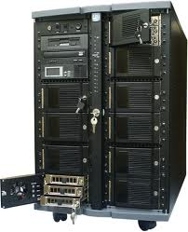


Comparison of the Internet related Software Architectures
1）体系结构
2）共享的资源在哪里？
3）怎样互动？
Client/Server Architecture: clients share resources from the server(s)，on the
other hand, a client may be a resource contributor if the client uploads any
resource to the server.

Slide 17
Comparison of the Internet related Software Architectures
1）体系结构
2）共享的资源在哪里？
3）怎样互动？
P2P Architecture: peer nodes share resources from each other. A peer is a server, if it provides services to a client, and a peer node is a client if it uses resources from another node.

Slide 18
Comparison of the Internet related Software Architectures
Lot of PC’s
Lot of PC’s
Local cluster
server
Local cluster
server
1）体系结构
2）共享的资源
在哪里？
3）怎样互动？
Main cluster
Server
Local cluster
server
Database farm
Local cluster
server
Lot of PC’s
Lot of PC’s
Grid computing: many grid users uses a grid, which integrates a lot of geographically disperses resources, including computing resources and data resources. In this sense, grid users share resources provided by a grid computing system.

Slide 19


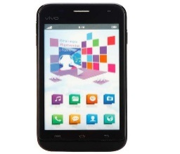
Comparison of the Internet related Software Architectures
云计算提供商
1）体系结构
2）共享的资源在哪里？
3）怎样互动？
Cloud computing: many cloud service users
rent services from cloud service provider,
which uses the resources owned by the
cloud service company
to provide rental services to the users.
In this sense: the users share resources
provided by the cloud computing enterprise.
IaaS
PaaS
SaaS
租户

Slide 20
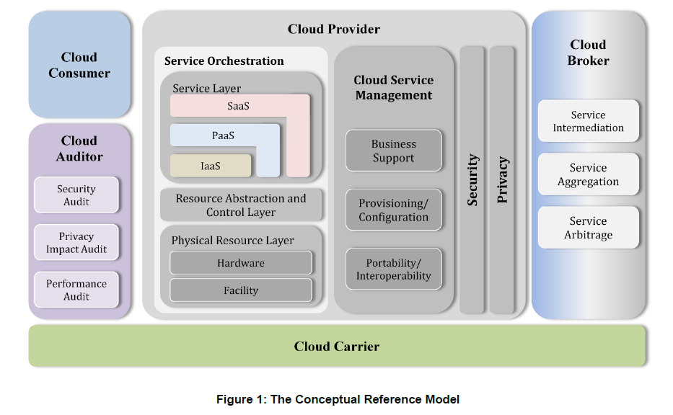
5. Architectures of Cloud Computing
云提供者
云代理者
服务编制
云消
费者
云审
计者
Cloud computing architecture given by NIST
美国国家标准和技术研究院(NIST)给出的云计算模型

Slide 21
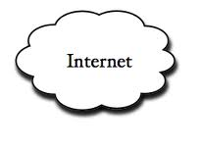
Comparison of the Internet related Software Architectures
1）体系结构
2）共享的资源在哪里？
3）怎样互动？
Server
Servers
SOA Architecture

Slide 22
Comparison of the Internet related Software Architectures
Service
Consumer
Find
Bind and execute
Registry
Contract
Service
Provider
Register
包含很多服务提供者目录
SOA architecture: a service consumer uses services provided by the service provider, by calling the provider’s interface. On the internet, any software system can be a service provider as well as a service consumer. In this sense, software systems share resources from each other.

Slide 23
Comparison of the Internet related Software Architectures
5种架构的区别
架构 | 是否有中心 服务器 | 资源共享方式 | 是否付费
Client/ server | 有 | 资源共享由中心服务器提供 | 一般不付费，有的需付费
Grid computing | 有中心服 务器群 | 资源共享由网格系统提供 | 免费、付费
Cloud computing | 有中心服务器群 | 资源共享由云提供商软件系统（以出租的方式）提供 | 免费、大多数付费
P2P | 没有 | 资源共享由P2P网络的任何一个节点负责 | 通常免费
SOA | 没有 | 由服务提供者提供，任何在线的软件系统都可以是服务提供者 | 通常免费
Back

