Slide 1
Programming Workshop:
GitHub, Vim, and Python Basics
Beginner’s Workshop #3
26 September 2016

Slide 2
Outline
Speed Exercises
“Homework” - Completion
GitHub - Fork Our Repository
Using Vim
Python:
Making a script
I/O
Making a Function

Slide 3
Speed Exercises
# 1:
Make a function that counts to 15 and prints each odd number.
60 seconds

Slide 4
Speed Exercises
# 2:
Make a function that prints all prime numbers between 1 and 100.
180 seconds

Slide 5
Speed Exercises
# 3:
Make a script that takes a string from the user and prints how many characters it contains.
120 seconds

Slide 6
“Homework”
Get Linux and Python running!
Make a GitHub account
Go through the Codecademy Python lesson

Slide 7
Forking our GitHub Repository
What is a clone?
Copy of repository stored locally
What is a fork?
Bifurcation of repository
Can be cloned to local machine

Slide 8
Forking our GitHub Repository
Forking our repository:
Open our repo in a web browser
In the upper right side of the interface, click “fork this repository”
In the list of your repositories, select the fork of our repository
Clone your fork of our repository to your computer

Slide 9
VIM!
Open a terminal
Open a file with Vim
Follow along and try each step

Slide 10
VIM!
For more practice, head to:
http://vim-adventures.com/

Slide 11
Python Basics: Scripting
Involves making a file and running the file
Similar operation to interpreter - the Python interpreter still interprets the script - but not an interactive interface
Unlike other languages, DON’T need:
Main()
Functions
Classes

Slide 12
Python Basics: I/O
Many types of input:
input()
open(“filename”, “mode”)
file.read()
with open() as csvfile: …
csv.readrow()

Slide 13
Python Basics: I/O (cont’d)
Command line input collected via:
variable = input(“Print this statement then collect: “)
Sometimes must cast type:
int_variable = int(input(“Give us a number: “))
float_variable = float(input(“Give us a number: “))

Slide 14
Python Basics: I/O (cont’d)
File input collected via:
file_reference = open(“filename”, “mode”)
Then can write to file:
file_reference.write()

Slide 15
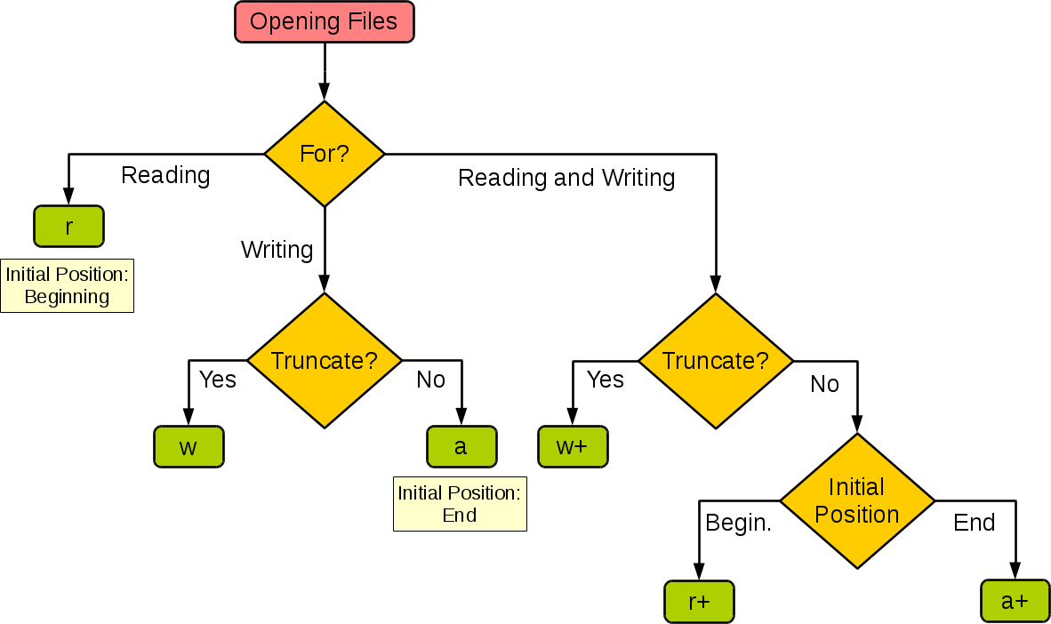
http://stackoverflow.com/questions/1466000/python-open-built-in-function-difference-between-modes-a-a-w-w-and-r

Slide 16
Python Basics: I/O (cont’d)
Many types of output:
print()
open(“filename”, “mode”)
file.write()
with open() as csvfile: …
csv.writerow()

Slide 17
“Homework”
Get Linux and Python running!
Make a GitHub account and use it to fork our repository
Go through the Codecademy Python lesson
Play Vim Adventures or read Vim tutorials

