Slide 1
MANG6297 Advanced Time Series Modelling
Individual Coursework

Slide 2
Part 1: Final Coursework
Submission Due Date: 14 May 2021 (Before 4 PM)
Word Count: 3,000 (+/- 10%)
Do expect tables / graphs / diagrams in this assignment (Each tables / graphs / diagrams will count as 25 words)
Additional graphs and tables can be put in the appendix as well as the output from any statistical software you have used for the analysis.
You must be aware that only you share responsibility for any academic integrity breaches or other issues that may arise from your coursework submission.

Slide 3
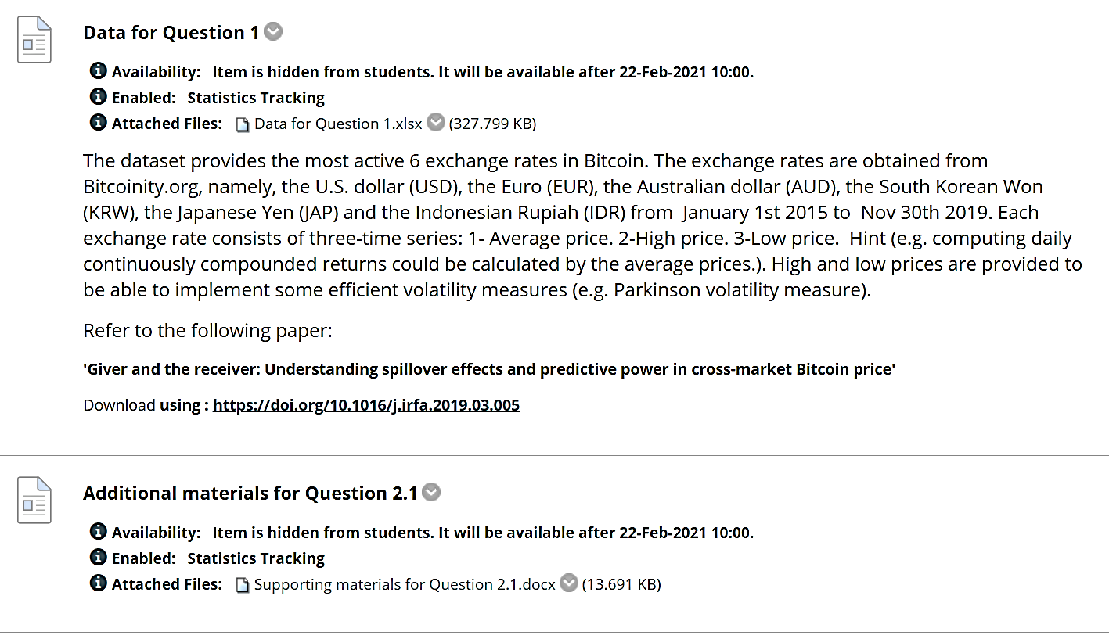

Slide 4
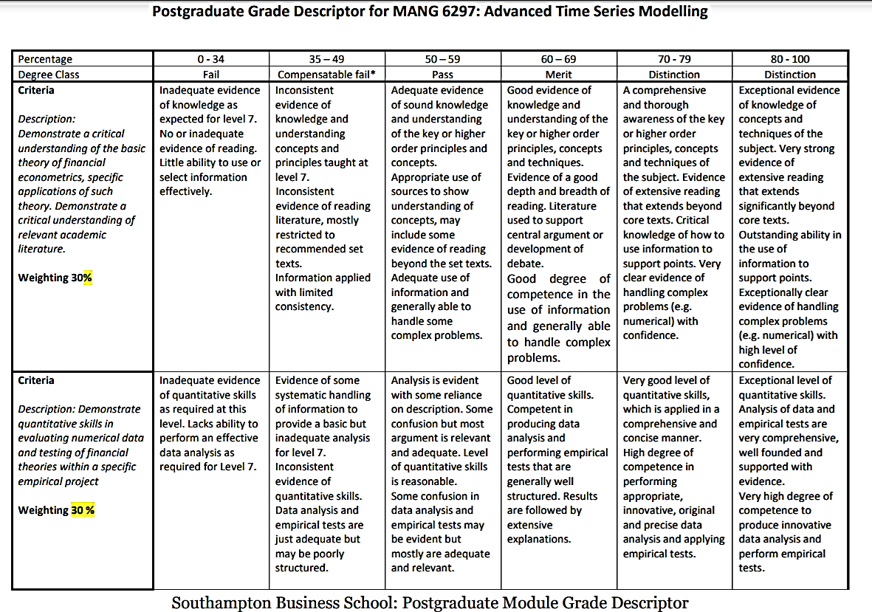
GRADE DESCRIPTOR – GUIDANCE OF WHAT WE EXPECT FROM YOU

Slide 5
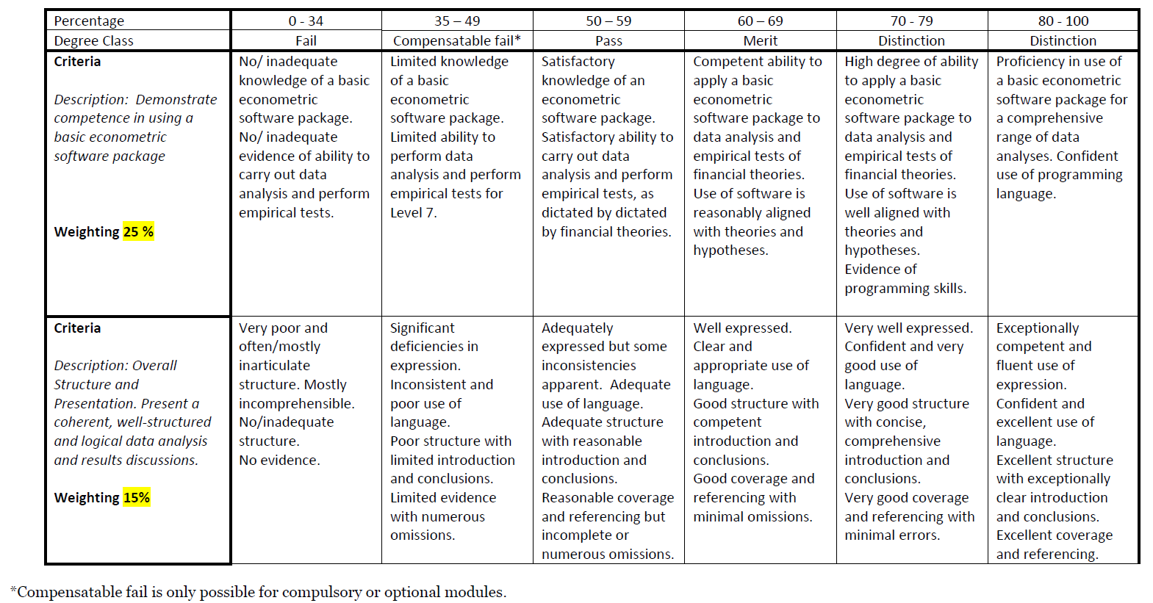
GRADE DESCRIPTOR – GUIDANCE OF WHAT WE EXPECT FROM YOU (Contd.)

Slide 6
Part 1: Final Coursework
In Question One, we have provided cross-market time series data for Bitcoin (one of the popular cryptocurrencies floating in the market). The Bitcoin is traded in various currencies, such as in Euros, USD, Korea, etc. The data have been collected from Coincheck (one of the platforms that provides aggregate price data for Bitcoin). In the Blackboard site of the course (see Assignment folder), we have included Bitcoin price data for six exchange markets (Europe, USA, Australia, Korea, Japan, Indonesia).
You can choose ANY file(s) depending on your interest. Eviews, Stata, R, Python or other any econometric software may be used for empirical estimation purpose.
(For the fist three sub-questions, you only need to choose one of the Bitcoin prices out of the six currency markets to do your analysis, while for the fourth sub-question you will need to choose three of them to do your analysis. )

Slide 7
Part 1: Final Coursework- Tasks for Question One
(1)By plotting the selected Bitcoin price series, explain if you find any ‘trend’ in the price behaviour. Use Hodrick-Prescott (H-P) Filtering Technique and Hamilton Filtering Techniques respectively to extract the 'cycles' from the 'trends'. Plot the Autocorrelation Function and comment on the persistence behaviour of the series.
(2)Test for (non-)stationarity in the selected series by using Augmented Dickey-Fuller, Phillips-Perron, and KPSS tests. Use options of intercept with and without trend term to compare your results. What implications do the ‘presence or absence of a unit root’ imply for the selected Bitcoin price regarding ‘weak, strong, semi-strong efficiency’ of the Bitcoin market?

Slide 8
Part 1: Final Coursework- Tasks for Question One
(3)Assume that the Bitcoin series you selected is neither I(1) nor I(0). Then what would an I(d) with 0<d<1 assumption imply for the Bitcoin market with respect to Efficient Market Hypothesis?
(4)Use any THREE Bitcoin prices from the list and find if there is any error-correction mechanism at work among them. Describe in detail, with regard to these specific selected series, a 3-variables cointegration and Vector Error Correction system.

Slide 9
Part 1: Final Coursework- Tasks for Question Two
Your task is to test a hypothesis (see topics below). You need to discuss the following steps:
(1) Data collection (e.g. method of sampling, data sources, selection criteria);
(2) Definition of variables (e.g. control variables);
(3) Model specification (e.g. Unit root, Cointegration framework; ARCH/GARCH models);
(4) Interpretation of findings and conclusion.

Slide 10
Part 1: Final Coursework- Tasks for Question Two
To illustrate your empirical findings, you are expected to use tables and figures.
Recommended data sources: Datastream, Bankscope, FAME, Yahoo Finance

Slide 11
Part 1: Final Coursework- Tasks for Question Two
Topic One
Economic policy uncertainty is known to exert a statistically significant and negative impact on bond yields. This is consistent with the theory that investors tend to increase their demands in bonds during periods of higher economic or government policy uncertainty and thereby increasing bond prices and reducing their yields.

Slide 12
Part 1: Final Coursework- Tasks for Question Two
HINT: You can examine the relationship between Economic Policy Uncertainty (EPU) of a country (see data here: https://www.policyuncertainty.com/) on future bond excess return across maturities and holding periods for the chosen markets.
You can collect bond data from the database of the US Treasury for the US data and the Bank of England for the UK data, for instance. The data of US government bonds are updated daily at website: https://www.treasury.gov/resource-center/data-chart-center/interest-rates.
The data of UK government bonds are daily updated at website: https://www.bankofengland.co.uk/statistics/yield-curves.

Slide 13
Part 1: Final Coursework- Tasks for Question Two
Topic Two
Test the following hypothesis: “(Regional) housing prices depict strong spillover effects”
HINT: You can calculate volatility in housing prices (within a country across regions or if you want across countries within a common economic union, such as Europe Economic Union). Try to use different types of GARCH models to estimate spillover effects (read literature).

Slide 14
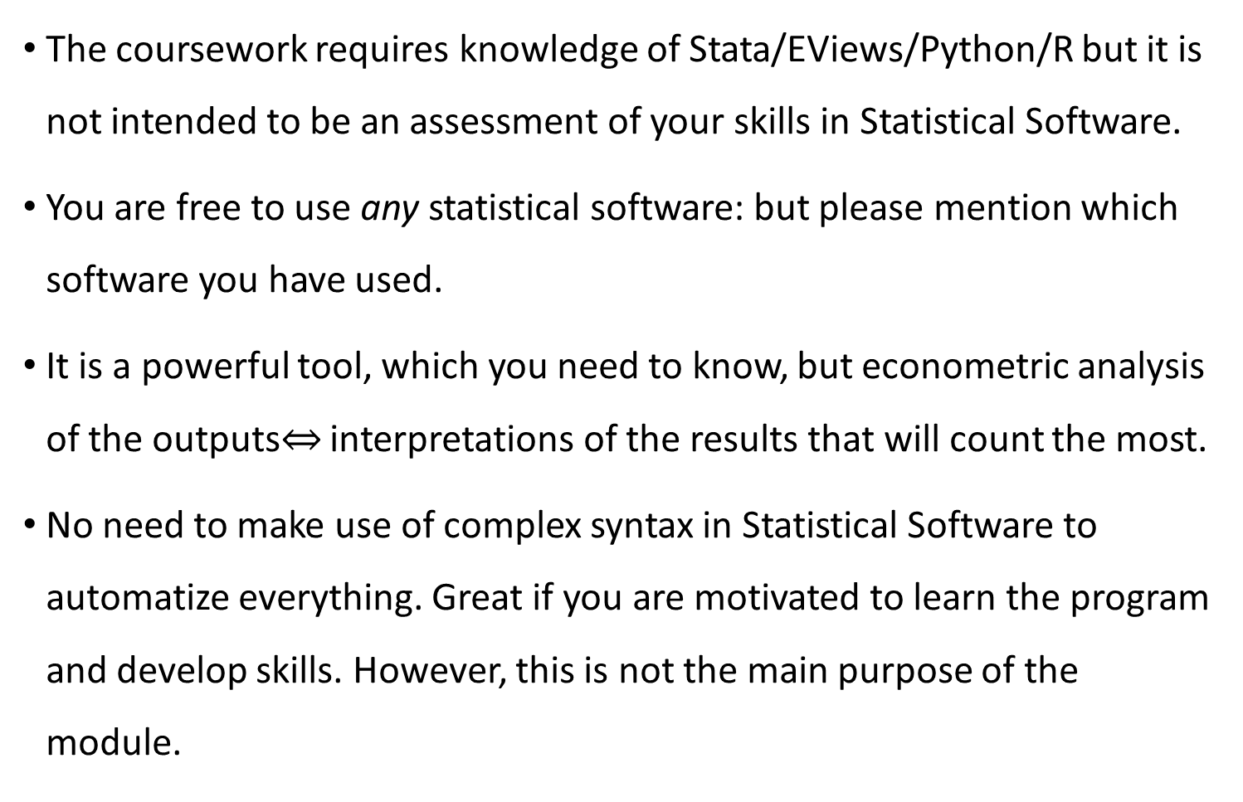
ASSESSMENT – The Use of Software
The coursework requires knowledge of Stata/EViews/Python/R but it is not intended to be an assessment of your skills in Statistical Software.
You are free to use any statistical software: but please mention which software you have used.
It is a powerful tool, which you need to know, but econometric analysis of the outputs$⇔$ interpretations of the results that will count the most.
No need to make use of complex syntax in Statistical Software to automatize everything. Great if you are motivated to learn the program and develop skills. However, this is not the main purpose of the module.

Slide 15
ASSESSMENT – the use of Software
Do not copy and paste output from the Statistical Software. Showcase your presentation skills!
In lecture notes, we often put screenshots of Stata output directly; however, this is for you to learn how to use it. You need to elaborate your narrative.
You can include Software code and/or output in the appendix. This is good practice.
Look at academic papers. They will show you good presentation of results.

Slide 16
ASSESSMENT – SUBMISSION
You can only submit one document.
The best would be a Word document so we can use track changes. If you include a pdf document or other format, I may not be able to add comments.
You can include any supporting documentation as an appendix to the end. The grading will be based on the main text of the document. However, an appendix can be useful if I do not understand some part of your work so I can check.

