Slide 1

COMP3217: Security of Cyber-Physical Systems
Coursework 2
Professor Shiyan Hu
School of Electronics and Computer Science
University of Southampton
1

Slide 2
Description
Option A: the purpose of this coursework is to understand the linear programming based energy scheduling for smart home cyber-physical system, understand the interdependence between the pricing information and the energy load scheduling, develop detection techniques for pricing attacks, and get familiar with some cyber-physical system security programming skills
2

Slide 3
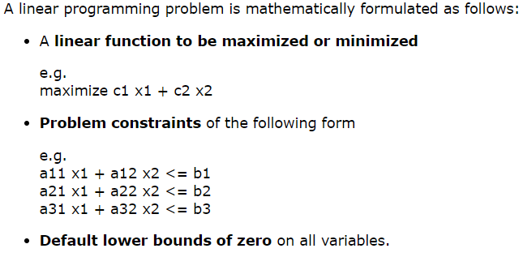
What is Linear Programming (LP)?
http://web.mit.edu/lpsolve_v5525/doc/LPBasics.htm7
3

Slide 4
Install LPSolve
Download LPSolve IDE at https://lpsolve-ide.software.informer.com/5.5/
More information:
http://web.mit.edu/lpsolve/doc/index.htm
http://lpsolve.sourceforge.net/5.5/IDE.htm
Read help to get more information how to use it
Windows standalone version
https://sourceforge.net/projects/lpsolve/files/lpsolve/5.5.2.0/lp_solve_5.5.2.0_dev_win64.zip/download
4

Slide 5
A Simple Example
/* Objective function */
max: 143 x + 60 y;
120 x + 210 y <= 15000;
110 x + 30 y <= 4000;
x + y <= 75;
/* Variable bounds */
COMP3217-example1.lp
5

Slide 6
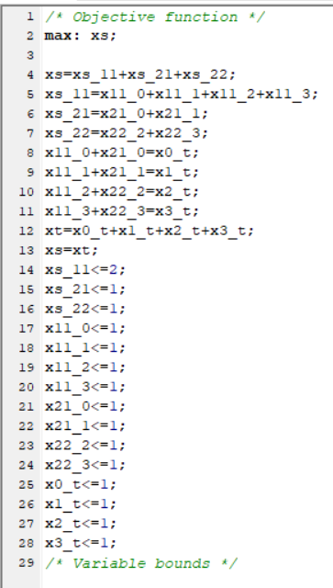
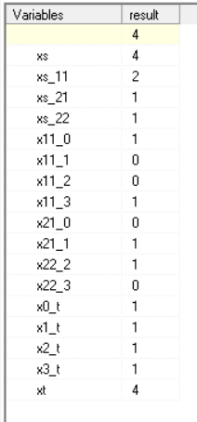
Example (COMP3217-example2.lp)
6

Slide 7
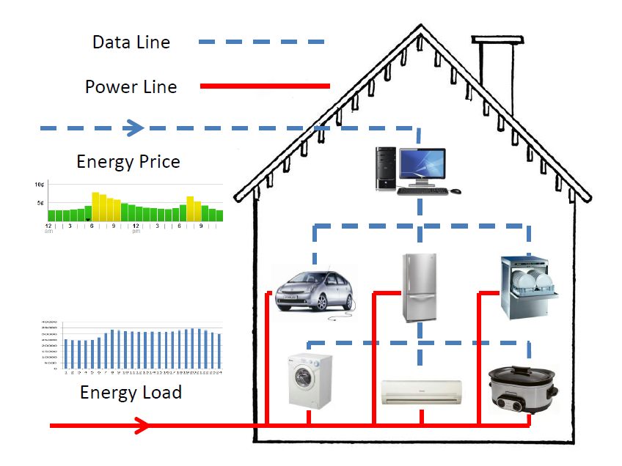
Energy Scheduling for a Single Smart Home
Given the predictive guideline electricity pricing, to decide
when to launch a home appliance
at what power level
for how long
utilize renewable energy
subject to scheduling constraints
Targets
Reduce user bill
Reduce PAR (peak to average ratio) of grid energy usage
Maximize renewable energy usage
7

Slide 8
Simplified Energy Scheduling
Assume that power level is continuous
Assume that there is no uncertainty in power load and supply
Given the predictive guideline electricity pricing, to decide
when to launch a home appliance
at what power level
for how long
subject to scheduling constraints
Targets
Reduce user bill
8

Slide 9
Map Scheduling Problem to LP
Consider a task set {T1,T2} to be scheduled in a time horizon of 24 hours.
A task is characterized by the ready time, deadline, maximum schedulable energy per hour (kWh), and energy demand (kWh).
T1=(17,19,2,3)
T2=(16,20,3,9)
0<=x1_17<=2;
0<=x1_18<=2;
0<=x1_19<=2;
0<=x2_16<=3;
0<=x2_17<=3;
0<=x2_18<=3;
0<=x2_19<=3;
0<=x2_20<=3;
x1_0, x1_1,… x1_16, x1_20,…x1_23=0;
x2_0, x2_1,… x2_15, x2_21,…x2_23=0;
9

Slide 10
Map Scheduling Problem to LP
Consider a task set {T1,T2} to be scheduled in a time horizon of 24 hours.
A task is characterized by the ready time, deadline, maximum schedulable energy per hour (kWh), and energy demand (kWh).
T1=(17,19,2,3)
T2=(16,20,3,9)
x1_17+x1_18+x1_19=3;
x2_16+x2_17+x2_18+x2_19+x2_20=9;
10

Slide 11
Cost Efficient Scheduling
According to the guideline price model, there is a unit cost for executing a task at a time interval. For example, the unit cost for 0,1,2,…,23 hours could be 5,6,7,…,28 cents/kWh, respectively. What is the minimum cost scheduling solution for this task set without any deadline miss?
Need to minimize the total cost c
c=21*x2_16+22*(x1_17+x2_17)+23*(x1_18+x2_18)+24*(x1_19+x2_19)+25*x2_20
11

Slide 12
Complete Cost Efficient LP Scheduling Formulation
minimize 21*x2_16+22*(x1_17+x2_17)+23*(x1_18+x2_18)+24*(x1_19+x2_19)+25*x2_20
s.t.
x1_17+x1_18+x1_19=3;
x2_16+x2_17+x2_18+x2_19+x2_20=9;
0<=x1_17<=2;
0<=x1_18<=2;
0<=x1_19<=2;
0<=x2_16<=3;
0<=x2_17<=3;
0<=x2_18<=3;
0<=x2_19<=3;
0<=x2_20<=3;
12

Slide 13
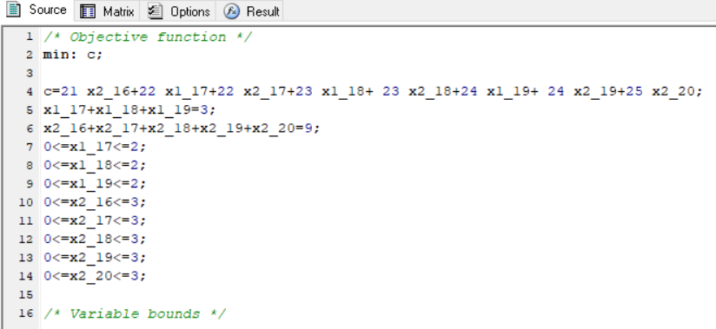
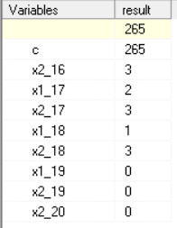
Example (COMP3217-example3.lp)
13

Slide 14
Exercise 1
A task T is characterized by T=(the ready time, deadline, maximum schedulable energy per hour, and energy demand). Given the task set {T1=(0,5,1,4), T2=(1,4,2,5)}, assume that the unit cost is {1, 2, 4, 8, 16, 32, …} cents/kWh for 0am,1am, 2am,…, respectively. What is the minimum cost energy scheduling solution for this task set without any deadline miss?
14

Slide 15
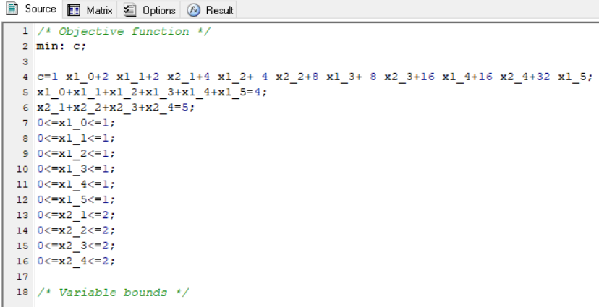
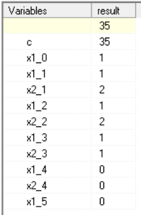
Exercise 1 Solution (COMP3217-example4.lp)
15

Slide 16
Multiple Users
Energy scheduling for multiple users is performed such that each user is assumed to be independent of any other user, i.e., no game theory is considered
16

Slide 17
Exercise 2
Consider 5 users where each user has 10 tasks. These task sets are given in the coursework wiki (“User & Task ID” in COMP3217CW2Input.xlsx). According to a normal pricing curve given in “NormalGuidelinePricing” in COMP3217CW2Input.xlsx, schedule these 5 task sets and plot the resulting energy scheduling solutions.
17

Slide 18
Scheduling according to an attacked pricing curve
An attacked pricing curve is also given in the course wiki (“AbnormalGuidelinePricing” in COMP3217CW2Input.xlsx), what is the resulting scheduling solution?
18

Slide 19
Coursework 2
Option A: Detection of Manipulated Pricing in Smart Energy CPS Scheduling
Option B: Zero Trust Architecture for Cyber-Physical Power System
19

