Slide 1
Simulation Basics
What ‘s in a simulation program?
simulated time: internal (to simulation program) variable that keeps track of simulated time
system “state”: variables maintained by simulation program define system “state”
  e.g., may track number (possibly order) of packets in queue, current value of retransmission timer
events: points in time when system changes state
  each event has associated event time
    e.g., arrival of packet to queue, departure from queue
    precisely at these points in time that simulation must take action (change state and may cause new future events)
  model for time between events (probabilistic) caused by external environment

Slide 2
Discrete Event Simulation
simulation program maintains and updates list of future events: event list
simulator structure:
initialize event list
get next (nearest future)
event from event list
Need:
well defined set of events
for each event: simulated system action, updating of event list
time = event time
process event
(change state values, add/delete
future events from event list
update statistics
n
done?
y

Slide 3
Simulation: example
packets arrive (avg. interrarrival time: 1/ λ) to router (avg. execution time 1/μ) with two outgoing links
arriving packet joins link i with probability φ_{i}
λ
μ₁
μ₂
state of system: size of each queue
system events:
  job arrivals
  service time completions
define performance measure to be gathered

Slide 4
Simulation: example
λ
μ₁
μ₂
Simulator actions on arrival event
choose a link
  if link idle {place pkt in service, determine service time (random number drawn from service time distribution) add future event onto event list for pkt transfer completion, set number of pkts in queue to 1}
  if buffer full {increment # dropped packets, ignore arrival}
  else increment number in queue where queued
create event for next arrival (generate interarrival time) stick event on event list

Slide 5
Simulation: example
λ
μ₁
μ₂
Simulator actions on departure event
remove event, update simulation time, update performance statistics
decrement counter of number of pkts in queue
If (number of jobs in queue > 0) put next pkt into service – schedule completion event (generate service time for put)

Slide 6
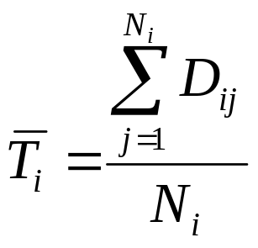

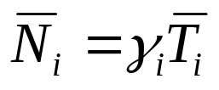
Gathering Performance Statistics
avg delay at queue i: record D_{ij} : delay of customer j at queue i. Let N_{i} be # customers passing through queue i
throughput at queue i, γ_{i} =
total simulated time
average queue length at i:
Little’s Law

Slide 7
Analyzing Output Results
Each time we run a simulation, (using different random number streams), we will get different output results!
distribution of random numbers
to be used during simulation
(interarrival, service times)
input
simulation
output
random number sequence 1
output results 1
input
simulation
output
random number sequence 2
output results 2
… …
… …
… …
input
simulation
output
random number sequence M
output results M

Slide 8
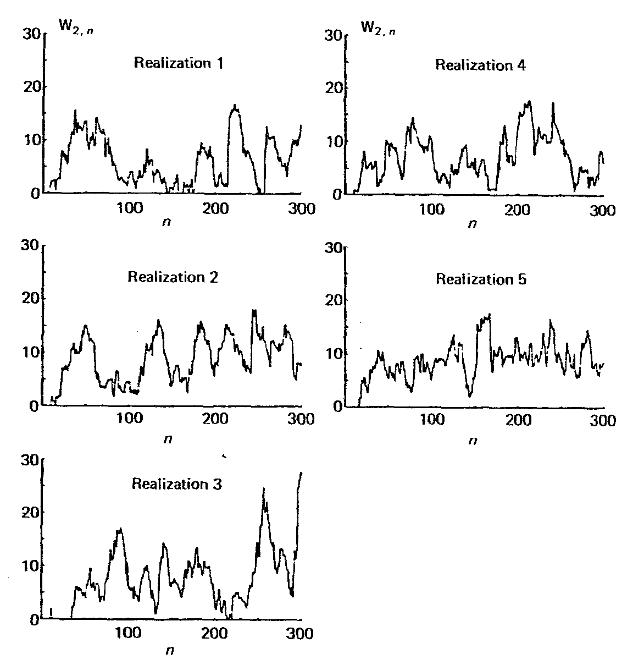
Analyzing Output Results
λ
μ₁
μ₂
W_{2,n}: delay of nth departing customer from queue 2

Slide 9
Analyzing Output Results
λ
μ₁
μ₂
each run shows variation in customer delay
one run different from next
statistical characterization of delay must be made
  expected delay of n-th customer
  behavior as n approaches infinity
  average of n customers

Slide 10
Transient Behavior
simulation outputs that depend on initial condition (i.e., output value changes when initial conditions change) are called transient characteristics
  “early” part of simulation
  later part of simulation less dependent on initial conditions
λ
μ₁
μ₂

Slide 11
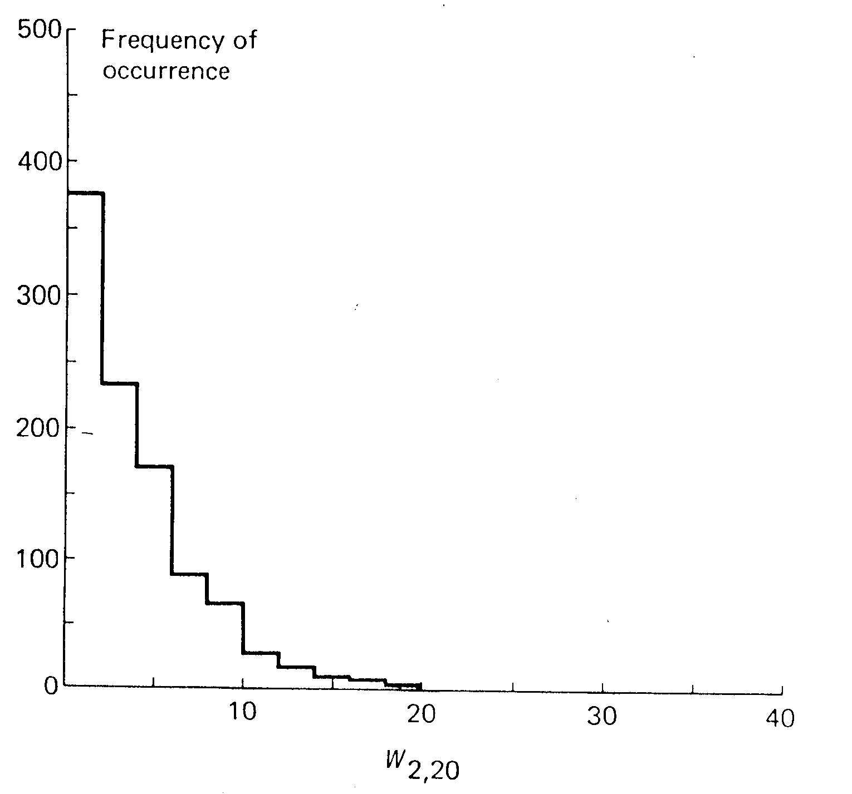
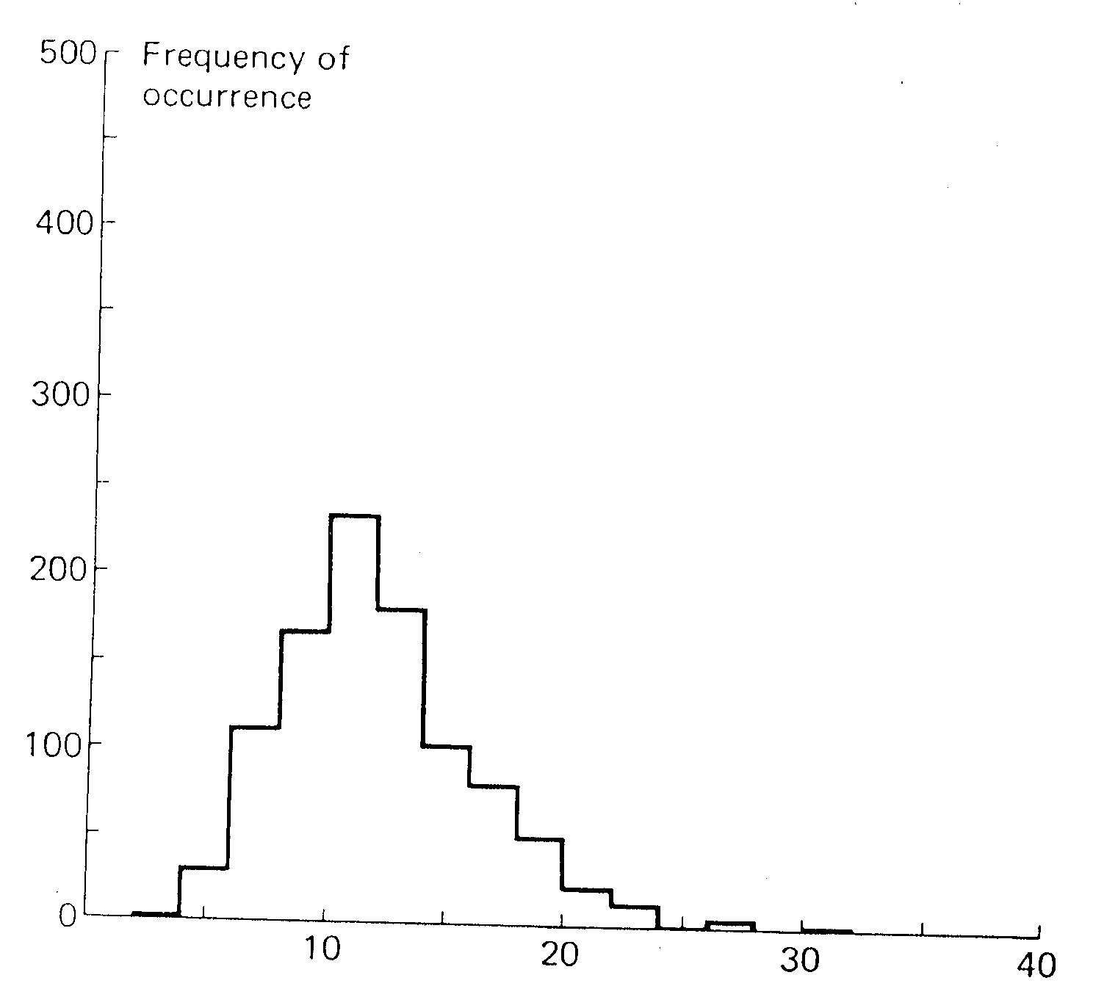
Effect of initial conditions
histogram of delay of 20th customer, given initially empty (1000 runs)
histogram of delay of 20th customer, given non-empty conditions (1000 runs)

Slide 12
Simulation: example
packets arrive (avg. interrarrival time: 1/ λ) to router (avg. execution time 1/μ) with two outgoing links
arriving packet joins link i with probability φ_{i}
λ
μ₁
μ₂

Slide 13
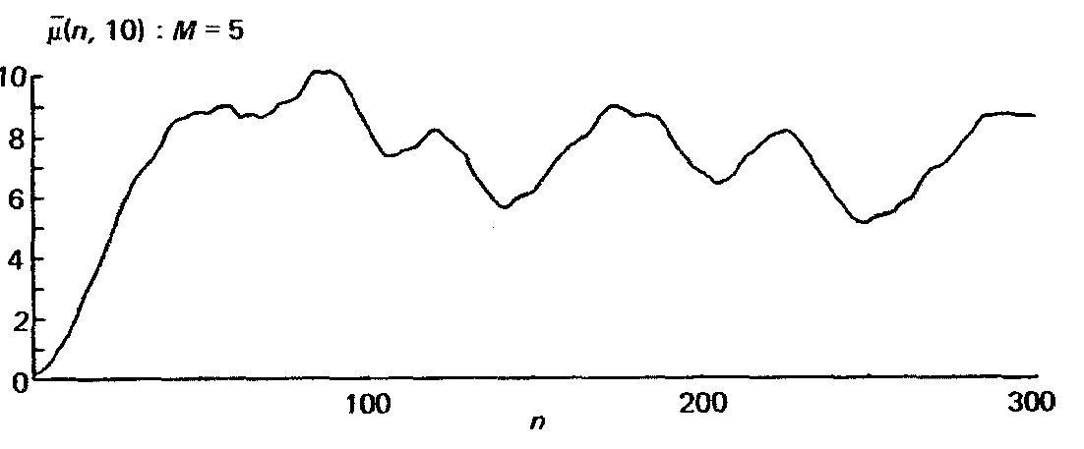
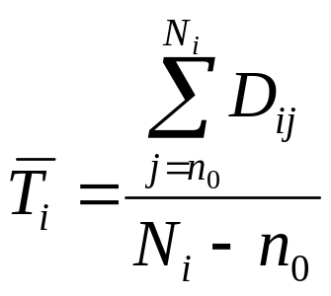
Steady state behavior
output results may converge to limiting “steady state” value if simulation run “long enough”
avg delay
of packets
[n, n+10]
avg of 5 simulations
discard statistics gathered during transient phase, e.g., ignore first n₀ measurements of delay at queue 2
pick n₀ so statistic is “approximately the same” for different random number streams and remains same as n increases

Slide 14
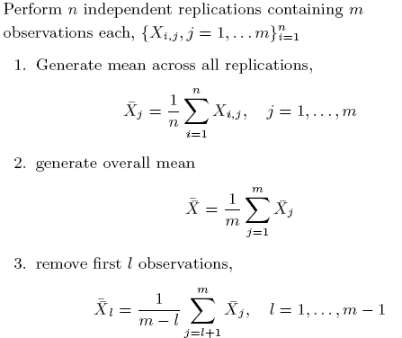

Slide 15
