Slide 1
Network Fundamentals
Routing
overview
Switching

Slide 2
Network devices and collision/broadcast domains
Media and cabling
IP Addressing and subnetting
Routing and switching overview
Network Fundamentals
Routing
Switching

Slide 3
Routing
Network Fundamentals
Static
Dynamic
Routing
Distance Vector
Link State
RIP
EIGRP
OSPF
Switching
Classful
Classless/VLSM
RIP
IGRP
RIPv2
EIGRP
OSPF

Slide 4
Network Fundamentals
Routing
Switching
Switch concept
Spanning-tree protocol
Virtual LAN (and VTP)

Slide 5

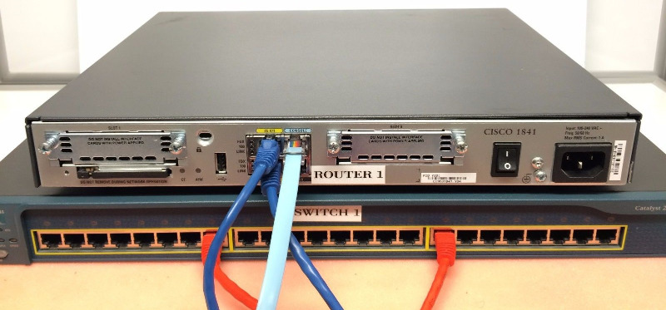
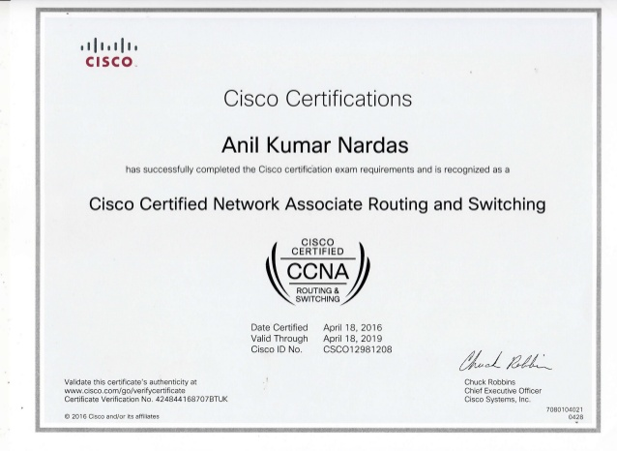
Theory
Hands-on lab
Professional cert
Network Fundamentals
Routing
Switching
Practice with real past test que
Question style
Pre-test Revision
Focuses
After-test review
Marking scheme
Before-exam remedial session
Solve your difficulty

