Slide 1
PG4200: Algorithms And Data Structures Lesson 01: Introduction
Dr. Andrea Arcuri

Slide 2
Contact
“Discussion Forum”
For announcements, and questions of general interest for the whole class
Use the discussion forum instead of sending me emails
If you send me a private email/message, I will tell you to post it on the Discussion Forum. However, if I am busy (as most of the time…), I might just ignore it…

Slide 3
Course Info
12 lessons, once a weak
Class 1-9: Foundation, algorithms and data structures that all of you will need to know if you are going to work as a developer
Class 10-12: Advanced, interesting and important topics, but that not all of you will need in your daily jobs
Check TimeEdit often to see if changes in schedule

Slide 4
Advanced
Foundation
Optimization Algorithms
Evolutionary Algorithms
Data Compression
Intro
Stack/Queue
Runtime analysis and Sorting
Advanced Sorting
Tree Maps
Hash Maps
Streams
Graphs
Regular Expressions

Slide 5
Class Structure
“Usually” 2+2
2-3 hours of lecture: code and slides
1-2 hours in which you should do exercises and get help
IMPORTANT: the 1-2 hours after lecture is not only for exercises. If you are falling behind, or you need some more revision, you can ask for my help on anything related to coding

Slide 6
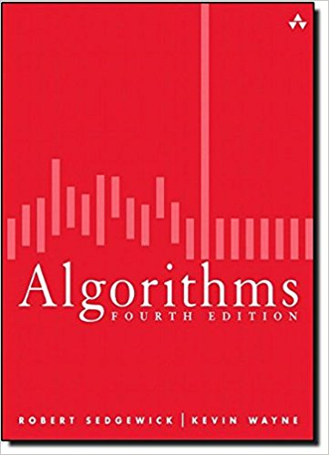
Course Material
Algorithms (4th Edition)
We actually use it in the course, so you should really try to get a copy

Slide 7
Git Repository
https://github.com/arcuri82/pg4200
Note: pull often, as new material and corrections can be added during the course
If you add code (eg working on exercises), recall to do a Git “rebase” or “stash” before pulling (which otherwise might fail)

Slide 8
Why Studying Algorithms?
Algorithms and data structures are the foundation of programming
ie, the base building blocks
Impact on all fields of engineering and science
internet, computer graphics, social networks, biology, physics, etc.

Slide 9
Like it or not…
… used in practically most programs you will write
… algorithms and data structures are very common exercises in job interviews
Especially for juniors straight out of university
Don’t be surprised to be asked to write a stack or a queue class on a whiteboard…
… or other advanced algorithms

Slide 10
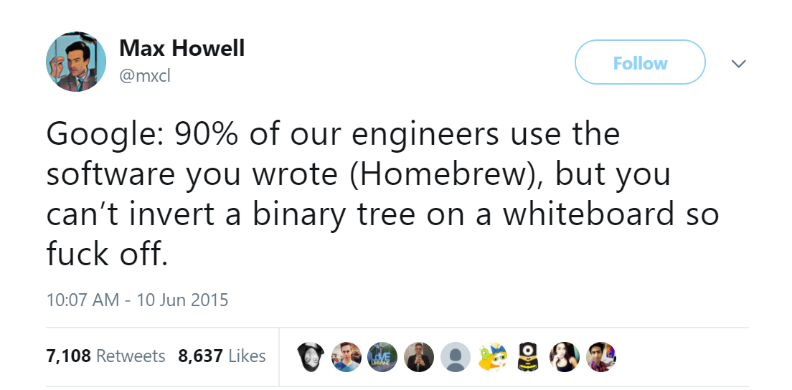

Slide 11
Math
(un)fortunately there is math involved…
Math: can tell you WHY a particular algorithm or data structure performs in a certain way
As an engineer, you need to make conscious decisions about what you use
I like math, but, in contrast to lecturers of previous years or in other universities, I put more emphasis on the programming side…

Slide 12
Coding
This course is heavily based on coding
There are going to be slides, but in class we will spend most of the time going through source code
Slides will often just be a quick overview of what we will cover in the code

Slide 13
Necessary Tools
Java 8 JDK
Git
IntelliJ Ultimate Edition
Maven

Slide 14
If You Skip Class…
Usually acceptable that a student skips 1-2 classes
You are supposed to attend, although no strict checks
If you skip too many classes, it is YOUR responsibility to catch up and find out what done in class
you are adults, after all…

Slide 15
Exams
3 hour written exam
Expect around 10 questions/exercises
1 per “Foundation” lesson (so 9), and 1 from the “Advanced” topics
Note: this might change in the actual exam
Expect theoretical questions and also the writing of code on paper (at least 1, but no more than 5)

Slide 16
Difficulty
This is a difficult course, more difficult than what you might be used to and expect
Not uncommon that more than 50% of students fail the exam
You need to study each week, and do all the exercises
Forget trying to learn it in just a couple of weeks/days before the exam…
I keep saying it every time, but students do not believe me, and then are surprised when they get an F…

Slide 17
Arrays and Lists

Slide 19
Unit Testing

Slide 21
For Next Week
Study Book Chapter TODO
Study code in the org.pg4200.les01 package
Do exercises in exercises/ex01
Extra: do exercises in the book

