Slide 1
PG4200: Algorithms And Data Structures Lesson 06: Hash Maps and Sets
Prof. Andrea Arcuri

Slide 2
Hash Function
A function that maps data from an arbitrary size to a specific size
eg, mapping strings to a int
h(x)=y , mapping from domain X to a value in domain Y
|X| is often much larger than |Y|
Note: in mathematics, given a set X, with |X| we represent its cardinality, ie the number of elements in it

Slide 3
Hash Properties
Deterministic: for a given input x’, should always get the same output y’
Uniform: mapping from X to Y should be ideally spread uniformly over Y,
ie the number of elements in X that map to a specific y’ should be close to |X|/|Y|
Performance: either fast (in this course) or slow (security, eg hashing of passwords)

Slide 4
Collisions
If |X| > |Y|, you cannot avoid h(x’)=h(x’’), two different values in X mapping to the same value in Y
Ideally, if uniform, no more than |X|/|Y| collisions per element
X
Y
“foo”
42
“bar”

Slide 5
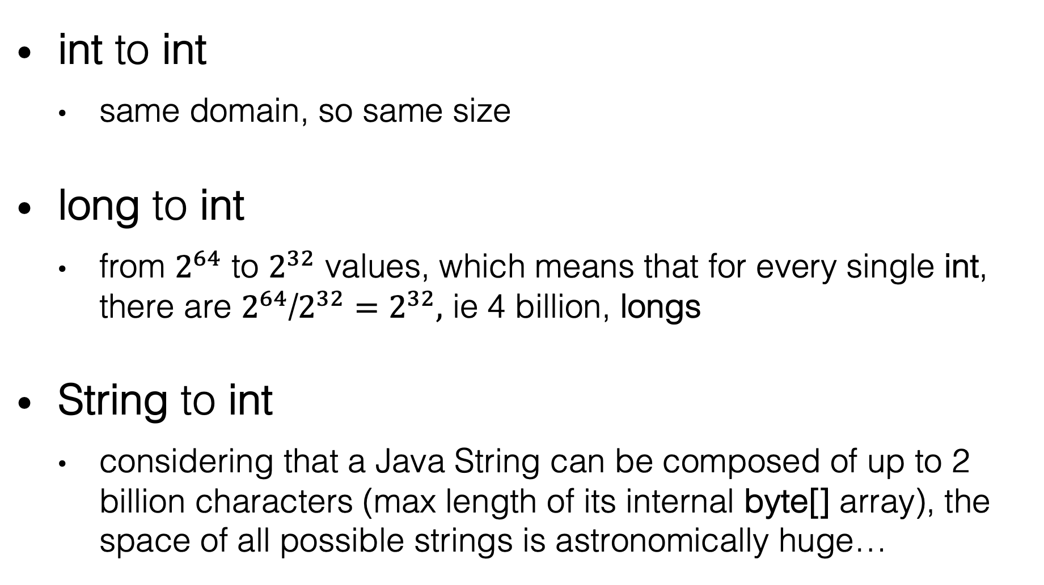
Hash Function Examples
int to int
same domain, so same size
long to int
from $2^{64}$ to $2^{32}$ values, which means that for every single int, there are $2^{64}$/$2^{32}=2^{32},$ ie 4 billion, longs
String to int
considering that a Java String can be composed of up to 2 billion characters (max length of its internal byte[] array), the space of all possible strings is astronomically huge…

Slide 6
public static int hash(int x) {
return 1; }

Slide 7
public static int hash(int x) {
return 1; }
Not particularly good…
It is in NOT uniform, as all values are mapped to the same value 1

Slide 8
public static int hash(int x) {
return x; }
So called identity function
Technically, it is a valid hash function (eg, deterministic and uniform)
Potential issue: trivial to revert, ie, knowing output, it is trivial to find the input
this would had be a huge problem if we were in the context of security, eg hashing of passwords, but not here in this course

Slide 9
public static int hash(int x) {
return x + 100; }
Still a valid hashing function
the addition overflow for high values is irrelevant here
But still trivial to revert, eg find input given output
As in this course we do not deal with security, we are mainly interested in hash functions from larger to smaller sets

Slide 10
public static int hash(long x) {
return (int) x; }
What does it mean to “cast” a long to a int?
long is 64 bits, whereas int is just 32
Somehow, here we lose information

Slide 11

L | L | L | L | L | L | L | L | R | R | R | R | R | R | R | R
R | R | R | R | R | R | R | R
Ignore first 32 bits in the long, and take last 32 to make an int out of them
WARNING: if the first bit in the right part is a 1, then the resulting int will be negative
as first bit in a int is used for the sign

Slide 12
L | L | L | L | L | L | L | L | R | R | R | R | R | R | R | R
R | R | R | R | R | R | R | R
Issue: any change in a long in its left part will end up in exactly the same hash value
What if we want to guarantee that a single bit change must result in a different hash?

Slide 13
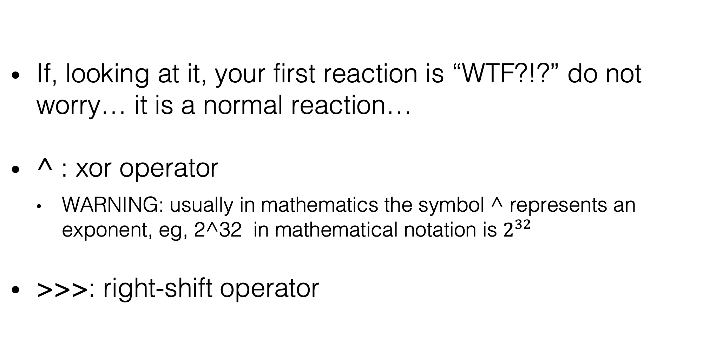
public static int hash(long x) {
return (int) (x ^ (x >>> 32)); }
If, looking at it, your first reaction is “WTF?!?” do not worry… it is a normal reaction…
^ : xor operator
WARNING: usually in mathematics the symbol ^ represents an exponent, eg, 2^32 in mathematical notation is $2^{32}$
>>>: right-shift operator

Slide 14
x >>> 32
L | L | L | L | L | L | L | L | R | R | R | R | R | R | R | R
0 | 0 | 0 | 0 | 0 | 0 | 0 | 0 | L | L | L | L | L | L | L | L
Move all bits to the right by 32 positions
On the left, empty positions will be filled with 0s
On the right, old elements are discarded
Note: there is a difference between “>>>” and “>>”
“>>>” ignores the sign, and always fill left part with 0s

Slide 15
(int) (x ^ (x >>>32))
Don’t care | R | R | R | R | R | R | R | R
Xor ^:
0 ^ 0 = 0
0 ^ 1 = 1
1 ^ 0 = 1
1 ^ 1 = 0
Changing any single bit in either the left or right part will guarantee that the resulting xor will be different
Note: changing more than 1 bit does not guarantee it… we are still going to have 4 billion collisions per int
Recall that with (int) we discard the left part of the resulting long value
XOR ^
Don’t care | L | L | L | L | L | L | L | L

Slide 16
public static int hash(String x) { int sum = 0; for (int i = 0; i < x.length(); i++) { sum += x.charAt(i); } return sum; }
A String could have any size…
actually bounded by its internal byte[] representation, where sizes of arrays are int, so at most 2GB of data
We can look at each char as 16-bit number, and sum all of them
don’t care of integer overflow

Slide 17
public static int hash(String x) { int sum = 0; for (int i = 0; i < x.length(); i++) { sum += x.charAt(i); } return sum; }
Problem: many small strings will end up with the same hash, especially permutations
eg, hash(“ab”) = hash(“ba”)
eg, hash(“B”) = hash(“!!”)
B has numeric code 66, whereas ! has code 33

Slide 18
public static int hash (String x) { final int delta = 31; int sum = 0; for (int i = 0; i < x.length(); i++) { sum = (delta * sum) + x.charAt(i); } return sum; }
Multiply by a constant at each character
We are still going to have collisions, but less between short strings using Latin letters (which are the ones we usually work with)

Slide 19
Hash Maps
Still a map from a K key to a V value
No requirement on ordering of K keys, just being able to compute an hash of it
In Java, all objects inherits from java.lang.Object, which defines a hashCode() method
Hash code used as an index for an internal array

Slide 20
Example
put(“foo”, v)
h(“foo”)=42
h(“foo”)%10 = 2
Benefit: operations (insert/search/etc) have cost due to hash independent of size N of the collection
Internal array buffer of size M=10
[2] = v

Slide 21
What About Collisions?
put(“foo”, v)
put(“bar”, z)
h(“foo”)=h(“bar”)
ie, collision due to same hash
h(“foo”)%10 = 2
What to do?
Internal array buffer of size M=10
v or z?

Slide 22
Different Strategies
put(“foo”, v)
put(“bar”, z)
h(“foo”)=h(“bar”)
ie, collision due to same hash
Use list at each position sharing same hash
Nodes containing keys and values
Internal array buffer of size M=10
“foo”
v
“bar”z

Slide 23
hashCode() computed on the keys to determine their bucket.
In this example, assuming “foo”.hashCode()==“bar”.hashCode(), because same bucket.
However, “foo”.equals(“bar”) is false
“foo”
v
“bar”z
Once the bucket is determined with hashCode(), we use equals() on the keys in the list (one at a time), to see if there is a match

Slide 24
java.lang.Object
Object does define two methods: hashCode() and equals()
Those methods will depend on the internal fields of the object
Important: if two objects are equals, then they MUST have same hash code
A.equals(B) implies A.hashCode()==B.hashCode()
The vice-versa is not necessarily true, ie A.hashCode()==B.hashCode() does not imply A.equals(B), although that could happen
What if constraint is not satisfied? Expect weird bugs when using maps and sets…

Slide 25
Cost
Worst case: O(N) if all elements end up in same “bucket” (ie same value for h()%M), the map would be equivalent to a list
operations to search on list would be O(N), albeit insert would be O(1)
But, if M large enough compared to N, and hash function is uniform enough, you can have a O(1) cost in many cases
even if you have some collisions, it will not be a problem, as you would have a small number of elements in the list

Slide 26
Hash or RBT?
Hash Maps is the most popular and widely used
If you know how much data you ll insert at most, can choose a good large enough M
So in most cases, we are in O(1) Hash vs O(log N) RBT
But Hash can be O(N) in worst case, vs RBT guarantees O(log N) in all cases
eg, in critical systems where you MUST guarantee a response within a certain amount of time, might want to use RBT
Hash does not need ordering of keys

Slide 27
Set
In mathematics, a set is a collection of elements where:
1) ordering is not important: ie {1,2,3} is equivalent to {2,3,1}
2) no repetitions: ie {1,2} is the same as {2,1,1,2,2,1,1,2,1}
How to implement a Set in Java?
Easy: use an internal Map<K,V> were your values in the set are the keys K, and you just ignore the values V

Slide 28
Keys and Immutability
Immutable Object: an object whose state cannot be changed once created
Example: Strings are immutable
eg, concatenation with + and methods like toUpperCase() and substring() do NOT change the String, but rather create a NEW one
Keys in a Map/Set MUST be immutable… why?

Slide 29
Different Hash
Foo foo = new Foo();
set.add(foo);
assertTrue(set.contains(foo));
// h(foo) = 42 , 42 % M = 2
foo.setSomeVariable(…);
// h(foo) = 55 , 55 % M = 5
assertFalse(set.contains(foo));
foo
miss

Slide 30
Using Maps and Sets
Should only use a Set for immutable types
What if you need a collection of mutable types <X>?
in most cases, creating a Set<X> would be wrong!
Option 1: rather use a list, eg List<X>
however, it would allow duplicates
Option 2: use a map Map<K,X> where the key is an immutable field derived from X
eg, if mutable User, map.put(user.getId(), user), where the id could be a String (recall strings are immutable)

Slide 31
Creating an Immutable Object
public class UserImmutable { private final String name; private final String surname; private final int id;
The first step is to make each field “final”
this means that they cannot be modified
This is enough for primitive values (eg, int and double) but not for objects!
those must be immutable as well!!!

Slide 32
“final” Limitation
final int[] foo = {1,2,3};
foo = {4,5}; // would not compile foo[0] = 42; // no problem!
A “final” reference cannot be modified, but you can modify the referenced state!
Note: no problem for “final String”, as String is immutable
So, if you have a mutable object M inside an immutable one X, must guarantee that no operation in X can change the state of M once initialized

Slide 33
Modifying an Immutable Object
public UserImmutable withName(String s){ return new UserImmutable(s, surname, id); }
Technically, you cannot modify an immutable object
However, can return a new instance with the modified state
Recall all methods in String return a new copy of the String, as String is immutable

Slide 34
Object Copy
When copying an object, it is a huge difference on whether its fields are mutable or immutable objects
Immutable: can just copy the reference, ie, actual objects can be shared
aka “shallow copy”
Mutable: must make a new complete copy, with new memory allocation on the heap
aka “deep copy”

Slide 35
Original
Copy
A (mutable)
new A (mutable)
B (mutable)
C (mutable)
new B (mutable)
new C (mutable)
D (immutable)
E (immutable)

Slide 36
Homework
Study Book Chapter 3.4 and 3.5
Study code in the org.pg4200.les06 package
Do exercises in exercises/ex06
Extra: do exercises in the book

