Slide 1
PG4200: Algorithms And Data Structures Lesson 02: Generics, Stacks and Queues
Dr. Andrea Arcuri

Slide 2
Generics

Slide 3
Data Types
In Java (and other statically typed languages) you need to declare the type of the variable
eg, “int x” or “String y”
In collections (arrays, lists, queues, stacks, etc.) you store data, but of which type?

Slide 4
Example
StringContainer: to store strings
IntegerContainer: to store integers
WebSocketContainer: to store web socket objects
SongContainer: to store song objects
ShopCartContainer: to store items in a shop cart
etc.
Do you see the problem here?

Slide 5
Polymorphism?
Issue: would need a different implementation for each container for each possible type class ever
What about using a ObjectContainer to store java.lang.Object instances?
In Java, all objects have Object class as ancestor, so could add any type due to polymorphism
e.g., can add String and Song in same ObjectContainer
Problem: yes, we can insert anything, but what would we read back is Object, and not String or Song

Slide 6
//Add: String “foo”, Integer 5
container.add(“foo”);
container.add(5);
ObjectContainer
add(Object x)
[0] | “foo”
[1] | 5
Object x = container.get(0);
//we do not know if String or
//something else

Slide 7
Java Generics <T>
List<T>: define a generic type, which can be substituted with any type
note: “T” is just a label, could be anything
Eg. List<String>, List<Integer>, List<Song>
If I am only storing a variable (e.g., in a class field or array), I do need to care of its type, as not going to call any method on it
eg, “T x = input;” do not need to care of actual type of T, as long as input is of that type

Slide 8
<T extends Foo>
In some cases you need Generics, but still need to call methods on it
With <T> you would only be allowed to call methods from java.lang.Objects
<T extends Foo> means any type that extends/implements the class/interface Foo
Note: there is also a <T super Foo>, but we will not need it

Slide 9
Stacks and Queues

Slide 10
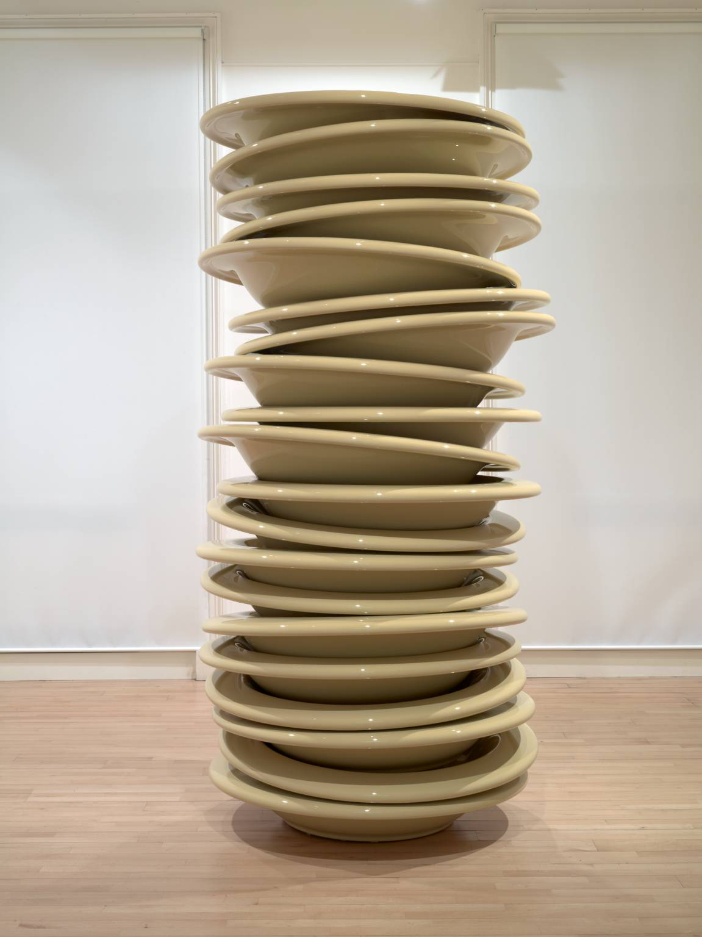
Stack
Type of collection
Add on top of the stack (push)
Remove from top (pop)
Can only read from top (peek)
LIFO: Last In, First Out

Slide 11
Why?
The type of operations are more restricted compared to other collections we saw so far
But if you are only interested in the operations of a stack, you can have specialized, high-performant implementations for it

Slide 12
Example
You need to work on some data X, so you push X on stack
While working with X, you need to work on some other Y (push Y), but, once done with it (pop), need to go back to X (peek)
While working on Y, might need to work on a Z (push Z), which itself might need to push more data on stack, etc.

Slide 13
Method Call Stack
For each method call, there is a frame, eg containing input parameters
At each call, the JVM needs to push frame, and pop it once method is completed
public class StackOverflow { public static void main(String[] args){ a(0); } public static int a(int x){ x++; x = b(x); return x; } public static int b(int y){ return a(y); } }

Slide 14
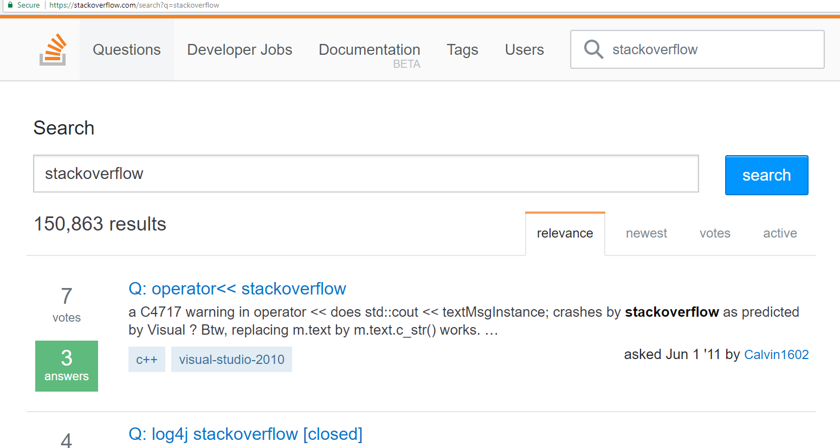
Stack Overflow
Exception in thread "main" java.lang.StackOverflowError at org.pg4200.datastructure.stack.StackOverflow.b(StackOverflow.java:22) at org.pg4200.datastructure.stack.StackOverflow.a(StackOverflow.java:16) at org.pg4200.datastructure.stack.StackOverflow.b(StackOverflow.java:22) at org.pg4200.datastructure.stack.StackOverflow.a(StackOverflow.java:16) at org.pg4200.datastructure.stack.StackOverflow.b(StackOverflow.java:22) at org.pg4200.datastructure.stack.StackOverflow.a(StackOverflow.java:16) at org.pg4200.datastructure.stack.StackOverflow.b(StackOverflow.java:22) at org.pg4200.datastructure.stack.StackOverflow.a(StackOverflow.java:16) at org.pg4200.datastructure.stack.StackOverflow.b(StackOverflow.java:22) at org.pg4200.datastructure.stack.StackOverflow.a(StackOverflow.java:16) at org.pg4200.datastructure.stack.StackOverflow.b(StackOverflow.java:22) at org.pg4200.datastructure.stack.StackOverflow.a(StackOverflow.java:16) at org.pg4200.datastructure.stack.StackOverflow.b(StackOverflow.java:22) at org.pg4200.datastructure.stack.StackOverflow.a(StackOverflow.java:16) at org.pg4200.datastructure.stack.StackOverflow.b(StackOverflow.java:22) at org.pg4200.datastructure.stack.StackOverflow.a(StackOverflow.java:16) ...

Slide 15

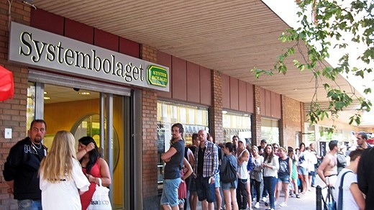
Queue
Type of collection
Add at the back, tail of the queue/line (enqueue)
Remove from the head of the line (dequeue)
FIFO: First In, First Out

Slide 16
Example: Task Scheduler
Process/thread add tasks to do on a queue
Other process/thread workers read from queue and execute the task
The oldest tasks need to be completed first
While workers are executing tasks, new tasks could be added to the queue

Slide 17
Memory Model

Slide 18
Questions
Node bar = new Node();
what is the variable “bar” concretely?
what does “new” actually do?
what is the difference between “bar” variable and the object created by “new Node()”?
bar.next = bar.next.next;
what is happening here?
are objects created or deleted?

Slide 19
Overview
Before we go into details of how to implement a Stack or a Queue, we need to have clear understanding of how memory is handled in Java
Pointers and memory are usually hard to understand… but critical, otherwise it will be nearly impossible to understand the data structures in this course
Should had been covered in the 1st year
so this is just a high level revision…

Slide 20
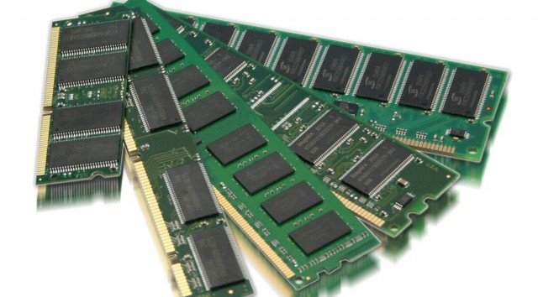
Very Simplified Model
A process will get allocated a certain amount of space on your RAM by the Operating System (OS)
eg, you have 16G on your laptop and process needs 1G
The process will use such memory to allocate variables and objects
How the process handles this memory should be independent from the other processes
Think of the memory like a big array, where process is allowed to write/read within a [i] – [j] range
Eg, if process got 1GB, it could use RAM from position 12G till 13G

Slide 21
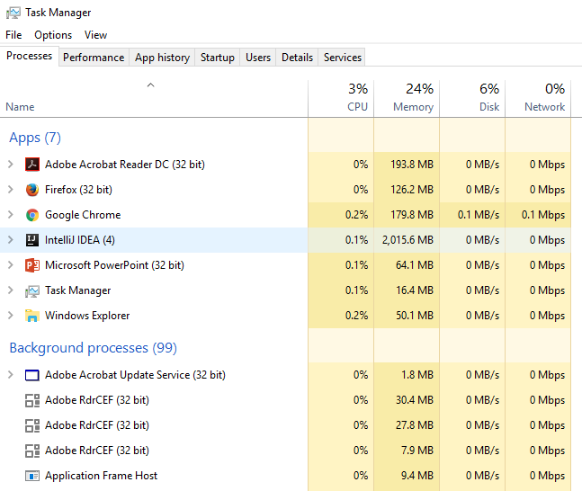

Slide 22
Java Memory
Static | Function Call Stacks | Memory Heap
At a very, very high level, the JVM divides its allocated memory in 3 main parts
Static: containing for example the bytecode to run
FCS: one stack per thread for the function calls
Heap: where objects are stored

Slide 23
Function Call Stack
When foo() is called, we need to store x and k somewhere in memory
When bar() is called, we need to store y and z, plus we should not lose x from foo()
Once bar() is terminated, we do not need y and z any more
public void foo(){
int x = 0;
int k = bar(x);
print(k);
}
private void bar(int y){
int z = y * y;
return z;
}

Slide 24
Function Call Frame
Create a frame for each function call
A frame stores all the input and all the local variables, eg., x, k, y and z
When we start a function call, we push its frame to the stack
Once function call ends, we pop its frame

Slide 25

Before bar() Is Called
public void foo(){
int x = 2;
int k = bar(x);
print(k);
}
private void bar(int y){
int z = y * y;
return z;
}
x = 2
k = ?
One frame on stack for the foo() call

Slide 26
Inside bar()
public void foo(){
int x = 2;
int k = bar(x);
print(k);
}
private void bar(int y){
int z = y * y;
return z;
}
y = 2
z = 4
x = 2
k = ?
Push new frame for bar(y)
Note that y is initialized with same value of x. Changing y does not affect x, as in different frames

Slide 27
Once bar() Is Completed
public void foo(){
int x = 2;
int k = bar(x);
print(k);
}
private void bar(int y){
int z = y * y;
return z;
}
x = 2
k = 4
Pop stack of bar(y), as no needed any more.

Slide 28
Actual Bytes In Memory
0
0
0
0
0
0
0
0
0
0
x = 2
k = 0
0
0
0
0
0
0
0
0
y = 2
z = 4
x = 2
k = 0
0
0
0
0
0
0
0
0
2
4
x = 2
k = 4
Consider each cell as contiguous 32 bits
When we pop frame, data is still actually there. Will be overwritten at next frame push

Slide 29
Performance Issue
When we call bar(x), the 32 bits of x are copied from current frame to the frame of bar() in the y variable
32 bits are OK, but what if we have large objects???
Passing by value is inefficient
public void foo(){
int x = 2;
int k = bar(x);
print(k);
}
private void bar(int y){
int z = y * y;
return z;
}

Slide 30
Pointers/References
Java does not allow you (yet) to have objects on the FCS
Only allowed primitive values (eg, int, double, boolean) and pointers
Note: other languages allows you objects on FCS, eg C++
To have objects, those will be allocated on the heap
The FCS will have pointers to the heap

Slide 31
Allocation on Heap
public void foo(
int a, boolean b,
char c, double d){
X x = new X(a,b,c,d);
int k = bar(x);
print(k);
}
private void bar(X y){
int z = y.compute();
return z;
}
The x variable is not going to contain the 4 inputs
These are stored in the heap
x is just a pointer to the location on the heap
Assume X has 4 private fields, initialized in constructor

Slide 32
public void foo(
int a, boolean b,
char c, double d){
X x = new X(a,b,c,d);
int k = bar(x);
print(k);
}
a | b | c | d | x | k | Remaining Space on FCS | Heap
FCS growing from left to right
Frame contains data for 4 inputs and 2 local variables
X is a 64 bit address in the memory, ie it is a number, like an index in an array

Slide 33
public void foo(
int a, boolean b,
char c, double d){
X x = new X(a,b,c,d);
int k = bar(x);
print(k);
}
a | b | c | d | x | k | Remaining Space on FCS | Heap | Data of x | Heap
0
10,000
74,321
The new keyword allocates memory in the heap for storing all the data of x
Can’t control where in heap data of x is allocated, but will be at some known position, eg 74321
When JVM calls new, it will choose a free area in the heap
The variable x in the FCS will contain the numeric address, eg 74321

Slide 34
public void foo(
int a, boolean b,
char c, double d){
X x = new X(a,b,c,d);
int k = bar(x);
print(k);
}
private void bar(X y){
int z = y.compute();
return z;
}
a | b | c | d | x | k | y | z | Remaining Space on FCS | Heap | Data of x | Heap
0
10,000
74,321
The frame pushed for bar(x) contains data for y and z
x in the frame of foo() has same value of y in frame of bar(), ie 74321
The “Data of x” has not be copied when calling bar(x), we just copied the reference, ie the address 74321

Slide 35
Linked List Example
Assume linked list based on nodes
List has an head
Each node has a next reference
public void foo(){
List list =
new LinkedList();
list.add(“a”);
list.add(“b”);
list.add(“c”);
}

Slide 36
public void foo(){
List list =
new LinkedList();
list.add(“a”);
list.add(“b”);
list.add(“c”);
}
The list reference on FCS will point to position where list object is, ie 120
The head in such data will contain the value 200, ie address of first element
The next fields contains address of next elements
list | Remaining FCS | Free Heap | Data of List, Eg, head | Free Heap | Node for “a”, eg next / value pointers | Node for “c”, eg next / value pointers | Free Heap | Node for “b”, eg next / value pointers | Free Heap
0
100
120
200
240
500

Slide 37
list = 120 | Remaining FCS | Free Heap | Data of List, head = 200 | Free Heap | Node for “a”, next = 500 | Node for “c”, next = null | Free Heap | Node for “b”, next = 240 | Free Heap
0
100
120
200
240
500
Delete node for “b” with: current.next = current.next.next
Where current is the node for “a”
list = 120 | Remaining FCS | Free Heap | Data of List, head = 200 | Free Heap | Node for “a”, next = 240 | Node for “c”, next = null | Free Heap | Node for “b”, next = 240 | Free Heap
0
100
120
200
240
500

Slide 38
list = 120 | Remaining FCS | Free Heap | Data of List, head = 200 | Free Heap | Node for “a”, next = 240 | Node for “c”, next = null | Free Heap | Node for “b”, next = 240 | Free Heap
0
100
120
200
240
500
540
Deleting “b” means it is not accessible any more starting from list pointer in the FCS
but it is still there in memory!!!
When calling new many times, might run out of free space
At that point, somehow we need to be able to reuse the space occupied by the “b” node, ie location 500-540

Slide 39
Garbage Collector (GC)
Called by JVM when run out of space on heap
Starting from the pointers on FCS, recursively find all reachable objects
Non-reachable objects (eg “b” node) will be marked as “Free Heap”, and their space can be reused by new operator when new instances are created
GC are quite complex, as need to be very efficient, because they block the entire code execution

Slide 40
Stack Implementations

Slide 42
Queue Implementations

Slide 44
Arrays or LinkedLists?

Slide 46
Homework
Study Book Chapter 1.3
Study code in the org.pg4200.les02 package
Do exercises in exercises/ex02
Extra: do exercises in the book

