Slide 1
PG4200: Algorithms And Data Structures Lesson 07: Iterators, Lambdas and Streams
Prof. Andrea Arcuri

Slide 2
Iterators

Slide 3
Iterating Over All Elements
Many situations in which you need to look at and process all elements in a collection
For lists and arrays, can look at indices from 0 to N-1
But what about maps and sets that are unordered?
or other kinds of data structures like graphs that we haven’t seen yet
Would like to write loops like “for(X x : collection){…}”

Slide 4
java.util.Iterator
public interface Iterator<E> { /** * Returns {@code true} if the iteration has more elements. * (In other words, returns {@code true} if {@link #next} would * return an element rather than throwing an exception.) * * @return {@code true} if the iteration has more elements */ boolean hasNext(); /** * Returns the next element in the iteration. * * @return the next element in the iteration * @throws NoSuchElementException if the iteration has no more elements */ E next();

Slide 5
java.lang.Iterable
public interface Iterable<T> { /** * Returns an iterator over elements of type {@code T}. * * @return an Iterator. */ Iterator<T> iterator();

Slide 6
Iterators
The idea is to make our collections to implement Iterable interface
Need to implement an iterator for each collection, which keeps track of one element at a time
Java compiler is aware of Iterable, and so can automatically handle “for(X x : collection){…}”
ie, do not need to call “hasNext()” and “next()” by yourself
but only as long as that collection does implement Iterable
Collection should not be changed (eg, add/remove) while iterating over them

Slide 7
Lambdas

Slide 8
Functions as Parameters
At times, you need to pass “code” as input parameter to another method
To do that, you need to create a class with a method implementing the code you need
Writing a whole class definition for just a single line of code is too much boilerplate

Slide 9
Interfaces in java.util.function.*
Runnable.run()
Nothing as input/output, just execute some code with side-effects
Consumer<T>.accept(T t)
take an instance of T as input, and do something with it, and return nothing
Predicate<T>.test(T t)
input T, and then return a boolean
Function<T,R>.apply(T t)
take T as input, and return something of type R
There are more, but those 4 are enough for what we need

Slide 10
Anonymous Classes
Because interfaces, need to create concrete instances with our implementations
If used only once, can create class on the fly
Note that Consumer is an interface with method accept()
Consumer<String> anonymousClass = new Consumer<String>() { @Override public void accept(String s) { //your code here } };

Slide 11
Lambdas
Anonymous classes work fine, but are tedious to write
Lambdas: syntax sugar to reduce boilerplate
Java compiler is aware of the interfaces in java.util.function.*
Consumer<String> lambda = s -> {/* your code */}
//this is equivalent to previous example

Slide 12
() -> {}
Left-side: the input parameter name(s), with () if none
can choose the names you want, but usually a single letter
Right-side: the instruction to execute. If more than one, should be in a {} block
Based on input/output types, the compiler will automatically create the right class, eg Runnable, Consumer, Predicate or Function

Slide 13
Streams

Slide 14
Iterators + Lambdas
When a container has an iterator, and once we can write custom code in lambda expressions, we can introduce the concept of Stream
The idea is that we can iterate over all elements in collection, and easily execute code in sequence on each of the elements
This can drastically reduce the amount of code you write, and easier to understand (once you get familiar with it)

Slide 15

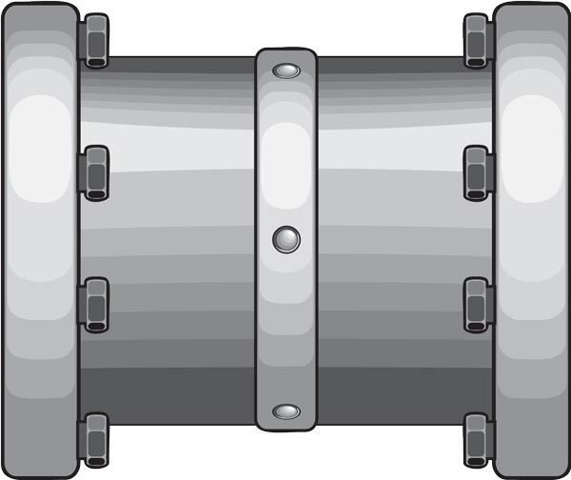
Stream / Pipeline
At each pipe, the elements can be transformed and/or blocked (ie not going to next pipe)
At the end of the stream, we need a collector, which defines what to do with elements that arrive at the end of the pipeline
Open Stream
Data
Structure
Collector
Pipe A
Pipe B
Pipe C

Slide 16
Type of Pipes
Filter: take as input a Predicate<T>, and based on that decide if elements propagate to next pipe
Map: transform input, and also change type, based on a Function<T,R>
FlatMap: get a stream from input element, and flatten it into the current stream (examples later)
There are more, but these are the main ones we will see in details

Slide 17
Filter
“a”
“foo”
“hello”
“bar”
Collector
String
String
Example: collection.stream().filter(s -> s.length() > 3)
Input/Output: String, does not change
Blocked: “a”, “foo”, “bar”
Allowed: “hello”
Collector will only get “hello”

Slide 18
Map
“a”
“foo”
“hello”
“bar”
Collector
String
Integer
Example: collection.stream().map(s -> s.length())
Input String, Output Integer
Note: compiler automatically infer type “Integer” based on the type returned by the function “String.length()”
Collector will receive: 1, 3, 5, 3

Slide 19
Combining Pipes
“a”
“foo”
“hello”
“bar”
Collector
String
String
Integer
Example: .filter(s -> s.length() > 2).map(s -> s.length())
“a” is the only blocked element by the filter
Collector will receive: 3, 5, 3

Slide 20
FlatMap
[1,2]
[3]
[4,5,6]
Collector
List<Integer>
Integer
Example: collection.stream().flatMap(l -> l.stream())
Input List<Integer>, Output Integer
On each of the 3 input lists we open a stream, and propagate its output, one element at a time
Collector will receive: 1, 2, 3, 4, 5, 6 and NOT [1,2], [3], [4,5,6]
So the values of the 3 lists are flattened into a single stream of integers, including all values in those lists

Slide 21
Collectors
collectToList(): each element that arrives at the end of the pipeline will be added to a new List container
forEach(Consumer<X> action): for each element that arrives at the end of the pipeline, execute the action specified by the user, which takes as input type X being the output of the last pipe in the pipeline
There are more, but these are the main ones we will see in details

Slide 22
Implementation
The collector is the one that starts pulling data from the collection using its iterator
At each step, the output of a pipe is going to be the input to the next pipe
Going to represent it with a chain of Consumers

Slide 23
Pipe A
Pipe B
Data T
Collector
T
OUT_A
OUT_B
IN_A is T, and IN_B is OUT_A
Collector has a Consumer<OUT_B>, as it consumes data from Pipe B
Pipe B has a Consumer<OUT_A>, which will call Consumer<OUT_B> in Collector (ie, chained)
Pipe A has a Consumer<T>, which will call Consumer<OUT_A> of Pipe B (ie, chained)

Slide 24
Collector Call
Get iterator from collection of type T
On each element of type T, call consumer of the first pipe
The collector is what starts the stream by pulling data
The consumer of the first pipe is called, and that will trigger a chain until the last consumer
However, the collector itself has to define a Consumer for the last pipe
Pipe A: Consumer<T>
Compute output of type OUT_A
Call consumer of Pipe B with such output
Pipe B: Consumer<OUT_A>
Compute output of type OUT_B
Call consumer of Collector with such output
Collector: Consumer<OUT_B>
Do its computation
End of the chain

Slide 25
Pipe A
Pipe B
Pipe C
T
OUT_A
OUT_B
OUT_C
//Pipe A
Consumer<T>.accept(T in){
… //process in, compute out
pipeB.accept(out)
}
// Pipe B
Consumer<OUT_A>.accept(OUT_A in){
… //process in, compute out
pipeC.accept(out)
}
Each Pipe has a Consumer<IN>, and also a downstream reference to the Consumer<OUT> in the next pipe

Slide 26
Homework
No Book Chapter
Study code in the org.pg4200.les07 package
Do exercises in exercises/ex07

