Slide 1
PG4200: Algorithms And Data Structures Lesson 02: Generics, Stacks and Queues
Prof. Andrea Arcuri

Slide 2
Generics

Slide 3
Data Types
In Java (and other statically typed languages) you need to declare the type of the variable
eg, “int x” or “String y”
In collections (arrays, lists, queues, stacks, etc.) you store data, but of which type?

Slide 4
Example
StringContainer: to store strings
IntegerContainer: to store integers
WebSocketContainer: to store web socket objects
SongContainer: to store song objects
ShopCartContainer: to store items in a shop cart
etc.
Do you see the problem here?

Slide 5
Polymorphism?
Issue: would need a different implementation for each container for each possible type class ever
What about using a ObjectContainer to store java.lang.Object instances?
In Java, all objects have Object class as ancestor, so could add any type due to polymorphism
e.g., can add String and Song in same ObjectContainer
Problem: yes, we can insert anything, but what would we read back is Object, and not String or Song

Slide 6
//Add: String “foo”, Integer 5
container.add(“foo”);
container.add(5);
ObjectContainer
add(Object x)
[0] | “foo”
[1] | 5
Object x = container.get(0);
//we do not know if String or
//something else

Slide 7
Java Generics <T>
List<T>: define a generic type, which can be substituted with any type
note: “T” is just a label, could be anything
Eg. List<String>, List<Integer>, List<Song>
If I am only storing a variable (e.g., in a class field or array), I do need to care of its type, as not going to call any method on it
eg, “T x = input;” do not need to care of actual type of T, as long as input is of that type

Slide 8
<T extends Foo>
In some cases you need Generics, but still need to call methods on it
With <T> you would only be allowed to call methods from java.lang.Objects
<T extends Foo> means any type that extends/implements the class/interface Foo
Note: there is also a <T super Foo>, but we will not need it

Slide 9
Primitive Types
Given a generic List<T>, then we cannot instantiate with int, eg, List<int> does not compile
int is a primitive type, and NOT an object extending java.lang.Object
others: double, float, long, char, boolean, etc.
For each primitive type, Java provides an object wrapper, eg Integer for int
so can have List<Integer>
Being an object, it can be null
eg, Integer i = null;

Slide 10
Autoboxing and Unboxing
Integer i = 5;
better than writing: Integer i = new Integer(5);
Other example: Character c = ‘a’;
Autoboxing: Java compiler can automatically box a primitive into a wrapper object
eg, primitive 5 into object of type Integer
Unboxing: automatically from wrapper to primitive
eg, int k = i;
It is not for free, so usually better to use primitives in your code, unless dealing with collections or nullable values

Slide 11
Stacks and Queues

Slide 12
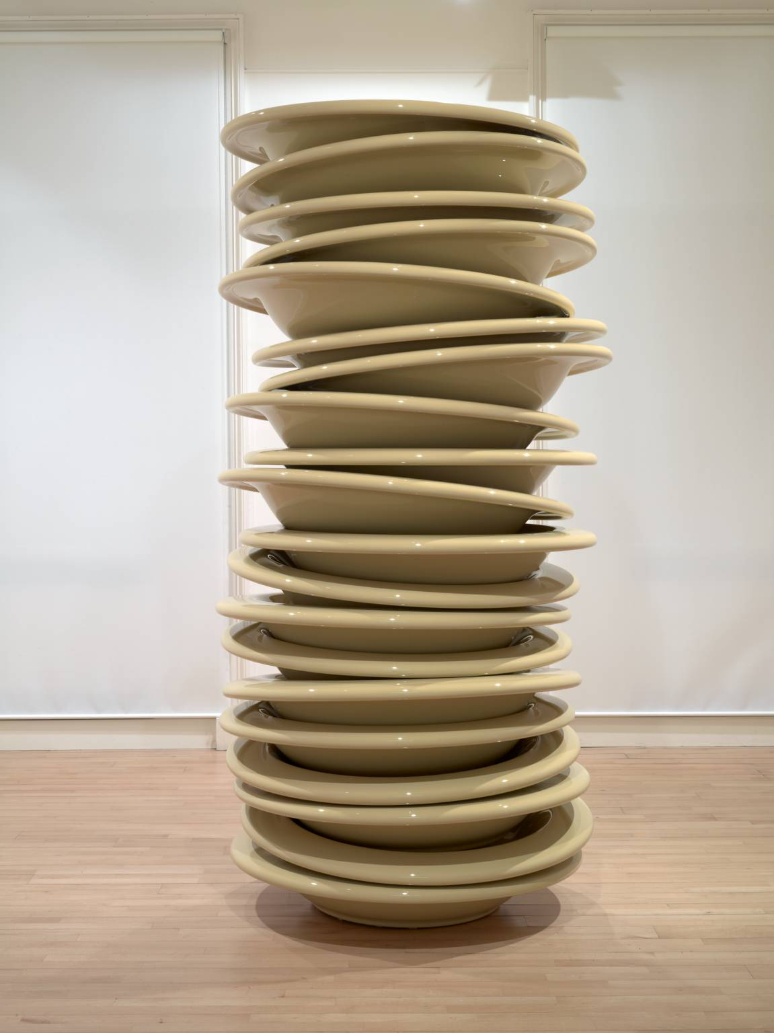
Stack
Type of collection
Add on top of the stack (push)
Remove from top (pop)
Can only read from top (peek)
LIFO: Last In, First Out

Slide 13
Why?
The type of operations are more restricted compared to other collections we saw so far
But if you are only interested in the operations of a stack, you can have specialized, high-performant implementations for it

Slide 14
Example
You need to work on some data X, so you push X on stack
While working with X, you need to work on some other Y (push Y), but, once done with it (pop), need to go back to X (peek)
While working on Y, might need to work on a Z (push Z), which itself might need to push more data on stack, etc.

Slide 15
Method Call Stack
For each method call, there is a frame, eg containing input parameters
At each call, the JVM needs to push frame, and pop it once method is completed
public class StackOverflow { public static void main(String[] args){ a(0); } public static int a(int x){ x++; x = b(x); return x; } public static int b(int y){ return a(y); } }

Slide 16
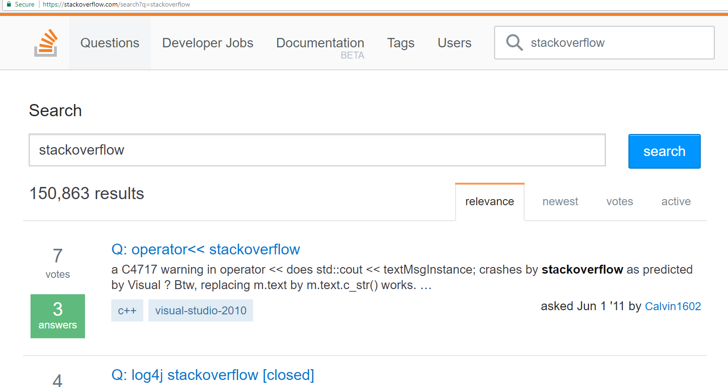
Stack Overflow
Exception in thread "main" java.lang.StackOverflowError at org.pg4200.datastructure.stack.StackOverflow.b(StackOverflow.java:22) at org.pg4200.datastructure.stack.StackOverflow.a(StackOverflow.java:16) at org.pg4200.datastructure.stack.StackOverflow.b(StackOverflow.java:22) at org.pg4200.datastructure.stack.StackOverflow.a(StackOverflow.java:16) at org.pg4200.datastructure.stack.StackOverflow.b(StackOverflow.java:22) at org.pg4200.datastructure.stack.StackOverflow.a(StackOverflow.java:16) at org.pg4200.datastructure.stack.StackOverflow.b(StackOverflow.java:22) at org.pg4200.datastructure.stack.StackOverflow.a(StackOverflow.java:16) at org.pg4200.datastructure.stack.StackOverflow.b(StackOverflow.java:22) at org.pg4200.datastructure.stack.StackOverflow.a(StackOverflow.java:16) at org.pg4200.datastructure.stack.StackOverflow.b(StackOverflow.java:22) at org.pg4200.datastructure.stack.StackOverflow.a(StackOverflow.java:16) at org.pg4200.datastructure.stack.StackOverflow.b(StackOverflow.java:22) at org.pg4200.datastructure.stack.StackOverflow.a(StackOverflow.java:16) at org.pg4200.datastructure.stack.StackOverflow.b(StackOverflow.java:22) at org.pg4200.datastructure.stack.StackOverflow.a(StackOverflow.java:16) ...

Slide 17


Queue
Type of collection
Add at the back, tail of the queue/line (enqueue)
Remove from the head of the line (dequeue)
FIFO: First In, First Out

Slide 18
Example: Task Scheduler
Process/thread add tasks to do on a queue
Other process/thread workers read from queue and execute the task
The oldest tasks need to be completed first
While workers are executing tasks, new tasks could be added to the queue

Slide 19
Stack/Queue as List
Stack
push(value) -> add(size(), value)
pop() -> delete(size()-1)
peek() -> get(size()-1)
Queue
enqueue(value) -> add(size(), value)
dequeue() -> delete(0)
It could be fine to use a list implementation for stacks/queues, but there are cases in which it is very inefficient

Slide 20
Memory Model

Slide 21
Questions
Node bar = new Node();
what is the variable “bar” concretely?
what does “new” actually do?
what is the difference between “bar” variable and the object created by “new Node()”?
bar.next = bar.next.next;
what is happening here?
are objects created or deleted?

Slide 22
Overview
Before we go into details of how to implement a Stack or a Queue, we need to have clear understanding of how memory is handled in Java
Pointers and memory are usually hard to understand… but critical, otherwise it will be nearly impossible to understand the data structures in this course
Should had been covered in the 1st year
so this is just a high level revision…

Slide 23
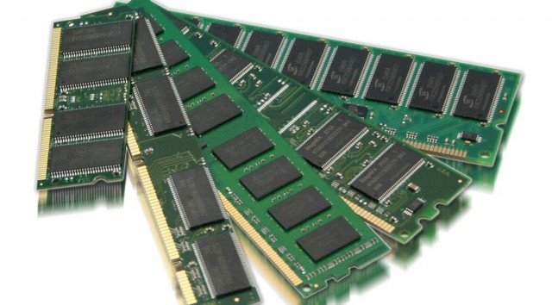
Very Simplified Model
A process will get allocated a certain amount of space on your RAM by the Operating System (OS)
eg, you have 16G on your laptop and process needs 1G
The process will use such memory to allocate variables and objects
How the process handles this memory should be independent from the other processes
Think of the memory like a big array, where process is allowed to write/read within a [i] – [j] range
Eg, if process got 1GB, it could use RAM from position 12G till 13G

Slide 24
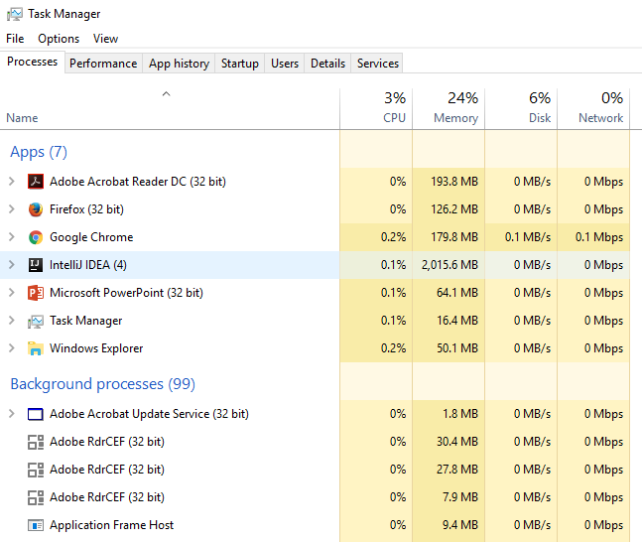

Slide 25
Java Memory
Static | Function Call Stacks | Memory Heap
At a very, very high level, the JVM divides its allocated memory in 3 main parts
Static: containing for example the bytecode to run
FCS: one stack per thread for the function calls
Heap: where objects are stored

Slide 26
Function Call Stack
When foo() is called, we need to store x and k somewhere in memory
When bar() is called, we need to store y and z, plus we should not lose x from foo()
Once bar() is terminated, we do not need y and z any more
public void foo(){
int x = 0;
int k = bar(x);
print(k);
}
private void bar(int y){
int z = y * y;
return z;
}

Slide 27
Function Call Frame
Create a frame for each function call
A frame stores all the input and all the local variables, eg., x, k, y and z
When we start a function call, we push its frame to the stack
Once function call ends, we pop its frame

Slide 28

Before bar() Is Called
public void foo(){
int x = 2;
int k = bar(x);
print(k);
}
private void bar(int y){
int z = y * y;
return z;
}
x = 2
k = ?
One frame on stack for the foo() call

Slide 29
Inside bar()
public void foo(){
int x = 2;
int k = bar(x);
print(k);
}
private void bar(int y){
int z = y * y;
return z;
}
y = 2
z = 4
x = 2
k = ?
Push new frame for bar(y)
Note that y is initialized with same value of x. Changing y does not affect x, as in different frames

Slide 30
Once bar() Is Completed
public void foo(){
int x = 2;
int k = bar(x);
print(k);
}
private void bar(int y){
int z = y * y;
return z;
}
x = 2
k = 4
Pop stack of bar(y), as no needed any more.

Slide 31
Actual Bytes In Memory
0
0
0
0
0
0
0
0
0
0
x = 2
k = 0
0
0
0
0
0
0
0
0
y = 2
z = 4
x = 2
k = 0
0
0
0
0
0
0
0
0
2
4
x = 2
k = 4
Consider each cell as contiguous 32 bits
When we pop frame, data is still actually there. Will be overwritten at next frame push

Slide 32
Performance Issue
When we call bar(x), the 32 bits of x are copied from current frame to the frame of bar() in the y variable
32 bits are OK, but what if we have large objects???
Passing by value is inefficient
public void foo(){
int x = 2;
int k = bar(x);
print(k);
}
private void bar(int y){
int z = y * y;
return z;
}

Slide 33
Pointers/References
Java does not allow you (yet) to have objects on the FCS
Only allowed primitive values (eg, int, double, boolean) and pointers
Note: other languages allows you objects on FCS, eg C++
To have objects, those will be allocated on the heap
The FCS will have pointers to the heap

Slide 34
Allocation on Heap
public void foo(
int a, boolean b,
char c, double d){
X x = new X(a,b,c,d);
int k = bar(x);
print(k);
}
private void bar(X y){
int z = y.compute();
return z;
}
The x variable is not going to contain the 4 inputs
These are stored in the heap
x is just a pointer to the location on the heap
Assume X has 4 private fields, initialized in constructor

Slide 35
public void foo(
int a, boolean b,
char c, double d){
X x = new X(a,b,c,d);
int k = bar(x);
print(k);
}
a | b | c | d | x | k | Remaining Space on FCS | Heap
FCS growing from left to right
Frame contains data for 4 inputs and 2 local variables
X is a 64 bit address in the memory, ie it is a number, like an index in an array

Slide 36
public void foo(
int a, boolean b,
char c, double d){
X x = new X(a,b,c,d);
int k = bar(x);
print(k);
}
a | b | c | d | x | k | Remaining Space on FCS | Heap | Data of x | Heap
0
10,000
74,321
The new keyword allocates memory in the heap for storing all the data of x
Can’t control where in heap data of x is allocated, but will be at some known position, eg 74321
When JVM calls new, it will choose a free area in the heap
The variable x in the FCS will contain the numeric address, eg 74321

Slide 37
public void foo(
int a, boolean b,
char c, double d){
X x = new X(a,b,c,d);
int k = bar(x);
print(k);
}
private void bar(X y){
int z = y.compute();
return z;
}
a | b | c | d | x | k | y | z | Remaining Space on FCS | Heap | Data of x | Heap
0
10,000
74,321
The frame pushed for bar(x) contains data for y and z
x in the frame of foo() has same value of y in frame of bar(), ie 74321
The “Data of x” has not be copied when calling bar(x), we just copied the reference, ie the address 74321

Slide 38
LinkedList Example
Assume LinkedList based on nodes
List has an head
Each node has a next reference
public void foo(){
List list =
new LinkedList();
list.add(“a”);
list.add(“b”);
list.add(“c”);
}

Slide 39
public void foo(){
List list =
new LinkedList();
list.add(“a”);
list.add(“b”);
list.add(“c”);
}
The list reference on FCS will point to position where list object is, ie 120
The head in such data will contain the value 200, ie address of first element
The next fields contains address of next elements
list | Remaining FCS | Free Heap | Data of List, Eg, head | Free Heap | Node for “a”, eg next / value pointers | Node for “c”, eg next / value pointers | Free Heap | Node for “b”, eg next / value pointers | Free Heap
0
100
120
200
240
500

Slide 40
list = 120 | Remaining FCS | Free Heap | Data of List, head = 200 | Free Heap | Node for “a”, next = 500 | Node for “c”, next = null | Free Heap | Node for “b”, next = 240 | Free Heap
0
100
120
200
240
500
Delete node for “b” with: current.next = current.next.next
Where current is the node for “a”
list = 120 | Remaining FCS | Free Heap | Data of List, head = 200 | Free Heap | Node for “a”, next = 240 | Node for “c”, next = null | Free Heap | Node for “b”, next = 240 | Free Heap
0
100
120
200
240
500

Slide 41
list = 120 | Remaining FCS | Free Heap | Data of List, head = 200 | Free Heap | Node for “a”, next = 240 | Node for “c”, next = null | Free Heap | Node for “b”, next = 240 | Free Heap
0
100
120
200
240
500
540
Deleting “b” means it is not accessible any more starting from list pointer in the FCS
but it is still there in memory!!!
When calling new many times, might run out of free space
At that point, somehow we need to be able to reuse the space occupied by the “b” node, ie location 500-540

Slide 42
Garbage Collector (GC)
Called by JVM when run out of space on heap
Starting from the pointers on FCS, recursively find all reachable objects
Non-reachable objects (eg “b” node) will be marked as “Free Heap”, and their space can be reused by new operator when new instances are created
GC are quite complex, as need to be very efficient, because they block the entire code execution

Slide 43
ArrayList

Slide 44
Insertion
Need to right-shift all values from index before inserting new value
On an array, we set 1 value at a time, ie a[i+1] = a[i], possibly in a loop
Loop must start from end to avoid overwrite
Assume adding a 9 at position 2 (currently occupied by value 3)
But what if array is full???
WRONG
CORRECT
1 | 2 | 3 | 4 | 5
1 | 2 | 3 | 4 | 5
1 | 2 | 3 | 3 | 5
1 | 2 | 3 | 4 | 5 | 5
1 | 2 | 3 | 3 | 3
1 | 2 | 3 | 4 | 4 | 5
1 | 2 | 3 | 3 | 3 | 3
1 | 2 | 3 | 3 | 4 | 5
1 | 2 | 9 | 3 | 3 | 3
1 | 2 | 9 | 3 | 4 | 5

Slide 45
Deletion
Similar to addition, here we need to shift left, and then remove last element
a[i] = a[i+1], in a loop
Assume delete(2), ie remove the value 9 at index position 2
1 | 2 | 9 | 3 | 4 | 5
1 | 2 | 3 | 3 | 4 | 5
1 | 2 | 3 | 4 | 4 | 5
1 | 2 | 3 | 4 | 5 | 5
1 | 2 | 3 | 4 | 5

Slide 46
LinkedList

Slide 47
Implementation
Each element T contained in a node instance
Each node contains a value, and a next field to the following node in the sequence
LinkedList object has pointers to the head and tail nodes of the list
could also keep track of the size in a variable, to avoid compute it when queried (which would be expensive)
LinkedList
Node head | null
Node tail | null
int size | 0
Node
T element | null
Node next | null

Slide 48
Insertion When Empty
Create new node for the element x
Update both head and tail to point to such node
LinkedList
Node head
Node tail
int size | 1
Node
T element | x
Node next | null

Slide 49
Insertion at 0
Insert y in a non-empty LinkedList
Besides creating new node, need to update the head
New node will have to point to the previous head
LinkedList
Node head
Node tail
int size | 1
Node
T element | x
Node next | null
Node
T element | y
Node next

Slide 50
Insertion At The End
Create new node for z
The next of current tail should point to this new node
The tail should then be updated to point to it
LinkedList
Node head
Node tail
int size | 1
Node
T element | y
Node next
Node
T element | x
Node next
Node
T element | z
Node next | null

Slide 51
Insertion In The Middle
Bit more complex, as no direct access to position index from the LinkedList
we only have head and tail
We need to navigate from head, following the nexts of next
eg, head.next.next.next.next…
usually in a loop current = current.next, starting from current = head
Node
T element | a
Node next
Node
T element | b
Node next
Node
T element | c
Node next
Node
T element | d
Node next | null
Node
T element | x
Node next

Slide 52
ArrayList or LinkedList?
For most cases, ArrayLists are better
Creating node objects for each element in a LinkedList is expensive, plus overhead for GC
ArrayLists have the issue of resize
although it can be automated, it is still expensive when it happens
but, if you have an idea of how many elements at most you will store, you can create a buffer array larger than that
Still very important to understand LinkedList, as foundation for Tree data-structures

Slide 53
Stack as List
Fine for both ArrayList and LinkedList implementations
operations at the end of the list are efficient in both implementations
In the case of LinkedList, code can be simplified
No need for head, as only working at the end of the list with tail
In the nodes, instead of pointer to next node, have pointer to previous node
otherwise could not delete

Slide 54
Queue

Slide 55
Queue As List
Fine for LinkedList
in a queue, we only operate on head and tail, no need to navigate whole list with head.next.next… (which would be inefficient)
VERY INEFFICIENT for ArrayList
each dequeue() call would force a left-shift of the whole list
If want to use an array as internal data-structure, we need a better implementation than an ArrayList

Slide 56
Implementation
Besides an internal array, need to have 2 indices, representing position of the head and tail of the queue on such array
When empty, head = tail = -1 (ie an invalid index)
We do not care what the array contains in the positions outside the head-tail range
[0] | [1] | [2] | [3] | [4] | [5] | [6] | [7] | [8] | [9]
? | ? | 1 | 4 | 5 | 3 | ? | ? | ? | ?
head = 2
tail = 5

Slide 57
Dequeue
Get the value at position head
Then increase head by 1
We could ignore the value that was stored at the head, but better to put it to null for GC
[0] | [1] | [2] | [3] | [4] | [5] | [6] | [7] | [8] | [9]
? | ? | 1 | 4 | 5 | 3 | ? | ? | ? | ?
head = 3
tail = 5

Slide 58
Enqueue
Increase tail by 1
Add at position given by the tail index
Assuming adding a 4
[0] | [1] | [2] | [3] | [4] | [5] | [6] | [7] | [8] | [9]
? | ? | 1 | 4 | 5 | 3 | 4 | ? | ? | ?
head = 2
tail = 6

Slide 59
End of the Array
What happens when tail reaches the end of the array?
Several options
Left-shift
Resize into longer array
Ring access (we will see this one in the exercises)
[0] | [1] | [2] | [3] | [4] | [5] | [6] | [7] | [8] | [9]
? | ? | ? | ? | ? | ? | ? | 3 | 1 | 5
head = 7
tail = 9

Slide 60
Left-Shift
Only possible if head>0, otherwise no space
Good if only few elements
[0] | [1] | [2] | [3] | [4] | [5] | [6] | [7] | [8] | [9]
? | ? | ? | ? | ? | ? | ? | 3 | 1 | 5
head = 7
tail = 9
[0] | [1] | [2] | [3] | [4] | [5] | [6] | [7] | [8] | [9]
3 | 1 | 5 | ? | ? | ? | ? | ? | ? | ?
head = 0
tail = 2

Slide 61
Resize
Create new, larger array
Copy over all elements
Use new array as current internal buffer
Only real option when head=0, but can also do it for head>0 and size()>k to avoid too many left-shits
head = 0
tail = 9
array =
[0] | [1] | [2] | [3] | [4] | [5] | [6] | [7] | [8] | [9]
3 | 1 | 5 | 7 | 1 | 1 | 9 | 9 | 8 | 2
[0] | [1] | [2] | [3] | [4] | [5] | [6] | [7] | [8] | [9] | [10] | [11] | [12] | [13] | [14] | [15] | [16] | [17]
3 | 1 | 5 | 7 | 1 | 1 | 9 | 9 | 8 | 2 | ? | ? | ? | ? | ? | ? | ? | ?

Slide 62
Homework
Study Book Chapter 1.3
Study code in the org.pg4200.les02 package
Do exercises in exercises/ex02
Extra: do exercises in the book

