Slide 1
PG4200: Algorithms And Data Structures Lesson 04: Recursion and Test Driven Development (TDD)
Prof. Andrea Arcuri

Slide 2
Sorting Overview
Many different kinds of sorting algorithms
Most language APIs provides good defaults
Unless very large data, default will be fine 99% of the cases
Sorting is very popular in programming
Important to understand how it works under the hood
Tractable mathematically
So good example to show how to analyze algorithms

Slide 3
Sorting Algorithms
Insertion Sort
Merge Sort
Quick Sort
There are more, but those are the most famous that you need to know (besides Bubble Sort)
Good way to see a problem been solved in many different ways

Slide 4
Insertion Sort
An array of size 0 or 1 is always considered sorted
From left to right, till length N
K-leftmost values are sorted
Position K+1 is not sorted, insert it in the first K
by swapping adjacent elements, like in Bubble Sort
4 | 5 | 1 | 3 | 2 | 6
K=0
4 | 5 | 1 | 3 | 2 | 6
K=1
4 | 5 | 1 | 3 | 2 | 6
K=2
4 | 5 | 1 | 3 | 2 | 6
K=3
4 | 1 | 5 | 3 | 2 | 6
swap
1 | 4 | 5 | 3 | 2 | 6
swap

Slide 5
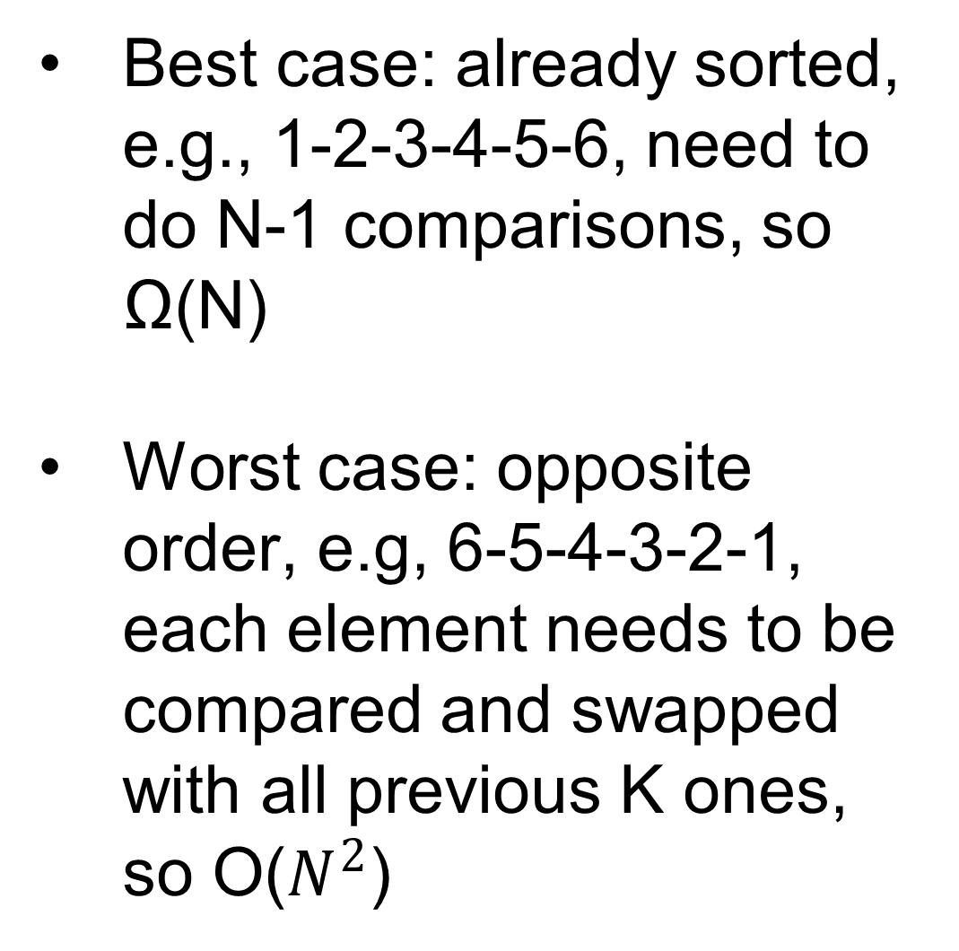
Cont.
1 | 4 | 5 | 3 | 2 | 6
K=4
Best case: already sorted, e.g., 1-2-3-4-5-6, need to do N-1 comparisons, so Ω(N)
Worst case: opposite order, e.g, 6-5-4-3-2-1, each element needs to be compared and swapped with all previous K ones, so O($N^{2}$)
1 | 4 | 3 | 5 | 2 | 6
swap
1 | 3 | 4 | 5 | 2 | 6
swap
1 | 3 | 4 | 5 | 2 | 6
K=5
1 | 3 | 4 | 2 | 5 | 6
swap
1 | 3 | 2 | 4 | 5 | 6
swap
1 | 2 | 3 | 4 | 5 | 6
swap
1 | 2 | 3 | 4 | 5 | 6
K=6

Slide 6
Merge Sort
Divide and Conquer
Recursive implementation
Split the array in two
Sort the two parts
Merge the two parts once sorted
4 | 5 | 1 | 3 | 2 | 6
4 | 5 | 1 | 3 | 2 | 6
1 | 4 | 5 | 2 | 3 | 6
1 | 2 | 3 | 4 | 5 | 6

Slide 7
Recursion
Writing mergeSort(T[] array)
How to sort the 2 halves if my goal was to write a sort algorithm???
Recursion: reuse function you are writing, but on smaller data
mergeSort(T[] array){
mergeSort(array, 0, array.length / 2)
mergeSort(array, array.length /2 , array.length)
mergeHalves(array)
}

Slide 8
Recursion End
To avoid infinite loop, you need to define a stopping condition
When do I know for certain that an array is sorted?
Answer: when its size is at most 1
So, stop recursion when reaching an half of size 1 or less

Slide 9
Merge of Halves
By recursion, I can sort the 2 halves, but array with 2 sorted halves is not sorted
Scan the 2 halves, and copy min to a new array
Between N/2 and N comparisons: once reached end of one half, copy over the other
1 | 4 | 5
1 | 4 | 5
2 | 3 | 6
2 | 3 | 6
1
1 | 2
1 | 4 | 5
1 | 4 | 5
2 | 3 | 6
2 | 3 | 6
1 | 2 | 3
1 | 2 | 3 | 4

Slide 10
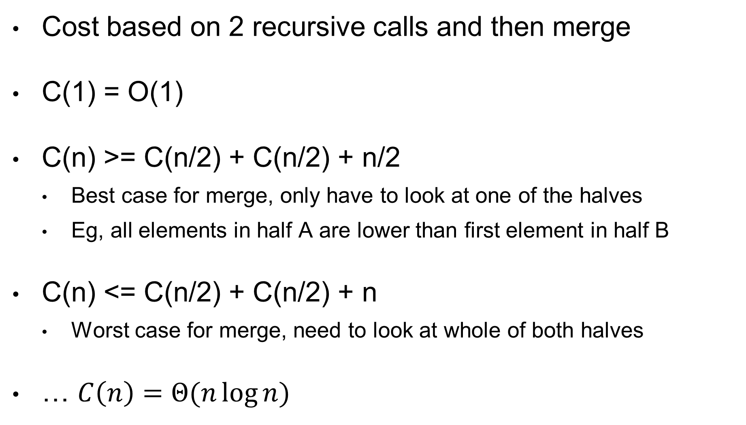
Cost
Cost based on 2 recursive calls and then merge
C(1) = O(1)
C(n) >= C(n/2) + C(n/2) + n/2
Best case for merge, only have to look at one of the halves
Eg, all elements in half A are lower than first element in half B
C(n) <= C(n/2) + C(n/2) + n
Worst case for merge, need to look at whole of both halves
… $C\left(n\right)=Θ(n\log{n})$

Slide 11
Considerations
Asymptotically, does not exist comparison-based sorting better than O(n log n)
Merge-sort is therefore asymptotically optimal
Ie, no instance for which get worse than O(n log n)
But… more memory, need extra array buffer
… might be not best on average

Slide 12
Wikipedia
Besides book, Wikipedia is good source to read about algorithms and data structures in layman terms
https://en.wikipedia.org/wiki/Merge_sort

Slide 13
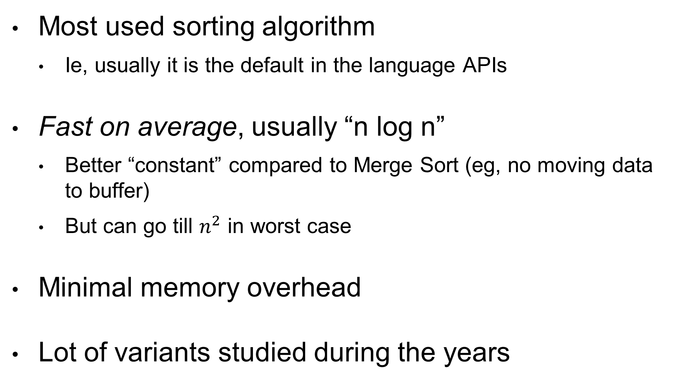
Quick Sort
Most used sorting algorithm
Ie, usually it is the default in the language APIs
Fast on average, usually “n log n”
Better “constant” compared to Merge Sort (eg, no moving data to buffer)
But can go till $n^{2}$ in worst case
Minimal memory overhead
Lot of variants studied during the years

Slide 14
Recursion
Still Divide and Conquer algorithm, like Merge Sort
Choose a value X (pivot)
Move values <X before X, and >X after it
After one step X is in the correct position
Apply recursion on subarrays before and after X

Slide 15
Choose a pivot, eg value 5
Scan from left till > 5, from right till < 5
Swap (eg 6 with 1), and continue
Note how 3 is not touched, as < 5
At the end, the pivot 5 is in the right position
On left side, all values < 5
On right side, all values > 5
Apply recursively on left and right of pivot
6 | 3 | 7 | 5 | 4 | 2 | 1
1 | 3 | 7 | 5 | 4 | 2 | 6
1 | 3 | 7 | 5 | 4 | 2 | 6
1 | 3 | 2 | 5 | 4 | 7 | 6
1 | 3 | 2 | 5 | 4 | 7 | 6
1 | 3 | 2 | 4 | 5 | 7 | 6
1 | 3 | 2 | 4 | 5 | 7 | 6

Slide 16
Choice of Pivot
Choice of pivot is crucial for performance of Quick Sort
pivot = array[i]
For performance, would like a pivot value that gives the 2 partitions of equal size
How to choose “i”?
An option is to take “i” at random
Another option is to take middle, which is good when array nearly sorted
1 (and 7) is worst choice
4 | 3 | 7 | 1 | 5 | 2 | 6
4 is best choice
4 | 3 | 7 | 1 | 5 | 2 | 6

Slide 17
Which Sorting Algorithm to Use?
Unless you have very specific, advanced cases, you use the default of what is given by the standard library of the language/framework you use
Most of the time, it will be a variant of Quick Sort
Fast on average, often “n log n” cost, no extra memory

Slide 18
Test Driven Development (TDD)

Slide 19
TDD in One Slide
First write the test cases, which will fail, and then write code to make the test cases pass

Slide 20
What TDD is Not
It is not a fancy tool you can buy/download
No cutting edge novel technology
No silver bullet solving all your software development problems
It is just a (relatively simple) design methodology to improve productivity

Slide 21
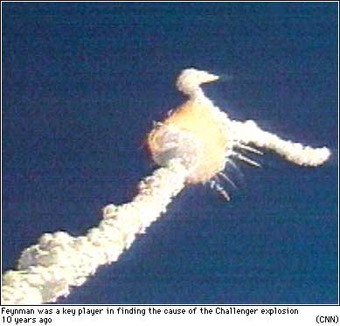
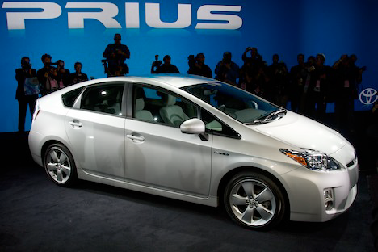
Why TDD???
Bugs in the field can be extremely expensive
Ariane 5 explosion, Toyota braking system (100k recalled cars), etc
Aim at improving quality (“testing”) within acceptable cost
Lot of hype on TDD as possible solution

Slide 23
Some Facts on TDD
There isn’t much scientific evidence that it helps on large scale systems
Small improvements in quality, but also small decrease in productivity
But many anecdotal, success stories
My opinion might be different from what you might hear/read on TDD

Slide 24
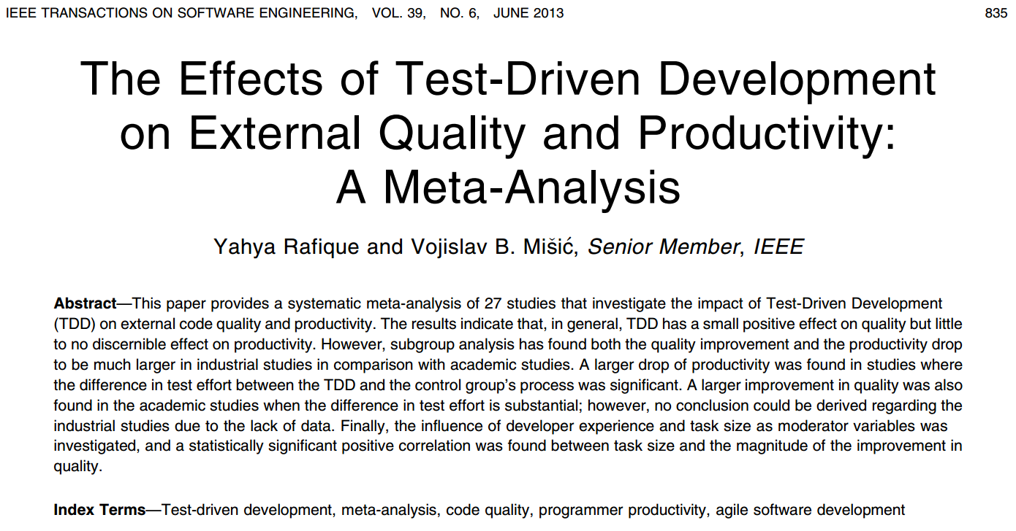

Slide 25
TDD and Algorithms
Algorithms is a good a place to start with TDD, as having clear functions with clear expected outputs
Lot of hype on TDD
However, here we deal with small functions and classes, and not whole applications

Slide 26
Do You Practice What You Preach?
TDD can be useful, especially for students / junior developers
But to be honest, I am not using TDD...
TDD is a bottom-up approach to software design, whereas I prefer top-down
As any technique, its success depends on the context
eg, type of software, stage in which TDD is introduced (at the beginning or in a mature project), etc
Can test software even without TDD
Success of TDD depends also on management

Slide 27
General Principles of TDD

Slide 28
- Empty code stub
- Test case that fails
- Integrate changes (eg commit to Git)
- Minimal coding to pass test case
- Refactor to improve code

Slide 29
Example: A List
//Start from an “empty” stub that compiles
class List{
int size(){return -1; //wrong value}
}

Slide 30
First Unit Test
void testEmptyList(){
List list = new List();
Assert.equals( 0 , list.size());
// expected empty list
}
This will fail!

Slide 31
Fix The Code
class List{
int size(){return 0;}
}
Now the test case does not fail

Slide 32
Refactor Step
class List{
int counter = 0;
int size(){return counter;}
}
Improve code

Slide 33
Integration Step
As all test cases do pass, make changes permanent
Example: commit to repository
Git, CVS, SVN, Mercurial, etc.
Do you really need to at each TDD step??? I do not think so...
overhead, tedious, side effects if email generated for each commit, etc.

Slide 34
Back to First Step
class List{
int counter = 0;
void insert(int value){ /* do nothing */}
int size(){return counter; }
}

Slide 35
Write A Second Test
void testInsertOneElement(){
List list = new List();
list.insert(42);
Assert.equals( 1 , list.size());
}
This will fail!

Slide 36
Minimal Fix
Does not work:
- testInsertOneElement does pass
- but testEmptyList will fail
class List{
int counter = 1;
void insert(int value){ }
int size(){return counter; }
}

Slide 37
Still need all passing tests
class List{
int counter = 0;
void insert(int value){ counter++;}
int size(){return counter; }
}

Slide 38

Refactoring Step
class List{
int[] data = new int[16];
int counter = 0;
void insert(int value){ data[counter]=value;
counter++;}
int size(){return counter; }
}
Do not do that!
You have no test case checking for internal state!

Slide 39
New Empty Stub
class List{
int counter = 0;
void insert(int value){ counter++;}
int size(){return counter; }
int getLast(){return 0;}
}

Slide 40
Write A Third Test
void testInsertAndGetOneElement(){
List list = new List();
int value = 42;
list.insert(value);
Assert.equals( value , list.getLast());
}
Note: we are not testing for “size” here
This will fail!

Slide 41
Minimal Fix Before Refactoring
class List{
int counter = 0;
void insert(int value){ counter++;}
int size(){return counter; }
int getLast(){return 42;}
}

Slide 42
And so on... keep following the cycle
Test
Integrate
Code
Refactor

Slide 43
Measuring Test Effectiveness
Big issue, regardless of TDD
#bugs found in QA is a tricky measure
Code coverage is often used

Slide 44

TDD
Set Of Test Cases
54% Statement Coverage
“Regular” Development
Set Of Test Cases
54% Statement Coverage

Slide 45
TDD and Coverage
TDD is not about more code coverage
Managers can just set a target (eg >50%) and let engineers decide how to achieve it
TDD is about design

Slide 46
Coverage Does Not Tell You Much
void testInsertOneElement(){
List list = new List();
list.insert(42);
int size = list.size();
Assert.equals( 1 , size );
}
Let’s say 15% coverage
Coverage does not change!!!
//

Slide 47
How Good Are Your Test Assertions?
Current tools cannot tell you that
However, “Mutation Testing” is starting to get usable
TDD helps you because force you to write effective assertions
tests first need to fail, and then pass

Slide 48
TDD is A Design Methodology
You can write tests even without TDD
Incremental, small steps, each one verified
Can be useful for complex code
Can apply TDD only on subset of a project
TDD might lead to write very different code
impact on architecture

Slide 49
Homework
Study Book Chapter 2.2 and 2.3
Study code in the org.pg4200.les04 package
Do exercises in exercises/ex04
Extra: do exercises in the book

