Slide 1
PG4200: Algorithms And Data Structures Lesson 05: Tree Maps
Prof. Andrea Arcuri

Slide 2
Overview
Together with lists, maps are the most common data structures used in programs
No “index” of position, in contrast to arrays/lists
Association between “keys” and “values”
Ie keys are mapped to values

Slide 3
Insert/Find
When inserting a new value V, also insert a key K for it
A K key is an object (eg, String, Integer, etc.)
When we want to retrieve V, we will query for its K
The idea is that retrieving data for given K should be fast

Slide 4
Examples
Collection/map of songs: the Song class is the V, where the K is the String title
Collection/map of users: the User class is the V, where the K is the Integer id of the user

Slide 5
Search
How can we efficiently search for a K?
Let’s assume that Ks are orderable, eg a compareTo() is defined for them
This is the case for String and Integer

Slide 6
Search Value in Array
7 | 2 | 4 | 9 | 1 | 3 | 0 | 5 | 8 | 6 | 10
Assume content of array is numeric keys
And we want to search for key 8
Scan from left-to-right, and check if == 8
Complexity O(n)

Slide 7
Search In Sorted Array
7 | 11 | 40 | 42 | 70 | 78 | 80 | 92 | 93 | 94 | 99
Assume we search for 92
Is there any clever way to check if 92 by exploiting knowledge of array being sorted?

Slide 8
Binary Search
7 | 11 | 40 | 42 | 70 | 78 | 80 | 92 | 93 | 94 | 99
Check middle of array, ie 78
As 78 < 92, check middle of subarray between 80 and 99, ie 93
As 93 > 92, ignore the rightmost values
Look at middle of 80-92
Finally find 92
7 | 11 | 40 | 42 | 70 | 78 | 80 | 92 | 93 | 94 | 99
7 | 11 | 40 | 42 | 70 | 78 | 80 | 92 | 93 | 94 | 99
7 | 11 | 40 | 42 | 70 | 78 | 80 | 92 | 93 | 94 | 99

Slide 9
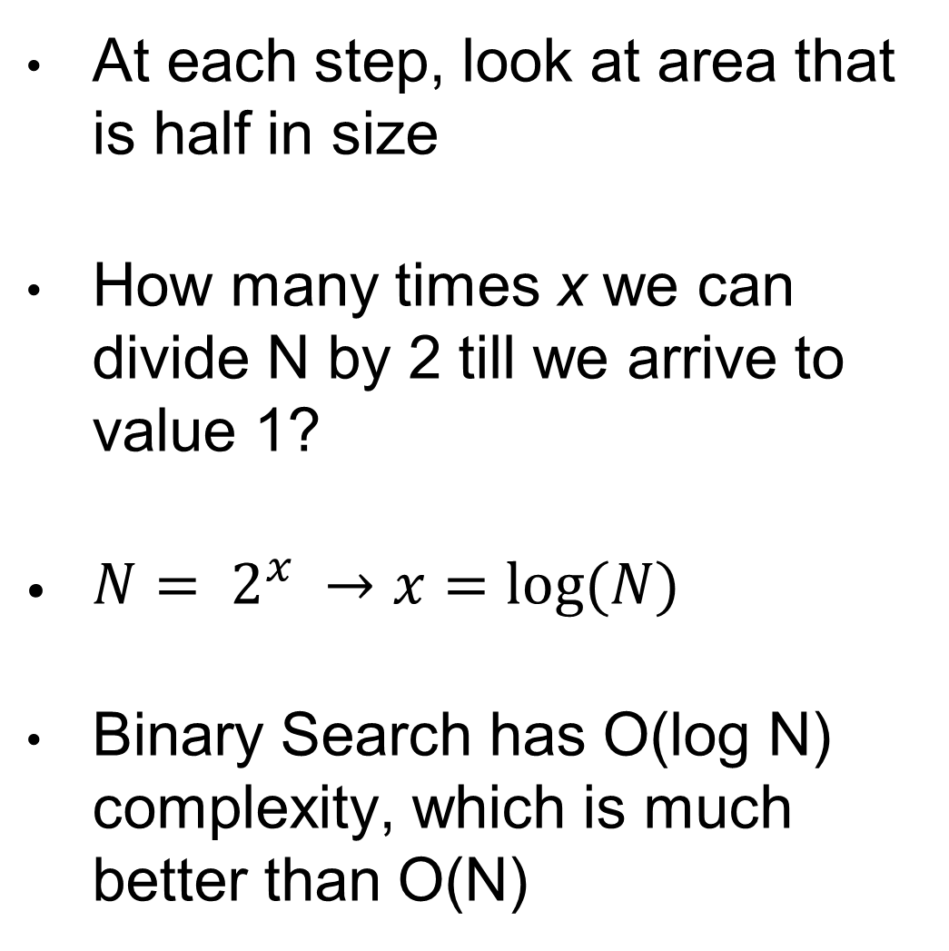
Complexity
At each step, look at area that is half in size
How many times x we can divide N by 2 till we arrive to value 1?
${N= 2}^{x} →x=log⁡(N)$
Binary Search has O(log N) complexity, which is much better than O(N)
7 | 11 | 40 | 42 | 70 | 78 | 80 | 92 | 93 | 94 | 99
7 | 11 | 40 | 42 | 70 | 78 | 80 | 92 | 93 | 94 | 99
7 | 11 | 40 | 42 | 70 | 78 | 80 | 92 | 93 | 94 | 99
7 | 11 | 40 | 42 | 70 | 78 | 80 | 92 | 93 | 94 | 99

Slide 10
List/Array Based Map
Each element is an Entry object, containing K and V
Insertion: O(N), can keep list/array sorted
Deletion: O(N)
Search for K: O(log N) if sorted, otherwise O(N)
Can we do better? Eg, O(log N) in all operations

Slide 11
Tree-based Maps
Data structures resembling a tree
Nodes contain values, and links to child nodes
Starting point is the root of the tree
Two main / most famous versions
Binary Trees (“simple”)
Red-Black Trees (“very complex”, but high performance)
7
4
11
2
8
14
0
3
9

Slide 12
Binary Tree
Each Node has 1 value and up to 2 children: left and right
Values in left subtree are all smaller
Values in right subtree are all larger
Insertion/deletion do keep these invariants
Search starts from root
7
4
11
2
8
14
0
3
9

Slide 13
Insertion
Assume inserting entries with keys 4, 2, 3, 5 and 1
Recall: each node has a key and an associated value
Here in the circles I am just showing the keys, not the values
4
4
4
4
4
2
2
2
5
2
5
3
3
1
3

Slide 14
Insertion Order
Assume inserting same entries but in this order: 5, 4, 3, 2, 1
Shape of tree depends on order in which elements are inserted
Worst case the tree degenerates into a list
5
5
5
5
5
4
4
4
4
3
3
3
2
2
1

Slide 15
Search
Start from root
Recursively navigate left or right subtree based on when searched key is smaller or bigger than the one in the node
Worst case: searched key is in a leaf node
Max number of comparisons bound by depth of tree
Eg 4 in the example
7
4
11
2
8
14
0
3
9

Slide 16
Tree Depth
Depth: longest distance between root and a leaf
Given N nodes
Depth bounded between N (worst case) and log(N) (best case)
5
4
4
2
5
3
1
3
2
1

Slide 17

Deletion
To delete K, need to find it first
Actual deletion depends on numbers of children of K
Simple case: deleting with no children, eg delete key 9, just set to null the link of the parent (8 in this case)
7
7
4
11
4
11
2
8
14
2
8
14
0
3
9
0
3

Slide 18
Deletion With 1 Child
Eg, delete 8 (or 4)
Look at the parent of deleted node (ie 11)
Change the child link of parent to the child of deleted node (ie 9)
7
7
4
11
4
11
2
8
14
2
9
14
0
3
9
0
3

Slide 19
Deletion With 2 Children
Eg, delete 7 (or 2 or 11)
Find minimum in right subtree (ie 8) and delete it
Replace the content of right-minimum into deleted node
7
8
4
11
4
11
2
8
14
2
9
14
0
3
9
0
3

Slide 20
Runtime Complexity
In worst case, Binary Map degenerates into a list
All operations have O(N) complexity in worst case
But random trees would be nearly balanced, and operations would hence be in the O(log N) order
So good performance on average

Slide 21
Red-Black Trees (RBT)
Complex type of tree
Likely the most complex algorithm we see in this course (and likely in your degree as well…)
If you have difficulties in this course, keep this one as last to study/revise, unless you are aiming for an A grade…
Insertions and deletions always keep the tree balanced
Guarantee O(log N) on all operations
Ie, insertion, deletion and search
Extremely efficient
Can guarantee search into Billions of data with just 30-50ish node lookups

Slide 22
2-3 Search Trees
Before discussing RBT, let’s consider 2-3 Trees
2-3 Tree: composed of 2-nodes and 3-nodes
2-node: 1 value, 2 children (left and right)
3-node: 2 values, 3 children (left, middle and right)
M
E J
R
A C
H
L
P
S X

Slide 23
Perfectly Balanced Trees
When distance from root to any null-child-link is the same
Important property to guarantee O(log N)
M
M
E J
R
E J
R
A C
H
L
P
S X
A C
H
L
S X
Balanced
Not Balanced

Slide 24
Insertion
After an insertion we want to keep the tree balanced
Based on key, search starting from root to the position where to insert
This takes O(log N) steps
Same concept as Binary Search Trees
Insertion will depend on position, but many cases to consider
Insertion on empty tree: just create a 2-node root

Slide 25
Insertion on 2-node
Trying to insert K, reached node for L
Node for L is a 2-node: easy, just transform into 3-node
M
M
E J
R
E J
R
A C
H
L
P
S X
A C
H
K L
P
S X

Slide 26
Insertion on 3-node, where Parent is a 2-node
Inserting Z
3-node (S,X) with 2-node parent (R)
Split node, and transform parent into a 3-node
M
M
E J
R
E J
R X
A C
H
L
P
S X
A C
H
L
P
S
Z

Slide 27
Insertion on 3-node, where Parent(s) are 3-nodes
Inserting D
3-node (A,C) with 3-node parent (E,J)
Split node, add middle to parent, repeat recursively bottom up until find 2-node
M
E J
R
A C
H
L
P
S X
M
E M
C
E J
R
C
J
R
A
D
H
L
P
S X
A
D
H
L
P
S X

Slide 28
Insertion on 3-node Root, with No Children
Inserting a new value, eg S
Split the 3-node, and create new 2-node
A E
E
A
S

Slide 29
Splitting The Root
Adding D
What happens when going bottom-up adding recursively to parent we reach a 3-node root?
Same as root with no children
Note: this is the only case in which depth increases
E
E J
C
E J
C
J
A C
H
L
A
D
H
L
A
D
H
L

Slide 30
Cost
Searching for position to insert is O(log N)
Worst case, when inserting, need to go upward till the root, which add a further O(log N)
So final cost of insertion is O(log N)
Recall, constants are not important in asymptotic analyses, so O(log N) + O(log N) = 2O(log N) = O(log N)
After each insertion, tree is perfectly balanced

Slide 31
From 2-3 Trees to RBT
Using 2-3 trees is cumbersome, as we need to handle both 2-nodes and 3-nodes
And not particularly efficient when transforming 2-nodes into 3-nodes, and vice-versa
RBT: represents 2-3 Trees by only using 2-nodes
Each link between nodes has a color: RED or BLACK
This is where the RBT name comes from

Slide 32
3-nodes
Represented with two 2-nodes
Link with smaller is RED, and RED links can only lean left
Any other kind of link is BLACK
For simplicity, using color directly on the node to represent link to parent
Cannot have two consecutives RED links
B
A B
A
A
B
A
B

Slide 33
Black-links Balance
In RBT there is only guaranteed balance for the black-links
Every path from root to a black-null-link has same number of black links
So, depth is still bounded by O(log N)

Slide 34
Rotations
When inserting/deleting, need to maintain RED-link properties, ie, most 1 leaning left
So need to have transformation operators on the tree, which are used to maintain the tree balance
These operations have O(1) cost

Slide 35
Left Rotation
S is moved up
Still RED link between E and S, but now E is child of S
Left child of S now becomes right child of E
Color (RED/BLACK) of link toward E is maintained in new rotated root S
Right-rotation does the exact opposite
E
S
Less than E
S
E
Greater than S
Between E and S
Greater than S
Less than E
Between E and S

Slide 36
Recall Insertion on 2-node
2-3 Trees
2-node transformed into 3-node
M
M
E J
R
E J
R
A C
H
L
P
S X
A C
H
K L
P
S X

Slide 37
Insertion into 2-node
2-node will need to transformed into a 3-node
In RBT, need to have new node with RED link
Need left rotation if new value is greater
B
B
A
B
A
B
C
B
B
C
C
B

Slide 38
Recall Insertion on 3-node Root, with No Children
2-3 Trees
Split the 3-node, and create new 2-node
A E
E
A
S

Slide 39
Insertion in Single 3-node
3 cases, based on whether new value is larger, smaller or between
Simple case: new value is greater, eg F
Flip color from RED to BLACK once inserted
D
D
D
B
B
F
B
F

Slide 40
Insertion in 3-node: Smaller Case
Smaller value, eg adding A
After insertion, need right rotation
Finally, need flipping of RED colors
D
D
B
B
B
B
A
D
A
D
A

Slide 41
Insertion in 3-node: Between Case
Between value, eg adding C
After insertion, need left rotation, followed by right rotation
Finally, need flipping of RED colors
D
D
D
C
C
B
B
C
B
D
B
D
C
B

Slide 42
Cost of 3-node Insertion
3 cases, based on inserted key
Larger: color flip
Between: left rotation, right rotation, color flip
Smaller: right rotation, color flip
These are constant costs

Slide 43
Insertion in Leaf 3-Node
Flipping color makes parent RED
Root is always put back to BLACK once insertion completed
Inserting H, which “smaller” value in the 3-node (R,S)
E
E
Right rotation: R and S
A
C
R
S
A
C
R
H
H
S
E
Color flipping: H,R, and S
E
R
A
C
R
A
C
H
S
H
S
Left rotation: E and R

Slide 44
Recursion
When flipping colors, need to fix parent
If parent is a 3-node, we need to recursively handle the propagation of RED color up to a 2-node or the root
Handling a RED child in a 3-node is equivalent to handling insertion of new RED node

Slide 45
Right
Rotation
Left
Rotation
Color flipping
Apply recursively to parent till 2-node, or root

Slide 46
Deletion
“Insertion” in a RBT is the easy part…
… the fun begins with the “Deletion” operator
As Insertion is already complicated enough, we will not see Deletion in this course
But look at book/code if you are curious

Slide 47
Homework
Study Book Chapter 3.1, 3.2 and 3.3
Study code in the org.pg4200.les05 package
Do exercises in exercises/ex05
Extra: do exercises in the book

