Slide 1
Web Development and API Design Lesson 08: Authentication and CSRF
Prof. Andrea Arcuri

Slide 2
Goals
Brief revision of HTTPS
Revision of how session-based authentication with cookies work
Understand the risks of Cross-Site Request Forgery (CSRF)
Learn how to add auth to a NodeJS/React application

Slide 3
HTTPS

Slide 4
HTTP is Not Secure
Messages in HTTP are not secure, because not encrypted
HTTPS extends HTTP by using encryption on all messages
Important to do for ALL kinds of communications, even if not critical
Not just for authentication (login) in banks or other internet services
Example, ISPs (eg Comcast) can inject ads in web pages
ISP -> Internet Service Provider

Slide 5





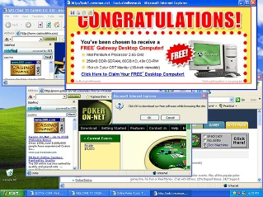
What would be the point of encrypting pages of a newspaper?
If not encrypted (ie HTTP instead of HTTPS) anyone between you and the target server can alter the payload of the messages…
HTTP: GET vg.no
Home WiFi
Your ISP
HTML of vg.no
Vg.no
Your Computer
Modified HTML
Modify the HTML payload content of the HTTP response, eg, by injecting ads

Slide 6
TLS/SSL Digital Certificates
When using HTTPS to a server, first download a digital certificate
Digital Certificate (DC) contains:
domain name (eg, www.facebook.com)
trusted certificate authority (CA)
server's public encryption key, ie RSA algorithm
Certificates have expiration time
The certificates themselves are signed, with the OS having public keys to check their integrity , ie they are signed with the private keys of the CA

Slide 7
Cont.
Eve would not be able to forge a DC for www.facebook.com (eg needed for her phishing attacks), because she would need to sign it with the private key of a CA
Note: this is secure only as long as one can trust the CAs, but some of those have been compromised in the past…

Slide 8
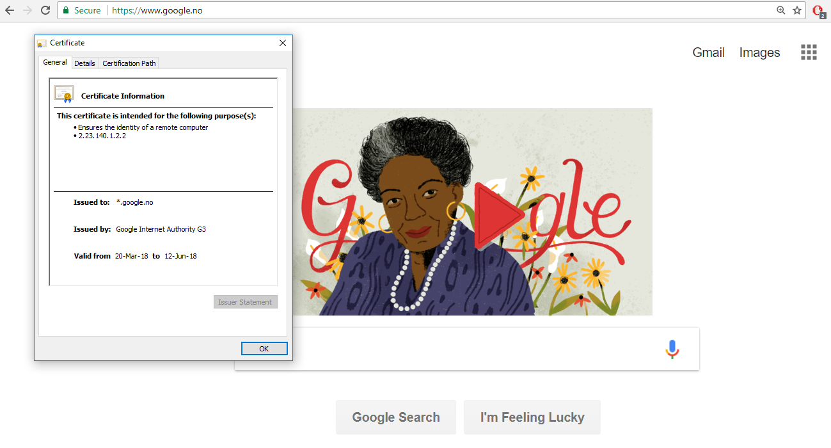

Slide 9
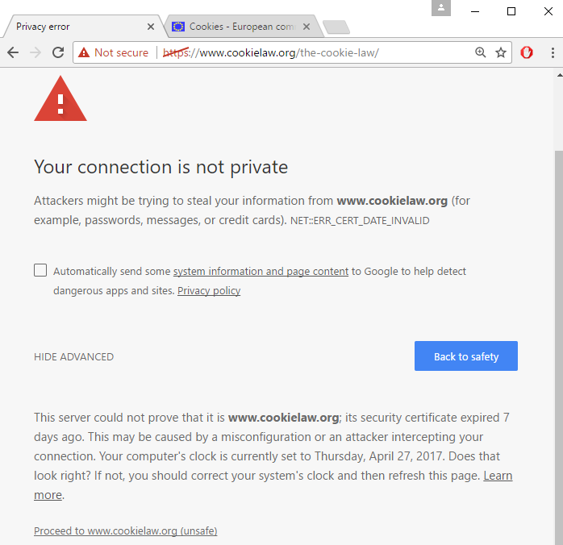
What if browser detects that the certificate is invalid?

Slide 10
If Certification Fails
2 main possibilities
1) Expired certificate: developers have not renewed their certificates with the CA
2) Man-in-the-middle attack
Trying to pretend to be the web app you want to connect to, so can steal your login/password, eg by serving a fake login page that is equal to the original one
Easy way to do such attack? Use a router, have an open WiFi called “Free WiFi”, go close to a bar/restaurant, and wait for people to connect to it, give them fake pages with fake certificates, and wait for those people to click “Proceed” when browser complains about certificate is invalid
NEVER PRESS “PROCEED” WITH INVALID CERTIFICATE ON UNTRUSTED NETWORK!!! And if you really have to, do not provide any sensitive information, eg passwords, although it would be still a problem with cookies…

Slide 11
HTTPS in This Course
When building and testing apps locally, we will use HTTP
dealing with HTTPS would add a lot of complications
But, when we will deploy apps in the “cloud”, those will be behind gateways using HTTPS
we will not need to do anything special to handle it

Slide 12
Login

Slide 13
Authentication/Authorization
Authentication:
do I know who a user X is?
how to distinguish X from a different user Y?
Authorization:
once I know that the current user is X, what is X allowed to do?
can s/he delete data?
can s/he see data of other users?
etc.
Of course, they only make sense with encryption (eg HTTPS), so no one can decode and tamper with the messages…

Slide 14
Authentication/Authorization failures
If not authenticated, server can:
in SSR, redirect to login page, HTTP status code 3xx
error page, HTTP status 401 Unauthorized
If authenticated but not authorized
eg user X tries to access data of Y
3xx redirection
HTTP status 403 Forbidden

Slide 15
Blacklisting vs Whitelisting
Authorization is done on the server, and will depend on the language/framework
JEE, Spring, PHP, .Net, NodeJS, etc.
user will just get either a 3xx or 403 response
Blacklisting: everything is allowed by default. What is not allowed for a given user/group has to be explicitly stated
Usually not a good idea, as easy to forget to blacklist some critical operation
Whitelisting: nothing is allowed by default. What is allowed has to be explicitly stated
“forgetting to allow something” (reduced functionality) is much, much better than “forgetting to forbid something” (security problem)

Slide 16
Authentication: first steps
Server does not know who the user is
Server only sees incoming HTTP/S messages
not necessarily from a browser… user can do direct TCP connections from scripts
HTTP/S is stateless
Need a way to tell that sequence of HTTP/S calls come from same user
User has to send information of who s/he is at each HTTP/S call
But users can lie… (eg, hackers)

Slide 17
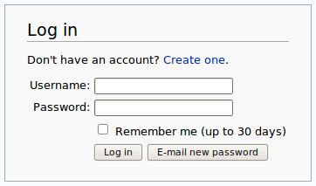
Ids and Passwords
A user will be registered with a unique id
Need also secret password to login
Otherwise anyone could login with the ids of other users…
HTTP/S does not prevent attempts to login to accounts of other users

Slide 18
Sending id/pwd
Need to send userId (id) and password (pwd) at EACH HTTP request
Can put them inside the HTTP header Authorization
Can be different formats to specify how id/pwd should be encoded
Basic (RFC-7617): string “id:pwd” in Base64 encoding
Ex id=test and pwd=123£, then header on EACH request:
Authorization: Basic dGVzdDoxMjPCow==

Slide 19
Problems
Base64 is NOT encrypted… it is just a mapping from bits into printable ASCII codes
When sending id/pwd, must use HTTPS
otherwise, anyone on the network can read them
anyway, always use HTTPS instead of HTTP…
What if someone intercepts a HTTP in clear, or has direct access to the browser (eg, via a malware)?
s/he will get the password

Slide 20
Authentication Token
“Login” with id/pwd only once
Server will return a token associated with that user id, stating s/he authenticated (assuming pwd was correct)
From now on, instead of sending id/pwd, rather send the token
Token will be valid only for a certain amount of time, after that, need to get new one via id/pwd
Benefits???

Slide 21
Stolen Token
If token is stolen, hacker can use it only for a limited amount of time, until it expires
If user does logout, then token becomes invalid, and server will reject any further HTTP request with such token
so, even if hacker has the token, it will become useless for him/her
Critical operations like changing password or transfer money could require a new login with id/pwd
and so hacker with stolen token cannot use it

Slide 22
Creating a Token
Server could be instructed to create a token when receiving a HTTP request with header “Authorization: Basic …”
This could be on any endpoint…
… and/or could have a specific endpoint, e.g. “/login”
But, in that case, I could choose how I want to send the id/pwd pair

Slide 23
How to send id/pwd to create a token?
When talking about security and what to implement on the server, think about HTTP/S messages, not necessarily coming from browsers.
Could have endpoint to get token from server given userId/password
Use such token on each following request as parameter
GET /login?userId=x&password=y
userId/password as URL parameters to the /login endpoint
get back new token Z associated to this user, as HTTP/S response body, no HTML page
GET /somePageIWantToBrowse?token=z
pass “token=z” parameter to each HTTP/S request

Slide 24
Awful Solution
That solution would work, but…
“/login?userId=x&password=y” would be cached in your browser history, even after you logout
How to handle the adding of “?token=z” to all your <a> tags in the HTML pages?
doable, but quite cumbersome
How to handle browser bookmarks?
tokens would be there, and made the links useless once they expire, eg after a logout

Slide 25
Login with POST
User ids and passwords should never be sent with a GET
GET specs do not allow body in the requests
Should be in HTTP body of a POST
This is typical case in HTML forms, and also what we need in SPAs
POST /login {“userId”: id, “password”: pwd}
in SPAs, wants to send in JSON instead of x-www-form-urlencoded to help protecting from CSRF attacks… more on this later

Slide 26
Storing Tokens
Browser needs to store authentication tokens somewhere
Tokens need to be added at each HTTP request
Best way to store tokens is HTTP Cookies marked with HttpOnly
automatically added on each HTTP request
cannot be read by JavaScript
If you do not store authentication tokens in HttpOnly cookies, you are more vulnerable to XSS attacks!!!
Complex story… even with cookies, still vulnerable to XSS, but it would stop as soon as you close the browser… without cookies, token could be sent to malicious server via AJAX, and attacks continue from there
Note: this is a huge problem if you make the mistake of using JWT with no stateful whitelist/blacklist logout…

Slide 27
Cookies
Authentication “tokens” should not be in URLs, but in the HTTP Headers
Cookie: special HTTP header that will be used to identify the user
The user does not choose the cookie, it is the server that assigns them
Recall: user can craft its own HTTP messages, so server needs to know if cookie values are valid

Slide 28
Login with Cookies
Browser: POST /login
Username X and password as HTTP body
Server: if login is successful, respond to the POST with a “Set-Cookie” header, with some unique and non-predictable identifier Y
Server needs to remember that cookie Y is associated with user X
Set-Cookie: <cookie-name>=<cookie-value>
Browser: from now on, each following HTTP request will have “Cookie: Y” in the headers
Logout: remove association between cookie Y and user X on server.
Server: HTTP request with no cookie or invalid/expired cookie, give 401 error message

Slide 29
Request HTML page
GET /index.html
POST /api/login
userId=foo&password=bar
Send credentials by AJAX
Validate the credentials. If correct, create a session, identified by a cookie id
HTTP/1.1 204
Set-cookie: 123456
Add cookie header in all following HTTP requests
GET /api/someData
Cookie: 123456

Slide 30
Cookies and Sessions
Servers would usually send a “Set-Cookie” regardless of login
want to know if requests are coming from same user, regardless if s/he is registered/authenticated
ie cookies used to define “sessions”
After login could create a new session (ie, invalidate old cookie and create a new one) or use the existing session cookie (eg, the one set by the server when login page was retrieved with the first GET)
Problem with re-using session cookies: make sure all the pages were served with HTTPS and not HTTP
Ie, use HTTPS for all pages, even the login one
do not use HTTP and then switch to HTTPS once login is done

Slide 31
Handling Cookies
The browser will store cookie values locally
At each HTTP/S request, it will send the cookies in the HTTP headers
Cookies are sent only to same server who asked to set them
eg, cookies set from “foo.com” are not going to be sent when I do GET requests to “bar.org”
JavaScript can read those cookie values on the browser
What is the problem with it?
You can fabricate a website with JS that reads all cookies, and send them back to you, so that you can use them to access the user’s Google/Facebook/Bank accounts
As cookies are arbitrary strings, they can be used to store data
usually up to 4K bytes per domain can be stored in a browser

Slide 32
Expires / Secure / HttpOnly
Set-Cookie: <name>=<value>; Expires=<date>; Secure; HttpOnly
Expires: for how long the cookie should be stored
Secure: browser should send the cookie only over HTTPS, and NEVER on HTTP
There are kinds of attacks to trick a page to make a HTTP toward the same server instead of HTTPS, and so could read authentication cookies in plain text on the network
HttpOnly: do not allow JS in the browser to read such cookie
This is critical for authentication cookies to avoid XSS attacks

Slide 33

Cookie Tracking
Besides session/login cookies that have an expiration date, server can setup further cookies (ie Set-Cookie header)
There are special laws regarding handling of cookies
Why? Tracking and privacy concerns…

Slide 34
Tracking
Many sites might rely on resources provided by other sites
Images, JavaScript files, CSS files, etc.
eg, FaceBook “Like” button
When you download a HTML page from domain X (eg finn.no) which uses a resource from Y (eg, facebook.com), the HTTP GET request for Y will include previous cookies from Y
So, even if you are logged out from Facebook, FB can know which pages you visit (as long as they do use FB resources), as can have permanent cookies stored on your browser and not related to a current session on FB
Even worse, FB can track your browser even if you have never used FB!!!
This happens by simply opening the page from X, no need to click anything!!!
referer HTTP header: domain origin of request to Y from page not from Y
Eg, “Referer: X” is added when page loaded from X ask for resource in Y

Slide 35
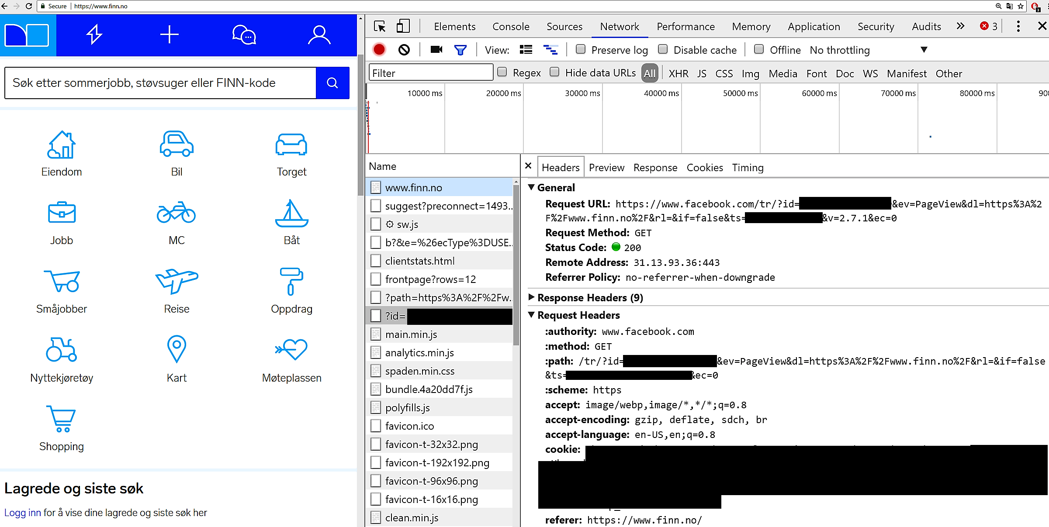
Note: this was in 2017, might have been removed/changed by now on Finn

Slide 36
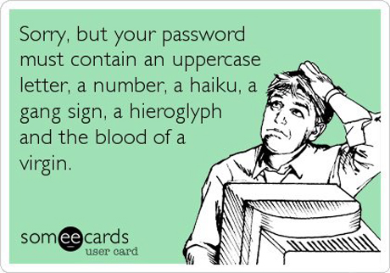
Passwords
Needed to verify identity of a user
Not too short or simple, otherwise too easy to crack with brute-force
Security vs Usability: hard to get a good balance
eg, ideally would have different passwords for each different site, and change them often, eg every week… but who the heck is going to do that???

Slide 37
Password Storage
When creating new user, need to save password somewhere, usually a database
NEVER SAVE A PASSWORD IN PLAIN TEXT
Passwords need to be hashed
Even if an hacker has full access to database, shouldn’t be able to get the passwords
Typical case is a successful SQL Injection attack
But many more cases: eg disgruntled employee, recovery from broken thrown away hard-drive, etc.
Besides being able to impersonate a user, hacker can try the same password on other sites (Amazon/Facebook/etc)
WARNING: in this course, we will not deal with hashing and proper storage of passwords

Slide 38
CSRF and CORS

Slide 39
HTTP and Cookies
When browser requests resource for “foo.com”, all cookies set by that domain are sent in the headers, session ones included
This applies to all HTTP calls
HTML <a> and <form>
AJAX requests made with XMLHttpRequest and fetch()
Do you see the problem here?
Cross-Site Request Forgery (CSRF) attack

Slide 40


Login to dnb.no
Set-cookie: dnb=123
www.dnb.no
Example of CSRF attack
Malicious AJAX POST
Cookie: dnb=123
Transfer all money to Eve
Visit malicious site, with malicious JavaScript automatically run on page load
www.evil.no

Slide 41
Cross-Origin Resource Sharing (CORS)
By default, JS downloaded from site X cannot do AJAX calls to another domain Y
browsers will allow only AJAX calls toward the same domain (ip:port) of where the JS was downloaded from
eg, JS downloaded from evil.no can only do AJAX towards evil.no
When trying to do such a HTTP call, a browser will first preflight it with an OPTIONS HTTP call
this will ask if the original HTTP call can be done to the server Y
Y will answer telling the browser whether to do or not the HTTP call
if Y said it was OK, then browser will do the original HTTP call
so, up to 2 HTTP calls

Slide 42
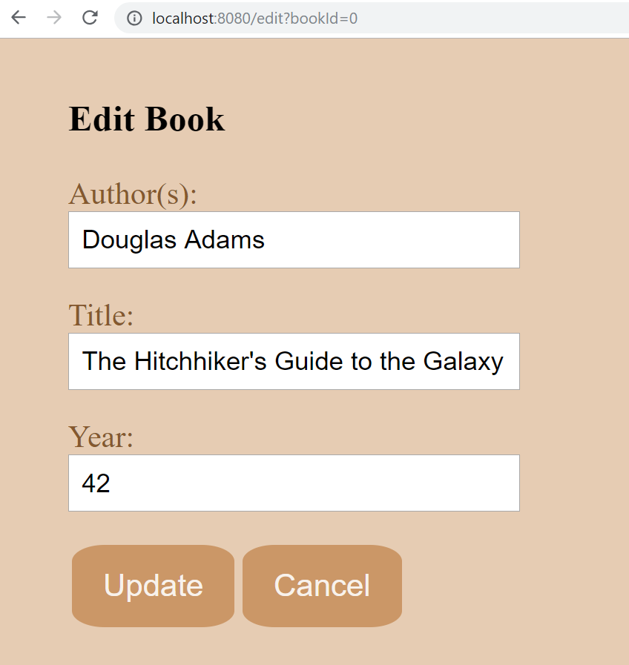
Separated Frontend and Backend
Recall example of book app, where frontend was served from localhost:8080, whereas REST API for backend was on localhost:8081
At that time we HAD to handle CORS on the backend
Eg, what happens when we want to do a PUT to modify the state of a book?

Slide 43
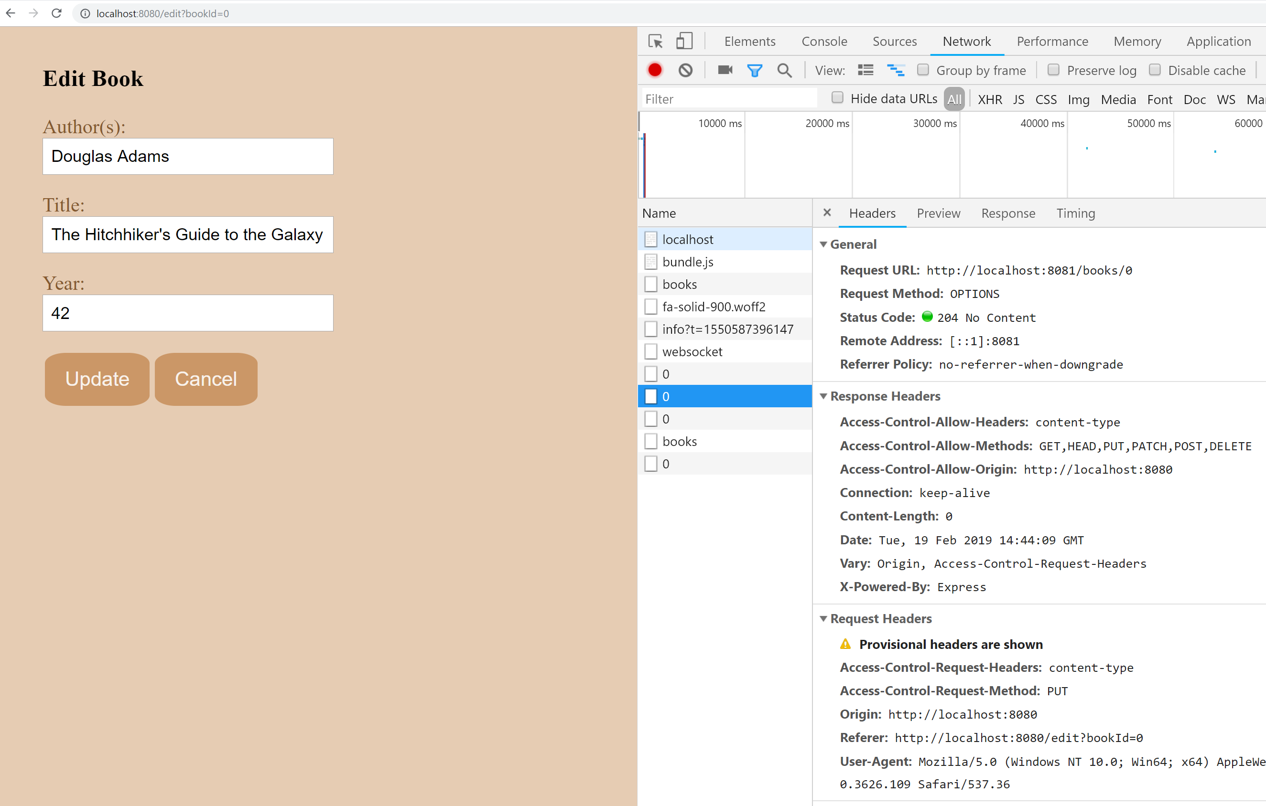
Browser first does an OPTIONS to check if allowed to do the PUT

Slide 44
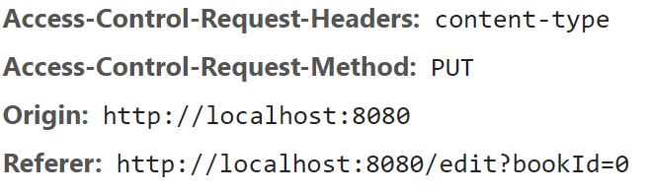
OPTIONS Request Headers
Access-Control-Request-Method: which HTTP method we want to use
eg, PUT in the previous example
Access-Control-Request-Headers: any custom header we want to use
eg, in our PUT, we want to specify that the payload is in JSON
Origin: specify from where the JS making the AJAX call was downloaded
automatically added when making OPTIONS CORS calls
server will check this field
set by browser, cannot modify it with JS
Referer: like Origin, but containing full path
used also outside of CORS, but could be blocked for privacy reasons

Slide 45
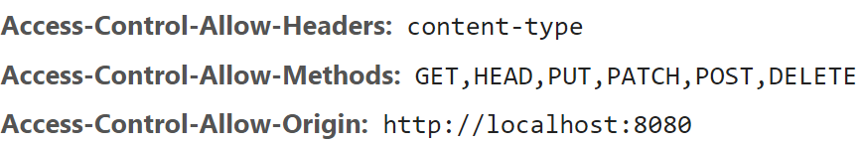
OPTIONS Response Headers
Tell the browser what is allowed on that endpoint
eg which HTTP methods can be called using Access-Control-Allow-Methods
By default, most servers will not allow cross-site requests
If needed, you have to setup the server to add such CORS allowing headers
This can be based on the Origin
eg, different origins might be allowed different rights

Slide 46
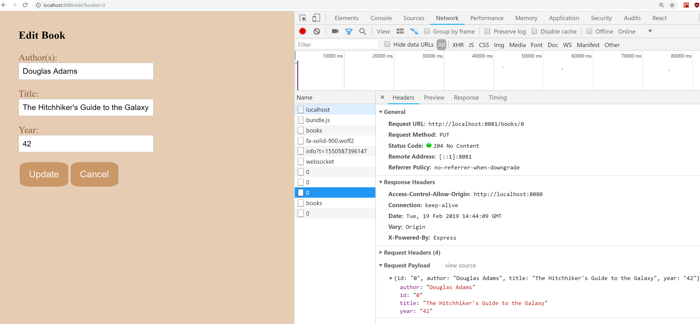
Browser will make the PUT request only if in the response of OPTIONS the server said it is OK

Slide 47
OPTIONS No-Preflight
Browser does not preflight all HTTP requests
Exceptions: GET, HEAD and POST with specific content-type
application/x-www-form-urlencoded
multipart/form-data
text/plain
Note: this is for “historical” reasons, but if not handled properly, it is a SECURITY HOLE

Slide 48
No-Preflight GET
Login to dnb.no
Set-cookie: dnb=123
www.dnb.no
Malicious AJAX GET
Cookie: dnb=123
Obtain sensitive info, like account balance
Can steal sensitive information
Visit malicious site, with malicious JavaScript automatically run on page load
www.evil.no

Slide 49
CORS and GET
Although GET requests are not preflighted with OPTIONS, they can still be secure
Server can respond with Access-Control-Allow-Origin on any request, including GET, and not just OPTIONS
If such header does not match the origin, then the browser will delete the content of the response, including for example the status code!
Ie, HTTP GET will still be made, but JS will not be able to read response

Slide 50
Even if HTTP call is successfully executed, it does not mean JS is allowed to read the response, as it depends if Origin is valid

Slide 51
GET and Side-Effects
GET requests are not preflighted with OPTIONS
If CORS not matching Origin, JS not allowed to read response
so, no information leak
But, the GET request is still made!
If side-effects on server, those will still happen regardless of CORS protection!
eg, creation/deletion of resources, like “GET /api/data?action=delete”
It is PARAMAOUNT to follow HTTP specs, and have GET requests be side-effect free!!!

Slide 52
No-Preflighted POST
This happens for following content-type:
application/x-www-form-urlencoded
multipart/form-data
text/plain
In SPAs, if you stick with JSON APIs, you will be “usually” fine
Issues when dealing with traditional Server-Sider-Rendering frameworks, as HTML <form> requests are not preflighted
ie, as typically using application/x-www-form-urlencoded
Solution: CSRF Tokens, but we will not need them in this course
also the SameSite set-cookie option can help here

Slide 53
Performance
Preflighting is not free, as doubling number of HTTP calls
Caching can be used to save some requests, but problem persists
Note: do NOT have the brilliant idea to pass JSON data with content-type text/plain… you will “speed up” performance by bypassing CORS preflight requests, but then making site completely vulnerable to CSRF!!!

Slide 54



If frontend and backend servers are separated, you must enable CORS headers on the backend responses
Still performance issues with preflighting
GET /
GET /style.css
GET /bundle.js
localhost:8080
localhost:8081
OPTIONS /api/products
POST /api/products

Slide 55
If everything coming from same Origin, then do not enable CORS headers on server, and you should have no problems with CSRF
Note: could also be different servers behind a single gateway
GET /
GET /style.css
GET /bundle.js
GET /api/products
POST /api/products
DELETE /api/products/42
localhost:8080

Slide 56
Third-Party APIs
Still have to enable CORS in those remote servers, if want to contact them directly from JS
But what if I cannot change those settings, or want to avoid preflight requests?
Third-Party Server X
My Server

Slide 57
Proxy Requests
Option: do not call a Third-Party Server X directly from JS, but via your own server
Eg, have a REST API that calls X
CORS only applies to browsers, and not to your server apps!
Third-Party Server X
POST /x/foo
POST /myserver/foo
My Server

Slide 58
Disabling CORS
People that do not understand CORS can be tempted to disable it by setting “Access-Control-Allow-Origin: *” in their servers
ie, “*” means all origins are valid
This “could” be fine for read-only services with no sensitive data
What if need to do authenticated requests with cookies?
Some browsers have “idiot-proof” mechanisms that block authenticated requests to servers responding with “Access-Control-Allow-Origin: *”
ie, it would be pointless to have an auth system if then you disable CORS protection…

Slide 59
Blog Posts and Tutorials
Security is a very complex topic
Unfortunately, many universities do not cover it, or only superficially
Result: plenty of resources online written by people with no clue of what they are talking about
eg, not only using JWT for sessions (d’oh! what about logout?), but also not storing them in HttpOnly cookies (OMG!!! ever heard of XSS???)
Recommendation: be wary of this issue, and do not trust blindly when reading of security (including these slides…)

Slide 60
Security in React and NodeJS

Slide 61
Passport
To enable auth in an Express/NodeJS application, we will use the library called Passport
We will use session-based auth with cookies
We will need to create a REST API to handle signup, login and logout operations
When HTTP requests with valid session cookie, Passport will automatically generate a “user” object identifying the logged-in user
Note: we will NOT see how to properly store passwords…

Slide 62
Auth in React
React has no concept of auth
Still, want to render components based on whether logged-in or not
eg, display a “Login” button if not logged-in, or a “Logout” otherwise
Whether we are logged in depends if the browser has a valid session cookie
But React (and JS in general) CANNOT access a HttpOnly cookie
and even if it could, would not know if server would still accept such cookie

Slide 63
State for Logged-in
Could use a variable to represent if user is logged-in
with rendering of components based on such variable
At each HTTP call in the whole app requiring auth, update such variable if needed
eg, mark as logged-out if we get any 401
React cannot show the current login/logout state, but rather the state at the last HTTP interaction
note: even if no direct logout, a cookie can still expire

Slide 64
Frontend “Security”
In frontend, choosing what to display based on login status has no impact on security… it impacts only usability
Security MUST be handled on the backend… anyone can open a TCP connection and use HTTP to send messages to your backend without using the GUI!
Each REST endpoint that needs protection has to handle auth regardless of frontend
Not logged-in?
No button with AJAX for protected resource
My Server
Logged-in?
Render button with AJAX
onClick = POST /api/protected
My Server

