Slide 1
Web Development and API Design Lesson 10: Online Multi-Player Game
Prof. Andrea Arcuri

Slide 2
Goals
See a full working example of a non-trivial, multi-player, online game based on what learned so far in class
Learn how to deploy your app on a cloud provider
Some discussions on databases…

Slide 3
Online Game

Slide 4
Multi-player Connect4
Turn-based, but need WebSockets to get informed when opponent has done his/her move
How to pair players on different machines?
How to prevent cheating?
etc.

Slide 5


REST API call to start match, same endpoint (IP:port)
Put on queue until at least 2 players
POST /api/match
POST /api/match

Slide 6
When match starts, each player creates a WebSocket toward the server
To avoid cheating, the state of the match is on server, the players only see a view of it (recall users can do whatever on his/her browser…)
Match state: board plus 2 WebSockets for the 2 players
At each state change on server, opponent gets informed via WebSocket
Actions out of sequence must be discarded (possible cheater)
WebSocket
WebSocket

Slide 7
WebSocket Security
Assume match with id X between players A and B
How does server know that incoming WebSocket request for player A on match X is actually made by player A???
At least 2 options
As first WS message is in HTTP, can use same auth
Create a unique, one-time-use random token in a secured way for A (eg authed REST endpoint), associate such token to A on server, auth the WS when such token is provided
This is a more general approach, not tied to implementation details of how the WS is established
Recall that WS is for a single user (own TCP socket), so need auth only once, and not like on every single request like in HTTP (eg using cookies)

Slide 8
WebSocket Cost
WSs are EXPENSIVE, as TCP sockets are OS resources
Need to keep open a TCP socket for each WS
In HTTP, if running out of ports, can close TCP after resolving each incoming request
Recall a TCP connection is defined by 4 coordinates: IP and port of client, and IP and port of server
So, there can be at most 2^16=65,536 TCP connections at same time on server
Ie, in HTTP keeping a TCP on after a request is only for performance reasons, eg if expecting other following requests
See also: “Connection: Keep-Alive” HTTP header

Slide 9
WebSocket Topics
There can be different types of communications between a client and server over WS
eg many different functionalities and operations
Too expensive to open a different TCP socket for each operation
Must re-use same WS for each different kind of operation
(Simple) Solution: wrap JSON data into an object defining a discriminating “topic” field, which identifies the operation
Note: there are more sophisticated message protocols like STOMP
Server will decide what to execute based on topic’s field value

Slide 10
Example
{
“topic”: “update”
“data”: {
“matchId”: 42,
“boardDto”: {…},
“isX”: true,
“opponentId”: 1234
}
{
“topic”: “…”
“data”: {…}
}

Slide 11
Cloud Deployment

Slide 12
Cloud Deployment
Different companies provide cloud hosting solutions for your applications, which frees you from hardware issues, but for a price
Amazon Web Services‎ (AWS) is perhaps the most famous/used one
eg, Netflix runs on AWS
Automated scaling: if you need more load, automatically rent more nodes, and automatically scale down if less load
this is also good for applications targeting a specific country (eg Norway), in which you will not get much load during the night

Slide 13

Definition of “Cloud”

Slide 14
Heroku
One of the main cloud providers
At the time of this writing, it provides easy to use free hosting
note, this might change at any time
Supporting NodeJS applications
and many others

Slide 15
Using Heroku
First you need to create an account at www.heroku.com
Most instructions on Heroku shows how to deploy with Git, but I do not like it… we will use a CLI
however, you can use whatever you like…
Install Heroku CLI, which allows you to interact with Heroku from command line
On the web interface, create an “app” with a name of your choice. In these slides, I will use “pg6300-c4”
as names are unique, you will need to choose a different name

Slide 16
From Command Line (CLI)
heroku plugins:install heroku-builds
need to be run only once, to install the “builds” plugin
heroku login
will setup credential for the other commands.
note: if using Windows, this might not work on GitBash, and need to do this command once from a regular Terminal
heroku builds:create -a pg6300-c4
zip all your files in current folder, and deploy them in the app
note: use “.gitignore” to specify what to exclude

Slide 17
Settings
Can have extra settings in “engines” under package.json, but not compulsory
eg., version of Node and YARN to use to run/build your app
Your app MUST bind to a port specified by process.env.PORT
otherwise, Heroku will not know how to reverse-proxy to it
Your app will be automatically built by Heroku with “yarn build”, and started with “yarn start”

Slide 18
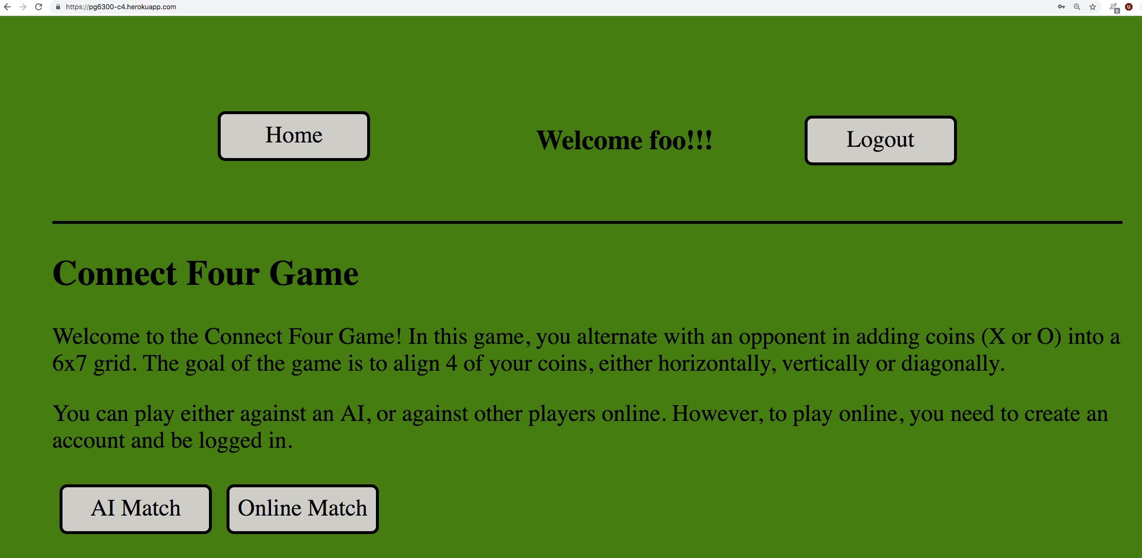
https://pg6300-c4.herokuapp.com/

Slide 19
Cloud and WebSockets
WebSockets are expensive resources
Free-tier cloud options might allow only small number of WS
Might shut them down automatically if inactive for even short period, e.g. 30-60 seconds
could implement some auto-reconnect when sockets are forcibly closed…

Slide 20
Databases

Slide 21
Why Databases?
Need to store your data somewhere
If in memory, lose everything as soon as the app restarts
For a full app, you need a database
cloud providers like Heroku give you databases as well
We are not going to see databases in this course, but need to briefly discuss them

Slide 22
The 3 Rules of Choosing a Database
New project or unsure what to do? Choose Postgres
If you are already using MySQL and migration to Postgres would be too expensive, can stick with MySQL
If you have a long experience with databases, know exactly what you are doing, and can measure objectively the performance benefits of different tradeoffs compared to just using Postgres, then, and only then, choose best database for the specific problem you are facing

Slide 23
Example: MySQL
Open source, but own (and mainly developed) by Oracle… and let’s not forget that one of its main commercial products is Oracle Database…
so, yes, in theory those 2 databases are competitors…
For most use cases, MySQL is on par with Postgres, but usually slower at adding new advanced features
eg support for NoSQL features like JSON data type, or SQL compliance

Slide 24
Example: MongoDB
Most famous NoSQL database
very, very popular in tutorials… especially in NodeJS
Meant for documents, not for data with relations
Usually documents are in JSON format, where the only relations are hierarchical, eg nested objects
Can be fast and easy to set up…
… but you need to sacrifice ACID for it…
eg, when you “save” some data, can be just cached, and not actually saved…
ACID transactions added in v4.0, in 2018…
Postgres/MySQL can save JSON fields, and be very fast at it
eg, in 2014, Postgres was actually faster than MongoDB in benchmarks at dealing with JSON

Slide 25
MongoDB Cont.
Might start with JSON documents… but then one day you need to add relations between data: you are screwed
“screwed” meaning ending up implementing JOINs at application level, which is a nightmare and very inefficient… and/or duplicate data, which need to be kept always in sync…
Or even worse, choosing MongoDB even when you deal with relational data, just because of hype…
…or when you do not really deal with the amount of data of Google/Amazon/etc…

Slide 26

But… MongoDB is “Web Scale”!
https://www.youtube.com/watch?v=b2F-DItXtZs
http://www.sarahmei.com/blog/2013/11/11/why-you-should-never-use-mongodb/
echo "MongoDB is Web Scale!" > /dev/null
Note: video is from 2010. At that time MongoDB was total “rubbish”. Today is better
eg ACID transactions added in 2018

