Slide 1
Web Development and API Design Lesson 06: Async Calls to Web Services
Prof. Andrea Arcuri

Slide 2
Goals
Understand how a SPA can communicate with a backend using AJAX, retrieving data in JSON format
Introduction to the “event-loop” model in JS, and how async/await can be used to simplify the code dealing with asynchronous behavior
e.g., calls to a remote web service, like REST and GraphQL

Slide 3
Browser-Server Communications
Usually based on HTTP over TCP
Address bar in browser: download that resource, e.g., typically starting from index.html
Then download all other resources used in that HTML file
eg, CSS, images and JS files
User interactions with server: clicking on <a> links and submitting <form>
after such actions, usually would get a new HTML page back from server

Slide 4
AJAX (Asynchronous JavaScript and XML)
Ability for JS code to start HTTP communications to server
XML in the name is just for historical reasons… nowadays the main data format is JSON (JavaScript Object Notation)
A SPA can use AJAX to retrieve the data it needs (in JSON), without getting whole new HTML pages
Once getting JSON data, update HTML in the browser (eg with React)

Slide 5
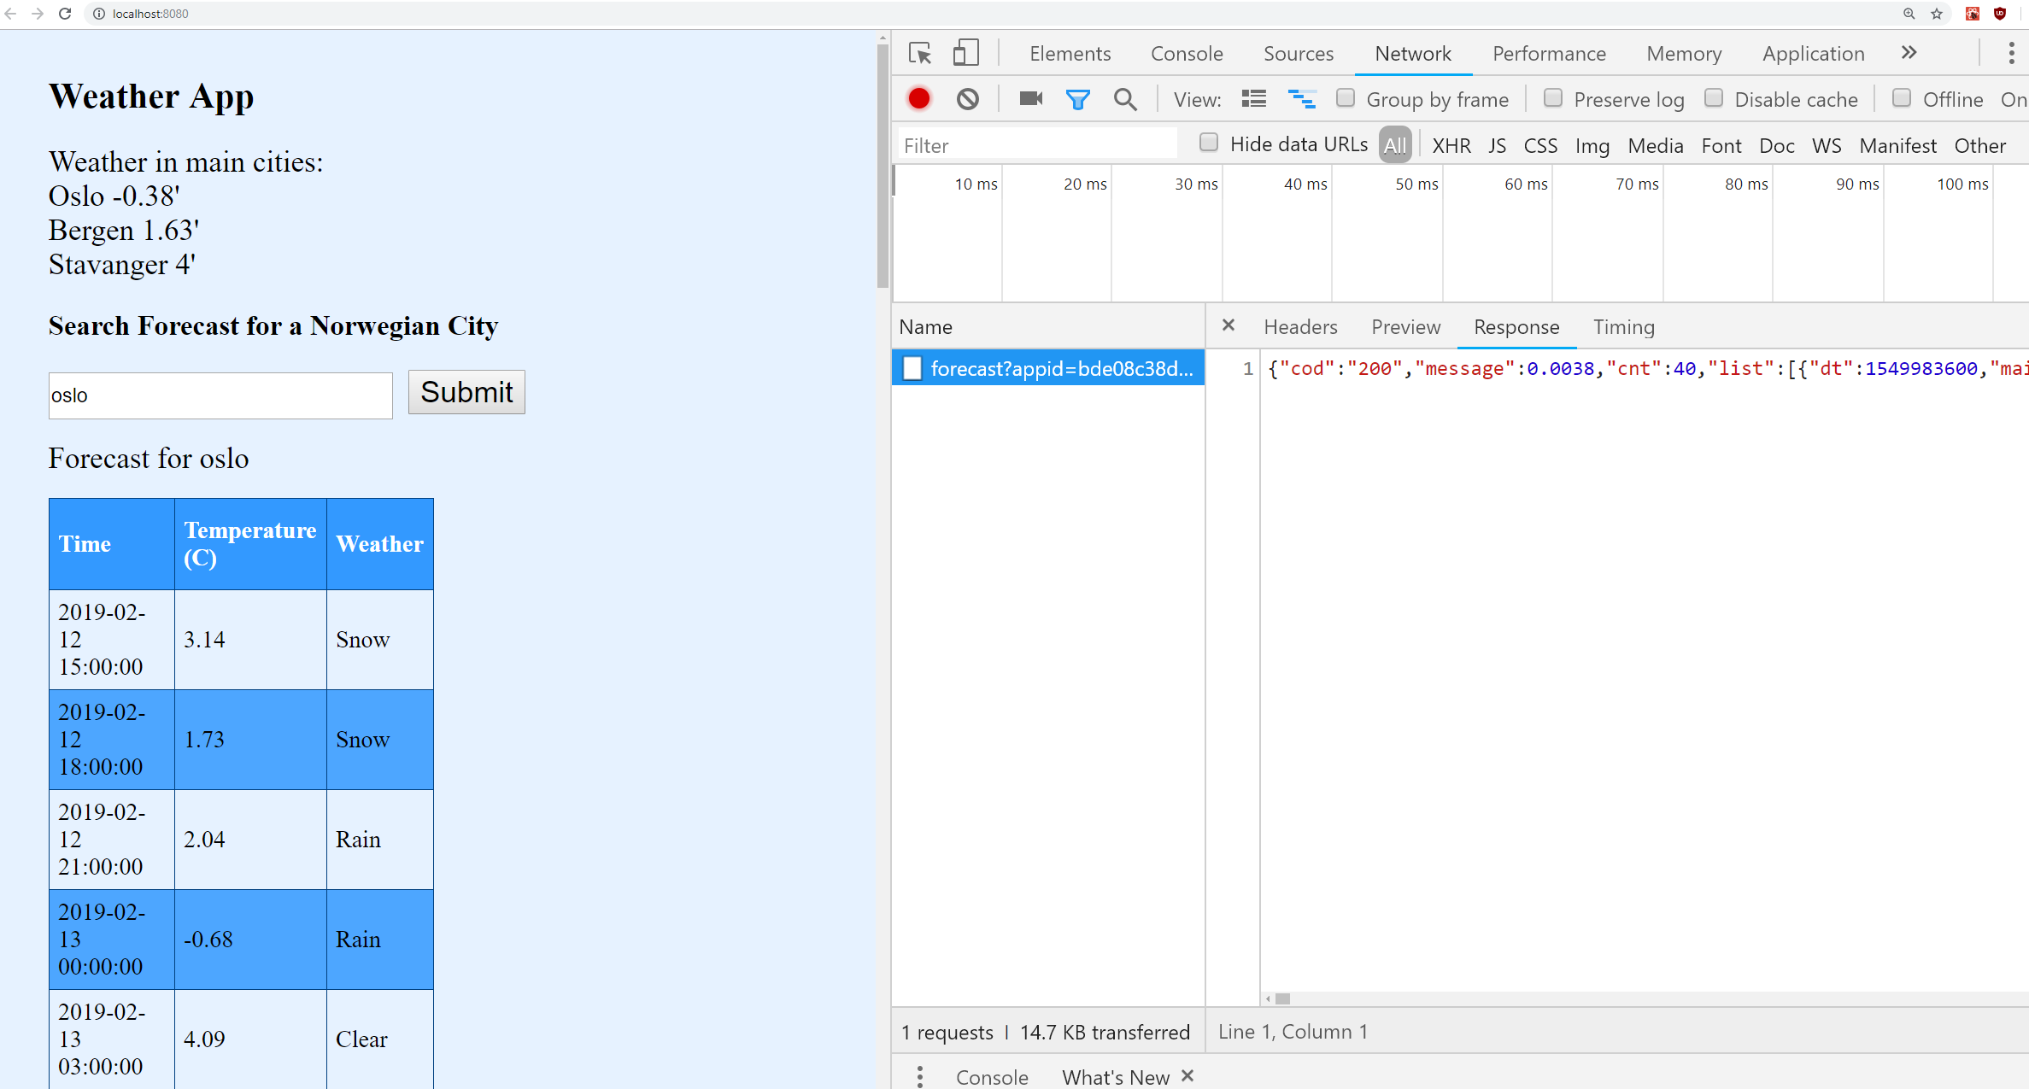
Example: just fetch data of forecast in JSON, and not a whole HTML page displaying it

Slide 6
Using AJAX
For JS in the browser, there are 2 main ways to do HTTP calls
XMLHttpRequest: old approach using Callbacks
same as AJAX, the XML in the name is only for historical reasons… you can use it to send/receive any kind of data besides XML, eg JSON
fetch(): more modern approach using Promises

Slide 7
Third-Party Service Rate Limits
Commercial web services might provide some free options to test them out
Usually need to create an account
At each HTTP call, need to provide a key to verify it is indeed you that made the request
If you make too many requests, can be blocked, and asked to buy a commercial license

Slide 8
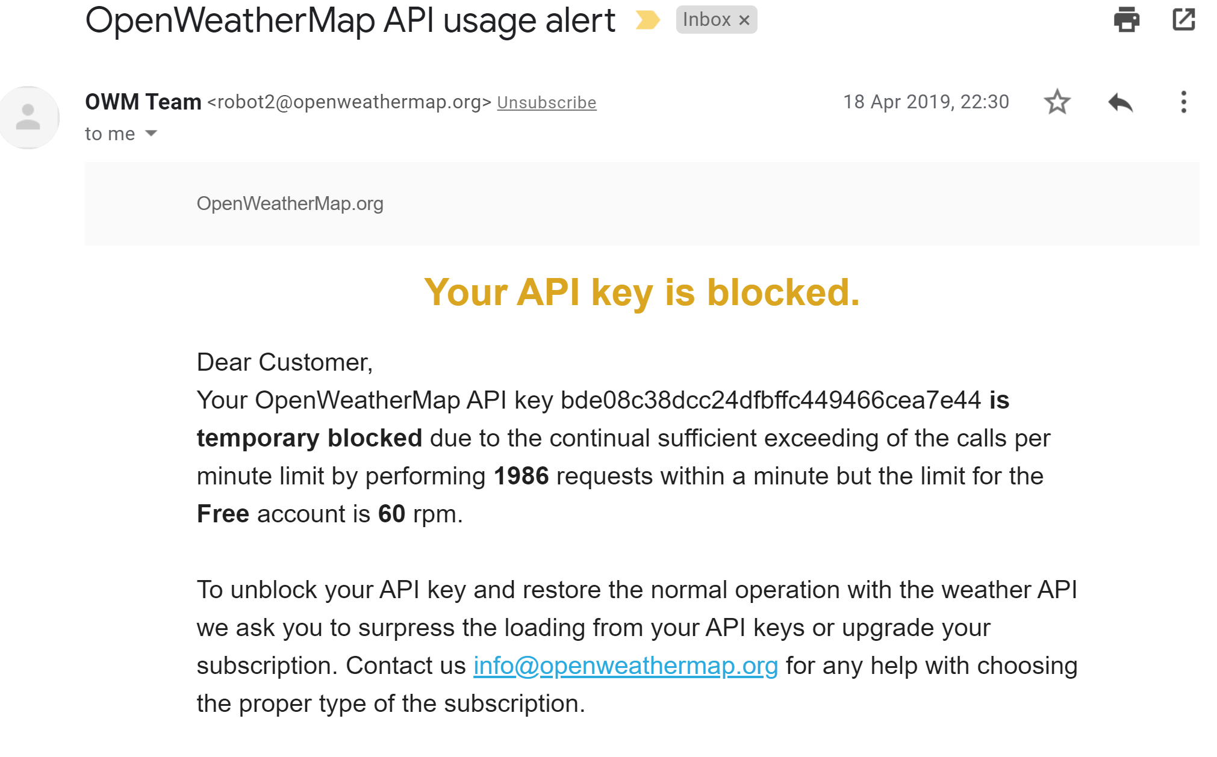

Slide 9
Issues with AJAX
You make an HTTP call over TCP with AJAX
Such call could take few milliseconds, or seconds, BEFORE you get a reply from the server
Even if just 1 ms, might need to do many HTTP calls to render current page (eg fetch data from different servers)
You do NOT want your app to freeze and be unresponsive till server replies
This is a problem due to how threading is handled in JS

Slide 10
JS Event-Loop Thread
Following is a very high-level, simplified story of how the event-loop works in JS
eg, not going to discuss things like Service Workers or the Job Queue
For what concerns you, your JS code is going to be executed on a single thread
Your functions will run to completion
These are the functions executed when intercepting events like onClick and onMouseOver

Slide 11
Run To Completion
Assume a user clicks on 2 buttons (A and B), executing x() and then y(), which are registered as onClick handlers
As long as x() is running, y() cannot start, as there is only 1 thread executing your code for the event handlers
x() is executing
y() is executing
time
Click on A
onClick=x()
Click on B
onClick=y()

Slide 12
Run To Completion Problems
while(true){}
Code above could completely freeze your app, as no other code could run, as that is an infinite loop and will never end
note, you can end up in infinite loops due to bugs…
Expensive CPU computations in JS can slow down the responsiveness of your app, making it feeling sluggish

Slide 13
AJAX and Run to Completion
AJAX: (1) execute a HTTP Request; (2) do something when you get the HTTP Response
Might take many ms before getting back the response
Cannot wait on event-loop thread for the response, otherwise the app would freeze in that period of time
i.e., no other code could be executed meanwhile
2 solutions: Callbacks and async/await on Promises

Slide 14
Callback
AJAX call in function x() will register a callback function y() which will be executed on the event-loop thread when getting results from server
The HTTP call will be made by an I/O thread, which will schedule y()
event-loop thread
x() starts HTTP call
and register y()
free time for other functions
y() is executed with HTTP result
Execute HTTP call and wait for result
time
I/O thread

Slide 15
const ajax = new XMLHttpRequest(); //register the "callback" to handle the server's response ajax.onreadystatechange = () => { const payload = JSON.parse(ajax.response); //do something with response }; ajax.open("GET", url); ajax.send();
Here, the onreadystatechange is the callback that is going to be executed once we get back the result
Note: such callback has to be registered BEFORE we send() the HTTP request, but will be executed AFTER

Slide 16
Callback Issues
Callbacks are fine when you make a single request
When you have many asynchronous communications, each one depending on the others, it can get very difficult to see what is going on and the order in which functions are executed
Often called Callback Hell

Slide 17
Promise
A Promise is a JavaScript object
“The Promise object represents the eventual completion (or failure) of an asynchronous operation, and its resulting value”
https://developer.mozilla.org/en-US/docs/Web/JavaScript/Reference/Global_Objects/Promise
A Promise will eventually return the value of the asynchronous computation, and we can await until such value is available
The fetch() method making an AJAX request does return a Promise

Slide 18
async doHttpFetch(url) { response = await fetch(url); payload = response.json();
//do something with response
Here there is no callback… we execute operation (fetch) and await for the results
Then we continue with the rest of the function
But what about “Run to Completion” in JS???
note: the function is declared as async

Slide 19
async/await
async functions are split in execution blocks, around the await commands
note, there can be many awaits inside the same async function
The event-loop thread will execute the functions blocks, and not the whole function
When I/O thread will get the HTTP response, it will schedule the execution of the second block after the await
The event-loop thread is NOT waiting during an await
event-loop thread
x() executed up to await
free time for other functions
continue x() with HTTP result
Execute HTTP call and wait for result
time
I/O thread

Slide 20
Benefits of async/await
It makes code much easier to read, as now the flow of execution looks sequential
this is particularly true when you have many asynchronous operations in the same function
No major performance drawback: the event-loop thread is not waiting, and can execute other commands meanwhile we wait for I/O
Recall that thread waiting and thread-context switches are expensive, because OS operations

Slide 21
Non-Blocking I/O
This model of a single event-loop thread running your code in blocks is often referred as Non-Blocking I/O
Such model was popularized by NodeJS
however, most other languages can do the same, e.g., Java, Kotlin and C#
Very good for CRUD web applications:
most operations are CPU cheap, where bottlenecks are in I/O on database
can serve many different users without thread-context switches
However, it is bad for CPU-bound applications
as you only have a single execution thread…
you could though replicate your app in many running instances, behind a load-balanced gateway (but this is not something we will see in this course…)

Slide 22
Creating a Promise
For this course, we deal with Promises mainly when we await on fetch() calls
But we can create our own Promises
we will need to do it for testing purposes
A Promise requires as input a function, which itself takes as input two functions:
resolve(someValue): we will call it when we want to state the Promise is resolved, ie successfully finished. The value we will be what returned to who is awaiting on such Promise
reject(): specify that the Promise has failed
note: if “your code” in the example below is “resolve(5)”, then the Promise would resolve immediately, giving the value 5 as output
new Promise( (resolve, reject) => {/* your code */});

