Slide 1
Web Development and API Design Lesson 01: Introduction
Prof. Andrea Arcuri

Slide 2
Goals/Topics
Develop Web Applications, with focus on Frontend
Technical details of JavaScript, but NOT web design
Single-Page Applications (SPA)
client-side HTML rendering, using React from Facebook
Intro to REST and GraphQL web services
JS on the server, using NodeJS
Websockets
Security

Slide 3






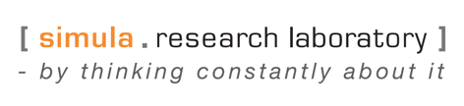



About Me
Prof. Andrea Arcuri

Slide 4
Course Info
12 lessons, once a week
Check TimeEdit for possible changes of time and rooms
During the course, do NOT send me private messages, but rather use the discussion forum of the course
If you send me a private email/message, I will tell you to post it on the discussion forum. However, if I am busy (as most of the time…), I might just ignore your message…

Slide 5
Class Structure
“Usually” 2+2
2 hours of lecture: code (and very few slides…)
2 hours in which you should do exercises and get help
IMPORTANT: the 2 hours after lecture is not only for exercises. If you are falling behind, or you need some more revision, you can ask for my help on anything related to coding

Slide 6
If You Skip Class…
Usually acceptable that a student skips 1-2 classes
You are supposed to attend, although no strict checks
If you skip too many classes, it is YOUR responsibility to catch up and find out what done in class

Slide 7
Necessary Tools
YARN
NodeJS
Git
An IDE
I recommend WebStorm
but Visual Studio Code is fine as well
A Bash command-line terminal
Mac/Linux: use the built-in one
Windows: I recommend GitBash

Slide 8
Git Repository
https://github.com/arcuri82/web_development_and_api_design
Note: pull often, as new material will be added during the course
No book, but plenty of external links to study from

Slide 9
Exam
100% home-assignment exam
48 hours

Slide 10
JavaScript

Slide 11
JavaScript
JavaScript (JS) has nothing to do with Java
Programming language executed in the browser
but now also on the server with NodeJS
JS code referenced by webpages like any other resource (eg images and CSS files), or can be embedded directly in HTML
JS can manipulate the DOM (Document Object Model) to alter the webpages structure/content based on user’s interactions (eg mouse clicks)

Slide 12
JavaScript is King on the Browser
If web page needs to execute code on browser, you use JS
But historically there were other options in the (not so long ago) past:
Java with Java Applets (practically dead)
Flash (still found in some old web pages)
Silverligth
Etc.
Those were not natively supported by browser, and you had to install plugins to run them

Slide 13
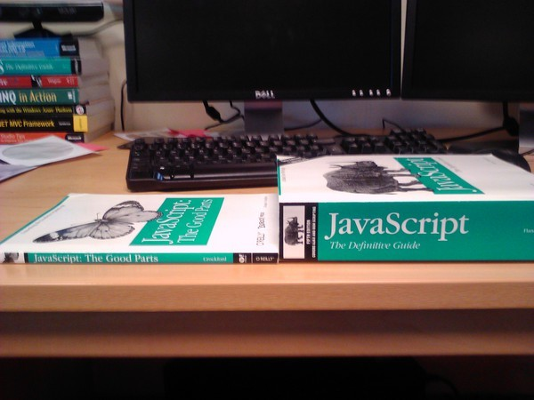
But JavaScript is a badly designed language…
When the most famous book is called “The Good Parts”, that tells you something…
However, there are other languages that do transpile to JS, like TypeScript and Kotlin
… and WebAssembly might (hopefully) replace JS one day…

Slide 14
Videos
https://www.destroyallsoftware.com/talks/wat
https://www.youtube.com/watch?v=EtoMN_xi-AM

Slide 15
Main Characteristics
Interpreted: you do not need to compile it (eg, in contrast to Java which is compiled down to bytecode)
Note: for performance reasons, the runtime (eg a browser like Chrome) will compile JS on the fly into machine code
Dynamically Typed: when declaring variables, no need to specify the type, eg String or Numeric, and can reassign to different types
Weakly Typed: you can use operators like “+” and “-” on different types (eg arrays and strings) without throwing errors

Slide 16
Interpreted
Can just provide source code directly to the browser
Can be directly inside HTML, or in separated “.js” files imported like any other resource (CSS, images, etc.)
Note: current practice is to use transpilation steps
eg, using build tools like NPM/YARN
bundle dependencies like libraries (React/Angular/Vue/etc.)
transformations to support old browsers
enabling typing with TypeScript
etc.

Slide 17
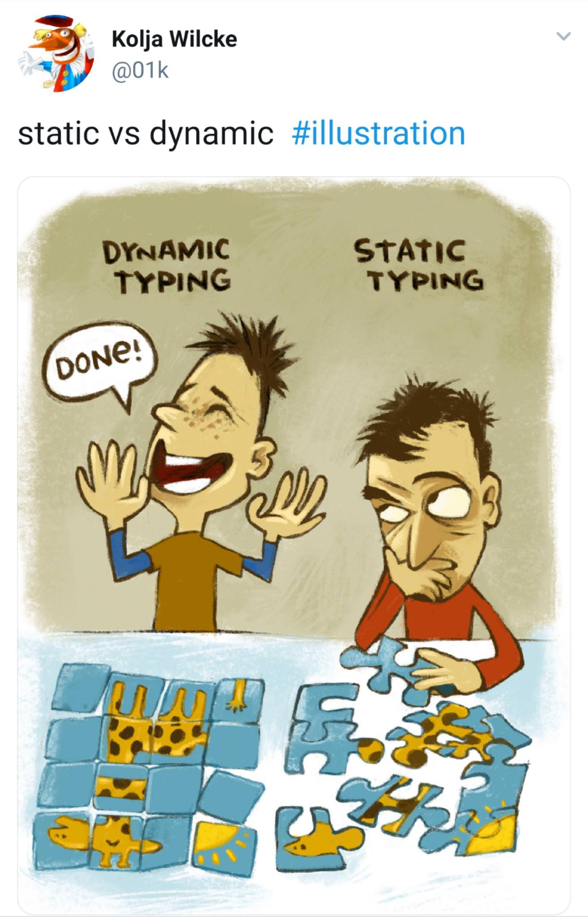
Dynamically Typed
var x = 1;
declare a variable called x with a numeric value equal to 1
note we did not need to specify the “numeric” type
var x = 1; var x = “a”;
x contains a string in the end. So, we changed the type from numeric to string
x = 1
the “var” and “;” could be omitted, but you should NOT omit them
“var”: makes a local variable, otherwise is global scope (which is bad)
omitting “;” can lead to subtle bugs…

Slide 18
let/const vs. var
If you declare a variable like x = 1, that will have global scope: you must avoid it
var x = 1, does declare it a function scope: variable in a block would still be visible after the block inside the same function
let x = 1, the sane way, ie block scope
const x = 1, block scope like let, but cannot change value (similar to final in Java)
In other words, use let/const

Slide 19
Weakly Typed
A string plus a number? Concatenation
“a” + 1 becomes “a1”
A string minus a number? Result is not a number…
“a” – 1 becomes NaN
An empty object plus an empty array? Numeric 0…
{} + [] becomes 0
Other dynamically typed languages (eg, Python) would throw an exception at runtime
They are called Strongly Typed
Statically typed languages (eg, Java) would not even compile
with the only exception of “+” on String objects

Slide 20
Quiz: what is the result of this expression?
('b'+'a'+ + 'a' + 'a').toLowerCase()

Slide 21

banana
“obviously”…
‘b’+ ‘a’ = ‘ba’
concatenation of strings… that’s OK
‘a’ + + ‘a’ is equivalent to ‘a’ + (+ ‘a’)
(+ ‘a’) does try to convert the content of the string as positive number… but ‘a’ is not a number, so get a NaN result
‘a’ + + ‘a’ = ‘a’ + (+ ‘a’) = ‘a’ + NaN = ‘aNaN’
'b'+'a'+ + 'a' + 'a' = ‘baNaNa’
the .toLowerCase() just changes the ‘N’ into ‘n’

Slide 22
Quiz: what is the result of this expression?
+(!![]+!![]+!![]+!![]+[]+(!![]+!![]))

Slide 23
42
Obviously…
[]: empty array
![]: negation of an array, which obviously returns false
!![]: equivalent to !false, which results in true
this actually makes sense…
!![]+!![]: equivalent to true+true, which JS converts to numbers, and sees 1+1
!![]+!![]+!![]+!![]: equivalent to 1+1+1+1, which is 4

Slide 24
Cont.
!![]+!![]+!![]+!![]+[]: equivalent to 4+[], which JS sees as a concatenation of strings, where [] is obviously coerced into the empty string, so result is “4”+ “”, which is just “4”
!![]+!![]+!![]+!![]+[]+(!![]+!![]): equivalent to “4”+2, which, as a concatenation of strings and not numbers, results into “42”
ie, 2 is coerced into a string like “2”, and NOT “4” into a number like 4
+(!![]+!![]+!![]+!![]+[]+(!![]+!![])): equivalent to +(“42”), which considers the string as a positive number, and so coerced into 42

Slide 25

+(!![]+!![]+!![]+!![]+[]+(!![]+!![])) yes… obviously 42…

Slide 26


Anyway… why 42?
You will see 42 all the time…
Geeky reference to the “The Hitchhiker's Guide to the Galaxy”
It is the “Answer to the Ultimate Question of Life, the Universe, and Everything”

Slide 27
Quiz: what happens when you sort an array of integers like the following?
[3,18,1,2].sort()

Slide 28
[1, 18, 2, 3]
“Obviously” 18 is smaller than 2 and 3, isn’t it?
What the heck is happening here?
JS has no concept of typed array… you could add all different kinds of types in same array
So, no default way to define ordering on a JS array
JS, by default, converts all values into STRINGs, and does comparisons based on string ordering
The string “18” is smaller than string “2”, as starting with a 1

Slide 29

Do Not Do Drugs…
Otherwise, one day you might end up designing languages like JavaScript…

Slide 30
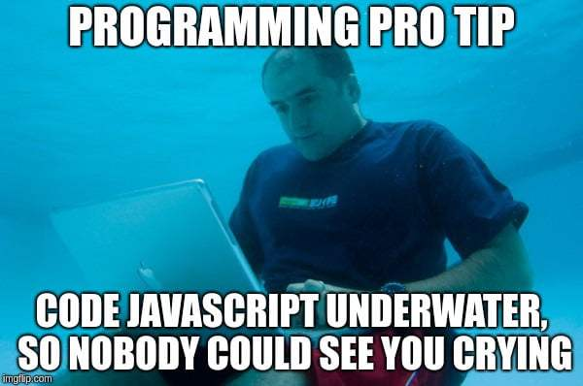

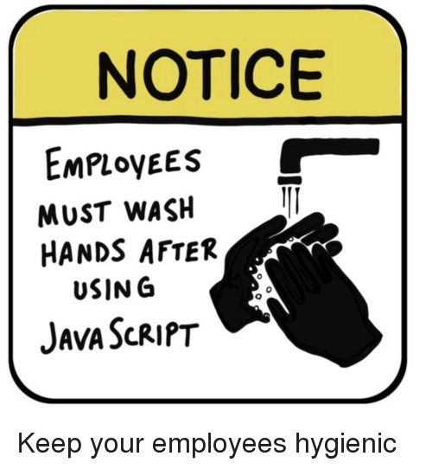
By now… you should have guessed what is my opinion of JavaScript
But JS is a must to learn if you are dealing with web development…
… even if you just want to focus on backend
Until WebAssembly will support DOM manipulation, or Kotlin transpilation will have better support, unfortunately we need to endure JS
TypeScript can ease the pain meanwhile…

Slide 31
Jokes apart…
The pain of JS (and other dynamically typed languages) is when working on large projects…
… where you might need to do refactoring
good luck, you poor souls…
… and/or have to work on code written by others…
For what you will see in this course, and during your degree, you will be (hopefully) fine, as working only on small systems
You need to get experience in building a project with a dynamically typed language (and so TypeScript will not be allowed in the exam)
Remember: what does not kill you, makes you stronger

Slide 32
For equality, use “===“ and not “==”
false == 0
result is true, ie, boolean false is equivalent to numeric 0, as the 0 gets transformed into a boolean to compare it with false
false === 0
result is false, as a boolean value is not equal to a numeric value
0 == []
surprisingly, that is true in JS, ie the numeric 0 is equal to an empty array
plenty of these hilarious cases, see https://dorey.github.io/JavaScript-Equality-Table/
For negation, use !== instead of !=

Slide 33
Booleans
6 values evaluate to “false” when used as boolean, all others evaluate to “true”
false
0
“” (empty string)
null
undefined
NaN
Ex. if(“foo”) and if(42) would execute the then branch, but not if(“”) nor if(0)

Slide 34
Function Declaration
function foo(){ return 1;}
calling foo() will return value 1
add = function(x,y){return x+y;}
calling add(1,2) will return 3
calling add(“a”, “b”) will return “ab”
add = (x,y) => {return x+y;}
the arrow notation is similar to function, but it treats this keyword differently, as not defining its own scope
this will become more clear when we will define callbacks inside React objects

Slide 35
Functions as variables
function foo(x,y){return x+y;}
declare a function called foo
x = foo(1,2)
call the function, and store its result 3 in the variable x
x = foo; x(1,2)
store the code of the function foo in a variable x, and then call it by using () on such variable with inputs 1 and 2
x = () => foo(1,2); x()
create a new function with no inputs and that just calls foo(1,2), and store it in a variable x. Then call such function by using () on it
addOne = y => foo(y,1); addOne(5)
create a new function that takes an input y, and return it with a +1. So, addOne(5) does return the value 6 here

Slide 36
Code Comments
To document software, typical case of writing comments directly in the source code
JS uses similar syntax to other languages (eg Java)
Single-line comment: //
Multi-line comment: started with /* and then closed with */

Slide 37
Map and Filter
Throughout the course, we will often use .map() and .filter() operations on arrays/lists
They return a new copy the array
Filter: a subset of the array, according to a predicate
Map: each element is transformed into a new element, according to the provided mapping function

Slide 38
Filter Example
[-2, 1, 4, -7].filter( e => e > 0)
this returns
[1, 4]
Each element e in the array is given as input to the arrow function e => e>0
Such function must return either true or false
The element will be part of the output array only if the predicate was true

Slide 39
Map Example
["foo", "hello", "hi"].map( e => e.length)
this returns
[3, 5, 2]
Each element e is transformed into something else, possibly changing the type (eg from string to number)

Slide 40
Optional Index
["foo", "hello", "hi"].map( (e,i) => "" + i +"_" +e.length)
this returns
["0_3", "1_5", "2_2"]
e is the element value, whereas i is the index in the array
Note: you can use different variable names instead of (e,i)

Slide 41
Index can be ignored
const len = s => s.length
["foo", "hello", "hi"].map(len)
this returns
[3, 5, 2]
The function len here accepts only 1 input (called s), and so index is ignored

Slide 42
Quiz: what is the result of this expression?
["10", "10","10"].map(parseInt)
where parseInt("42") gives 42, ie from string to number

Slide 43
[10, NaN, 2]
obviously…
parseInt takes 2 inputs: a string and a radix
as map provides 2 inputs (e,i), the index i is going to be used as radix
parseInt(“10”, 0) === 10
parseInt(“10”, 1) === NaN
parseInt(“10”, 2) === 2 (ie, “10” is read like it was in binary)
Better to write: ["10", "10","10"].map(e => parseInt(e, 10))

Slide 44
DOM Manipulation
Document Object Model (DOM): object representation of the displayed HTML
One of the main reasons to use JS is to manipulate the DOM, ie altering what is displayed to the user
To access the DOM, JS can refer to the object called “document”
Call methods on document to retrieve object representations of the DOM

Slide 45
clearText = function(){ const textArea = document.getElementById("textId"); const resultArea = document.getElementById("resultId"); textArea.value = ''; resultArea.value = ''; };
Easiest way to retrieve DOM objects is by id
The id needs to be set as HTML attribute, e.g. <textarea id="textId"></textarea>

Slide 46
JS Interactions
There are different ways to execute JS in a page
One simple approach is to directly register event handlers on the HTML tags
<div onclick="clearText()" >Clear</div>
when user on browser clicks on that button, the JS function “clearText()” is going to be executed
Event handlers:
onclick, onchange, onmouseover, onmouseout, onkeydown, etc.
see for example https://www.w3schools.com/js/js_events.asp

Slide 47
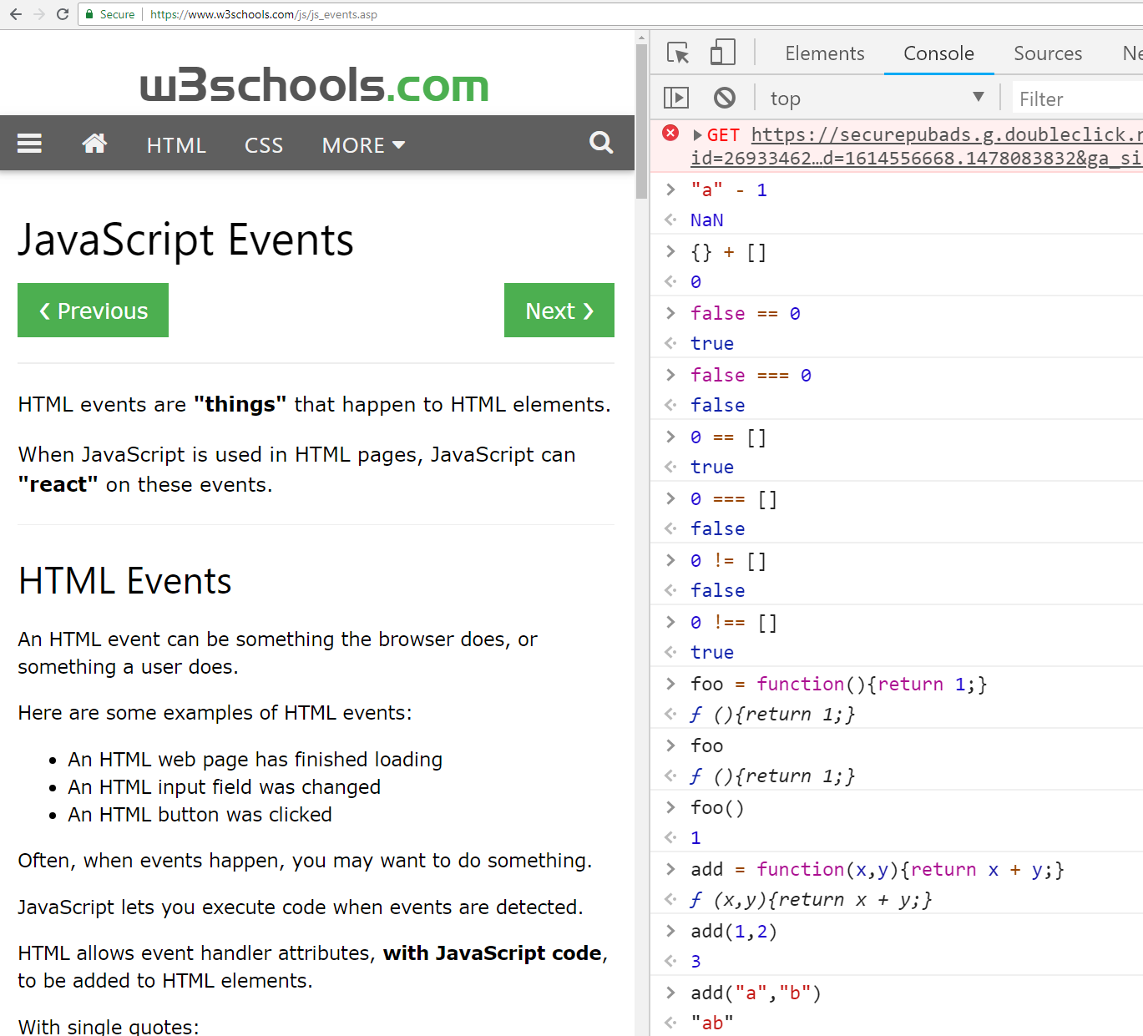
JS Console, from Chrome Developer Tools
Useful for debugging and learning by running custom JS directly on page

