Slide 1
Web Development and API Design Lesson 11: GraphQL APIs
Prof. Andrea Arcuri

Slide 2
Goals
Understand how to use and develop GraphQL web services
Understand the differences between REST and GraphQL

Slide 3
Graph Query Language (GraphQL)
Made by Facebook
in 2012, but publically released in 2015
Actual protocol used to define how an API can be queried with a specific query language
A GraphQL Web Service will typically run on HTTP, where the GraphQL queries are sent as part of the HTTP messages
GraphQL can be used outside of HTTP

Slide 4
API Data as a Directed Graph
Eg, forum posts with comments, and author info
On backend, could be saved in a SQL database
News:
- author
- text
- comments
- id
User:
- name
- surname
- id
COMMENT:
- author
- news
- text
- id

Slide 5
GraphQL Queries
Start from a method that returns elements of one of the nodes in the data graph
Exactly specify which fields in the node to retrieve
eg just surname and no name in Author
Can follow links on the graph to retrieve other connected data
On such links, still need to specify the fields to retrieve
From links can follow other links
being a graph and not a tree, same data could be accessed several times

Slide 6
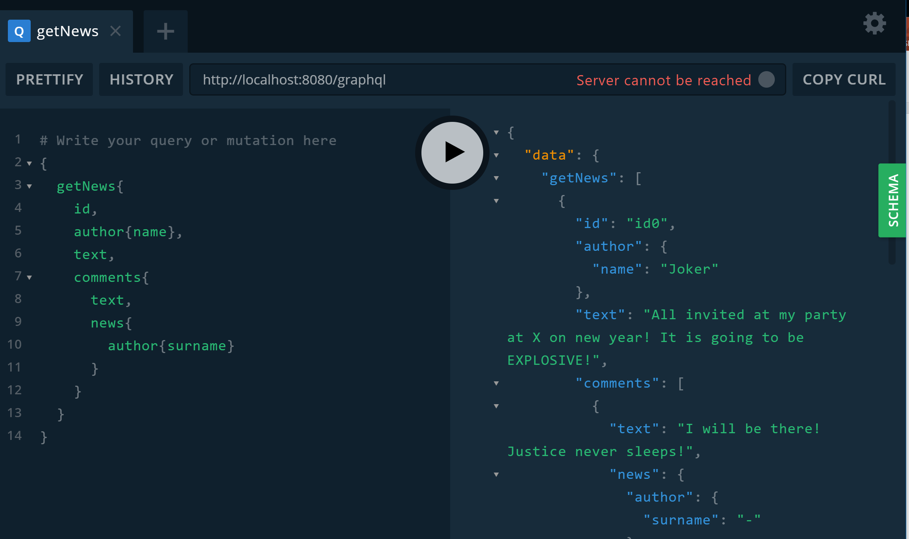
Can use tools to visualize and debug queries

Slide 7
Structure of a Query
{
getNews{
id,
author{name},
text,
comments{
text,
news{ author{surname}}
}
}
}
Need an entry point
eg, getNews
Specify which fields to retrieve from that type
e.g., id, author, text, comments
When field is a reference to another type in the graph, need to specify its fields
eg, name for author

Slide 8
Cont.
comments here does retrieve a list of comments
Note the use of author: the same instances are accessed twice, but retrieving different fields
ie, name and surname
news.author === news.comments[i].news.author
Working on a graph, a query could be arbitrarily deep when following links between nodes
{
getNews{
id,
author{name},
text,
comments{
text,
news{ author{surname}}
}
}
}

Slide 9
Response
What we get back is a JSON object
Payload is under a “data” field
Payload will have same shape of the query
In case of errors, we have “data” being null and a “errors” field with info on the error(s)
{
"data": {
"getNews": [
{
"id": "id0",
"author": {
"name": "Joker"
},
"text": "All invited at my party at X on new year! It is going to be EXPLOSIVE!",
"comments": [
{
"text": "I will be there! Justice never sleeps!",
"news": {
"author": {
"surname": "-"
}
// other posts…

Slide 10
Change Operators
To modify data, GraphQL defines “mutation” operators
These are Remote Procedure Calls (RPC)
In other words, a GraphQL server can define a set of methods that can be invoked remotely
Input/output data should be basic types
Benefits: high flexibility, can do whatever you want
Downsides: high flexibility, each API will behave differently

Slide 11
GraphQL Over HTTP
Either via a POST or a GET
Eg, POST localhost/graphql
JSON payload: { "query" : "{all{id}}" }
Here, the actual query is a string stored in the variable called “query”
Eg, GET localhost/graphql?query=%7Ball%7Bname%7D%7D
Here the query is passed as a URL query parameter called “query”, and not in a JSON object
Note that symbols { and } need to be escaped with %7B and %7D

Slide 12
HTTP Idempotency
Need to remember that GET is idempotent, whereas POST is not
So, a “mutation” operation that changes the server state must not be sent via a GET
GraphQL HTTP Services will likely throw an exception in those cases
So, “mutations” must go via a POST, whereas read operations could go either way, POST or GET

Slide 13
GraphQL Benefits
Why did Facebook need to create a yet another type of web service instead of just using REST???
Client has full control on what retrieved
Do not retrieve fields that are not needed
Can retrieve all needed data in a SINGLE HTTP call
Very important for mobiles, to reduce bandwidth and energy consumption
Can have drastic changes in what called from clients without the need to change the server
ie, GraphQL is very flexible
Note: could achieve same things in REST, but it will end up in manually re-implementing GraphQL on top of a REST service

Slide 14
GraphQL Downsides
More difficult to implement the server when dealing with databases
can use existing libraries, but still it is more difficult to achieve high server-side performance
eg, think about how to create optimized SQL queries on databases which could be based on GraphQL queries of any shape on the graph
eg., in REST, could provide high performant, optimized endpoints for widely used operations
No common semantics of “mutations” among different services
so, for each new service, need to study its docs/code to have an idea of what they do… which is quite different from typical POST/PUT in REST APIs
No native handling of authentication, versioning and caching
eg, have to rely on transport protocol like HTTP
eg, more complex HTTP caches, as here there is only one single endpoint

Slide 15
Cont.
Relatively new technology, so tooling still needs improvement
fine for JavaScript, but not so well supported yet in other languages
but this will get better with passing of time…
No unbound recursive relationships
eg, assume you can have Comments on Comments… in GraphQL, you cannot specify to retrieve all comments in a tree regardless of its depth… whereas it would be simple with REST

Slide 16
REST or GraphQL???
Will GraphQL replace REST???
Maybe… maybe not… too early to tell
Better for clients, but can be worse for servers
RPC for mutations has quite a few downsides
Personally, I quite like GraphQL, but current tooling still has many rough edges, and not so widespread yet

Slide 17
GraphQL in NodeJS
Going to use library Apollo to add a “/graphql” endpoint to Express
When making requests with “Accept:*/*” or in JSON, we will get back the JSON response of GraphQL
However, if “Accept:text/html”, we will get a web app in which we can test the GraphQL API
this is what happens when using address bar in a browser

