Slide 1
Web Development and API Design Lesson 11: WebSockets
Prof. Andrea Arcuri

Slide 2
Goals
Understand what is the problem that WebSockets solve
Learn how to add WebSocket support to a React/NodeJS app

Slide 3
WebSockets

Slide 4
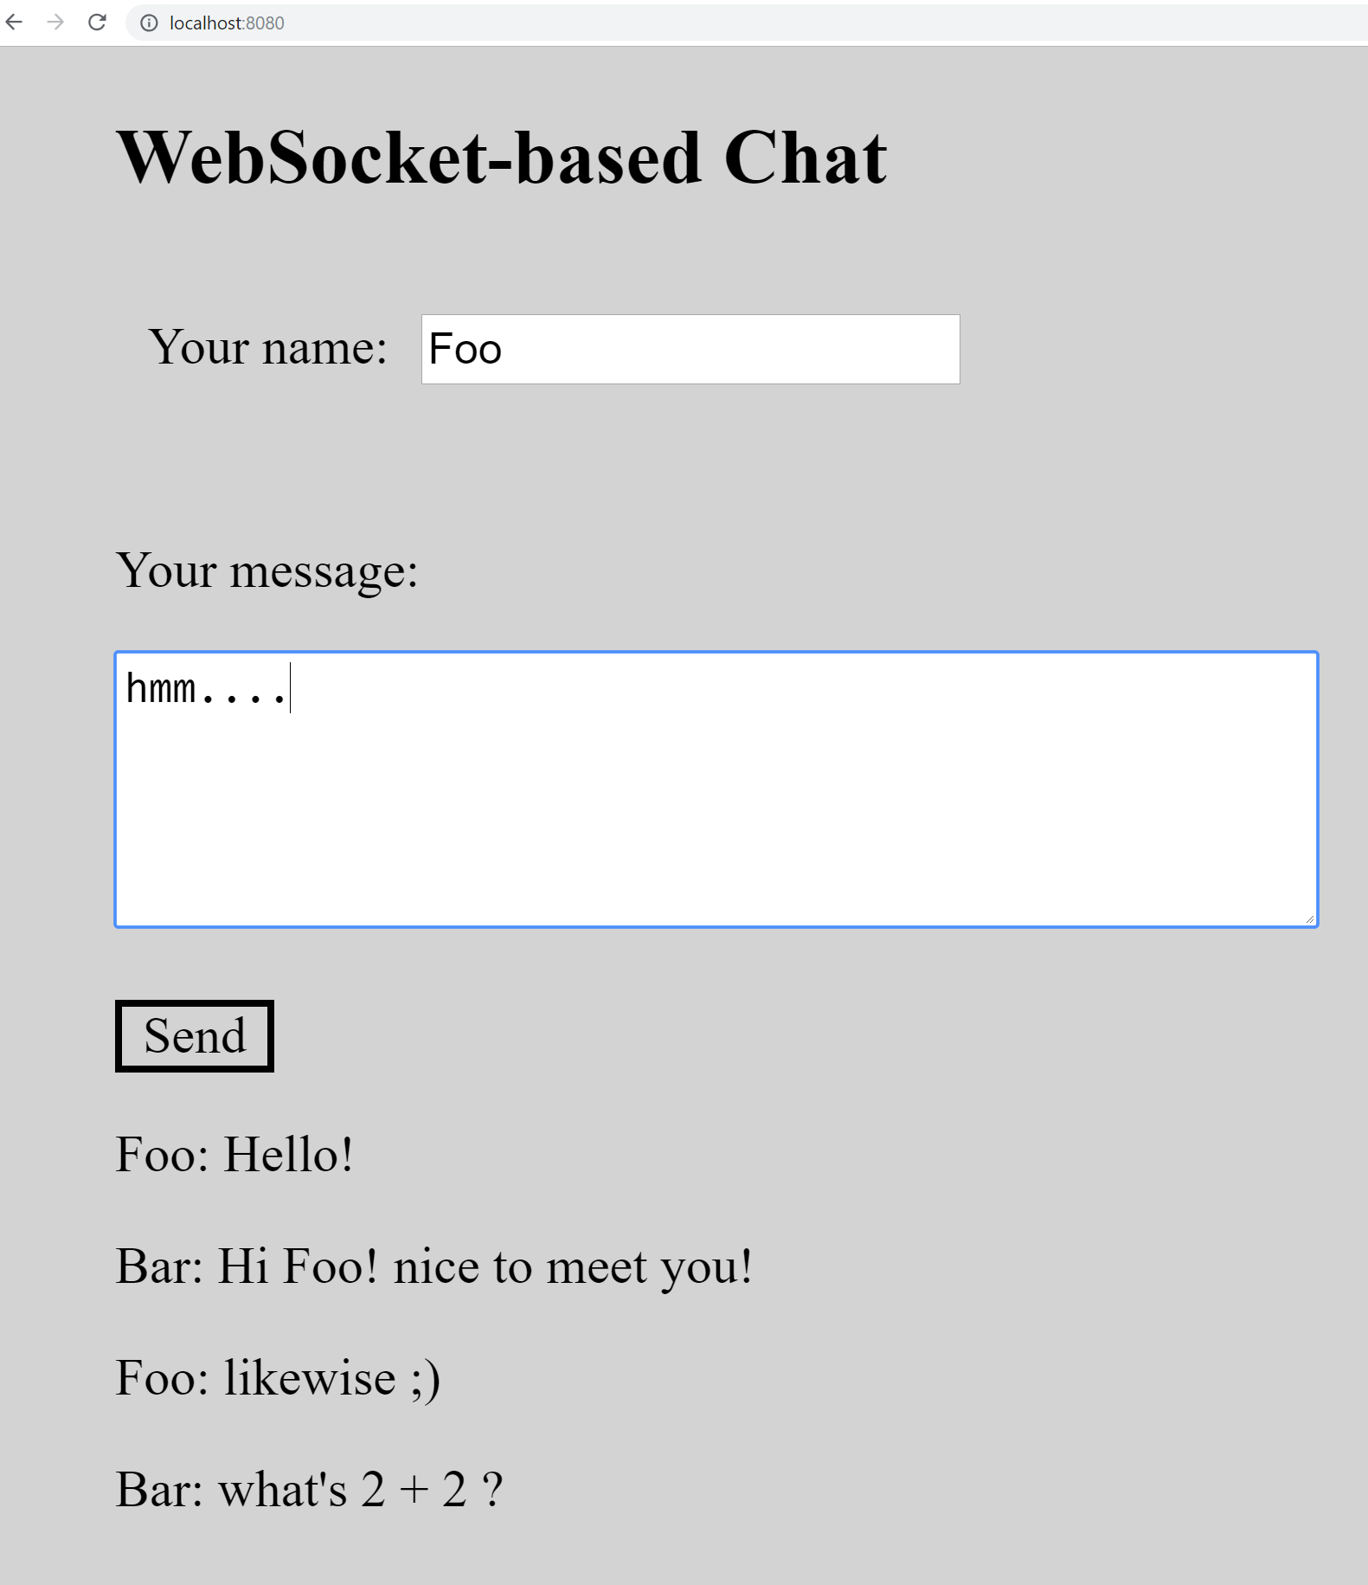
Chat Application
How would you implement a chat app in a browser?
It is not as simple as it sounds…

Slide 5
Option 1: Server-Side Templates
GET HTML page with current messages
Create new message with a POST form submission, returning the updated HTML page
Issue 0: download all messages even if only 1 new is created
Issue 1: current user will not see the new messages of other users until s/he interacts with the app
eg, reload page or post new message

Slide 6
Option 2: AJAX Polling
Use AJAX to fetch list of only the new messages to display
Repeat AJAX calls in a loop, eg every X milliseconds
Issue 0: might have to wait up to X ms before seeing the new messages from other users
Issue 1: if no new messages, all these AJAX requests are a huge waste of bandwidth
Choosing X is a tradeoff between Issue 0 and 1
eg, small X improves usability, but at a huge bandwidth waste cost

Slide 7
Option 3: WebSockets
Besides HTTP, establish a WS connection
most browsers do support WS
WS enables duplex communications
server can decide to send data to browser, which will listens to updates
Server will keep an active TCP connection for each client
When new message, server can broadcast it to all clients
Browser just waits for notifications, and update HTML when it receives incoming messages from server
Server pushes data only when available
no bandwidth waste

Slide 8
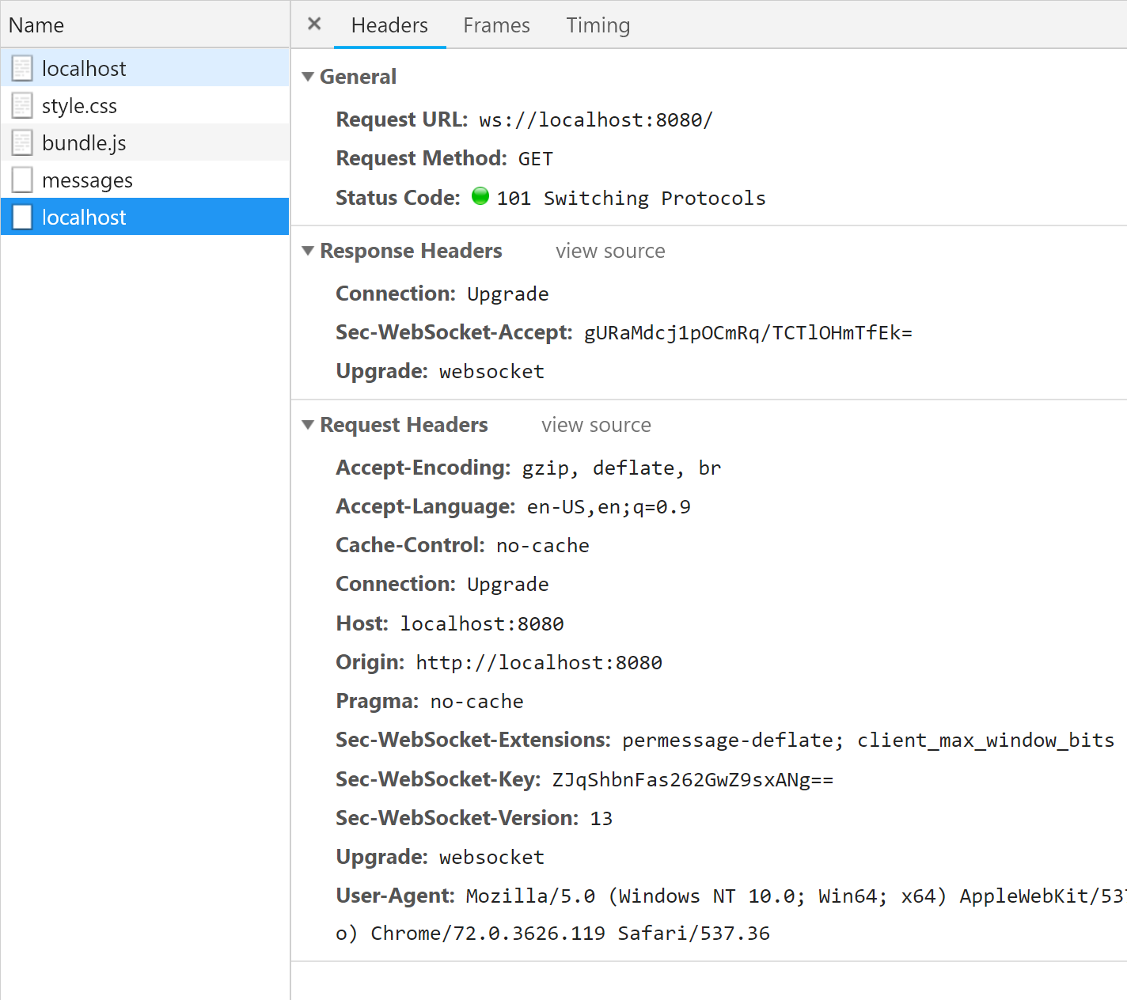
WebSocket Protocol
Usually over TCP
It is NOT HTTP, but first message has same syntax as HTTP
Note the different protocol in the URL, eg ws://localhost:8080
wss is for encrypted, like HTTPS

Slide 9
Request ws://localhost:8080
When making a request using WS protocol, browser will craft a message with same syntax as HTTP, with following headers
Sec-WebSocket-Extensions
specify some WS extensions to use during the communications, like how to compress the messages, eg, permessage-deflate tells to use the “deflate” compression algorithm
Sec-WebSocket-Key
needed to tell the server that this is indeed a WS connection, and not a HTTP one
using a random key
Sec-WebSocket-Version
tell the server which version of WS protocol the browser is using
Upgrade: websocket
standard HTTP header, telling that, although this request was handled like HTTP, the client (ie browser) wants to switch to a different protocol (WS in this case)

Slide 10
Server Response
If server supports and accepts the WS connection, it will answer with a HTTP message having the following
Connection: Upgrade
tell browser to update the connection from current HTTP to something else
Upgrade: websocket
the protocol to use for all following requests
Sec-WebSocket-Accept
used to confirm that server is willing to use WS protocol for all following requests
it contains the hashed key sent by the browser. Useful to prevent caches to resend previous WS conversations
HTTP status code 101
it represents “Switching Protocols”

Slide 11
Established WS Connection
Once WS is established, can send blocks of byte data or strings over TCP
Can wait for receiving messages
duplex communications between browser and server
data split and sent as “frames” of bytes, with special codes to specify sequences of frames belonging to the same message
How to structure messages is up to you
eg, could use protocols like STOMP
Typically, we will just send JSON objects, serialized as strings

Slide 12
Why First Message in HTTP?
It allows server to have a single listening TCP socket
eg, either 80 or 443, serving both HTTP(S) and WS(S)
Easy to integrate in current web infrastructures, including reverse-proxies
often you do not speak directly with a server, but rather with proxies and gateways in front of them… but this is not something we will see in this course
WS is younger than HTTP
first version in Chrome in 2009
Needed an easy way to integrate the new WS protocol in the existing web infrastructures tailored for HTTP

Slide 13
WebSocket in the Browser
In JavaScript, can use the WebSocket class from global scope
Most browsers nowadays support WS
WebSocket(url)
create a WS object, trying to connect to the given URL of the server
recall to use either “ws” or “wss” as protocol, and not “http”
WebSocket.send(payload)
send the given payload (e.g., a string) to the server
WebSocket.onmessage
callback used to handle messages from server
WebSocket.close()
to close the connection

Slide 14
WebSocket in the Server
Backend support for WS depends on the programming language and libraries we use
In this course, we will use the library “ws”, and “express-ws” to integrate it with Express
In Express, we will have an endpoint dealing with the “ws://” protocol
When called, a WS object will be created, on which we can register callbacks for incoming messages, open/close events, send messages to browser, broadcast to all users, etc.

