Slide 1
Web Development and API Design Lesson 02: Bash, Regex, Build Tools and Testing
Prof. Andrea Arcuri

Slide 2
Goals
Review/intro to Bash Terminal
Review/intro to Regular Expressions
Build tools: YARN, WebPack and Babel
How to write test cases

Slide 3
Bash

Slide 4
Bash
Bash is a Linux/Mac/Unix shell and command language
There are also other kinds of shells
eg, PowerShell in Windows
A shell is also called: terminal, console, command-line, etc.
Enable to type commands (eg programs), and execute them

Slide 5
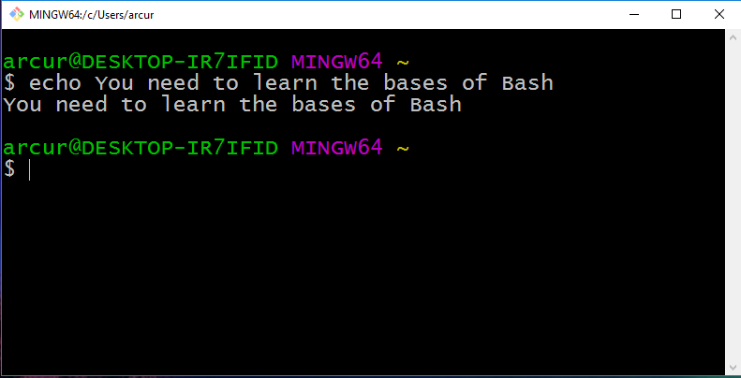

Slide 6
Why?
Critical skill when you are a programmer
Help automating several tasks
When dealing with web/enterprise systems, many servers will NOT have a GUI…
… you will access them remotely via SSH using a terminal
… this also applies for embedded and IoT devices
Helpful when commands with specific parameters (eg Git)
You need to be able to do basic commands
You will need Bash commands if using Docker

Slide 7
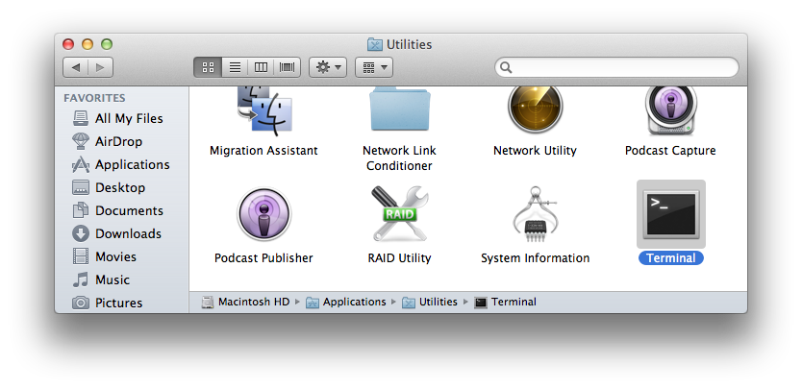
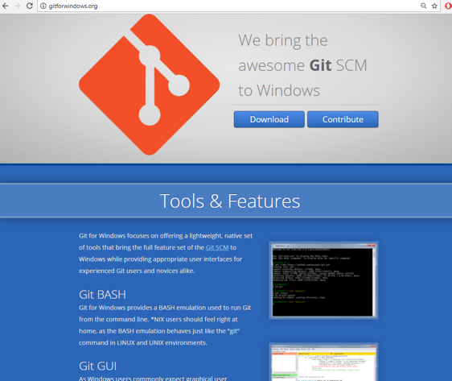
Installing Bash
If you are using Linux/Mac, it is already installed
Mac: Utilities -> Terminal
If using Windows, strongly recommended to install GitBash
which is part of “Git for Windows” at http://gitforwindows.org/

Slide 8
Basic Commands
“.” the current directory
“..” the parent directory
“~” home directory
“pwd” print working directory
“cd” change directory
“mkdir” make directory
“ls” list directory content
“cp” copy file
“mv” move file
“rm” remove (“-r” for recursive on directories)
“man” manual for a specific command

Slide 9
Cont.
“echo” print input text
“cat” print content of file
“less” scrollable print of file
“>” redirect to
“>>” append to
“|” pipe commands
“which” location of program
“$” resolve variables
“wc” word count
“find” files
“grep” extract based on regular expression
“touch” modify access time of file, and create it if non-existent

Slide 10
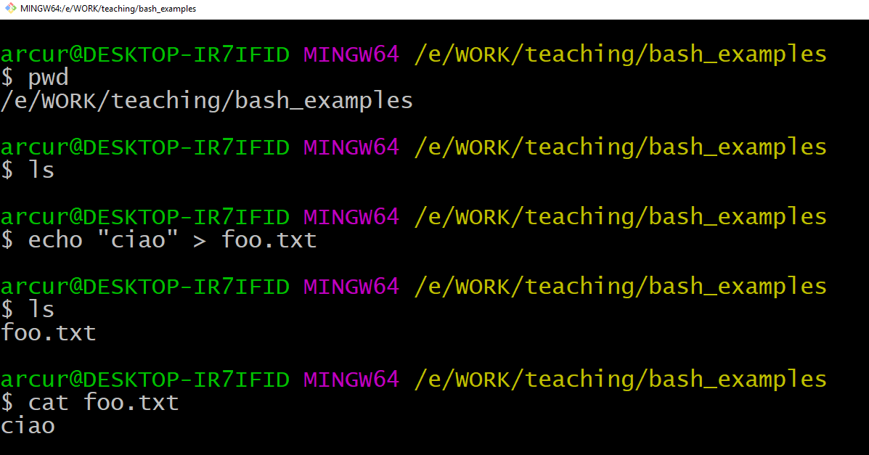

Slide 11
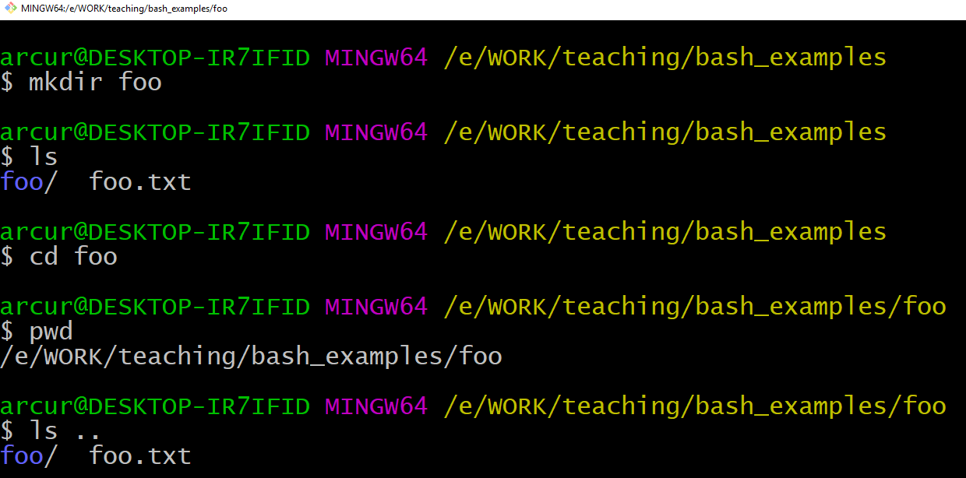

Slide 12
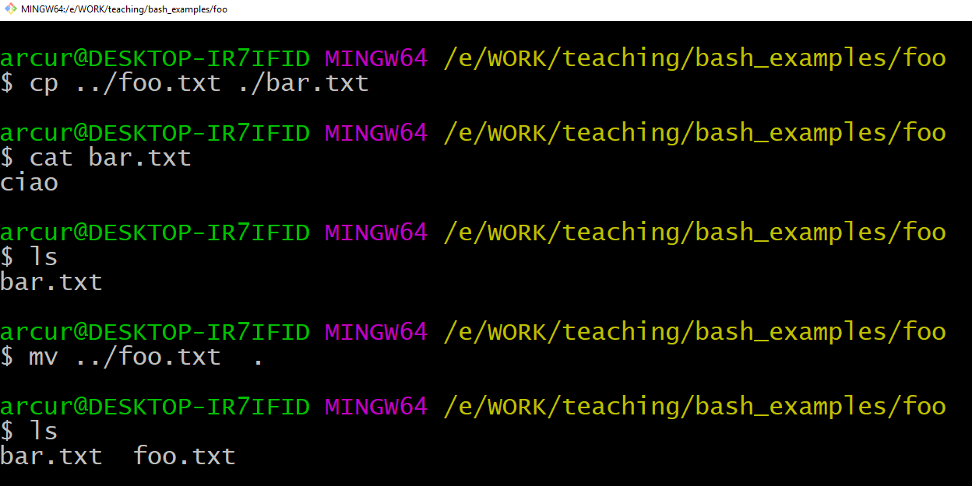

Slide 13
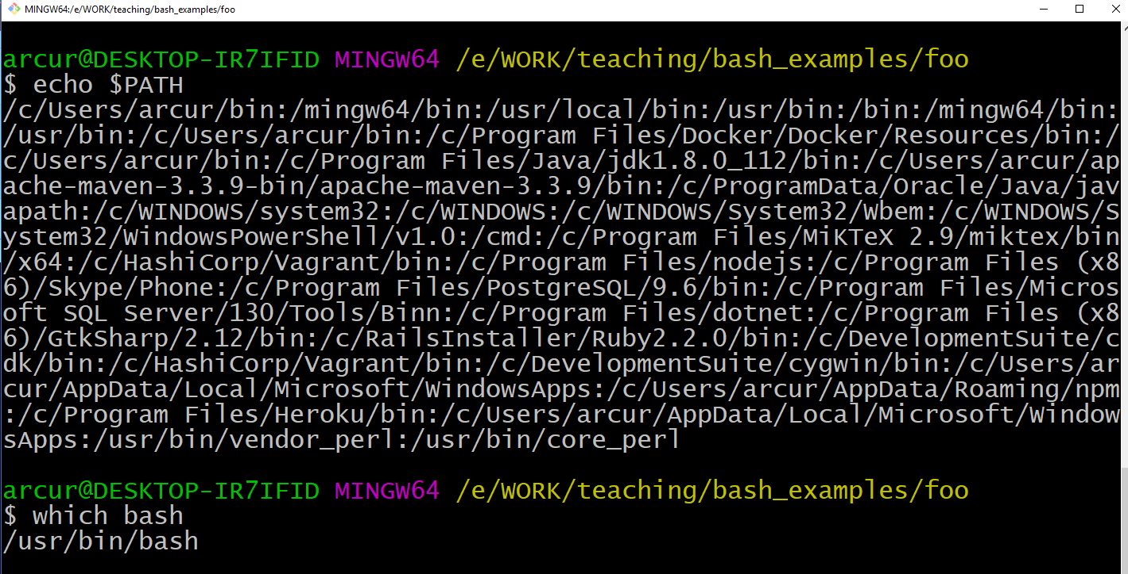

Slide 14
What if you want to count the number of JavaScript files in your project?
Or count the total number of lines in all those files?

Slide 15
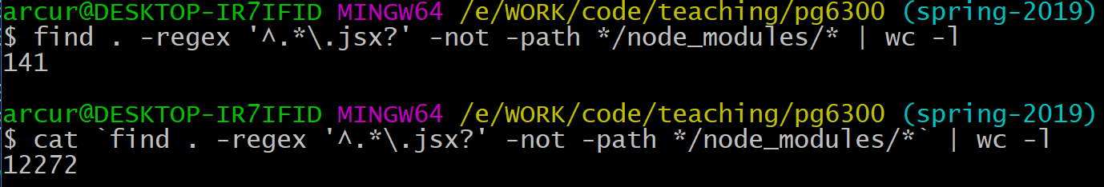
“find” all the files recursively in the current folder “.”
matching the regular expression for JS/JSX files
“^” beginning of file name
“.*” any character (.), any number of times (*)
“\.” escaped any-character to represent the character “.”
“\.jsx?” file ending, where the last “x” is optional (ie “?”)
“-not -path */node_modules/*” excludes files of imported dependenices
“| wc -l”: pipe file names to line count program
cat `x`: the `` executes the command inside it, and then puts the output on the terminal
so, we print all content of all JS/JSX files with cat

Slide 16
Useful Tips
User arrows (up/down) to go through history of commands
Use “tab” key to complete words, ie commands / file names
Bash commands can be put in executable scripts
Can use “*.sh” as file extension, eg “foo.sh”
First lines needs to be “#!<pathToBash>”, eg “#!/usr/bin/bash”
Then it can be executed from terminal like any other program

Slide 17
Regular Expressions

Slide 18
TODO

Slide 19
Build Tools

Slide 20
YARN/NPM
We need to use external libraries, typically open-source
An important library we are going to use in the rest of the course is for example React
Two main tools in JS: YARN and NPM
Both YARN and NPM access the same dependency repository
YARN tends to be better, with new features coming earlier
We will use it from terminal
As YARN executes JS code, we need a runtime for it: that is the reason why you also need to install NodeJS
not going to start a build tool inside a browser…

Slide 21
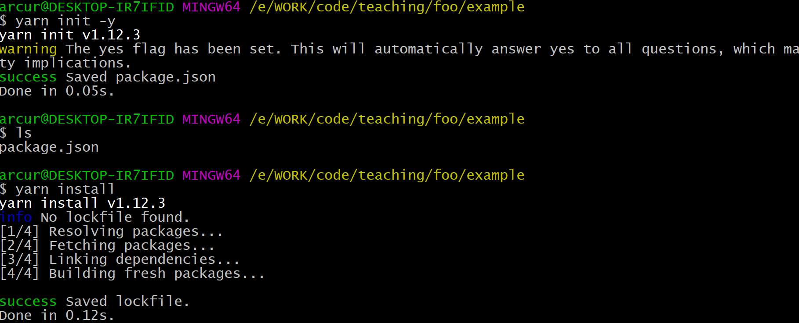
yarn init –y
create a new package.json in current folder, needed when starting new project
yarn install
download and install in “node_modules” folder all the dependencies declared in package.json

Slide 22
package.json
Main configuration file for the project
Similar to pom.xml in Maven Java projects
Three main parts you need to care about:
scripts: executable commands from YARN. Eg, to build or run the app
dependencies: dependencies used in the project
devDependencies: dependencies only used during development, but not being part of the final app (eg, we will see WebPack)

Slide 23
JSON for Configuration Files
<rant>
JSON as format for configuration files is simply awful.
For example, you cannot have comments…
NPM is not better, as uses exactly the same package.json
</rant>

Slide 24
yarn.lock
Once you install the dependencies, you will see that YARN does create a yarn.lock file
Dependencies need to define which version to use, eg 1.0.2
You can use caret ^ to represent the most recent major version
e.g., ^1.0.2 will match ^1.4.1, but not 2.0.0
yarn.lock just tells YARN to use the exact same versions of the libraries when such file was created
extremely important when working in a team, and new minor updates break backward compatibility or introduce new regression bugs
even if you fix a version X of a dependency, this could use other third-dependencies with ^, and so yarn.lock becomes essential

Slide 25
WebPack
Downloading dependencies is not enough
Such dependencies need to be accessed by the HTML pages
Might be cumbersome to update HTML files for each dependency, for each different version
Furthermore, we might only need a small set of functions from a specific library
Solution: bundling with WebPack

Slide 26
Bundling
In the end, we get a single JS file
Your JS files:
foo.js
bar.js
whatever.js
etc.
WebPack
bundle.js
Your libraries:
lodash
react
react-router
etc

Slide 27
Configuring WebPack
Needs to be installed and called with YARN from package.json
webpack-dev-server is a useful tool that starts a HTTP server with hot-reloading
ie, if you modify your JS files, it automatically re-bundle them
"scripts": { "dev": "webpack-dev-server --open --mode development", "build": "webpack --mode production" },
"devDependencies": { "webpack": "^4.16.5", "webpack-cli": "^3.1.0", "webpack-dev-server": "^3.1.5" }

Slide 28
webpack.config.js
Besides being called from package.json, WP also needs its own configurations
Eg, name of the file to create, and which directory to save it into
Configuration done in a JavaScript file

Slide 29
Code Transformation
Bundling is not enough, might need to do transformations
Support other languages: TypeScript and JSX
which are not natively supported by browsers, which only deal with JS
JSX will be essential when dealing with React
Support old browsers:
eg, transform code using new JS features (eg, async/await) into equivalent, valid old JS
Minification:
eg, remove comments and empty spaces from JS files to decrease their size, needed to make their download faster
etc.

Slide 30
Babel
Babel is the main tool to make JS transformations
Need to be installed and configured from package.json
"babel": { "presets": [ "@babel/env" ] }, "devDependencies": { "@babel/cli": "7.7.4", "@babel/core": "7.7.4", "@babel/preset-env": "7.7.4", "babel-jest": "24.9.0",

Slide 31
Testing

Slide 32
Testing
To check the correctness of a program, writing test cases is very important
For dynamically typed language, is even more important
as you lose a lot of warnings and checks from a compiler
Different libraries in JS for testing, but we will use Jest
which is one of the most popular

Slide 33
Configuring Jest
Need entry in scripts to start it
Need extra configurations to find out where the tests are
"scripts": { "test": "jest --coverage" },
"jest": { "testRegex": "tests/.*-test\\.(js|jsx)$", "collectCoverageFrom": [ "src/**.(js|jsx)" ] }

Slide 34
Need Babel for Jest
JS code running in browser
But where are the tests run? We need a JS runtime: NodeJS
But frontend code might not be directly executed on NodeJS
eg, different ways to handle JS modules
Using Babel to make the required transformations to be able to run such code on NodeJS

