Slide 1
NAAN MUDHALVAN PROJECT
EMAIL PHISHING DETECTION
Presented By:
POORNIMA.S
AALIM MUHAMMED SALEGH COLLEGE OF ENGINEERING
COMPUTER SCIENCE AND ENGINEERING(CSE)

Slide 2
OUTLINE
Problem Statement
Proposed Solution
System Development Approach
Algorithm & Deployment
Result
Conclusion
Future Scope
References

Slide 3
Problem Statement
Phishing emails pose a significant threat to individuals and organizations, leading to financial losses, data breaches, and compromised security. Despite advancements in email filtering techniques, detecting phishing emails remains a challenge due to the evolving tactics employed by cybercriminals. Current solutions often rely on single classification algorithms and may not effectively utilize all relevant features for accurate detection

Slide 4
Proposed Solution
To address this issue, this research proposes a comprehensive approach to phishing email detection. Firstly, manual feature selection based on the email structure will be employed to identify the most discriminative features for detection.
Subsequently, various classification algorithms, including Naive Bayes, Random Forest, and Logistic Regression, will be evaluated to determine the most effective algorithm for phishing detection. The selected algorithm will then undergo fine-tuning to optimize performance.
Furthermore, a multi-classifier integration model will be developed, combining the strengths of multiple classification techniques to enhance detection accuracy and robustness. By integrating the best performing classifiers, the system aims to provide improved prediction capabilities against phishing emails

Slide 5
System Approach
The development of the phishing email detection system will follow a systematic approach. Initially, data collection and preprocessing will be conducted to prepare the dataset for analysis. Manual feature selection will be performed to identify relevant features from the email structure. Subsequently, various classification algorithms will be implemented and evaluated using appropriate performance metrics.
Following algorithm evaluation, the selected algorithm will undergo fine-tuning using techniques such as hyperparameter optimization to enhance its performance. Finally, a multi-classifier integration model will be designed and implemented to combine the strengths of different classifiers for improved detection.

Slide 6
Algorithm & Deployment
The selected algorithms will be implemented using suitable programming languages and machine learning libraries. The deployment of the system may involve integrating it into existing email security solutions or developing standalone software for deployment in organizations.

Slide 7
Result
The performance of the developed system will be evaluated using standard evaluation metrics such as accuracy, precision, recall, and F1-score. Comparative analysis will be conducted to assess the effectiveness of different feature sets and classification algorithms. Additionally, the performance of the multi-classifier integration model will be compared against individual classifiers to demonstrate its efficacy in phishing email detection.

Slide 8
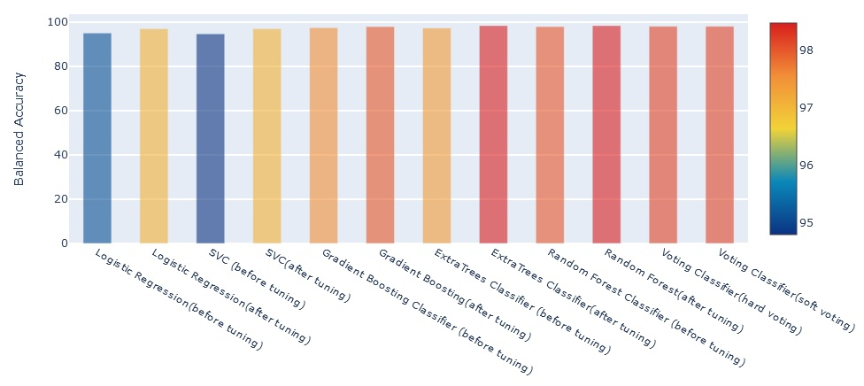
Result

Slide 9
Conclusion
The research aims to provide insights into effective phishing email detection techniques and contribute to the development of robust email security solutions. The findings will help organizations enhance their cybersecurity posture by better protecting against phishing attacks.

Slide 10
Future scope
Future research could explore advanced feature engineering techniques, ensemble learning methods, and deep learning approaches for phishing email detection. Additionally, the integration of real-time threat intelligence and behavioral analysis could further improve the accuracy and efficiency of the detection system.

Slide 11
References
Detection of E-Mail Phishing Attacks - using Machine Learning and Deep Learning January 2022
International Journal of Computer Applications 183(47):1-7:Dhruv Rathee Suman Mann

Slide 12
THANK YOU

