Slide 1
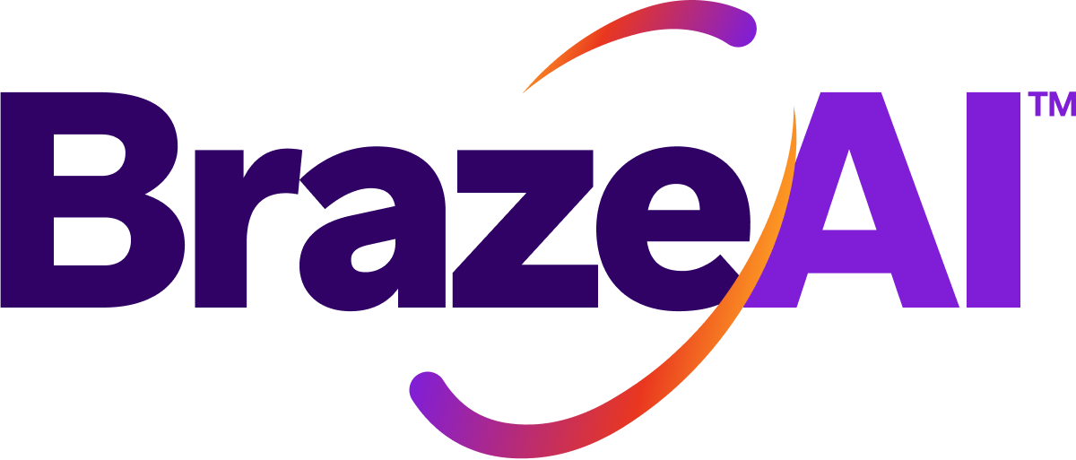
AI DECISIONING
Commercials for Blue Light Card
Year-one investment, cost structure & path to ROI
Confidential

Slide 2
Mutual action plan to go-live
Foundations are complete. Next is commercial alignment and executive sign-off to lock the Nov 2026 implementation slot.
# | Milestone | Owner | Target | Status
1 | Priority use case identified — Engagement (absorbs re-engagement + cross-cat) | BLC + Braze | 27 May | ✓ Completed
2 | Business case & impact model built (£4.37M target run-rate) | Braze | 27 May | ✓ Completed
3 | Data validation & audience sizing (4.2M MAU) | BLC + Braze | 27 May | ✓ Completed
4 | Customer Readiness Assessment (CRA) — in-flight | Braze | 16 Jun | ● In flight
5 | Commercial proposal & cost structure shared | Braze | 17 Jun | ● Today
6 | Lifecycle team review model & price → internal alignment | BLC (Marie) | w/c 23 Jun | Upcoming
7 | Executive review — Director of Data, CPO, Head of Engineering | BLC + Braze | w/c 23 Jun | Upcoming
8 | Finance approval (if incremental budget required) | BLC | early Jul | Upcoming
9 | Go / No-Go decision | BLC | by mid-Jul | Upcoming
10 | Order form finalised & signature | BLC + Braze | late Jul | Upcoming
11 | Implementation kickoff | Braze + BLC | November 2026 | Upcoming
12 | Go live — Engagement engine in production | Braze + BLC | February 2027 | Upcoming
Note: BLC's current Braze contract was renewed Jan 2026 ($1M+). Decisioning Studio is net-new on top of that contract.
2

Slide 3
COMMERCIALS
Year-one investment — Engagement proof of value
Priced at the 4M-MAU tier — sign by 17 July to lock the early-sign rate
Price breakdown
35% PARTNERSHIP DISCOUNT
AI Expert Services
forward-deployed eng.
$100,000
List price $409,000
$264,000
Use Case
Engagement
$175,000
Audience entitlement
4M-MAU tier
$134,000
USD ≈ £200,000 / year
List price
$409,000
All-in annual fee — technology subscription plus a dedicated forward-deployed AI expert team for year 1. Sign by 17 July to lock this rate.
Partnership discount (35%)
–$145,000
Year-one investment
$264,000
3

Slide 4
08 · COMMERCIAL
Your cost structure, broken down
One indivisible all-in fee — three components
1
2
3
AI Expert Services
Use Case
Audience Entitlement
Embedded ML experts who design, configure, tune and monitor your use case — at launch and ongoing.
One fully-configured, live RL use case optimised 1:1 across your audience. Additional cases are land-and-expand (~$300K each).
Annual entitlement on a monthly-average audience; flexes month to month and is revisited at renewal — not metered with immediate overages.
Commercial anchor: a single, indivisible all-in fee per use case. BLC's 4.2M MAU sits at the 4M-MAU tier ($134K). Additional use cases are land-and-expand ~$300K each; audience entitlement is shared.
4

Slide 5
What your AI Expert Services team does
Forward-deployed ML experts embedded alongside your team — required at launch AND for the entire life of the use case.
At launch
Ongoing
• Design the use case: action bank, reward signal, exploration parameters
• Set up the holdout and integrate your data feeds
• Configure, train and tune the model; run pre-go-live testing
• Stand up live reporting and agree the success metric
• Continuously tune the model as behaviour and seasonality shift
• Monitor controls and dimensions; troubleshoot and course-correct
• Add and test new dimensions, actions and creative to unlock fresh value
• Quarterly reviews and expansion: value keeps compounding years in, not just at go-live
One use case, one annual fee. AI Expert Services, the Use Case and Audience are three SKUs but a single, indivisible all-in price required at launch and ongoing.
5

Slide 6
How your audience is measured & billed
Annual entitlement, priced on a monthly average — designed to flex, not to penalise.
How it's measured
How it's billed
• Measured daily — audience size tracked every day, per use case
• Calculated as a monthly average — averaged over the year to give the audience size
• Charged annually — that average monthly audience is charged once a year; runs over and under with seasonality
• Annual entitlement — invoiced annually, not a monthly charge
• Not like message credits — no immediate overage when a month runs high
• Right-sized at renewal — we review and reset the tier together
• Standard policy — overages (1.25× rate) only if you run materially above, over time
Built-in headroom: your 4M tier sits at the audience level of BLC's 4.2M MAU base — comfortable for normal seasonality.
6

Slide 7
ENGAGEMENT
Engagement — path to ROI, month by month
Cumulative incremental value clears break-even by May 2027, inside Year 1
3.9×
3.4×
2.8×
2.3×
1.8×
Break-even · $264k subscription
1.3×
0.8×
0.1×
0.4×
Nov
M1
Dec
M2
Jan
M3
Feb
M4
Mar
M5
Apr
M6
May
M7
Jun
M8
Jul
M9
Aug
M10
Sep
M11
Oct
M12
 | M1 | M2 | M3 | M4 | M5 | M6 | M7 | M8 | M9 | M10 | M11 | M12
Value / mo | $0 | $0 | $0 | $34k | $68k | $102k | $136k | $136k | $136k | $136k | $136k | $136k
ROI | – | – | – | 0.1× | 0.4× | 0.8× | 1.3× | 1.8× | 2.3× | 2.8× | 3.4× | 3.9×
Cost / mo | $22k | $22k | $22k | $22k | $22k | $22k | $22k | $22k | $22k | $22k | $22k | $22k
Cumulative value in USD at the target lift ($1.64M annual run-rate ÷ 12 ≈ $136k/month). Audience ramps 25%→50%→75%→100% across Feb–May 2027. ROI vs $264k early-sign subscription; at $317k standard rate, year-end ROI is 3.2×. FX £1 = $1.32 (30 Jun 2026).
7

Slide 8
ROI compounds as the model trains
Year-1 ramps to full run-rate; the subscription stays flat (Engagement · Target)
Year 1 (ramp)
Year 2
Year 3
$1.09M
$1.64M
$1.64M
≈ £825,000
≈ £1.24M
≈ £1.24M
In-year 2027 value
Feb go-live, partial year
Full run-rate incremental
value over BAU
Full run-rate continues;
subscription unchanged
$264,000 Subscription · year 1
4.1× Year 1 ROI
6.2× Year 2 / 3 ROI
ROI = annual incremental value ÷ year-1 subscription. Shown at $264k early-sign rate. At $317k standard rate (after 17 July): Year 1 = 3.4×, Year 2/3 = 5.2×. Low case ($493k run-rate): Year 2 ROI 1.9× / 1.6×. RL models improve at maximising the reward over time.
8

Slide 9
How we get to 2.3× ROI by July 2027
ROI multiple = cumulative incremental value to date ÷ annual subscription. Build, month by month.
ROI multiple = cumulative incremental value to date ÷ annual subscription ($264,000)
Month | Nov M1 | Dec M2 | Jan M3 | Feb M4 | Mar M5 | Apr M6 | May M7 | Jun M8 | Jul M9
Value that month | $0 | $0 | $0 | $32k | $65k | $97k | $129k | $129k | $129k
Cumulative value | $0 | $0 | $0 | $32k | $97k | $193k | $323k | $451k | $580k
$614,000 ÷ $264,000 = 2.3×
cumulative value to July 2027 (month 9) ÷ annual subscription
Run-rate value is $136,000/month (≈£103,000) ($1.64M target ÷ 12 — engagement use case, 27 May model). ROI shown at $264k early-sign price; at $317k standard rate, July 2027 ROI is 1.9×. Audience ramps 25%/50%/75% over Feb–Apr 2027.
9

Slide 10
Cumulative cost vs. value — and the ask
Value compounds while the subscription accrues evenly — break-even May 2027, 3.9× year-end at the early-sign rate
 | Nov M1 | Dec M2 | Jan M3 | Feb M4 | Mar M5 | Apr M6 | May M7 | Jun M8 | Jul M9 | Aug M10 | Sep M11 | Oct M12
Cum. value | $0 | $0 | $0 | $34k | $102k | $205k | $341k | $477k | $614k | $750k | $887k | $1,023k
Cum. cost | $22k | $44k | $66k | $88k | $110k | $132k | $154k | $176k | $198k | $220k | $242k | $264k
ROI × | – | – | – | 0.1× | 0.4× | 0.8× | 1.3× | 1.8× | 2.3× | 2.8× | 3.4× | 3.9×
BREAK-EVEN
May 2027
Month 7 — cum value crosses $264k
YEAR-END
3.9× ROI
$1.02M cum value ÷ $264k subscription
YEAR 2 / 3
6.2× ROI
$1.64M run-rate ÷ $264k subscription
THE ASK TODAY Sign order form by 17 July to lock $264,000 → November 2026 kickoff → February 2027 go-live.
All values in USD. Cum. value is incremental over BAU at the target lift (4.2M MAU × 20% × £3.00/conv × 5.1% lift = $1.64M annual run-rate). Cost shown linearly at $22k/mo. ROI at $264k early-sign; at $317k standard rate: year-end 3.2×, Year 2+ 5.2×. FX £1 = $1.32 (Morningstar, 30 Jun 2026).
10

Slide 11
Let’s lock the November slot.
Sign by 17 July to lock $264,000 → Feb 2027 go-live.
BrazeAI Decisioning Studio™ · Confidential

