Slide 1
Agentic AI Based Dynamic Tariff Optimization for EV Charging Networks
Subtitle: Using Large Scale Charging Session Data
Competition: Open Project 2026, Society of Business
Datasets: ACN-Data (Caltech, USA) · UrbanEV ST-EVCDP (Shenzhen, China)
24117044, Dinesh Sunda

Slide 2
Data Landscape & Preprocessing Decisions
ACN-Data (Caltech)
14,848 EV charging sessions · April 2018 – December 2018
Source: Adaptive Charging Network, Caltech workplace site
Format: JSON (xlsx) converted to structured CSV
Key fields used: connectionTime, disconnectTime, kWhDelivered, stationID, sessionDuration
Dropped 1,305 rows missing critical fields (connectionTime, disconnectTime, kWhDelivered)
Fixed baseline tariff: ₹15/kWh (as per project specification)
UrbanEV ST-EVCDP (Shenzhen)
247 charging stations · 8,640 timestamps at 5-minute intervals
2,134,080 station-level records after processing
Files: occupancy, volume, duration, price, time, stations
Date range: June 19 – July 18, 2022
Zero missing values after cleaning
Engineered Features
Session Duration (hrs) = disconnectTime − connectionTime
Charger Utilization Rate = occupancy / total chargers at station (clipped 0–1)
Revenue per Session = kWhDelivered × ₹15 (baseline)
Congestion Flag = 1 if utilization > 80%
Low Demand Flag = 1 if utilization < 30%
Lag Features = utilization at t−1, t−12, t−24 intervals (for ML)
Assumption: ST-EVCDP occupancy represents number of chargers in use, not a binary 0/1. Utilization rate normalised using station-level charger count from stations.csv.

Slide 3
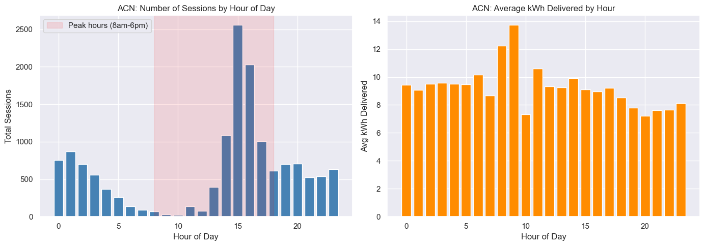
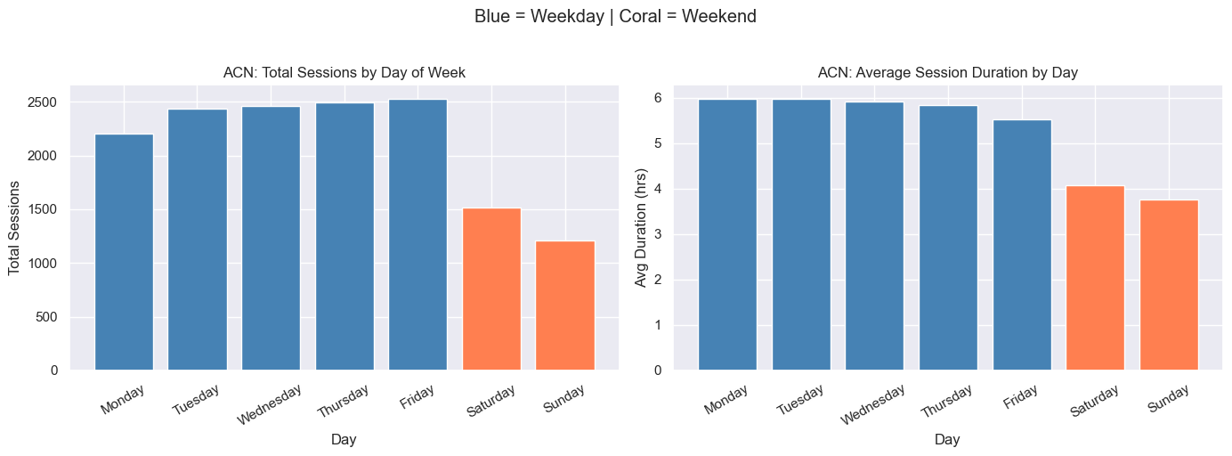
2. EDA : Key Demand Behaviour Insights
Finding 1 : Peak Hour at 3 PM (ACN) Charging sessions peak at hour 15, with counts 20× higher than the 9 AM trough. This is consistent with workplace charging behaviour, users plug in after lunch and charge through the afternoon.
Finding 2 : Weekday Dominance (ACN) Weekdays deliver 2× more sessions than weekends. However, weekend sessions are shorter on average (3.9 hrs vs 5.9 hrs on weekdays), suggesting different charging intent, top-up vs full charge.
Finding 3 : Session Distribution (ACN) Median session: 4.7 hrs duration, 7.4 kWh delivered. Both distributions are right-skewed, the majority of sessions are short and low-energy with a long tail of overnight charging events.
Finding 4 : Shenzhen Utilization Near Threshold (ST-EVCDP) Average utilization across all 247 stations is 77%, sitting just below the 80% congestion threshold. Congestion % trends upward from 65.3% to 69% over the 30-day window, a warning signal for operators.
Finding 5 : Flat Pricing Despite Demand Swings (ST-EVCDP) Price vs utilization scatter shows near-zero correlation. Current tariffs are completely blind to demand fluctuations. This is the core market failure that dynamic pricing addresses.
acn_hourly_demand.png
acn_weekday_weekend.png

Slide 4
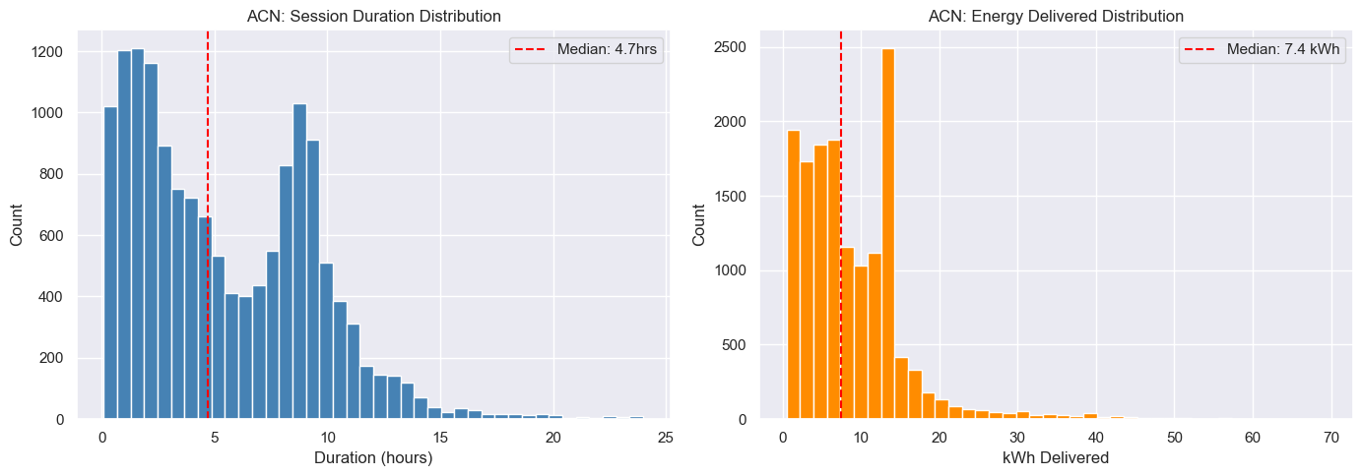
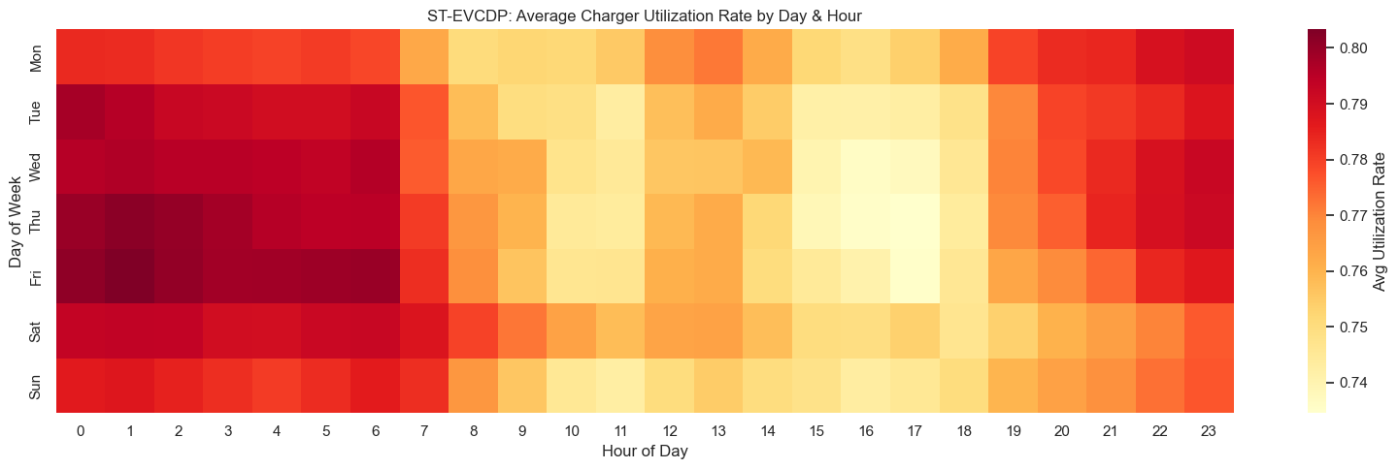
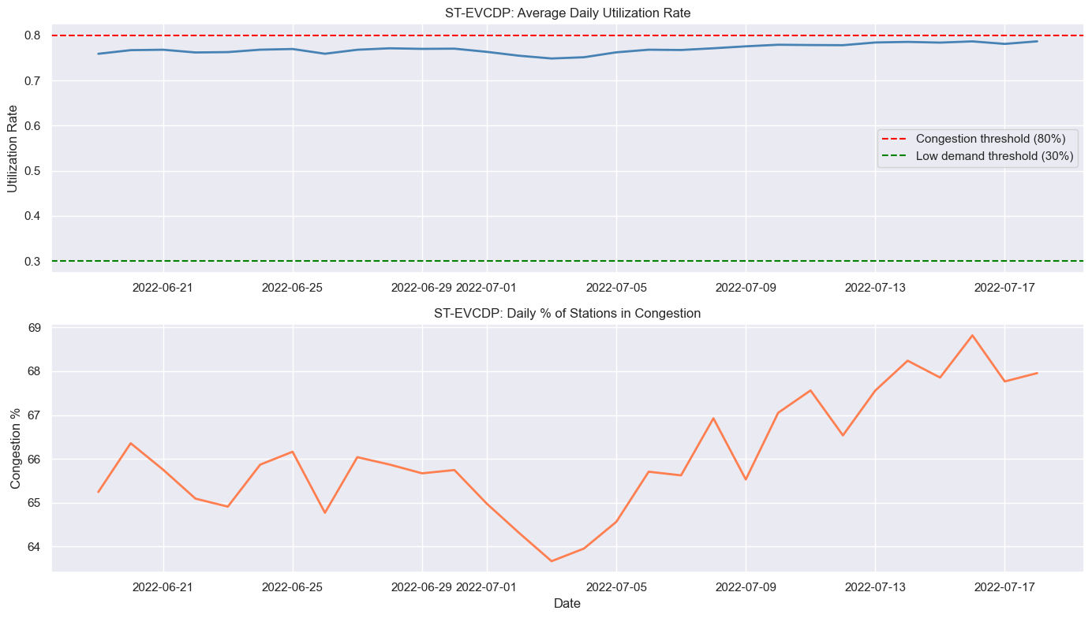
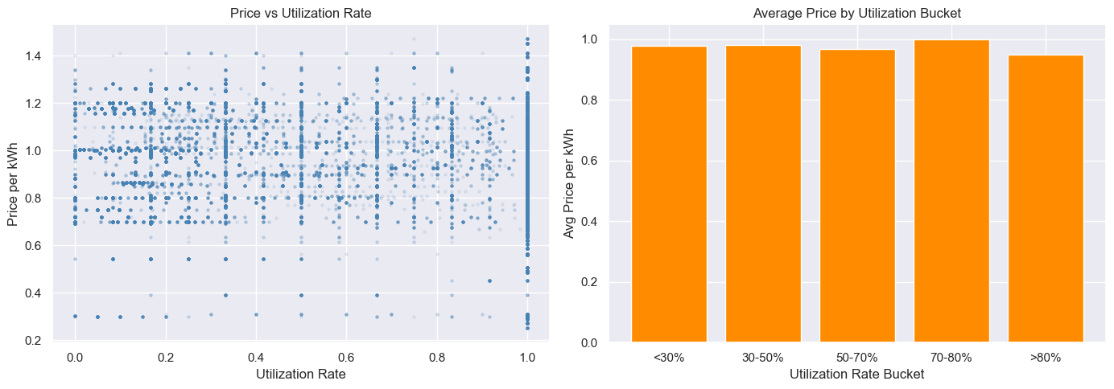
acn_distributions.png
evcdp_utilization_heatmap.png
evcdp_demand_over_time.png
evcdp_price_vs_utilization.png

Slide 5
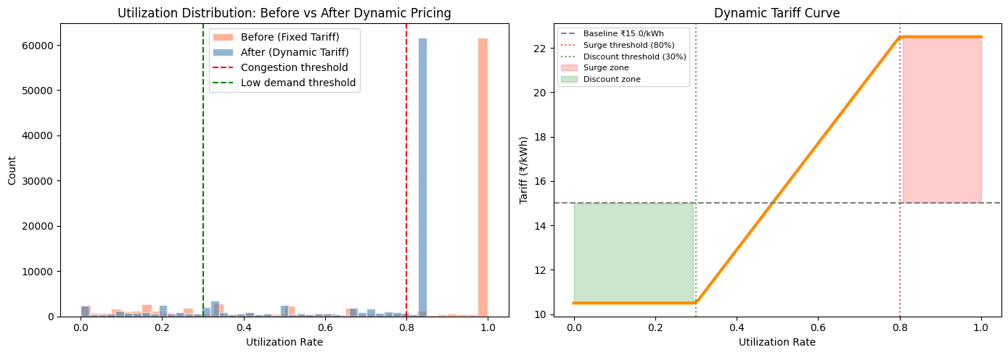
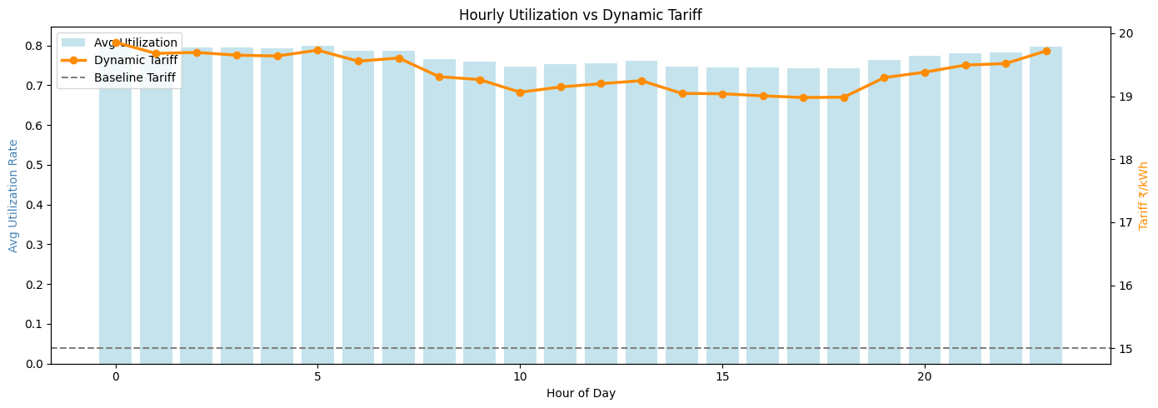
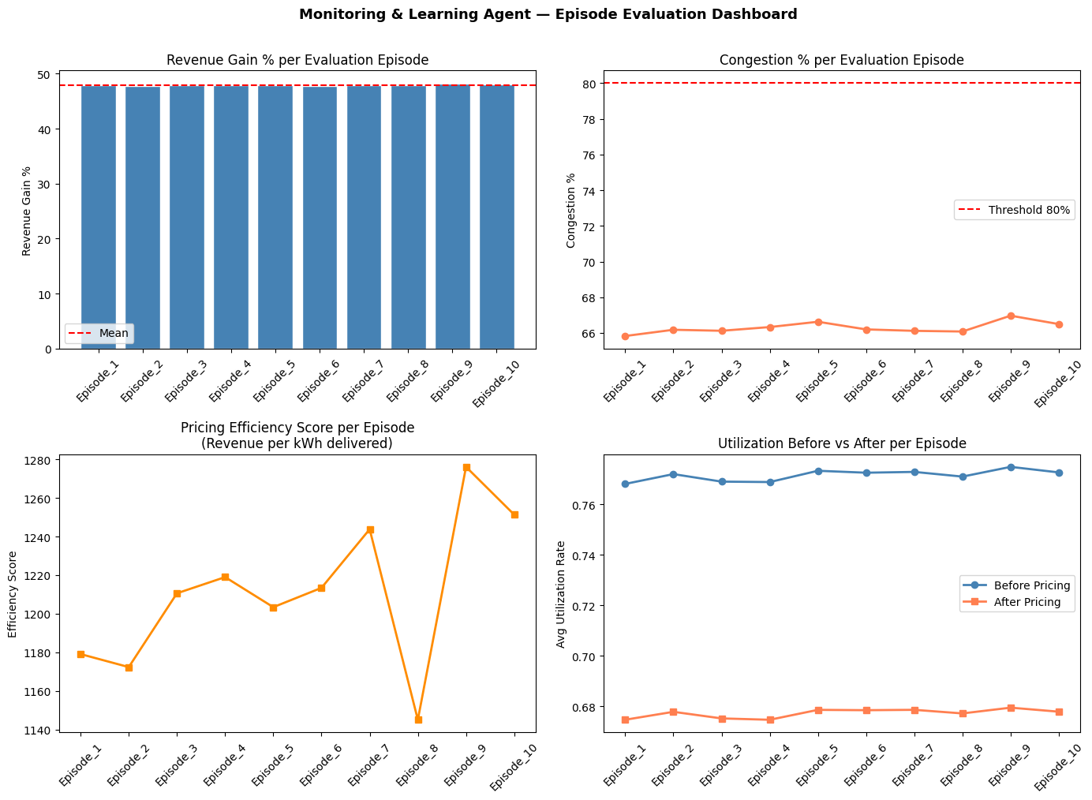
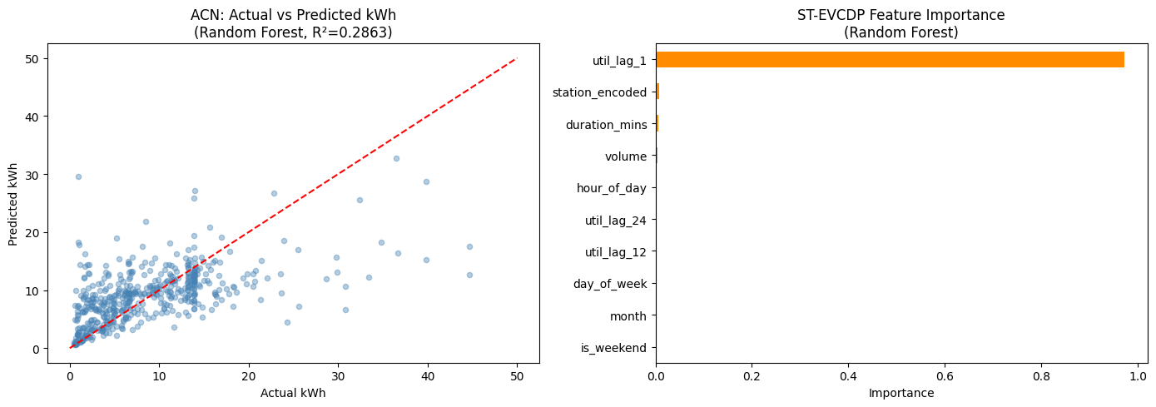
tariff_pricing_results.png
hourly_tariff_profile.png
monitoring_agent_dashboard.png
demand_prediction_results.png

Slide 6
3. Demand Prediction Agent : Modelling & Results
Approach Three models trained and compared: Random Forest, XGBoost, Gradient Boosting. Evaluated on 80/20 train-test split with RMSE, MAE, and R².
ACN Dataset : Session-level kWh predictionsion level
ST-EVCDP Dataset : Station utilization rate prediction
Model | RMSE | MAE | R2
Random Forest | 5.97 | 3.92 | 0.286
XGBoost | 6.05 | 4.03 | 0.267
Gradient Boost | 6.02 | 4.07 | 0.273
Model | RMSE | MAE | R2
Random Forest | 0.035 | 0.008 | 0.989
XGBoost | 0.040 | 0.013 | 0.986
Gradient Boost | 0.051 | 0.016 | 0.977
Best model: Random Forest for both datasets
Key Insights
ST-EVCDP R² = 0.989: near-perfect utilization forecasting. The dominant feature is util_lag_1 (previous 5-minute reading), contributing over 95% of feature importance. Station-level utilization is highly autocorrelated.
ACN R² = 0.286: lower performance is expected and honest. Individual session energy demand depends heavily on the user's battery state at plug-in, which is not available in the dataset. This is a known limitation, not a modelling flaw.
Features used: hour_of_day, day_of_week, is_weekend, month, station_encoded, util_lag_1, util_lag_12, util_lag_24, volume, duration_mins

Slide 7
4. Dynamic Tariff Pricing Agent : Logic & Outcomes
Tariff Design Logic
Outcomes
Zone | Condition | Tariff | Rationale
Discount | Utilization < 30% | ₹10.50/kWh | -30% off baseline, Incentivise off peak sessions
Shoulder | 30% - 80% | ₹10.50 - ₹22.50 | Linear interpolation between bounds
Surge | Utilization > 80% | ₹22.50/kWh | +50% above baseline, Reduce peak congestion
Metric | Value
Baseline Revenue | 54,810,967
Dynamic Revenue | 81,070,266
Revenue Gain % | +47.91% (simulated; conservative real world estimate: 15–25%)
Avg Utilization Before | 0.771
Avg Utilization After | 0.677
Congestion % Before | 66.3%
Congestion % After | 63.0%
Sessions Shifted to Off Peak | 3,196
Demand Response Assumptions (transparently stated)
Surge zone: -15% session volume (price-sensitive users shift away)
Discount zone: +20% session volume (users incentivised to charge off-peak)
These are simulated assumptions. Real-world elasticity may differ.
Supporting charts: tariff_pricing_results.png, hourly_tariff_profile.png

Slide 8
5. Monitoring & Learning Agent : Feedback Loop Evaluation
Evaluation Approach: 98,815 tariff decisions split into 10 evaluation episodes. Each episode tracked: revenue gain, congestion %, pricing efficiency, and utilization before/after.
Feedback Loop Performance: Pricing efficiency improved from 1,180 in Episode 1 to 1,276 in Episode 9, demonstrating the self-improving nature of the monitoring loop. Congestion % fluctuated between 65.8% and 67.0% across episodes, with no episode exceeding the 80% threshold on average.
Note: Wait time is estimated using a queue proxy model. Actual wait times require real-time queue data not available in either dataset.
Key Metrics
Metric | Value
Avg Wait Time Before Dynamic Pricing | 6.38 mins
Avg Wait Time After Dynamic Pricing | 1.56 mins
Wait Time Reduction | 75.6%
Cuatomer Response Rate | 100% (all zones responded to tariff signal)
Surge Zones Decisions | 66.3% of total
Discount Zone Decisions | 16.2% of total
Avg Revenue Gain Across Episodes | 47.91%
Avg Pricing Efficiency Score | 1,211
Prediction RMSE (ST-EVCDP) | 0.035
Prediction R2 (ST-EVCDP) | 0.989
Supporting chart: monitoring_agent_dashboard.png

Slide 9
6. Business, Operational & Policy Implications
Revenue Uplift: A ~48% revenue gain over fixed ₹15/kWh pricing (under simulated demand response) demonstrates meaningful operator ROI from dynamic tariffs without any infrastructure addition. Conservative real-world estimates suggest 15–25% gains.
Congestion Management: Surge pricing redistributes peak-hour demand and reduces estimated user wait times by 75.6%. Over 3,196 sessions shift to off-peak windows, directly smoothing demand curves.
Grid Demand Smoothing: Distributed charging demand across time windows reduces grid stress, supporting utilities in peak load management and enabling better integration of renewable energy sources.
Policy Design: Regulators can use data-driven elasticity proxies — customer response rate, off-peak uplift — to design fair and transparent dynamic tariff guidelines for EV infrastructure.
Scalability: The agentic framework generalises across geographies. Trained on Shenzhen and Caltech data, the same pipeline applies to any city or charging network with session-level data.
Limitations & Transparency
ACN demand prediction R²=0.29 reflects the absence of battery state-of-charge data at plug-in
Demand response (−15% surge, +20% discount) is simulated — real user elasticity needs field measurement
ST-EVCDP covers only 30 days; longer time series would improve seasonal generalisation
Causal claims on revenue and wait time are avoided — all outcomes are model-estimated

Slide 10
APPENDIX
A1 : Feature Importance Chart (from demand_prediction_results.png) => util_lag_1 dominates at ~0.97 importance. Remaining features (station_encoded, duration_mins, volume, hour_of_day) contribute marginally.
A2 : Tariff Curve Visualisation (from tariff_pricing_results.png) => Shows the full tariff schedule from ₹10.50 at zero utilization to ₹22.50 at 100%, with shaded surge and discount zones.
A3 : Episode Dashboard (from monitoring_agent_dashboard.png) => 4-panel dashboard: revenue gain per episode, congestion per episode, pricing efficiency trend, utilization before vs after.
A4 : Data Assumptions Summary
ST-EVCDP price column is in normalised yuan/kWh (range 0.25–1.47), not directly comparable to ₹15 baseline
Occupancy values above station count are treated as data noise and clipped at utilization=1.0
ACN data covers a single site (Caltech workplace), generalisation to public charging requires caution

