Slide 1
START OF THE COMPETITION

Slide 2
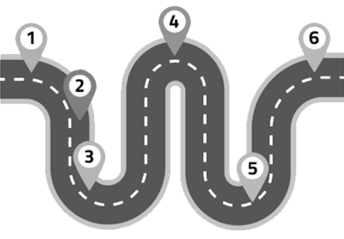
1 Start [today].
2 Meetings with advisors [next week].
3 Interim report [Apr 19th 23:59].
4 Final report [last week of May].
5 Finals [first week of June].

Slide 3
Communication
Slack [ http://fri-ds-project.slack.com/ ] and e-classroom (e-učilnica).
Important announcements over both channels.
Submissions by one member of the team over e-classroom.
Slack for discussions and internal team communication.

Slide 4
Repository
Private BitBucket repository.
Send your BitBucket emails to [jure.demsar@fri.uni-lj]!
The [master] branch: tagged, “production” ready material.
The [develop] branch: unfinished, under development material.

Slide 5

Repository #2
Subfolders for each of your tasks:
[/journal],
[/interim_report],
[/final_report],
[/presentation].
Codebase in:
[/src].
Repository description:
[README.md].

Slide 6

Journal
Each student writes his/her own log.
Journal is a log of all your work.
Short entries for everything you do.
Required for estimating the amount of hours put into the project.
Journal is also required by the RVP course for non-DS students.

Slide 7

Interim report
2 pages max!
A short overview of already completed tasks along with plans for the rest of the semester.
Use the [LaTeX] template in the repository!
The template includes examples for all reporting elements (figures, references, equations, code …)

Slide 8

Final report
Upgrade the interim report.
4 pages max!
IMRAD format sections:
Introduction/motivation,
Methods,
Results,
and
Discussion/conclusion.

Slide 9

Presentation
Short lightning talks [5-7 min].
Focus on methods & results.
Store the material in the /presentation repository subfolder.

Slide 10
Work
From week 2 onwards you are your own bosses.
Initiative for meetings must come from your side!
If stuck and have no idea how to move forward => contact advisors!
If you have something interesting to show => contact advisors!
Working with top data science experts in the region is a unique opportunity, use it!

Slide 11
Grading
Final grade is a consensus between all involved advisors.
Quality of work given the topic complexity.
Transparent methodology/replicability.
Appropriate evaluation/validation.
Level of the prepared materials (code, reports and presentation).
Results themselves are not the most important thing!

Slide 12


