Slide 1
Solution For Lending Club Case Study Assignment
Team:
Manish Jha
Abhilash shah

Slide 2
Why we need this analysis
To analyse and assist our fintech company in taking decision for providing loan to applicants.
Make it easy for decision makers to decide whether he should Reject/Accept the loan application
One should understand from historic data that
  What are the parameters which is affecting our loan disbursal and getting it back from customer
What are the factors which were affecting our business and the factors we should take care to make our business profitable.

Slide 3
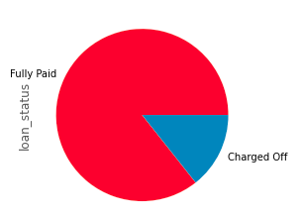
Charged off Percentez analysis
Upon analysing the total dataset we have found that out of 36847 applicants 14.33% applicants were declared as charged off. Below is the pie chart to show the percentez of application declared as charged off

Slide 4
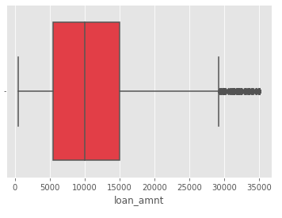
Loan amount distribution
From the below boxplot of loan amount distribution we can conclude that most of the loan we distributed is within the range of 5000 – 15000 and maximum loan amount we disbursed is 35000

Slide 5
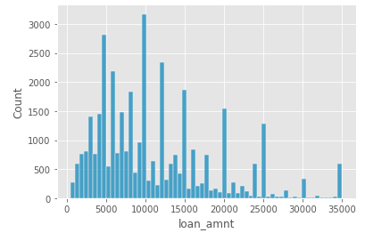
Loan amount distributed in numbers
Here is a histogram graph which states how many people got how much amount as loan from us.

Slide 6
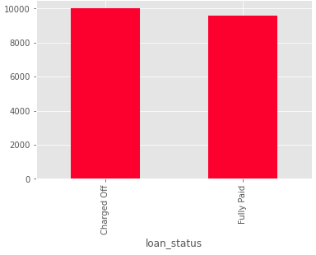
Loan amount and charged off vs fullypaid median report
Form the below bar graph it is still not clear that what median range of amount will have more probability of getting it back?

Slide 7
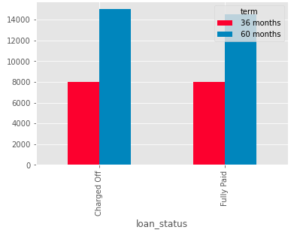
Loan Duration and charged off vs fully paid analysis
Form the below bar graph we can conclude that there is not much variation in charge off and fully paid customers based on the duration of loan. Below graph can depcit it.

Slide 8
Interest rate distribution of loan
Here is our analysis for ROI distribution using box plot. In this box plot we observed that mostly our ROI varies from 9 to 14 percent with a average of 12 percent. Here is the box plot which depicts the fact.

Slide 9
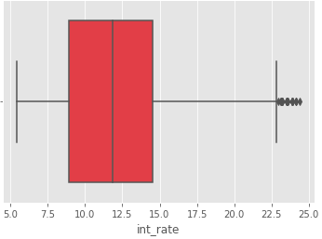

Slide 10
Interest rate and fullypaid vs charged off loan
From the median report of interest rate with respect to charge off and fully paid loans it shows that high interest rate loans are more open to charged off than the resonably moderate interest rate loan. Here is the median graph for charged off and fully paid loan against interest rate

Slide 11
