Slide 1

LUResource
BY
Pritom Jyoti Talukdar Nishat Anjum Chowdhury Sagor Mojumdar
ID: 1912020117
ID: 1912020100
ID: 1912020150
Leading University
Computer Science
2023

Slide 2
Our Project Supervisor
Add a little bit of body text
Md. Jamaner Rahaman
Lecturer
Dept. of Computer Science & Engineering
Leading University
Leading University
Computer Science
2023

Slide 3
Introduction
Leading University
Computer Science
2023

Slide 4
Project Overview
LUResource is an innovative website designed to enhance the academic experience of students and faculty members at Leading University
01
02
It has a user friendly interface, easy to use. It hav features that benefit all.
Presentation by Team LUResource

Slide 5
Required Tools
Frontend Development
Html
CSS
JavaScript
Bootstrap 5
Database
01
03
MySql
Other Tools
02
Backend Development
04
VsCode
Xampp
Php
Presentation by Team LUResource

Slide 6
Diagrams
Leading University
Computer Science
2023

Slide 7
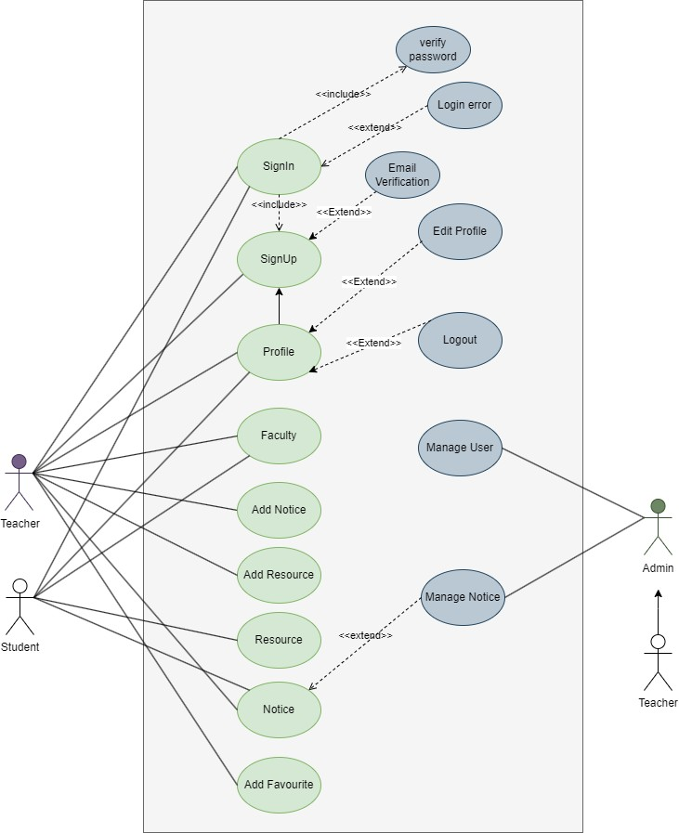
Use Case Diagram

Slide 8
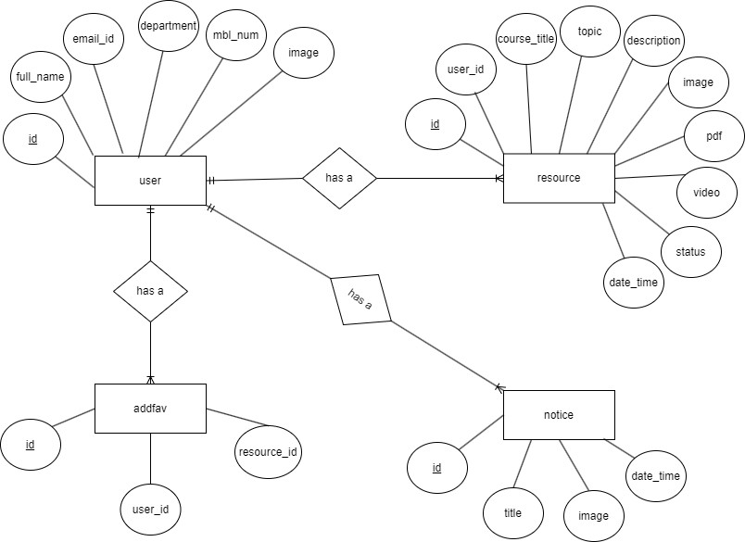
ER Diagram

Slide 9
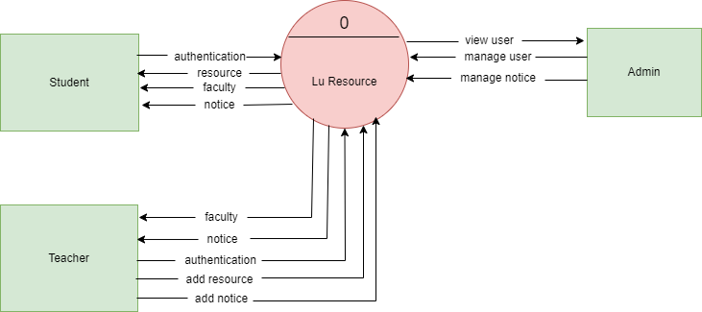
DFD level-0

Slide 10
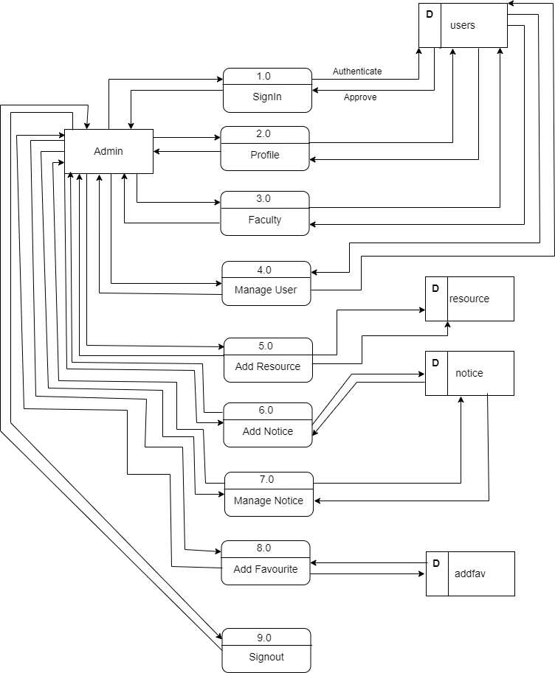
DFD level-1(For Admin)

Slide 11
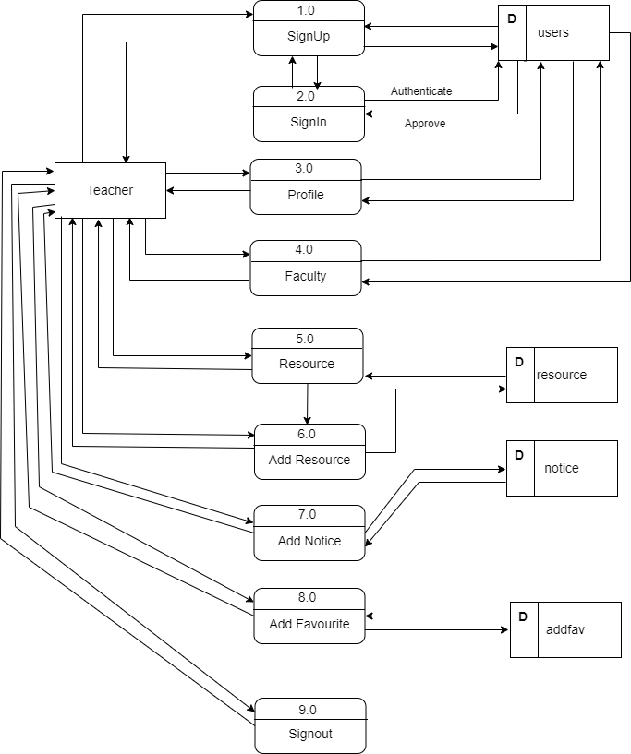
DFD level-1(ForTeacher)

Slide 12
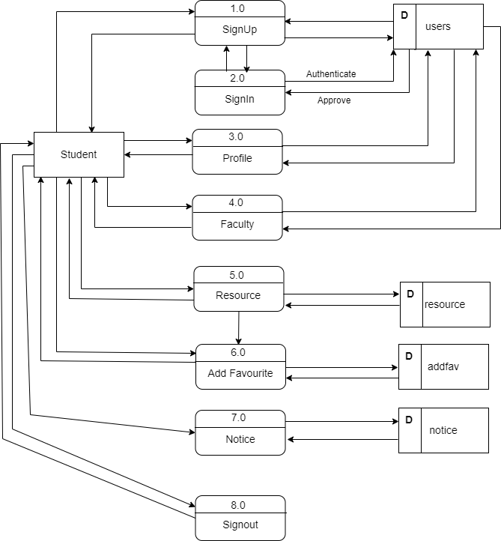
DFD level-1(For Student)

Slide 13
More About The APP...
Leading University
Computer Science
2023

Slide 14

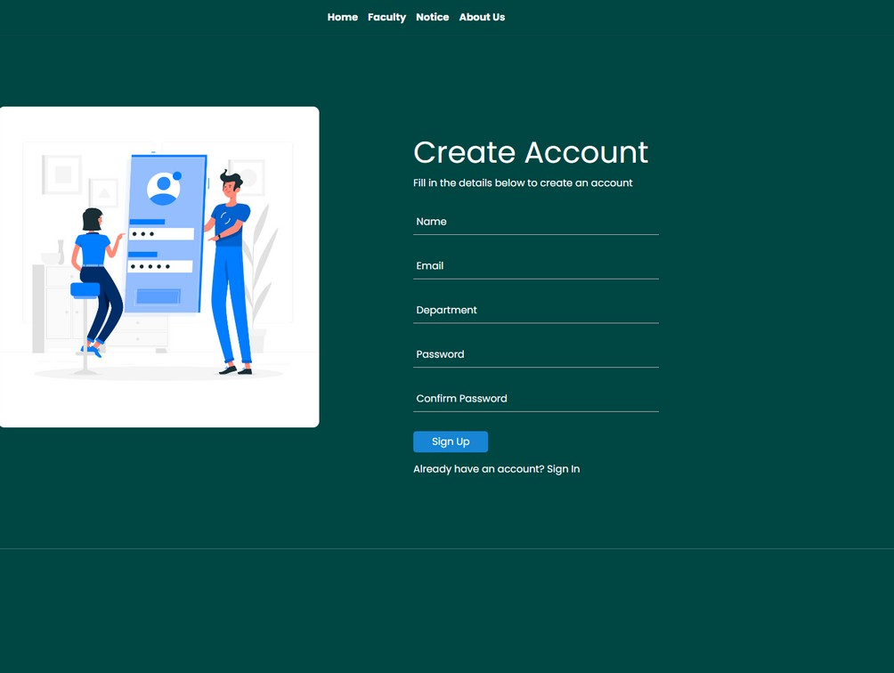
You need this website because…
For Faculty
To secure important resource
Easy to upload, edit and delete data Notice Update
Personalised upload system
For Students
Save a lot of time
Easily can download resources Stay upto date
Add favourite content
Conatact with faculty through profile View all available faculty
Presentation by
Team LUResource

Slide 15
Limitations
No realtime chat
Only G suite account can be registered Limited storage
No notifications feature Only English language
Leading University
Computer Science
2023

Slide 16
Future Plan
User can add comment
Mobile app version will be available Integrate with social media platforms User can follow other profile Advanced search functionality
Leading University
Computer Science
2023

Slide 17
Conclusion
Managing and storing teaching materials is a crucial responsibility for educators, and LUResource is a tool that can effectively manage these resources while also facilitating easy sharing with students

Slide 18
Thank You
So Much!
Leading University
Computer Science
2023

