Slide 1
Meet Doctor
Connects Patients with Doctors

Slide 2
Introduction

Slide 3
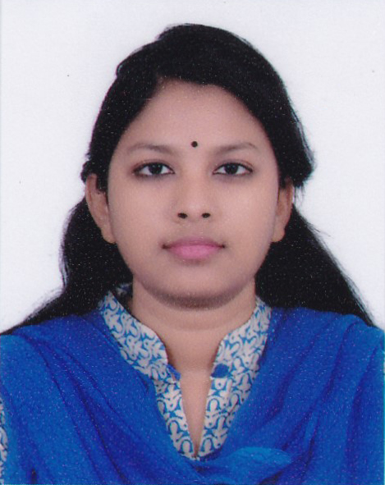
Our Project Supervisor
Syeda Tamanna Alam Monisha
Lecturer
Dept. of Computer Science & Engineering
Leading University

Slide 4
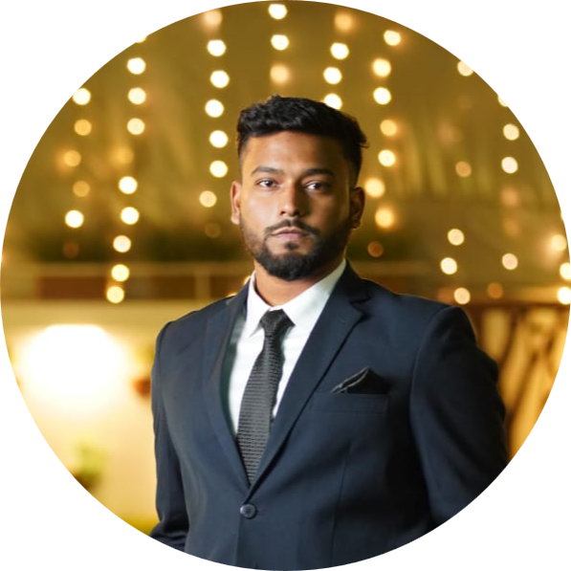
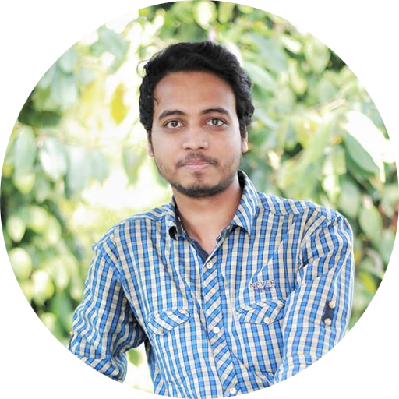
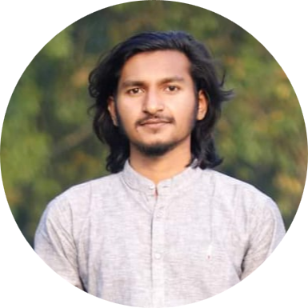
Meet our Team
Naeem Ahsan Chowdhury
ID: 1912020107
Md. Tanzim Ferdous
ID: 1912020112
Pritom Jyoti Talukdar
ID: 1912020117

Slide 5
About the App

Slide 6
Project Overview
Meet Doctor is an app which gets the appointment of a doctor in no time.
User friendly, easy to use.
All needs of the clients in one place.
Features that benefit all.

Slide 7
Relevant Study
A variety of projects have been undertaken in that area. They are:
Tonic
DocTime
Shebhagor
BanglaMeds.com.bd
Oshudhwala

Slide 8
Authenticity
Get the appointment and have a serial number.
Look for diagnostic centers.
Get health tips regularly.
Know about your meds.
Calculate your fitness.
Get emergency help right away from the doc.

Slide 9
Required Tools
For development
Android Studio
Flutter
Dart
For Database
Firebase
For Users
Internet Connection
Smart phone

Slide 10
Diagrams

Slide 11
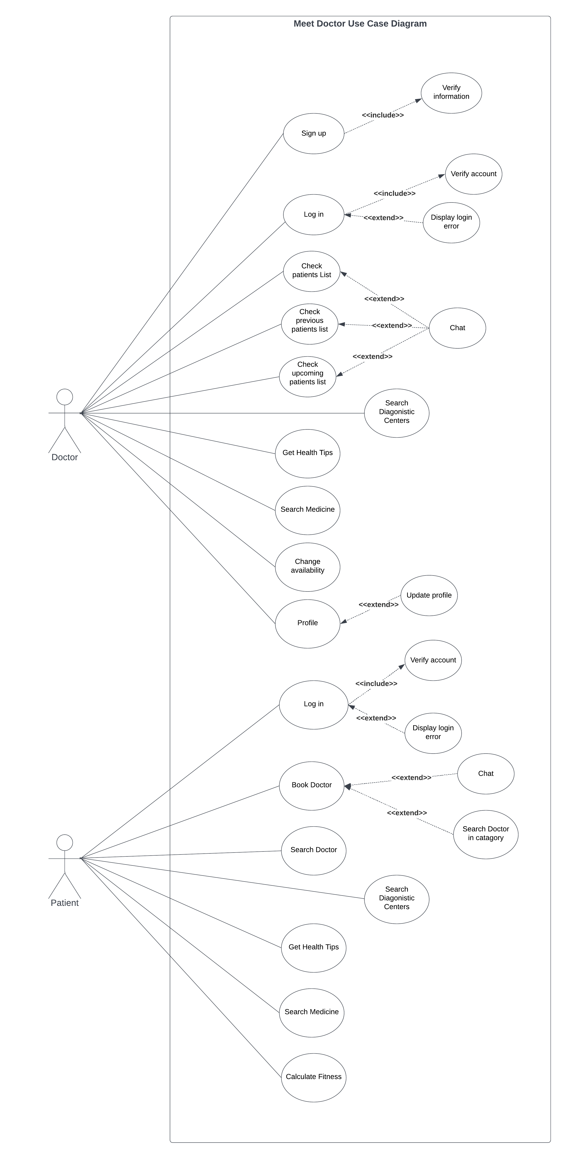
Use Case

Slide 12
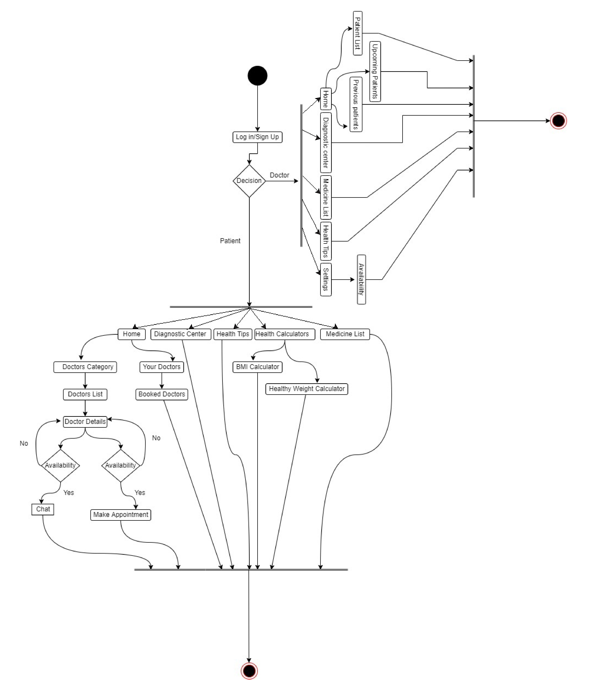
Activity Diagram

Slide 13
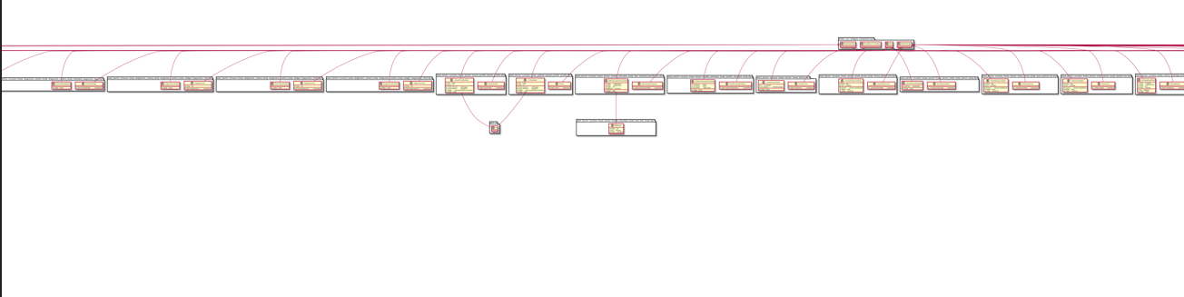
Class Diagram

Slide 14
More about the App

Slide 15
You need this app because…
No need to bribe the receptionist.
No more ask questions to the pharmacist.
Keep a track of your health.
Get treatment from distance.
Know more about your patients.

Slide 16
Limitations
Payment gateway system
Minimum SDK version 21
Notification for chats
Only in English language

Slide 17
Future Plan
Heath insurance system
Online Video calling appointment
Health packages
Rating system
Medicine Delivery

Slide 18
Conclusion
We all believe that health is an important sector, and that we should do something to improve it. We've done our best to provide a detailed description of the project above. The parameters of this project have been addressed. People’s health efficiency will improve as a result of this. We'll cover every detail to ensure that our program satisfies all of the standards.

Slide 19
Thank You !

