Slide 1
Study Planner
Saves your time

Slide 2
INTRODUCTION

Slide 3



Meet Our Team
Shariya Sultana
ID: 1912020094
Syed Nahin Hasan
ID: 1912020134
Nishat Anjum Chowdhury
ID:1912020100

Slide 4

Our Project Supervisor
Md. Ebrahim Hossain
Assistant Professor
Dept. of Computer Science & Engineering
Leading University

Slide 5
About The App

Slide 6
Review Previous Work
A variety of projects have been undertaken in this area. They are:
“My HomeWork Study Planner”.
“My Classes-Timetable and Study Planner ”.
“Todait”.
“My Study Life School planner” .

Slide 7
Required Tools
For development
Android Studio
JAVA
XML
For Database:
Firebase
For Users:
Internet Connection
Smart phone

Slide 8
Diagrams

Slide 9
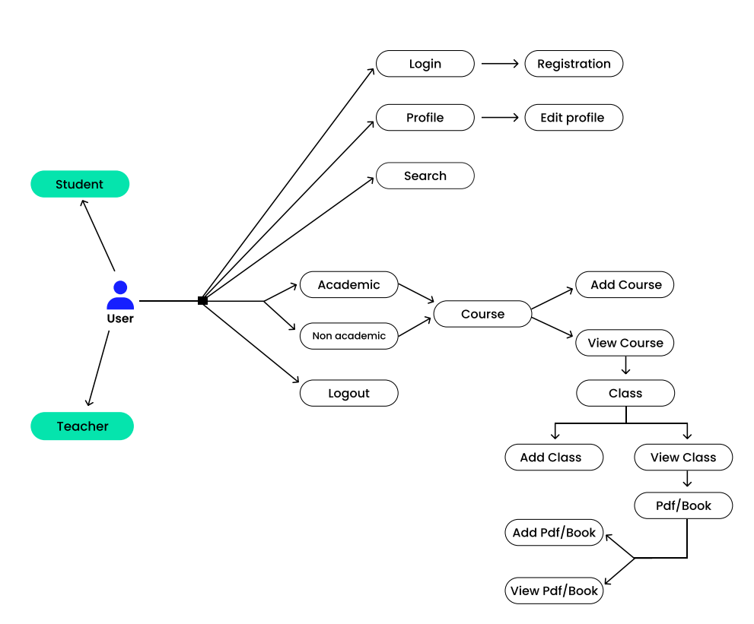
Use Case :

Slide 10
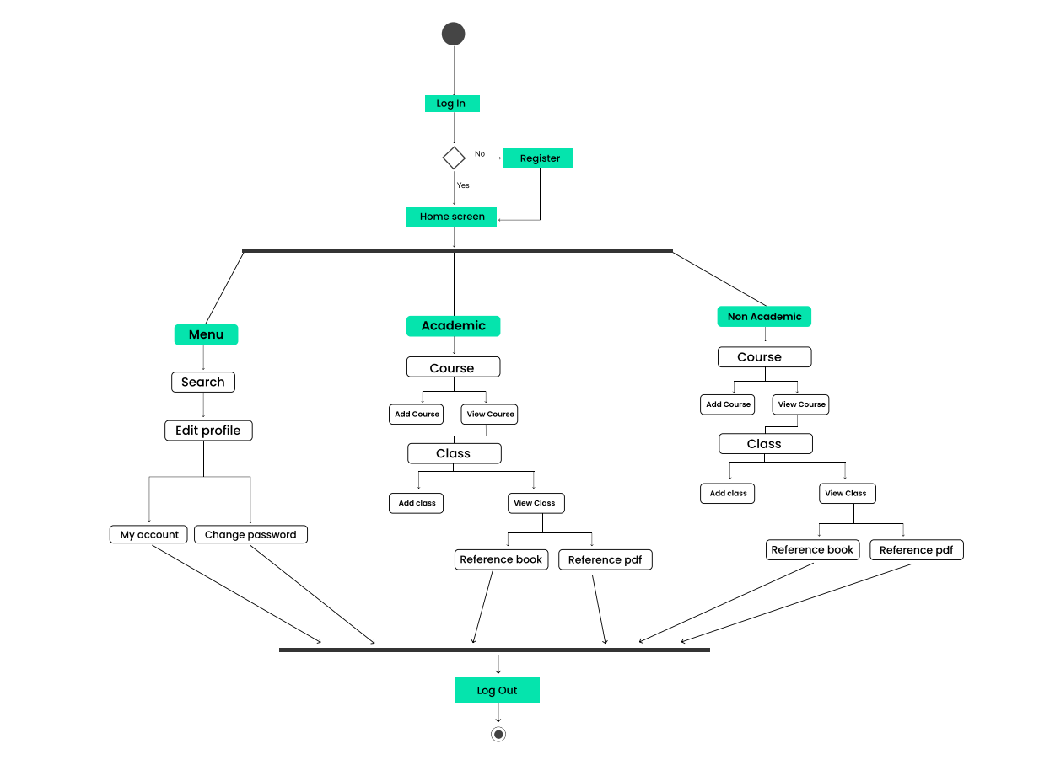
Activity Diagram

Slide 11
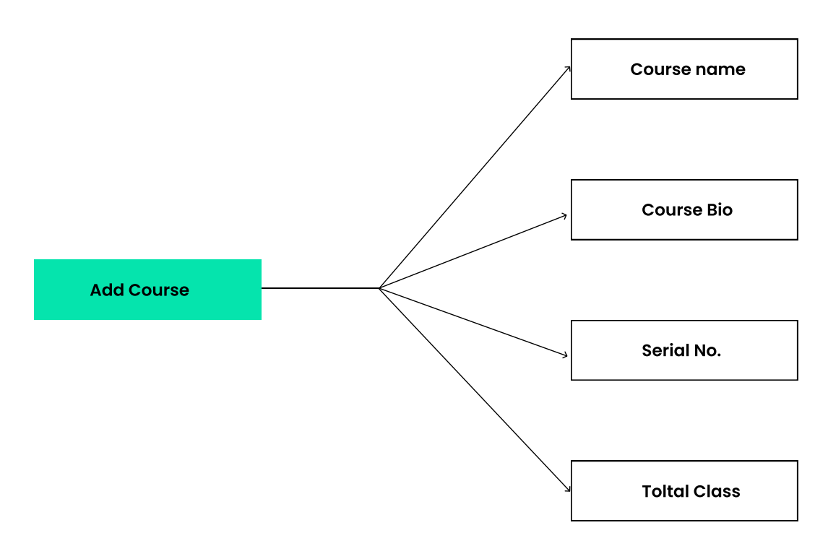
Step – 01 Add Course

Slide 12
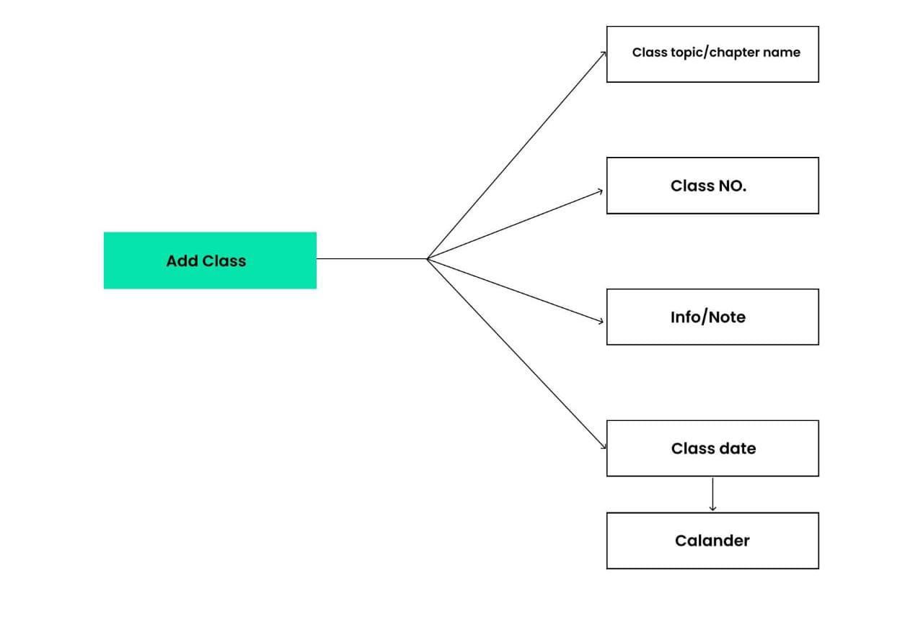
Step – 02 Add Class

Slide 13
More about the App

Slide 14
You need this app because…
To secure our important notes.
We can store notes according to the courses and classes.
Easy UI.
Easy to use for everyone.
Easy to upload and download different types of files.
Make study more efficient.

Slide 15
Limitations
It cannot edit or delete anything into this app.
There is no searching option.
Only English Language.
No notification feature.

Slide 16
Future Plan
User can follow a profile
User can add comment
User can private their content
Searching will be added.
Web version will be available

Slide 17
Conclusion
Time is most valuable for anyone. Especially for students it is extremely important to
maintain time and utilize time in a proper way in educational period.
So study planner will help The students or anyone who wants to utilize their time by using lots of study related tools in less time.

