Slide 1

Does the Cold Affect COVID?
James Yang
UW DATA 512

Slide 2

Background

Slide 3
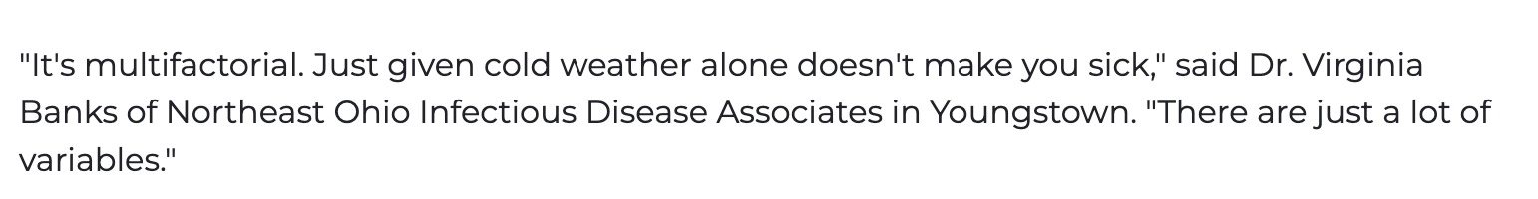
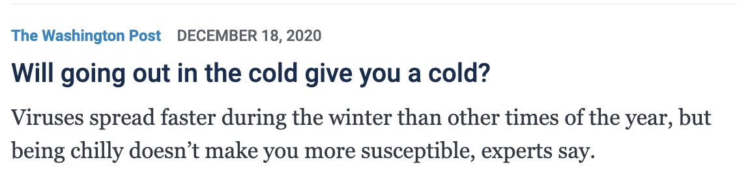
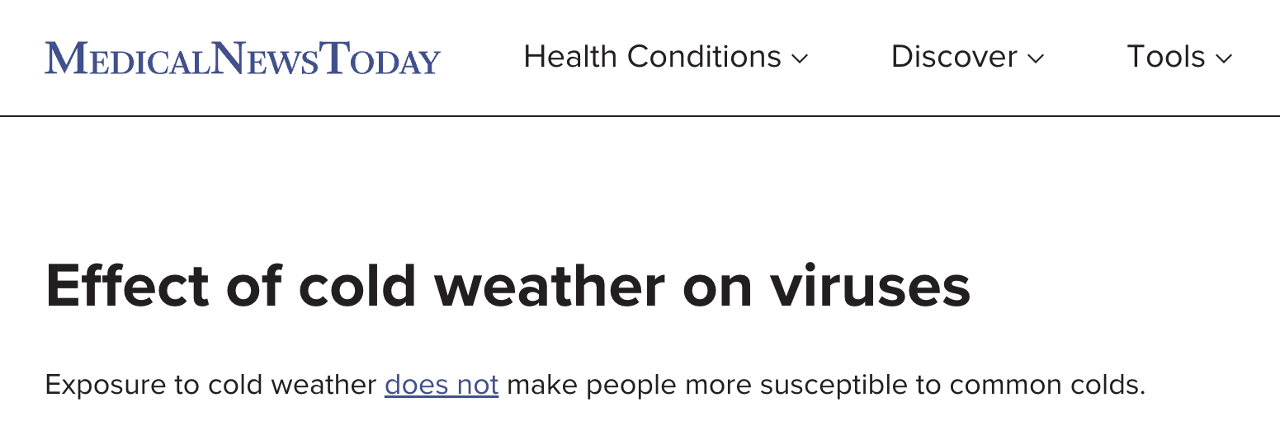
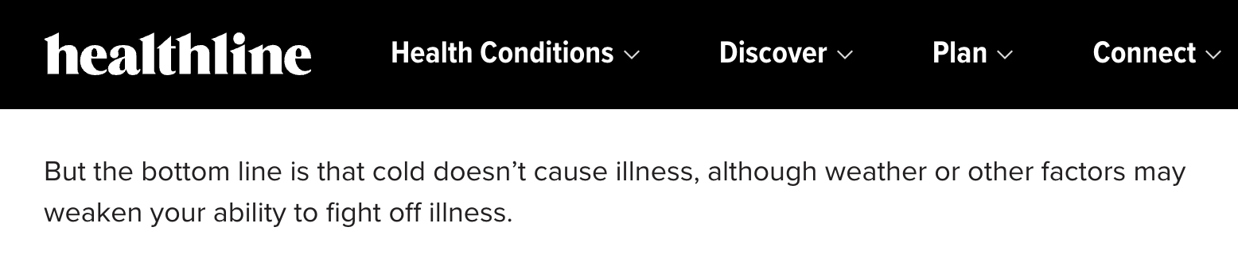
Search Results

Slide 4




What about COVID?
Pulled data from: Bergen, NJ

Slide 5
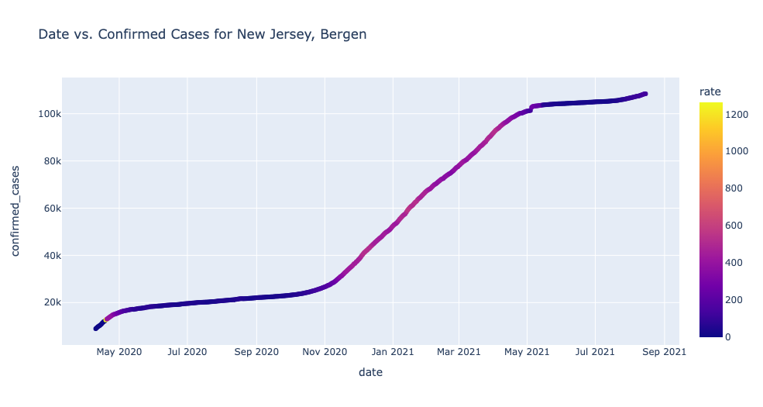

Slide 6
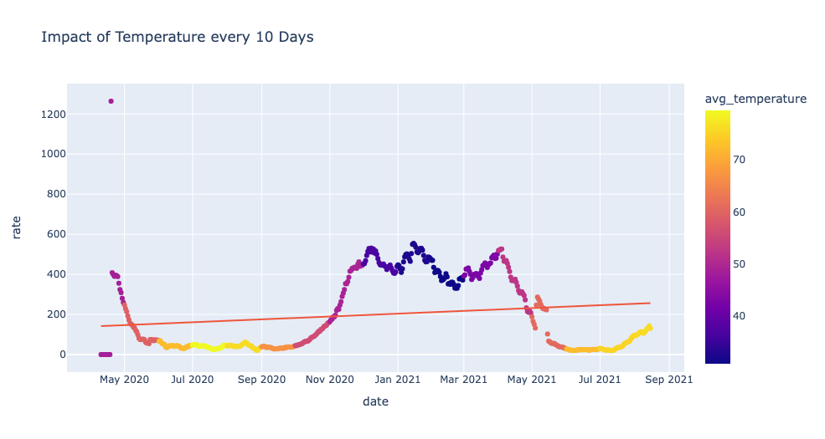

Slide 7
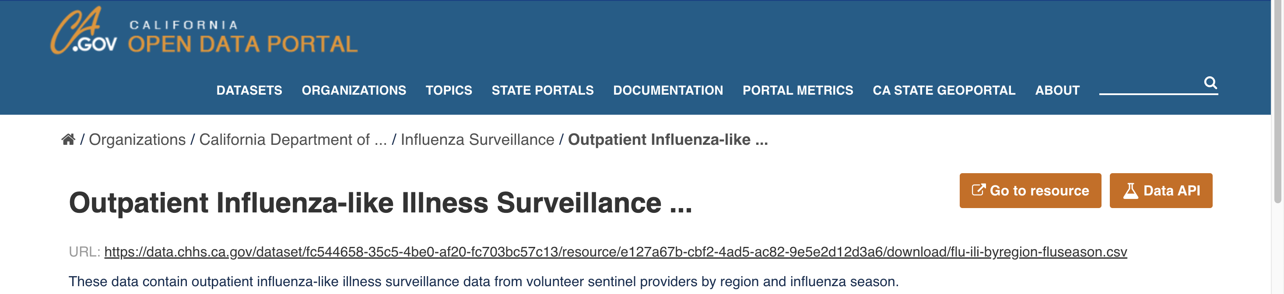
So what?
We need comparisons between cold/flu and covid-19
Statistical significance to answer whether the coldness of temperature impacts covid-19 or not.
Give a result!

Slide 8
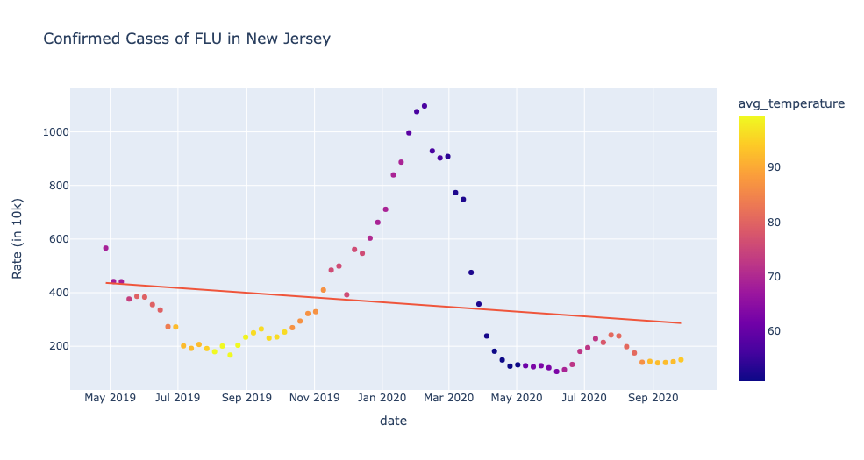

Slide 9

How do they compare?
Stats:
For an area of 0.05 (alpha), the Z-score is approximately 1.645.
Claim: Temperature does not affect the rate for both diseases.
(μ1 = μ2) given (T1 = T2)
Alternative: Temperature affects the rate for both diseases.
(μ1 != μ2) given (T1 = T2)
Z = 220.3 – 199.5 / (188/sqrt(450)) = 2.31
2.31 > 1.645 so we reject the null hypothesis

Slide 10
Results
There is a difference between the cold itself making a person sick and the cold impacting the rates of disease.
We believe that temperature affects the rates for both diseases. (as shown in the hypothesis test)
There are many claims that cold temperature itself cannot get a person sick.
But it does affect the rates for both a cold and COVID-19

Slide 11
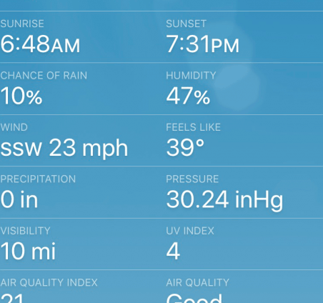
How do we expand on this?
There are many external features we could include in the project.
Average humidity, wind, AQI (Air quality), etc.
Create a forecasting model that predicted future years past COVID-19.
Differentiating a “Feels-like” temperature with true temperature.

