Slide 1

Does the Cold Affect COVID?
James Yang
UW DATA 512

Slide 2

Motivation

Slide 3
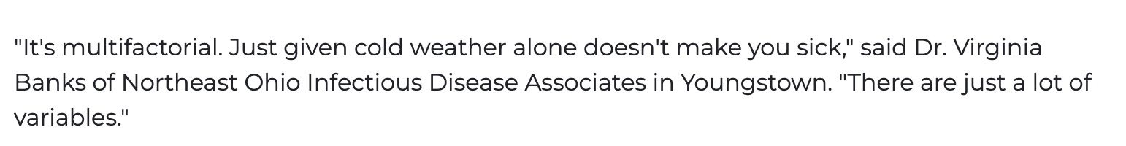
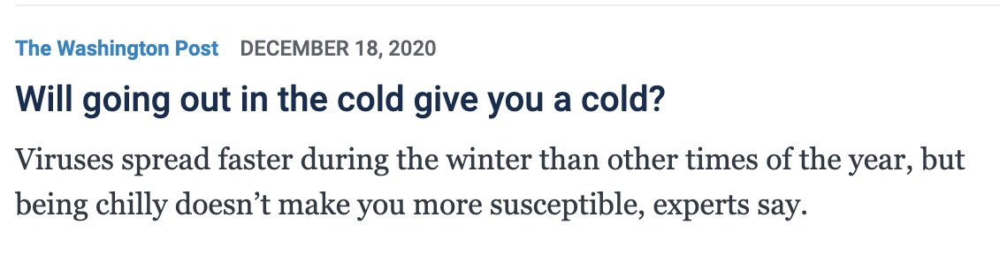
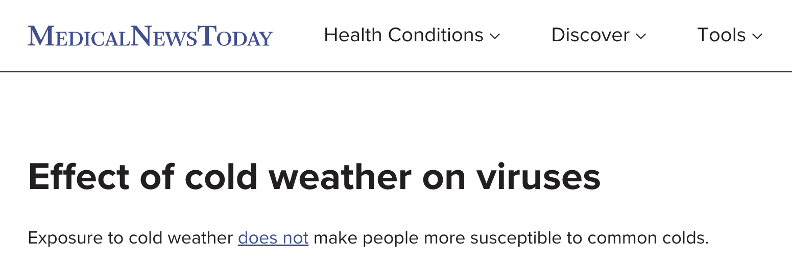

Search Results

Slide 4




Problem: What about COVID?
Pulled data from: Bergen, NJ

Slide 5
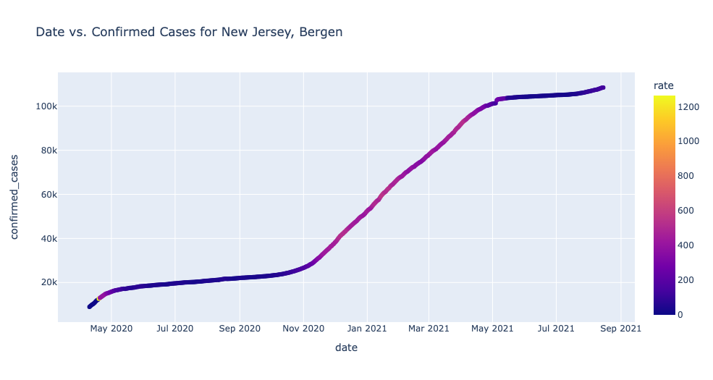

Slide 6
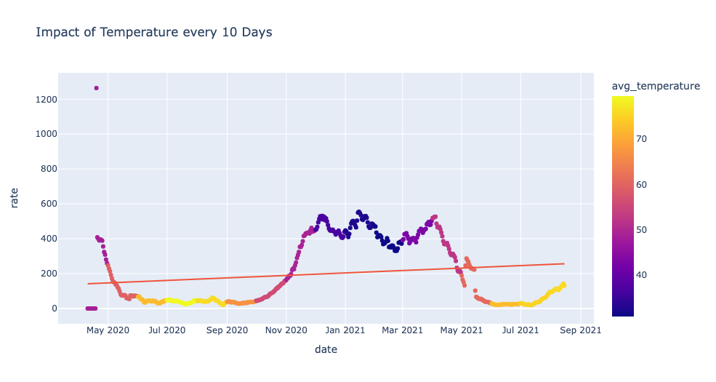

Slide 7
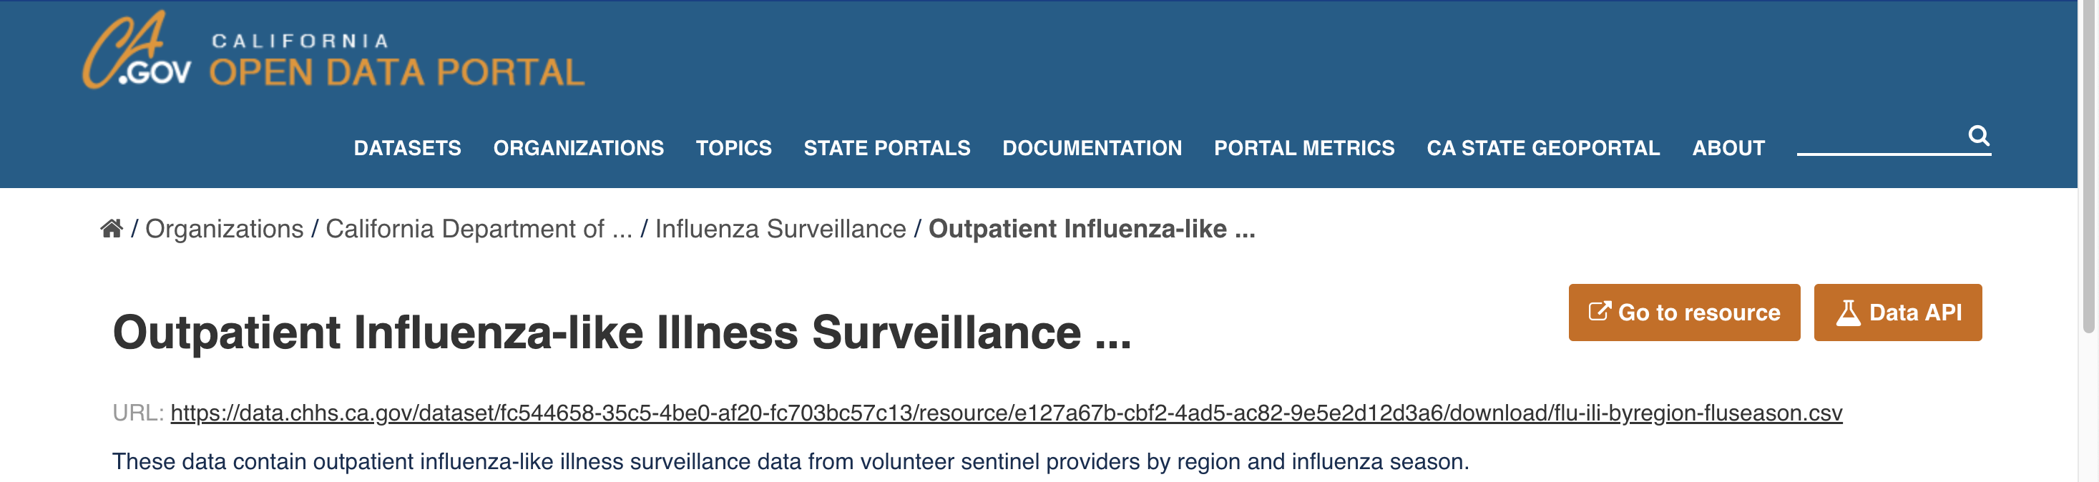
So what?
We need comparisons between cold/flu and covid-19
Statistical significance to answer whether the coldness of temperature impacts covid-19 or not.
Give a result!

Slide 8
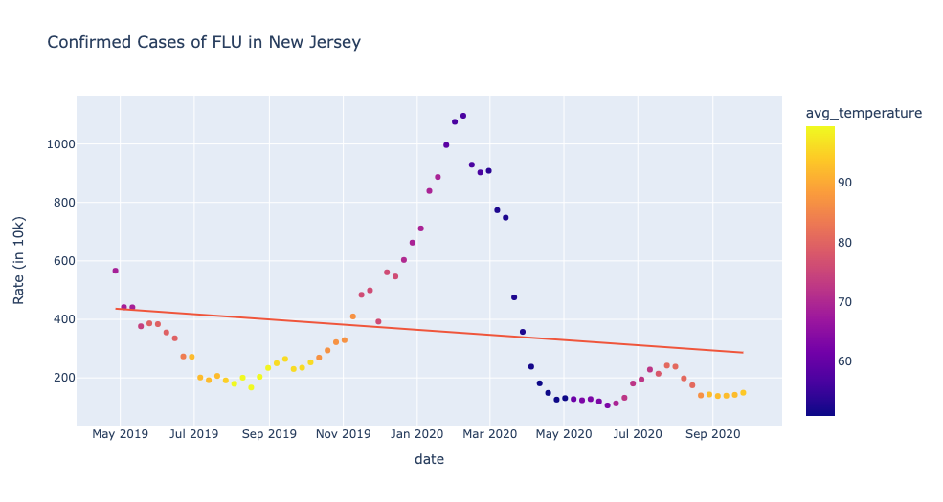

Slide 9

How do they compare?
Stats:
For an area of 0.05 (alpha), the Z-score is approximately 1.645.
Claim: Temperature does not affect the rate for both diseases.
(μ1 = μ2) given (T1 = T2)
Alternative: Temperature affects the rate for both diseases.
(μ1 != μ2) given (T1 = T2)
Z = 220.3 – 199.5 / (188/sqrt(450)) = 2.31
2.31 > 1.645 so we reject the null hypothesis

Slide 10
Results
We believe that temperature affects the rates for both diseases. (as shown in the hypothesis test)
There are many claims that cold temperature itself cannot get a person sick.
But it does affect the rates for both a cold and COVID-19

Slide 11
Why do the results matter?
There are a lot of news reports that speculate COVID-19 being the same as the common cold.
In this case, we were checking if the temperature had effects on COVID like it does with the common cold.
This is a helpful result in determining similarities between the behaviors of the cold and COVID-19.

Slide 12
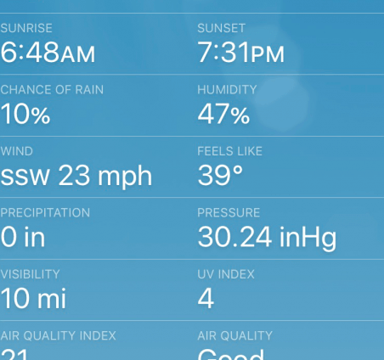
Why is it human centered & how can we expand?
The project revolves around humans and how temperature affects their symptoms of covid-19.
Average humidity, wind, AQI (Air quality), etc.
Create a forecasting model that predicted future years past COVID-19.
Differentiating a “Feels-like” temperature with true temperature.

