Slide 1
rcol_load = 0;
rrow_load = 1;
c1_sum = 1;
write_value = read_value;
read_value = ‘0…10’;
o_address = ‘0…10’;
c1_sum = 0;
sub_delta = 1;
rmin_load = 1;
rmax_load = 1;
S0
i_start = 1
S1
S2
S3
S3
i_start = 0
col = 0 and row = 1
S7
o_address = ‘0…00’;
o_en = 1;
o_address = ‘0…01’;
rcol_load = 1;
S7
S1
S2
rdata_load = 0;
o_done = 1;
c2_reset = 1
S14
S14
c2_reset = 1
col = 0 and row = 0
S4
S5
c2_reset = 0
rdata_load = 1;
rrow_load = 0;
c1_sum = 0;
o_address = ‘0…10’;
read_value = ‘0…11’;
dim_read = 1;
c2_reset = 1
S13
S13
c1_sum = 1;
o_address = read_value;
write_value = read_value;
rmin_load = 1;
rmax_load = 1;
c2_reset = 0
o_address = read_value; c1_sum = 0;
rdata_load = 0;
o_we = 0;
S4
S6
S5
S6
S12
c1_sum = 0; read_value ++;
c2_reset = 0
S12
S10
S9
S8
S11
o_address = read_value; c1_sum = 0;
rdata_load = 0;
S9
sub_delta = 0;
rmin_load = 0;
rmax_load = 0;
rshift_load = 1;
write_value ++;
read_value ++;
o_address = write_value;
c1_sum = 1;
rdata_load = 0;
o_we = 0;
rdata_load = 1;
rshift_load = 0;
S8
S10
S11

Slide 2
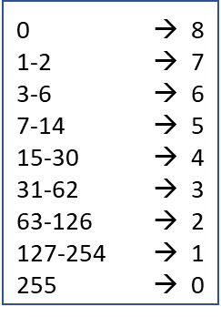
rshift
1
c2
1
c1
rshift_load
c1_sum
c1_reset
delta
+
+
O_DATA
sub_delta
<<
rdata
c1
c2
-
c1_reset
c2_reset
rdata_load
rmax
rmin
=
=
-
rcol
rcol_load
rrow
rrow_load
rmax_load
rmin_load
>
>
I_DATA

