Slide 1
Simple Profit Analyst Dashboard Project

Slide 2
BACKGROUND
This interactive dashboard is intended for management to monitor performance and analyze SuperStore revenue over time, as well as by product category, geography, and consumer segmentation.
In addition, this dashboard is also intended to provide insight in making strategic decisions to increase SuperStore revenue.

Slide 3
METRICS
% Profit contribution by Product Category
% Profit contribution by Region
% Profit contribution by Segment
Annual profit trend
% Profit Growth YoY
% Profit Growth by same Quarter in last 1 year

Slide 4
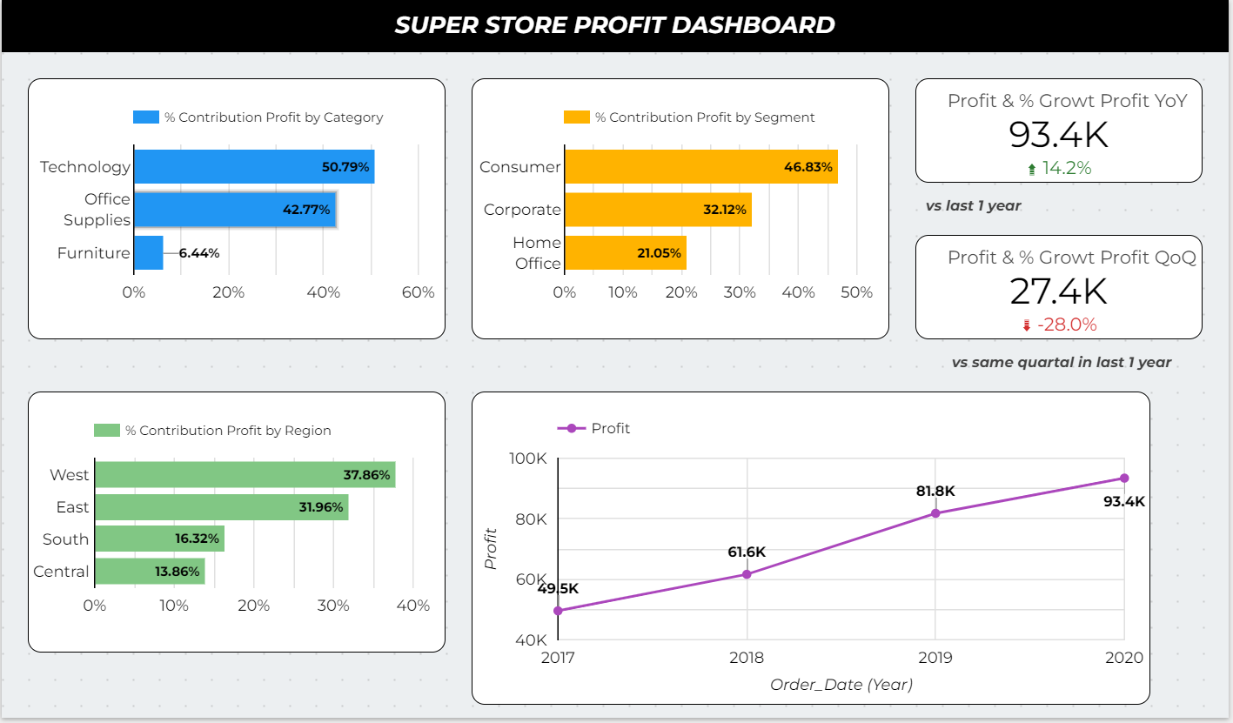
OVERVIEW

Slide 5
CONCLUSION
Based on the data, SuperStore's revenue increased year-on-year for 4 years with the technology product category accounting for about 50% of the total profit, from Location West accounting for about 37%, and the consumer segment accounting for about 46%.

Slide 6
RECOMMENDATION
Based on this data, to increase revenue SuperStore can focus on the Technology product category for the consumer consumer segment in the West region.

Slide 7
ATTACHMENT
Dashboard Looker Studio
Script SQL

