Slide 1

Waveform Drawing using Qt/QML
Genesis Shadow Project
Status Report by:
Mohammed Sadiq Afreed Meeran (99002449)
Kavya k (99002567)
Akash Shetty(9900)
Ankita D.Joil (99002660)
Notes:
<number>

Slide 2
Introduction

Slide 3
Project Highlights
Project Mentors
BU Mentor: Hrushi A C
GEA Mentor: Rajesh Sola
Team
Intern Name: Afreed Meeran
PS#: 99002449
GENESIS Track Code: 2009BLRMED01
Education Details: B.E(CSE)
Intern Name: Akash Shetty
PS#: 99002
GENESIS Track Code: 2009BLRMED01
Education Details: B.E(ECE)
Intern Name: Ankita D Joil
PS#: 99002660
GENESIS Track Code: 2009BLRMED01
Education Details: B.E(CSE)
Intern Name: Kavya K
PS#: 99002567
GENESIS Track Code: 2009BLRMED01
Education Details: B.E(CSE)

Slide 4
Problem Statement
Qt/QML application for multi waveform drawing.
Limited features Waveform drawing with given input data file, Waveform scaling, Waveform speed, Waveform color, Waveform thickness.

Slide 5

Methodologies
MVC(Model View Controller)
MVVM(Model View View-model)
Solid Principles

Slide 6
Scope
The scope of the project is to :
Simulate the various hardware requirements of the function generator circuit
To analyze the signal by implementing the mathematical model of the signal's algorithm
To find the required waveform.​

Slide 7
Objectives
Requirements specification and detailed scope
Learning on C++
Learning on QT/QML

Slide 8
Key Deliverables
Requirements specifications
Source code
Waveform drawing using Qt/QML

Slide 9
Implementation

Slide 10
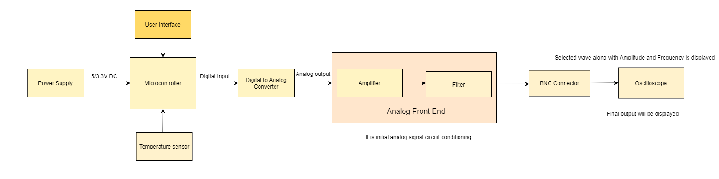
Block Diagram
The input from the power supply that is the regulated 5V DC is required to power up the controller.
The microcontroller powers up, the user interface (Capacitive touch Screen Display) is interfaced.
Later the Micro controller is connected to DAC through specified pins.
Then the Analog Front End has Amplifiers and filters to get the required amplitude of the output waveform that will be Noise Free.
The Output will be displayed in Oscilloscope using BNC- BNC Connectors.

Slide 11
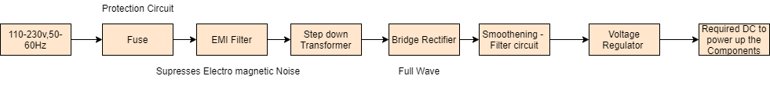
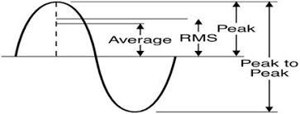
Power Supply Section
The Supply 110-230V,50-60Hz is designed based on the requirement.
The Input provided to Step down Transformer is 230V, 50 Hz (India). After stepping down the output voltage is 12V AC (Vpeak= 17V)
Now AC signal must be converted to DC so here Bridge Rectifier is used.
This signal is passed through filter to smoothen the wave and to remove ripples.
Voltage regulator is used to Regulate as per the required Voltage to power up the components.

Slide 12
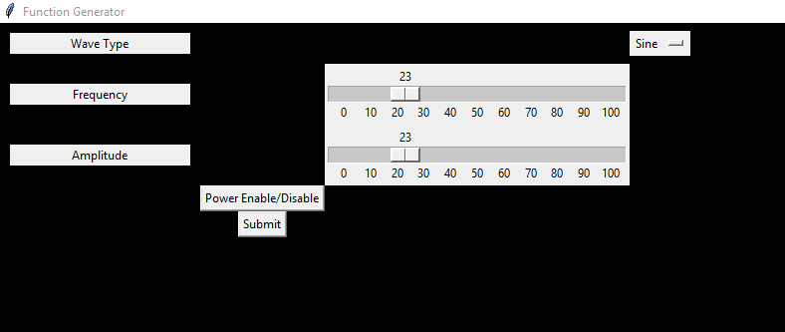
GUI Design
This is the GUI designed based on the requirement specifications.
The GUI designed in Python language whereby importing the TKinter Module.
The GUI has different buttons.
In waveform selection, it the dropdown menu where the user can select different types of waveforms
Once the selections are done, the user must submit the values.

Slide 13
Weekly Progress

Slide 14
Project Timeline
Completed
Active
Yet to Start
S.No | Tasks | Week 1 | Week 2 | Week 3 | Week 4 | Week 5
1. | Understanding the System
2. | Requirement Specifications
3. | Block Diagram/Methodology
4. | Understanding of the tool used
5. | Simulation of the system
6. | Designing the firmware/algorithm
7. | Testing of the algorithm/firmware
8. | Porting the firmware in the target board
9. | Validating the results on simulator
10. | Submission of project
Notes:
<number>

Slide 15
Task Summary
Completed
Active
Yet to Start
Tasks during Week 1 and Week 2 (18-11-2020 to 28-11-2020)
Sl No | Tasks | Activity | Remarks
1 | Understanding the System | Exploring resources
 |  | Problem statement, Objectives
2 | Study on Concepts | Understanding the power supply section
 |  | Analog Front End | New concepts
 |  | Digital to Analog Converter
 |  | Safety measurements
3 | Block Diagram | Designing power supply section | Selection between SMPS or LMPS
4 | Documentation | Requirement Specifications and Weekly report | Achieved major deliverable

Slide 16
Completed
Active
Yet to Start
Tasks during Week 3 and Week 4(30-11-2020 TO 12-12-2020)
Sl No | Tasks | Activity | Remarks
1 | Selection of Components | Comparing different types of Microcontrollers
 |  | Various other components like DAC, Temperature sensor and display
2 | Study on Concepts | Understanding Mathematical equations of the signals
 |  | Analog Front End
 |  | Interfacing the peripherals to the microcontroller
 |  | GUI for function generator
3 | Block Diagram | Designing main block diagram
 |  | Designing of Power supply section

Slide 17
Completed
Active
Yet to Start
Tasks during Week 3 and Week 4 (30-11-2020 to 12-12-2020)
Sl No | Tasks | Activity | Remarks
4 | Documentation | Block Diagram documentation, Daily and Weekly reports
5 | Simulating the system | Installation of IDE
 |  | Simulating in the software
6 | Designing the firmware | Implementing the logic

Slide 18
Thank you

