Slide 1


Slide 2
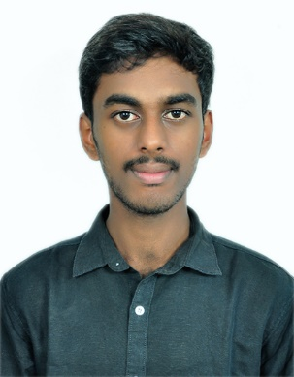

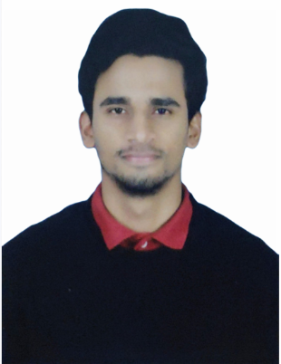
Project Highlights
Project Name : Employee Database Management System
Team Size : 3
BU Mentor Name : Raghavendra C S, Milind Hatkamkar, Jagdeesh B
Team Members Details :
Intern Name – Chethan G C
PS# 99002457
GENESIS Track Code - 2009BLRICP01
Education Details – B.Tech CS
Professional Skills - Problem Solver (Intermediate), Team Player
Intern Name – Roshan Kochgawe
PS#99002461
GENESIS Track Code - 2009BLRICP01
Education Details - B.Tech EEE
Professional Skills - Team Player,Management skills
Intern Name – Harshith H K
PS# 99002442
GENESIS Track Code - 2009BLRICP01
Education Details – B.Tech
Professional Skills – Team Player, Mentoring

Slide 3
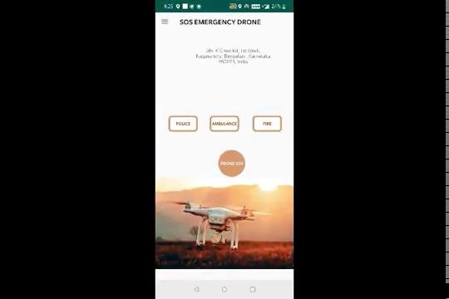
Project Video Snippet
https://drive.google.com/file/d/18ysmhNrBxnfWPQPR33CrlCaF-uqTxbiL/view?usp=sharing

Slide 4
Future development that can be implemented further
Drone SOS can be integrated to drones
Direct messages to the drone minicomputers
Drone SOS needs to be enhanced and and user profile can be expended
Emergency contacts can be expended

Slide 5

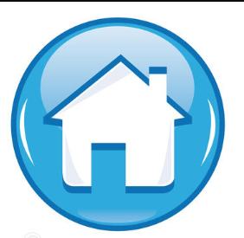
Thank You !

