Slide 1
Social Influencer
UI/UX Design
Nov, 2020

Slide 2




System Overview
Opportunity
Solution
Commercials
Advertiser
Social Influencer
Platform
Influencer
Social Network
Admin

Slide 3
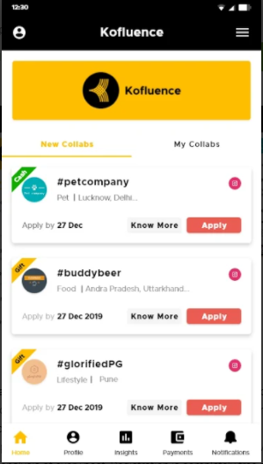
Android Mobile UI/UX : Landing Screen
Opportunity
Solution
Commercials
Left side screen is just for reference to give an idea. (Ankitha) (Thrinath)
Sl. No | UI Components | Timelines in days
1 | Bottom Navigation with following components: Home Search Notification Profile
2 | Home Screen: Card View with list of Campaigns Basic info about Campaigns and Know More & Apply Button
3 | Know More -> Shows details about Campaign. Even click on the Card should show details.
4 | Apply -> Trigger notification for Advertisers. Notification screen shall show it.
5 | Once Applied the information should be listed in the respective Influencer Profile Screen.
6 | Past campaigns should clearly show that it’s over and button should be disabled to apply for the same.
7 | Click on Active/Past Campaigns should show the details of the campaigns.

Slide 4
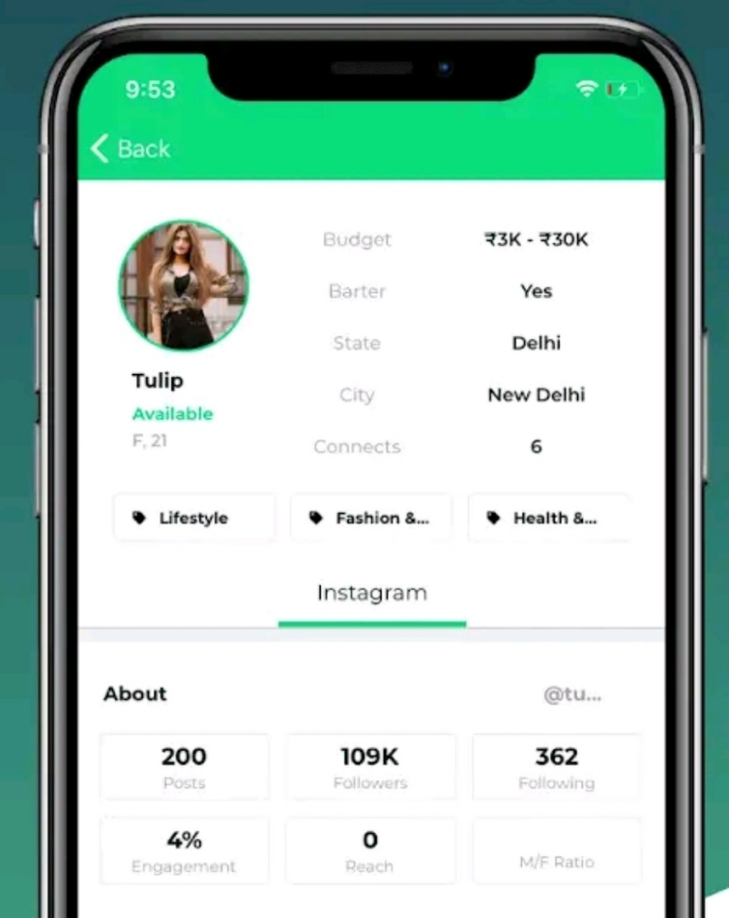
Android Mobile UI/UX : Profile Screen
Opportunity
Solution
Commercials
Left side screen is just for reference to give an idea.(Girish) (Sudarshana)
Sl. No | UI Components | Timelines in days
1 | Profile Screen should contain a rounded profile image of the Influencer on the left
2 | On the Right of the profile image, there should be basic information about the Influencer (Name, Gender, Min Budget set) .Area of Influence – Fashion, Art, Business should be present as well.
3 | Capture information about his Social Media Followers – Instagram, Facebook and YouTube. Use separate Card View to present information one below another.
4 | Campaign participation history should be available in the profile page with status – Applied, Running, Approved, Completed
5 | Click on the campaigns should show the details of the campaign.
6 | Total earning from the campaign should be shown in the profile page.

Slide 5
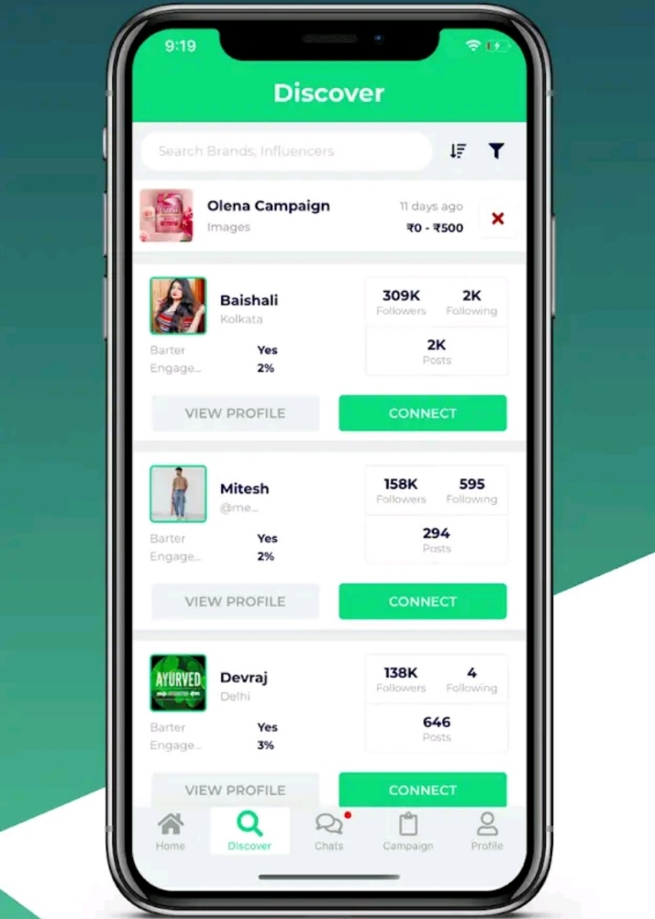
Android Mobile UI/UX : Search Screen
Opportunity
Solution
Commercials
Left side screen is just for reference to give an idea (Girish) (Sudarshana).
Sl. No | UI Components | Timelines in days
1 | Search Screen should allow Advertisers to search for Influencers.
2 | There should be a filter to allow searching by category such as Fashion.
3 | By Default the Search Screen should show 10 entries and up on scroll should load next set of entries.
4 | Influencers can search the running campaigns with category and price.
5 | Click on the search result of Influencer should show details of Influencer besides earning.
6 | Click on the search result of Campaigns should show details of the campaigns.
7 | There should be an option to apply for a running campaign or approach an Influencer from the search page.

Slide 6
Android Mobile UI/UX : Notification Screen
Opportunity
Solution
Commercials
Left side screen is just for reference to give an idea (Ankitha) (Thrinath).
Sl. No | UI Components | Timelines in days
1 | Notification Screen will show all interaction and event triggers to Advertisers and Influencers.
2 | For Influencers – A list should be shown to display all the requests coming in for brand campaigns. It should have a “Time Left” & “Price” field to respond as well.
3 | For Advertisers – A list should be shown to display all the requests coming from different influencers for each campaigns. It should have Influencer’s “Follower” count info present as well as “Min” Price set by Influencer in profile.
4 | Click on the Notification by Influencer should show details of Campaign.
5 | Click on the Notification by Advertiser should show details of Influencer.
6 | There should be an option to apply/reject for a campaign from the notification screen.

Slide 7
Milestones
Opportunity
Solution
Commercials
Major Milestones for Project:
Sl. No | Milestones | Date
1 | Firebase database design draft 1.0 | 26-Nov-2020
2 | Web Wireframe | 26-Nov-2020
3 | Effort estimation | 25-Nov-2020
4
5

Slide 8
Thank You

