Slide 1
Philips MHB Architecture
Philips LIfeLine ACG products
LTTS Team
Medical Diagnostics
9 March-2021

Slide 2
Philips LifeLine – Mobile Help Button
MHB is a PERS(Personal Emergency Response Service) device used to summon emergency help by a subscriber.

Slide 3


Overview of the MHB and Backend System
Create Case for PRA
Reports Alarm to Backend
PRA Call MHB
MHB

Slide 4
Overview of the MHB and Backend System (contd.)
1) MHB triggers alarm (By Fall detect algorithm or Button Press) to Backend.
2) Once Backend notifies with alarm event , It creates case for PRA (Personal Response
Assistant).
3) MHB receives call from PRA ( Personal Response Assistant)

Slide 5
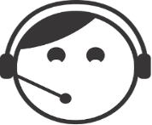

Representation of Back-End
Call
To be created:
Back-End
Webpage
x
MercierTerm
x
> dbg
> user: *****
> pass: *****
> fmv
> version
MercierTerm
Webpage
Call center
XMPP
USB BTLE
Future BLE HUB / Android
XMPP
Openfire
Server
Database
Alarm
XMPP
XMPP
Envoy
MySQL + PHP
XML
wan protocol
(Signal Sample)
= Alarm
7 = ATC
50 = HW Fail
17 = Last Breath
Client
(MHB)
EnggBot

Slide 6
Description of Back-End
MHB connects to Mercier Term (A console for serial communication)
Openfire Server holds all XMPP logs (from Mercier Term).
When MHB reports alarm, Openfire server creates Event ID.
Openfire server sends to Envoy.
Envoy is responsible for assigning value to Event ID.
After assigning, Envoy sends back the Event ID (XMPP) to Openfire server and then Openfire server to Mercier Term and MHB

Slide 8
Internet Solution Providers :
LBS API (LOCATION BASED SERVICE) : This allows to send and receive location requests using a REST based API to find the location of users and create rich & real-time applications.
PSAP API (PUBLIC SAFETY ANSWERING POINTS) : PSAPs are responsible for receiving emergency calls( emergency telephone number for police, firefighting, and ambulance services)and processing those calls according to a specific operating policy.
Mapping API : A Map API (also known as Mapping API) Includes features for geocoding(provides co-ordinates ,reverse geocoding(provides address), geolocation(determines coordinates), directions and navigation.
CTI (Computer Telephony Integration) : A way to control the functionalities of the phone with the computer. Telephone is no longer needed.
PBX (Private Branch Exchange) : It is a private telephone can communicate internally(within office) and externally(outside the world using different communication channels like analog/digital/Voip.

Slide 9
Hardware Description

Slide 10
Module | Purpose | Protocol used | Others
GPS | To find instantaneous location and time | UART | Cellular module -> I2C
Serial Flash | To store voice prompts for user | SPI | Store prompts in three languages
Audio amplifier | To play the voice prompts | DAC | Cellular module -> CODEC chip(to carry voice of PRA)
Accelerometer & Pressure Sensor | Fall Detector Algorithm & Bread crumbing Algorithm (BCA) | SPI | BCA – Keeps tracking on user movements
Help Button | Initiate a request for emergency response by Subscriber | GPIO | Produces interrupt each time button is pressed
Battery Charger | To charge Lithium Ion Battery | I2C | Battery Gauge -> measures remaining charge
Cellular Module(4G) | For data and voice connection | UART | AT commands -> to communicate with up. Wiced chip -> USB
Wiced Chip | Helps in location of subscriber by tracing nearest access points | UART | Tracks MAC address and neighboring Access points.

Slide 11
Operating System : Uses an embedded Real-Time Operating System (RTOS) called emBOS (to run tasks at different priorities).
->Task performs operation if it receives emBOS event.
->We have only three tasks: COMM (Hi priority), DACQ (Medium priority) and BKG (Low
priority)
State Machine Events : One task can handle 8 events. In order to handle more than 8 events we create our own events called SM_events.
-> Once a task receives emBOS event, SM_events allows task to perform specific
operations.
Task Messaging Schema :
->When another task or interrupt service routine needs to alert COMM of something, it will allocate a SM_Event from the SM_Events Table,
Another Task/Interrupt
alert
All the tasks turns to SM_events in SM_events table.
Task to be performed

Slide 12
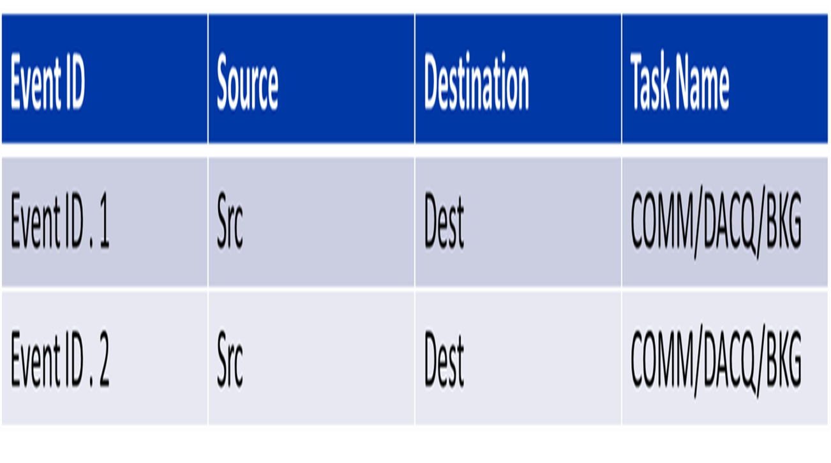
SM_events table
wakes up
-> When the COMM task wakes up, it will retrieve the first SM_Event in the mailbox
and process it.
emBOS event
Task in sleep mode

Slide 13
State Machines:

Slide 14
Each emBOS tasks has to support several different functional operations.
Each functional block divide into individual state machines(performs a specific operation depending on its current state and an input event)

Slide 15
Alarm Processing:
-> Two ways : Fall detection & Button press
-> Involves in Supervision, PERS, CELL, WIFI and driver(LED for event signaling) State
Machines
-> Cellular module helps in sending radio messages to Service Backend.
1) Sequential Walk through an Alarm :
Button Press by Subscriber -> interrupt in uc -> Debounce and event for Supervisor SM(BKG task)

Slide 16
2)
Supervisor SM fills alarm details in Backend Req. -> Insert in buffer -> Buffer attached to BACKEND_REQ event -> Supervisor to PERS SM
3) If PERS SM is idle -> sends Backend Req. Buffer to WIFI SM with info. About alarm
4)After receiving Buffer, CELL establish XMPP connection to backend server
5)After connection, CELL sends XML (MAC address, location parameters) to XMPP client envoy

Slide 17
6)Backend returns ack. to cell with ID no (event id)
.
CELL sends event to PERS to indicate event has reported and event place PERS in “waiting for reset “ state.
7) After receiving event id PERS SM enables auto answer, retrieve stored location points, send to XMPP envoy(by XML )
8)User receives call . After call, Reset happens.
XMPP server -> CELL -> PERS -> Supervisor

Slide 19
Supervision:
Periodic reporting(Problems) of the status of the MHB to the Backend server
Messages piped to Server mechanism is same as Alarm Processing
Supervisor SM -------------> PERS SM --------> WIFI ---------> CELL ----------> Server
(back_req event) (XMPP)
Supervision SM :

Slide 20
The SUP state machine has 6 major states :
SUP_ALLOCATING_RESOURCES , SUP_LOGGING_NON_RECOVERABLE_ERRORS , SUP_LOGGING_RESET , SUP_GET_VOLTAGE , SUP_GET_MAH , SUP_IDLE
1) System powers up enters to resources state it initializes its internal structures and retrieves the current “running” mode.
MGM_SLEEPING : Entire device operates in minimum current consumption mode and their functionalities will be in off mode
Send SLEEP_REQ_SM_EVENT -> SUP SM -> -> Resets the processor
EEPROM
To exit Press Help button that wakes up the processor.
MGM_AIRPLANE : All modules are turned off. No alarm will be send in this mode.
can enter to sleep mode by sending SLEEP_REQ_SM_EVENT to SUP SM.
MGM_SETUP : Series of audio and visual (LED) prompts guide the user to install his/her MHB and companion communicator.
After Installed, system will automatically put the system in MGM_RUNNING mode.
2) Once the SUP has allocated its resources and determined the current RUN_MODE, it will go through two other intermediate states, SUP_LOGGING_NON_RECOVERABLE_ERRORS and SUP_LOGGING_RESET
MGM_ SLEEPING

Slide 21
-> Handles activities related to error handling.
-> Non recoverable errors called “Tilts / Errors “ (to deal with unhandled events in SM)
->E.g. Divide by zero operation or a Watchdog expiration
Unhandled event -> SW store info. In RAM -> Reset -> After wakes up, writes the event to reset log.
3) SUP WAIT FOR BATT GAUGE INIT: Batter Gauge measures remaining charge and performance. After BATT GAUGE initialized itself, SUP gets notification from Power manager
4) SUP_GET_VOLTAGE: WAN chips threshold voltage (3.450 V). until the battery voltage gets high enough to operate, a button press or a fall will not generate any alarm.
5) SUP_GET_MAH: Waits until mAh > 150 mAh (To allow WAN subsystems to run)
6) SUP_IDLE : All housekeeping and dispatch functions of the SUP state machine are performed in this mode
SUP receives SUP_CELL_SUPERVISOR_EVENT . Checks battery status and sends “check-in” message to backend using cell for every & days

Slide 22
SUP receives SUP_PROC_TEMP_EVENT and checks temperature status for every
5 min.
a) if temp. is high > 15 minutes, IBC turned off, prevent WAN packets from going out
b) HW failure if temp. is high > 24 hrs.
If battery is about to deplete( < 150 mAh), Sup will send a “check-in” message to the backend using the cell phone.
If fall detector button lies flat for 20 min. send sleep event to SUP and IBC turns off . If button moves SUP turns on bread crumbing.

Slide 23
PERS State Machine
-> Manages all events that requires communication with call center. Events may be actual alarms / Button press / Status reports.
->PERS SM has 3 states:
Idle , Reporting , Waiting for reset state.
->Will have “pending queue” to store events/ status signals that cannot be readily processed.
->If the MHB has generated an Alarm event and it hasn’t been reported yet to the Call Center, it shall enter the “Reporting” state.
->If an Alarm event has been reported to the Call Center, it shall enter the “Waiting for Reset” state
->If the MHB is in the “Waiting for Reset” state and it receives a “Reset” event from the Lifeline Call Center, it shall go into the “Idle” state.
->When the MHB is in the “Waiting for Reset” state and there is another Alarm event generated by the MHB (Help or Fall Detected) the MHB will behave as following:
a) If the MHB has not received the call from Lifeline Call Center, it shall ignore the new event.
b) If the MHB has received a phone call and is left in “Waiting for Reset” state after the call is completed, it shall report the new event then stay in “Waiting for Reset” state.
c) If the MHB has currently an active voice connection to the Call Center, it shall ignore the new event

Slide 24
->If the MHB is in the “Waiting for Reset” state and it doesn’t have an active voice connection to the Call Center, the MHB shall allow the Lifeline Call Center to send a remote “Reset” event.
->If the MHB is in the “Waiting for Reset” state and it doesn’t have an active voice connection to the Call Center, it shall remain in receive mode and answer an incoming call.

Slide 25
BREAD CRUMBING
-> Periodically acquires the location of the user.
MHB will turn on its location devices (GPS and Wi-Fi) periodically.
When there is an alarm event MHB turns on the Cell Phone module to communicate with the service backend, it will acquire information about the Cell Tower it’s connected to (“Cell Tower”)
The combination of above location strategies is what we call “bread crumbing”.
This information will be reported to the service backend at the time of an event, which will allow the PRA to observe the current and past location (trajectory) of the subscriber, including the last time he/she was seen at home.
Breadcrumbing Walkthrough
->Handled by IBC SM, runs in BKG task.

Slide 27
IBC to start a 5 minute timer for periodically acquiring location information.
1)IBC acquires info from GPS and Wi-Fi (breadcrumb pair)
GPS gives location point and Wi-Fi gives access points
2) Stores GPS and Wi-Fi data in IBC log which occupies space in Serial Flash
3) PERS sends indication to IBS in order to retrieve breadcrumb logs by CELL , which further
send to Backend
4)Every 2 hrs. satellite position database need to update in GPS chip. This is done engaging CELL module connecting to the U-Blox Assist GPS database.

Slide 29
GPS
GPS SM handles GPS position acquisition.
Provides GPS aiding data to the GPS chip to speed up the GPS chip’s positioning computation.
Control the GPS operation mode to reduce GPS chip’s power consumption.
Keep GPS ON for extended period at startup if no 3D fix is obtained.
Put GPS to sleep when not in use till AGPS data is valid.
GPS in Alarm Mode
Operates in Max performance mode .
Goes to tracking mode after alarm resets.
GPS Positioning Walkthrough
GPS_INIT state
GPS_ACTIVE state
GPS_UBX_SOL state
GPS_UBX_TIMEUTC state
GPS_UBX_ANALYZE_RESULT state

Slide 30
GPS Positioning Walkthrough
1)GPS_INIT state
GPS wakes up after receiving GENERIC_POWER_ON from IBC
GPS will be in MAX_PERFORMANCE mode until it gets a 3D fix.
2)After GPS chip is ready, it goes to Tracking mode
Goes to GPS_ACTIVE STATE to start acquiring latitude, longitude and height.
3)In GPS_UBX_SOL state ,we will get velocity and orientation results.
4)In GPS_UBX_TIMEUTC , we get solution results.
5)In GPS_UBX_ANALYZE_RESULT , we get GPS UTC time result

Slide 31
Wi-Fi Operation
Wi-Fi operation is controlled by Wi-Fi SM and WICED application code.
Wi-Fi SM & Wiced -> Handles Wi-Fi Access points
Wi-Fi SM -> Wi-Fi operation and Scanning operation
Wiced application -> Provides interface b/w Wi-Fi chip and STM
During the configuration process, Wiced establish connection and pass commands, parameters
Wi-Fi Scan Walkthrough
IDLE state -> Before IBC triggers.
POWER_UP state -> When IBC triggers scan request.
Wiced application code sends ready request to Wi-Fi SM and performs scan operation and sends to Wi-Fi SM.
Wi-Fi SM receive the scan results and will perform some updates based on BSS id and RSSI value.
When to end Wi-Fi scan ? ->1.5 s timer and 4 s timer.
After completing the scan, Wi-Fi chip goes to Idle state.

Slide 32
WAN Operation
Managed by the WICED application.
Wiced controls u-Blox cellular module, generates XMPP messages, downloads agps data.
Receives most of the events from PERS SM also from IBC SM.
Also triggers LED controls and voice prompts messages.
u-Blox Module Control
controlled via “AT Commands”.
Turned ON and OFF by asserting PWR_ON line.
Module is turned on immediately after power is applied.
Module activation
u-Blox will be on during following circumstances.
When a PERS event needs to communicate to backend, module will be on until the event gets reset.
Event from IBC SM to download agps data and update it to GPS module.
PERS SM requests the module to upload a file from the MHB to an external HTTP server
PERS SM requests the module to download a new image from an external HTTP server
Command "power on cell" will make DEBUG SM send GENERIC_POWER_ON event through PERS SM and eventually reach CELL module, which will also turn it on.

Slide 33
Voice calls
Only permitted in case of alarm.
Generally, voice calls are incoming from the PRA. This is the case when processing an alarm through the WAN.
In special cases, the module may place a call to a phone number set in configuration parameter PSAP_NUMBER

Slide 34
CELL SM:

Slide 35
SUP SM -> PERS SM -> CELL SM
Cell SM Description
IDLE state:
1)User presses button, CELL SM retrieves configuration parameters from EEPROM SM.
Turning ON state: (When there is something to do)
1)Turn on cell module to get registered with tower.
Connect to Tower state: (Download assist data to GPS)
1)Once module gets registered ,configure the u-Blox parameters.
Connect to Server state: (If request is Alarm / Fall detection / status)
1)TCP connection to XMPP server.
Reporting state:
1)Now report alarm/status/last breath after opening XMPP session to Envoy. It replies with event ID.
2)CELL SM requests IBC logs (GPS and WIFI) from FLASH LOG SM. During alarm, it requests live breadcrumbs for every 5 min. and reported to CELL SM
3)FLASH LOG SM after sending breadcrumb pair CELL SM reports to backend via XMPP message.
Turning OFF state:
1)After reporting all the breadcrumb logs it will close XMPP session and module will be turned OFF and sends event to PERS SM to signal that job has been done.

Slide 36
During reporting following can happen:
1)Every 5 min. Cell SM will send query to backend to know about the request whether it has ‘Closed’ or ‘Alive’.
2)Any time CELL SM receives ring indication from u-Blox to activate speaker which allows PRA to communicate with user and starts new 30 min timer.
3)Any time CELL SM receives command from backend
Inc. or Dec. the vol. of speaker
Turn on/off audio beacon
Establish a 3-way call with e911 operator.
Close the case by Reset event
4)CELL SM may receive one more alarm event from PERS SM which means user has pressed button again. “Help still needed” message will send to backend.
5)After 30 min. case will reset(close).
6)A new bread crumb data may reported by IBC which needs to report to backend.
Once module is turned off, it will return to IDLE state to await new requests.

