Slide 1


Slide 2
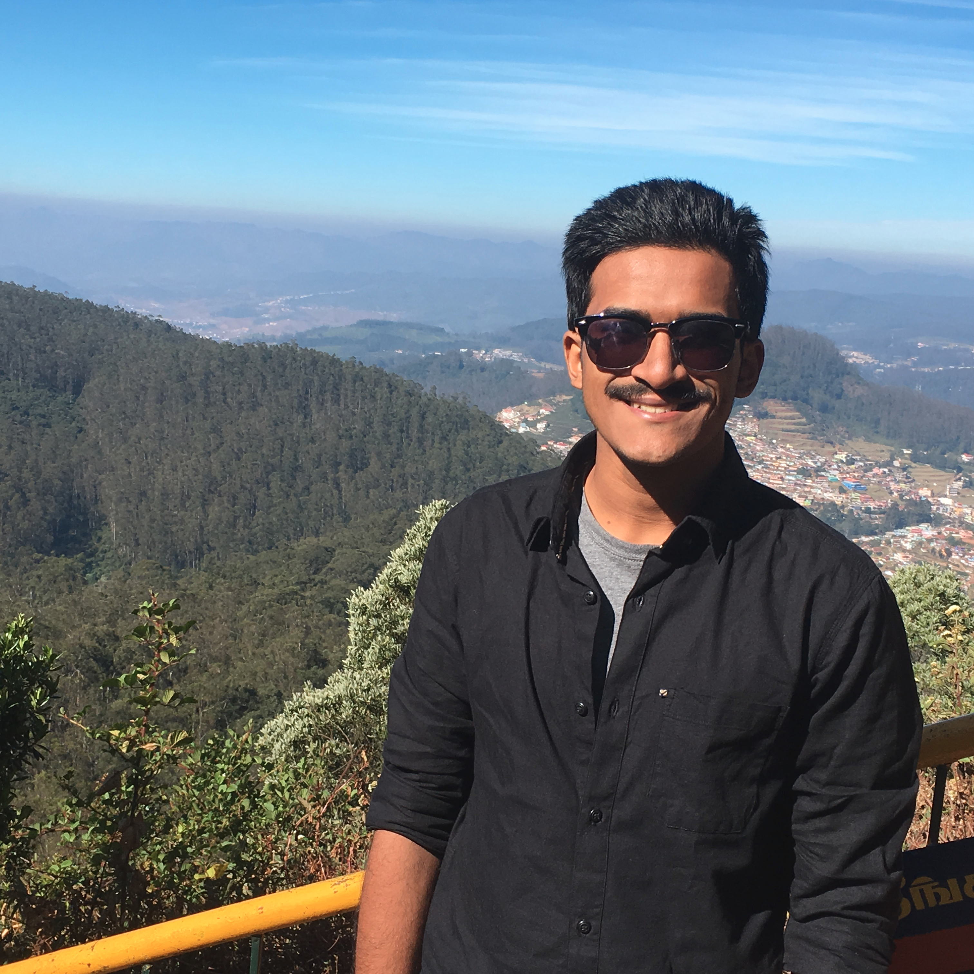
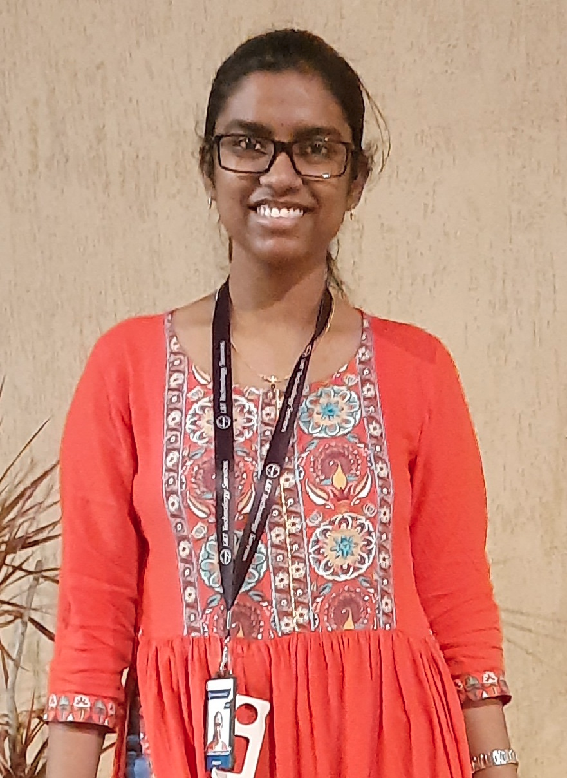
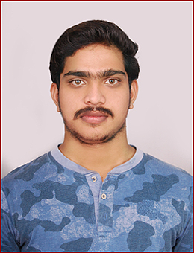
Project Highlights
Project Name : Movie Ticket Booking System
Team Size : 3
BU Mentor Name : Neha Bandi Mentor PS#
Labeeb Ali Koleth
99002617
2009BLRICP01
BE (EBE)
Technical Skills, Management
Naga Sai Jyothi Jaladi
99002575
2009BLRICP01
BTech(ECE) Teamwork, Problem Solving
Devineni Sai Kiran
99002624
2009BLRICP01
BE(CSE)
Communication, Teamwork

Slide 3
Project Video Snippet
Project work flow video : LINK

Slide 4
Future development that can be implemented further
Develop the user interface of the project
Increase the features like (adding the song we required).

Slide 5

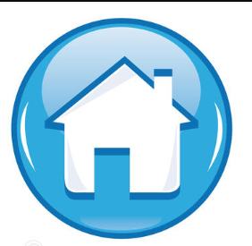
Thank You !

