Slide 1


Slide 2
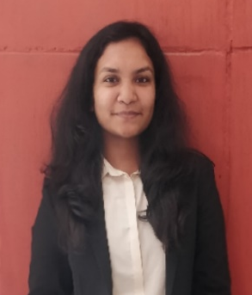
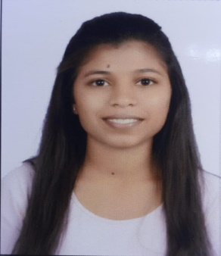
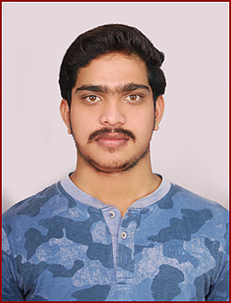
Project Highlights
Project Name : Movie Ticket Booking System
Team Size : 3
BU Mentor Name : Neha Bandi Mentor PS#
Shrawani Bawage
99002688
2009BLRICP01
BE (EXTC)
Technical Skills, Management
Tejasvi Mhase
99002669
2009BLRICP01
BE(Electronics) Teamwork, Problem Solving
Devineni Sai Kiran
99002624
2009BLRICP01
BE(CSE)
Communication, Teamwork

Slide 3
Project Video Snippet

Slide 4
Future development that can be implemented further
Market segment
Expand capabilities to cover more events and movies.
Acquiring more partnerships with various business entities
Open Segmentation

Slide 5

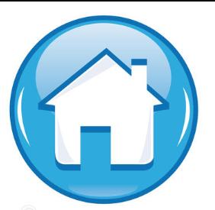
Thank You !

