Slide 1

SaMD (Software as a Medical Device) &
SiMD (Software in a Medical Device)
Madhura Ramojwar

Slide 2
Agenda
SaMD ( Software as a Medical Device)
SiMD (Software in a Medical Device)

Slide 3
SaMD (Software as a Medical Device)
Defined by the International Medical Device Regulators Forum (IMDRF).
It is a software intended to be used for one or more medical purposes that perform these purposes without being part of a hardware medical device.
Example:
  Software that is processing a patient image to detect diseases like cancer
  Treatment planning app that supply information to a patient
  Algorithm to Detect Atrial Fibrillation
  EEG Analysis
  Software that regulates an installed medical device, like a pacemaker.
Clinical evaluation of SaMD is conducted to generate, collect, analyze and assess the data related to the device to ensure its safety and efficacy.
Following are the major components of the clinical evaluations performed on SaMD:
  Valid Clinical Association – Verifies the association between the output of the SaMD and the target clinical condition
  Analytical Validation – Demonstrates the technical relevance of the output of the SaMD
  Clinical Validation – Demonstrates that reliable outcomes are generated from the SaMD after testing it on the target population

Slide 4
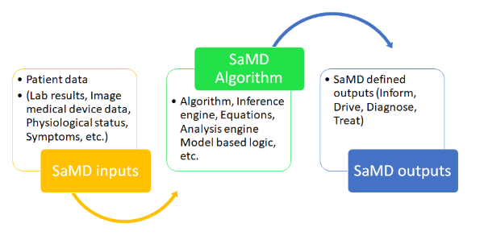
Input data source for SaMD could be medical devices, lab results, medical images, IVD instrument results, vital signs, medication, patient demography, allergies etc.
SaMD can have algorithm to process this and provide output that could be used for medical purpose (Inform, Drive, Diagnose, Treat).

Slide 5
Classification of SaMD
SaMD can be classified based on following two criteria:
  Based on the type of information provided by the device
    For treatment or diagnosis
    For driving clinical management
    For informing clinical management

Slide 6
  Based on the impact on treatment
    Critical
    Serious
    Non-serious

Slide 7
SaMD Categories
There are 4 categories ( I, II, III , IV ) based on the level of impact on the patient's health.
Category IV is the highest level of impact and Category I is the lowest.
Category IV – Provides information for the treatment or diagnosis of diseases or conditions that are critical and are considered “very high impact”
Category III – Provides information for the treatment or diagnosis or clinical management of diseases or conditions that are serious and are considered “high impact”
Category II – Provides information for the treatment or diagnosis or clinical management of diseases or conditions that are non-serious and are considered “moderate impact”
Category I – Provides information for the clinical management of diseases or conditions that are non-serious and are considered “low impact”

Slide 8
SiMD (Software in a Medical Device)
It is a software that is part of functioning of a medical device.
It does not have a medical purpose independent of a medical device with hardware components.
Purely embedded software within medical equipment , includes desktop, mobile and cloud software.
The fact that you cannot use the medical device without this software, makes it SiMD.
Example:
  Software within mobile applications that control a medical device through Bluetooth, Wi-Fi or other functionality.
  Embedded software that operates a pacemaker.
  Mobile application which is an interface for reading waveforms.

Slide 9
IEC 15408 (The Common Criteria for Information Technology Security Evaluation)
Also referred to as Common Criteria or CC i.e., an international standard (ISO/IEC 15408) for computer security certification.
Current version 3.1 revision 5.
It can be applied to Operating systems, databases, network devices, smart cards.
Certification of a specific version only applies to that version and not the newer version.

Slide 10
Services offered by IEC 15408:
  Professional support and help with the evaluation along with certification of your product.
  Well-trained personnel with in-depth knowledge of the Common Criteria standard.
  Reliable and extensive evaluation services from an independent Certification Body.
  Tailored consultancy on IT product security and certification.

Slide 11
