Slide 1


Cyber Security Maturity Model Certification (CMMC)
Madhura Ramojwar

Slide 2
Agenda
Topic 1: What is CMMA?
Topic 2: What is the standard for?
Topic 3: CMMA certification and it’s requirements
Topic 4: Additional Information

Slide 3
What is CMMC?
CMMC is the latest verification method put in place by department of defense.
The CMMC framework was developed by
OUSD(A&S), working with DoD stakeholders
University Affiliated Research Centers (UARCs)
Federally Funded Research and Development Centers (FFRDC)
Goal : implement appropriate level of cybersecurity across supply chain of DIB.
CMMC is the official certifying document for your company’s compliance with NIST SP 800-171.
The draft version of CMMC document version 4.0 was released on 30 August 2019.
RFP (request for proposal) will determine what CMMC level your company needs to meet based on your requirements.
Model is created on enhance and assess the cybersecurity posture of the DIB(Defense Industrial Base).

Slide 4
What is this standard for?
The goal of CMMC is to ensure the protection of two types of information from disclosure or unauthorized use:
Controlled Unclassified Information (CUI):
  This is the information the Government creates/possesses, or an entity creates/possesses on behalf of the Government.
  It is required for safeguarding or dissemination controls.
  Level 3 is the minimum requirement for CUI.
  Example : It includes personally identifiable information such as legal material or health documents, technical drawings and blueprints, intellectual property, etc.
Federal Contract Information (FCI):
  This is the information that is not intended for public release.
  It is provided / generated for the Government under a contract to develop / deliver a product or service to the Government, but not including the information provided by the Government to the public (such as on public websites) or simple transactional information, such as necessary to process payments.
  Level 1 and 2 is the minimum requirement for FCI.

Slide 5
What is the CMMC Accreditation Body (CMMC-AB)?
  The CMMC-AB is an independent organization that will authorize and accredit
    CMMC Third Party Assessment Organizations (C3PAOs)
    CMMC Assessors and Instructors Certification Organization (CAICO) in accordance with Department of Defense requirements.
Who will perform the CMMC assessments?
  Only Authorized and Accredited C3PAOs who are listed on the CMMC-AB Marketplace website will be able to conduct CMMC assessments.

Slide 6
When Does It Take Effect?
  As of September 2020, DoD began issuing a limited number of requests for information that contain CMMC specifications, and it is expected that CMMC will be a requirement of all new DoD requests for proposals beginning in 2026.
To Whom Does CMMC Apply?
  The certification is applicable to both
  “prime” contractors who engage directly with DoD
  subcontractors who contract with primes to provide fulfilment and execution of those contracts.

Slide 7
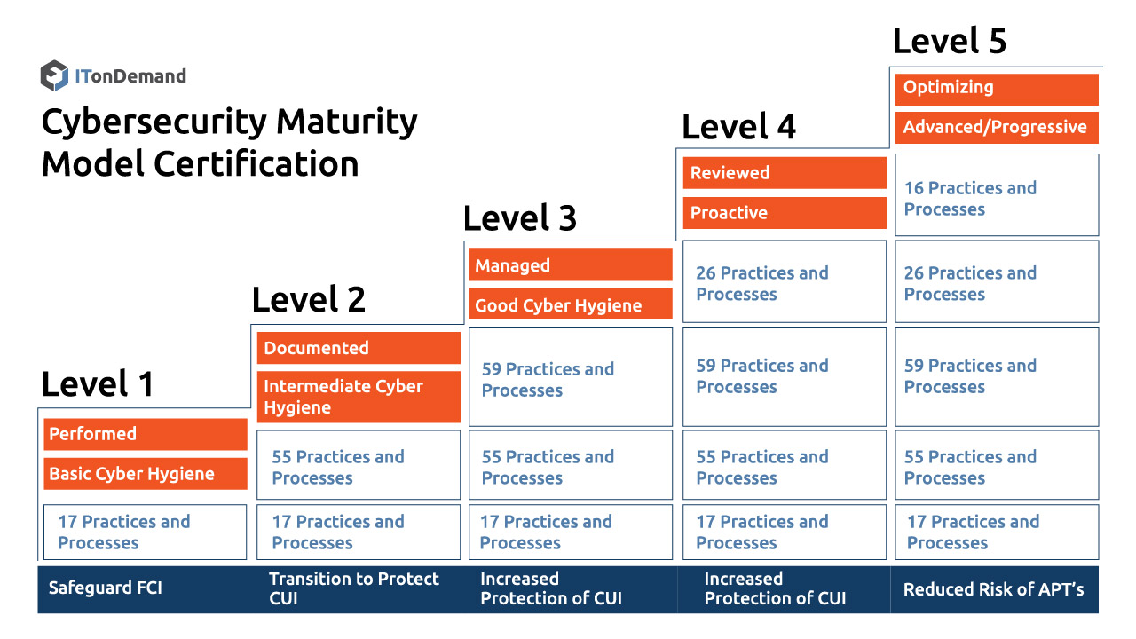
The CMMC Framework and 5 Levels

Slide 8
CMMC Level 1
Processes: Performed
Level 1 of CMMC requires an organization to perform specified practices. The organization may perform them as necessary without formal documentation.
Practices: Basic Cyber Hygiene
Level 1 is primarily concerned with the protection of FCI and corresponds to the basic safeguarding requirements.
Ex: Antivirus, Ad-hoc incident response.
CMMC Level 2
Processes: Documented
Process documentation ensures that necessary security and hygiene practices are performed in a “repeatable manner”.
Practices: Intermediate Cyber Hygiene
Level 2 serves as a transition stage between 1-3 of CMMC. This stage includes the hygiene and security of CUI.
Ex: Security awareness training, Risk management, Backups.

Slide 9
CMMC Level 3
Processes: Managed
Level 3 requires organizations to have resources devoted to the management of practice implementation.
Practices: Good Cyber Hygiene
Level 3 of CMMC focuses on the protection of CUI. It encompasses NIST-800 as well as other standards for threat mitigation.
Ex: Smart card, Multi-factor authentication.
CMMC Level 4
Processes: Reviewed
Level 4 includes a review of past practices for effectiveness. This also includes notification of higher-level management of status or issues on a periodic basis.
Practices: Proactive
Level 4 practices protection of CUI from Advanced Persistent Threats or APTs. It includes NIST SP 800-171B and includes enhanced detection and response capabilities.
  Ex: Security procedure from mobile devices, Network segmentation

Slide 10
CMMC Level 5
Processes: Optimizing
Level 5 requires an organization to take corrective action towards improving process implementation across the organization.
Practices: Advanced/Proactive
Level 5 increases the depth and sophistication of cybersecurity capabilities.
Ex: 24-hour security center, Real-time asset tracking

Slide 11
Certification
Certification process:
  Companies seeking a CMMC Certificate will first need to identify the desired maturity level they want to be audited for compliance.
  Companies will then need to find an available C3PAO.
  The third party will schedule the assessment with the certified independent assessor.
  DIB companies will select one of the Authorized or Accredited C3PAOs from the CMMC-AB Marketplace website.
  The DIB company and the selected C3PAO will coordinate and plan the CMMC assessment as well as complete appropriate contractual agreements.
  After the completion of the CMMC assessment, the C3PAO will provide an assessment report and if there are no deficiencies, issue the appropriate CMMC certificate to the DIB company for the specified certification boundary.
  The C3PAO will also submit a copy of the assessment report and CMMC certificate to the DoD.
  A CMMC certificate will be valid for 3 years and there are no self-certifications.
Cost of the certification:
    Office of the Under Secretary of Defense Acquisition & Sustainment, estimated that a company should expect to pay between $3,000 – $5,000 for CMMC level one certification.
    The costs will increase as the levels go up.

Slide 12
What Are the Requirements?
The requirements for CMMC certification will depend on the level of certification required.
So, a Level 2 certification includes all the Level 1 requirements, and a Level 5 certification requires an organization to meet the requirements for Levels 1-4.
Across the five levels, the certification requirements include:
  43 capabilities spanning 17 capability domains.
  Five processes to measure process maturity.
  171 practices to measure technical capacity.
The requirements are broken into practices and processes.
To meet each certification level, a contractor must achieve the requirements for both the practices and processes associated with the level across many capabilities.

Slide 13


Thank You !

