Slide 1

SaMD (Software as a Medical Device) ,
SiMD (Software in a Medical Device) &
IEC Standards
Madhura Ramojwar

Slide 2
Agenda
SaMD and SiMD
IEC 15408
IEC 62443
IEC 60601-4-5

Slide 3
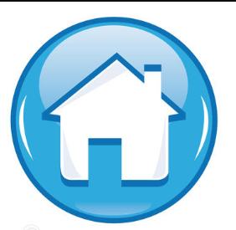
SaMD (Software as a Medical Device) SiMD (Software in a Medical Device)

Slide 4

SaMD (Software as a Medical Device)
Defined by the International Medical Device Regulators Forum (IMDRF).
IMDRF Definition : Group of medical device regulators from around the world that have voluntarily come together to harmonize the regulatory requirements for medical products that vary from country to country.
It is a software intended to be used for one or more medical purposes that perform these purposes without being part of a hardware medical device.
The applications of SaMD are not just limited to diagnosis but have also made their place in the monitoring and treatment process.
Example:
  Software that is processing a patient image to detect diseases like cancer
  EEG Analysis
  Software that regulates an installed medical device, a pacemaker.

Slide 5
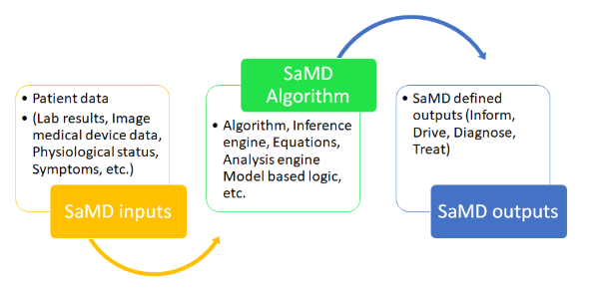
SaMD (Software as a Medical Device)
Input data source for SaMD could be
Medical devices,
Lab results,
medical images,
IVD instrument results,
Human body Vital signs,
Medication,
Patient demography,
Allergies etc.
SaMD can have algorithm to process this and provide output that could be used for medical purpose (Inform, Drive, Diagnose, Treat).

Slide 6
Classification of SaMD
SaMD can be classified based on following two criteria:
  1) Based on the type of information provided by the device
    For treatment or diagnosis
    For driving clinical management
    For informing clinical management

Slide 7
Classification of SaMD
  2) Based on the impact on treatment
    Critical
    Serious
    Non-serious

Slide 8
SaMD Categories
There are 4 categories ( I, II, III , IV ) based on the level of impact on the patient's health.
Category IV is the highest level of impact and Category I is the lowest.
Category IV – Provides information for the treatment / diagnosis of diseases or conditions that are critical and are considered “very high impact”
  Example : SaMD that functions as a heart monitor with Atrial Fibrillation diagnostic capability
  SaMD that performs analysis of cerebrospinal fluid spectroscopy data to diagnose tuberculosis meningitis or viral meningitis in children

Slide 9
SaMD Categories
Category III – Provides information for the treatment / diagnosis of diseases or conditions that are serious and are considered “high impact”
  Example : SaMD that uses the microphone of a smart device to detect interrupted breathing during sleep and sounds a tone to rouse the sleeper.
  SaMD that uses data from individuals for predicting risk score in high-risk population for developing breast cancer
Category II – Provides information for the treatment / diagnosis of diseases or conditions that are non-serious and are considered “moderate impact”
  Example: SaMD that analyzes heart rate data intended for a clinician as an aid in diagnosis of arrhythmia.
  SaMD that helps diabetic patients by calculating bolus insulin dose based on activities reported to adjust carbohydrate ratio and basal insulin.
Category I – Provides information for the clinical management of diseases that are non-serious and are considered “low impact”
Example: SaMD that collects fetus movement or development.
SaMD that collects information for control of conception, in IVF.

Slide 10
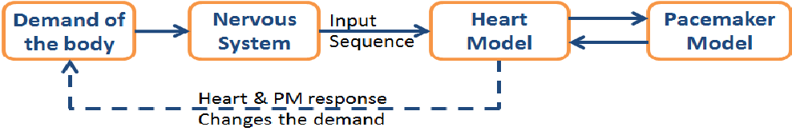
SiMD (Software in a Medical Device)
It is a software that is part of functioning of a medical device.
It does not have a medical purpose independent of a medical device with hardware components.
Purely embedded software within medical equipment , includes desktop, mobile and cloud software.
The fact that you cannot use the medical device without this software, makes it SiMD.
Example:
  Software within mobile applications that control a medical device through Bluetooth, Wi-Fi or other functionality.
  Embedded software that operates a pacemaker.
  Mobile application which is an interface for reading waveforms.

Slide 11
IEC 15408 (The Common Criteria for Information Technology Security Evaluation)

Slide 12
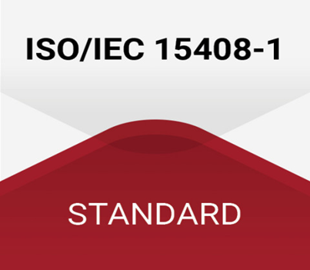
IEC 15408 (The Common Criteria for Information Technology Security Evaluation)
Also referred to as Common Criteria (CC) i.e., for computer security certification.
Current version 3.1 revision 5 (2015).
Designed for products - highly security-intensive markets, such as governmental, banking, or military sectors.
It is a framework where users can specify their Security functional / Assurance requirements (SFR/ SAR) in a Security target (ST) taken from a Protection profile (PP).
Network system users can define their cybersecurity functional and assurance needs.

Slide 13
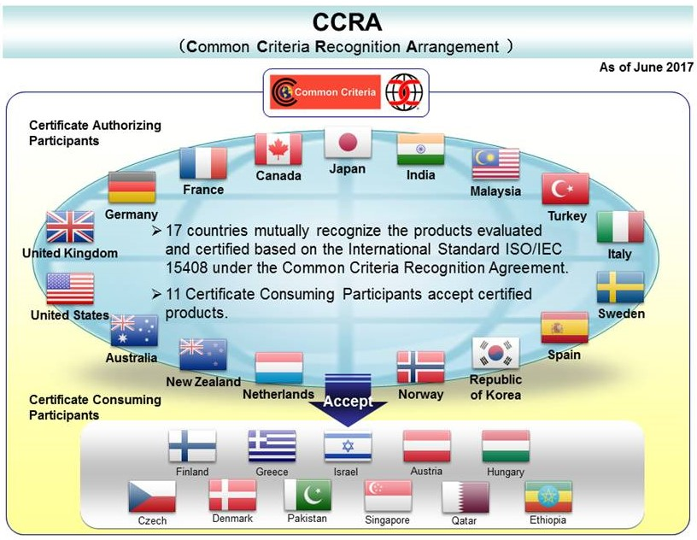
IEC 15408- Market acceptability

Slide 14
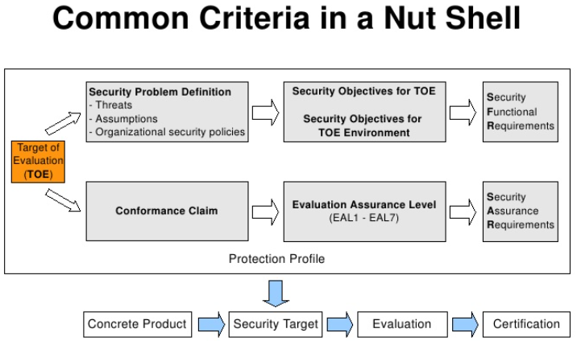
Evaluation procedure for Common Criteria (IEC 15408)
  With the support of a third party contracted laboratory, Common Criteria evaluations of computer security products and systems are performed.
  The partner laboratory must first define a target of evaluation (TOE) allowing for further assessment and documentation.
  Upon completion of the documentation review and a thorough CC evaluation, IT product security certification is provided.

Slide 15
IEC 15408 Components
TOE (target of evaluation):
  The product or system that is the subject of the evaluation.
  It is the product to be tested.

Slide 16
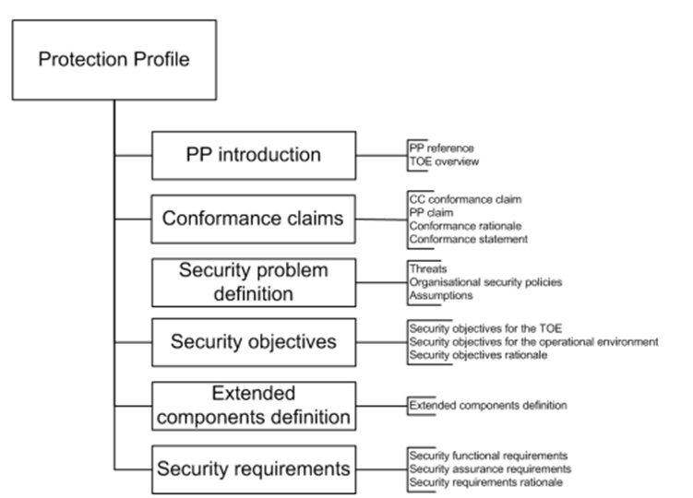
IEC 15408 Components
Protection Profile (PP) : (TYPE OF PRODUCT)
  It identifies security requirements for a class of security devices (e.g., smart cards used to provide digital signatures, or network firewalls) to the user.
  Description about the needed security solutions.
  PP serves as a template.
  A document created by a user/ user community.

Slide 17
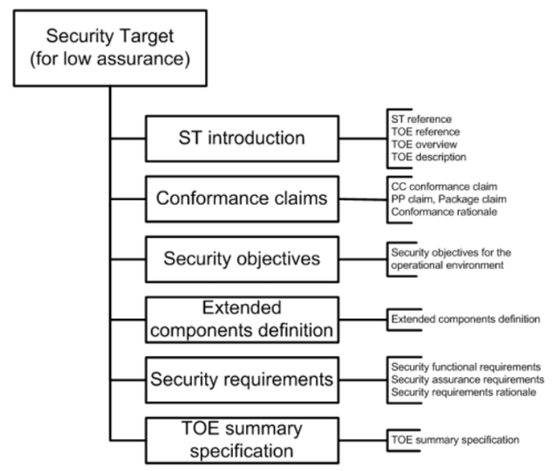
IEC 15408 Components
Security Target:
  It is a document that identifies the security properties of the target of evaluation.
  Allows to make changes for the evaluation to accurately match the intended capabilities / requirements of their product.

Slide 18
IEC 15408 : Quality Assurance processes
The Evaluation Assurance Level (EAL)
  Numerical rating used to describe the depth and rigor of a CC evaluation.
  Seven EAL’s from EAL 1-7 (low security to high security).
  Each EAL is corresponded to a package of security assurance requirements for the development of the product.
EAL 1 | Functionally tested (Black Box)
EAL 2 | Structurally tested (Black & White Box)
EAL 3 | Methodically tested and checked
EAL 4 | Methodically designed, tested, and reviewed
EAL 5 | Semi formally designed and tested
EAL 6 | Semi formally verified, designed, and tested
EAL 7 | Formally verified, designed, and tested

Slide 19
IEC 62443 (Secure Industrial Automation and Control Systems (IACS))

Slide 20
IEC 62443 (Secure Industrial Automation and Control Systems (IACS) )
Developed by The International Society of Automation (ISA99) committee.
Adopted by the International Electrotechnical Commission (IEC).
Current edition -1 (2018).
It helps organizations to reduce both
the risk of system failure and
the exposure to cyber threats.
Main security objectives of IEC 62443 are in-depth defense.
  i.e., taking low level requirements and extending security to other areas to consider different attacks.

Slide 21
IEC 62443 : Fundamental Requirements
The seven fundamental requirements of the IEC 62443 standard:
  Identify and authenticate all users (people, software processes and devices) before authorizing access to a system.
  Control use (enforce the privileges assigned to an authenticated user).
  Ensure the integrity of data, software, and equipment.
  Ensure the confidentiality of information in data flows, and in data storage spaces.
  Restrict unnecessary data flows.
  Respond to attacks by informing the competent authority in a timely manner.
  Ensure that the system is resilient against a DDoS attack.

Slide 22
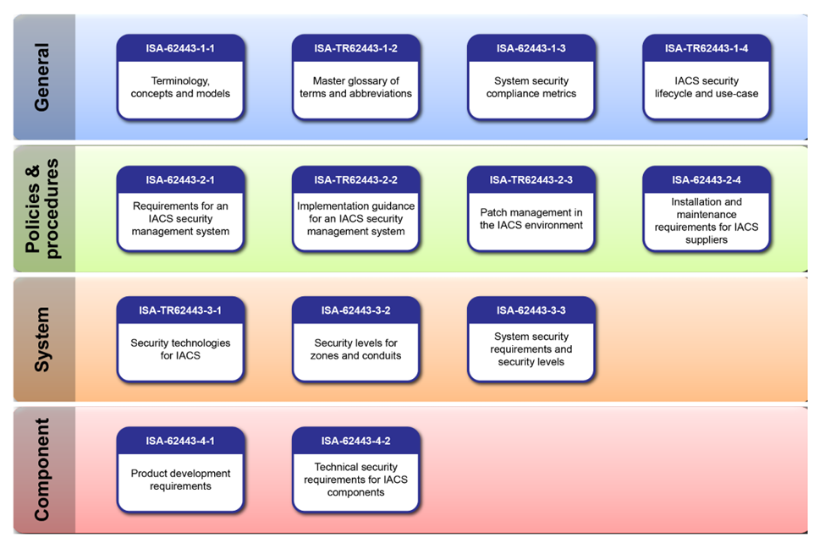
IEC 62443 : Division
ISA/ IEC 62443 consists of 14 documents divided into 4 groups:

Slide 23
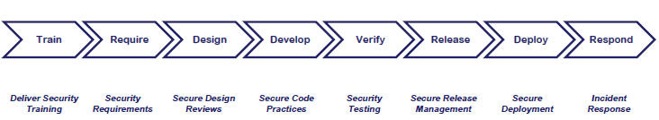
The key standards in the IEC 62443 series
IEC 62443-4-1 ( Secure development lifecycle requirements ) (2018)
Specifies process requirements for the secure development of products.
Lifecycle includes security requirements definition, secure design, secure implementation (including coding guidelines), verification and validation, defect management, patch management and product end-of-life.
These requirements can be applied to new / existing processes for
- developing
- maintaining
- retiring hardware, software, or firmware.

Slide 24
The key standards in the IEC 62443 series
  IEC 62443-4-2 ( IACS components security specifications ) (2019)
Current Edition - 1
Provides the cyber security technical requirements for components that make up an IACS.
  Mostly for embedded devices, network components, host components and software applications.
The standard sets forth security capabilities that enable a component to mitigate threats.

Slide 25
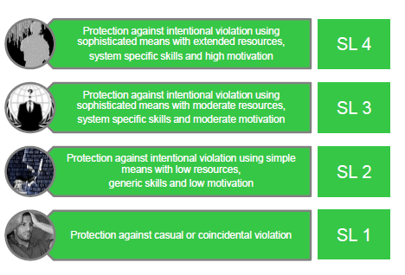
The key standards in the IEC 62443 series
  IEC 62443-3-3 ( security requirements and the security level ) (2013)
Defines the security assurance levels of the IACS components.
It includes the 4 security levels.
Level 1 and Level 2 correspond to threats originating from either insiders, such as careless or disgruntled employees or contractors, or intruders with low skills and motivation.
Levels 3 and Level 4 are related to threats from “professional” cyber criminals, industrial espionage or state-sponsored malicious actors.

Slide 26
Security Foundational Requirements in IEC 62443-3-3
  In addition, IEC 62443-3-3 defines the security Foundational Requirements,
  It includes :
    Processes for user authentication
    Enforcement of roles and responsibilities
    Change management : procedure controls any additions, deletions, or modifications to the department configuration of desktops, servers and network hardware and/or software.
    Use of encryption
    Network segmentation : splitting a computer network into subnetworks, each being a network segment. Advantages of such splitting are primarily for boosting performance and improving security.
    Audit logs : Audit log has records providing information about who has accessed the system and what operations he or she has performed during a given period. Audit logs are useful both for maintaining security and for recovering lost transactions.
    System backup and recovery

Slide 27
ISA/IEC 62443 Cyber security Certification Programs
Certificate 1: ISA/IEC 62443 Cyber security Fundamentals Specialist.
Certificate 2: ISA/IEC 62443 Cyber security Risk Assessment Specialist.
Certificate 3: ISA/IEC 62443 Cyber security Design Specialist.
Certificate 4: ISA/IEC 62443 Cyber security Maintenance Specialist.
ISA/IEC 62443 Cyber security Expert: Individuals who achieve Certificates 1, 2, 3, and 4 are designated as ISA/IEC 62443 Cyber security Experts.
Link for the certification requirements and training course:
https://www.isa.org/training-and-certification/isa-certification/isa99iec-62443/isa99iec-62443-cybersecurity-certificate-programs

Slide 28
IEC 60601-4-5 ( Safety-related technical security specifications)

Slide 29
IEC 60601-4-5 (Safety-related technical security specifications)
It is a technical report.
Provides detailed technical specifications of security features for MEDICAL DEVICES used in MEDICAL IT-NETWORKS.
It is currently available as a draft.
Current Edition -1 (2021)
This standard will help you to
  Develop safe products
  Avoid unnecessary expenses.
This standard gives you instructions
  On which measures to implement to improve IT security
  On which factors this obligation is dependent.

Slide 30
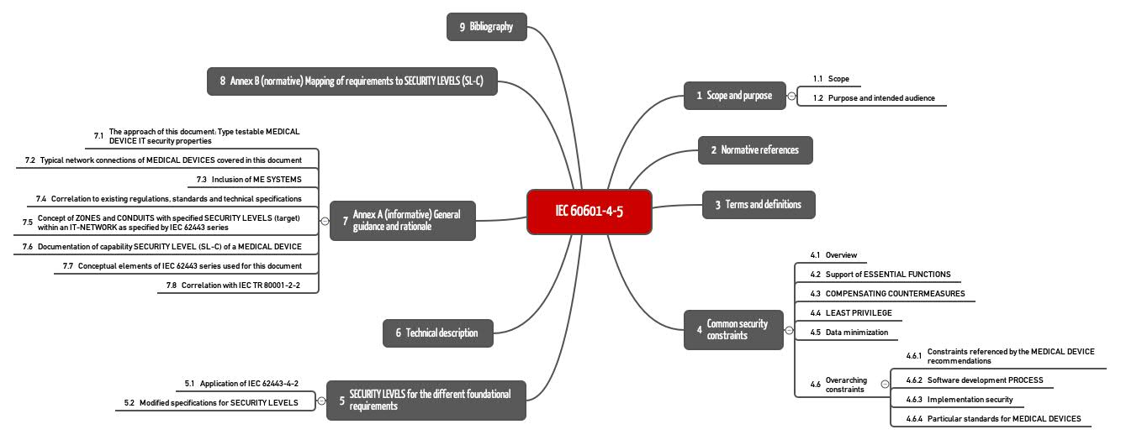
IEC 60601-4-5: Structure

Slide 31
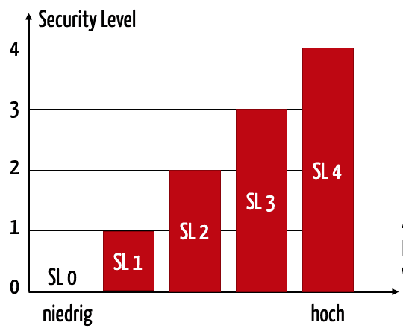
Security Levels – The central concept of IEC 60601-4-5
The standard works with three types of security level (SL):
SL-T: The Target Security Level, that one must achieve for the network including the networked medical devices, to achieve the set protection goal.
SL-C: The Capability Security Level, that can be achieved for the medical product and the network, if one takes measures to improve IT security.
SL-A: The Achieved Security Level, the level one achieves.
For each security level, the IEC 60601-4-5 proposes five levels, from SL 0 (nothing implemented) to SL 4, the highest level.
Naturally, high security levels must be achieved for high risks.

Slide 32
Security Levels – The central concept of IEC 60601-4-5
The SL-T must ultimately be determined by the operator or integrator, because only they can decide which network environment a medical device will be used in.
However, the manufacturer determines the SL-C, that can be achieved if the operator configures and operates the device according to specification.
The SL-C depends on which measures the manufacturer has implemented and reviewed.
Which actual security level (SL-A) the operator achieves, depends on multiple factors:
  Has the operator correctly configured within the network and the network itself?
  Has the operator implemented measures to increase IT security outside of the device?
  For example, "integration tests” determine the actual SL-A achieved, wherein “integration” means the integration of the device into the associated networks.

Slide 33
Security Levels – The central concept of IEC 60601-4-5
Determination of SL-T
ICE 60601-4-5 recommends individually determining the SL-Ts for these various environments.
But not only the network environment should have an influence, but also:
  Value of the product
  Amount of damage if the basic security or significant performance features are no longer present
  Presence of patient data
  User profile
  Home network versus hospital network
  Number of the medical products on the market

Slide 34
Benefits and use of Security Levels
The security levels help control the requirements and the expenses of IT security.
requirements | SL1 | SL2 | SL3 | SL4
User authentication | X | X | X | X
Multi-factor authentication at all interfaces |  |  | X | X
Role-based authorizations |  | X | X | X
Malware protection | X | X | X | X

Slide 35

Thank You !

